Slide 1
Kinematics vs Dynamics
Gabriele Carcassi

Slide 2

Define kinematics and dynamics, how they are different, …
Start with linear drag in Newtonian (solve the whole problem)
Can we do it in Lagrangian/Hamiltonian? Look at this cool Lagrangian
The kinamtics is right, but the dynamcis looks “fishy”
Suppose we keep that p=mv $⇒$ variable mass system
Also assumed we are in an intertial frame.
Rework the problem in non-inertial frame
The increase in mass is an “apparent” feature of the redefinition of time (like in relativity)
Conclusion

Slide 3
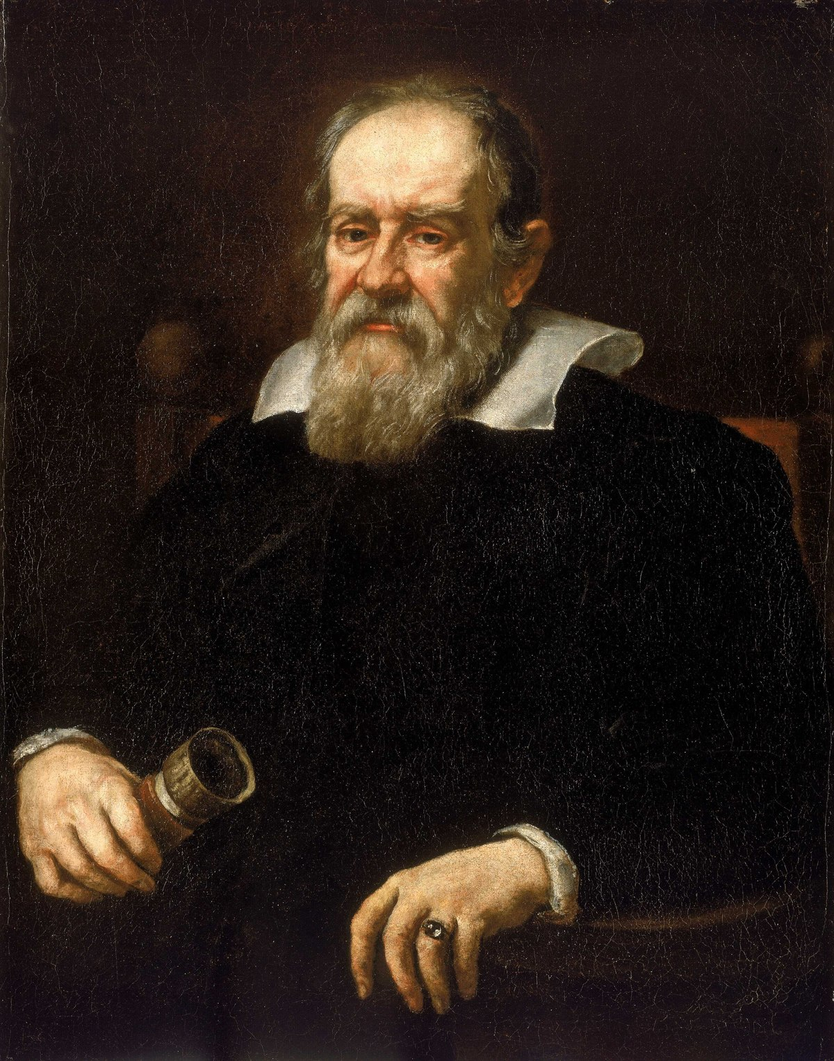
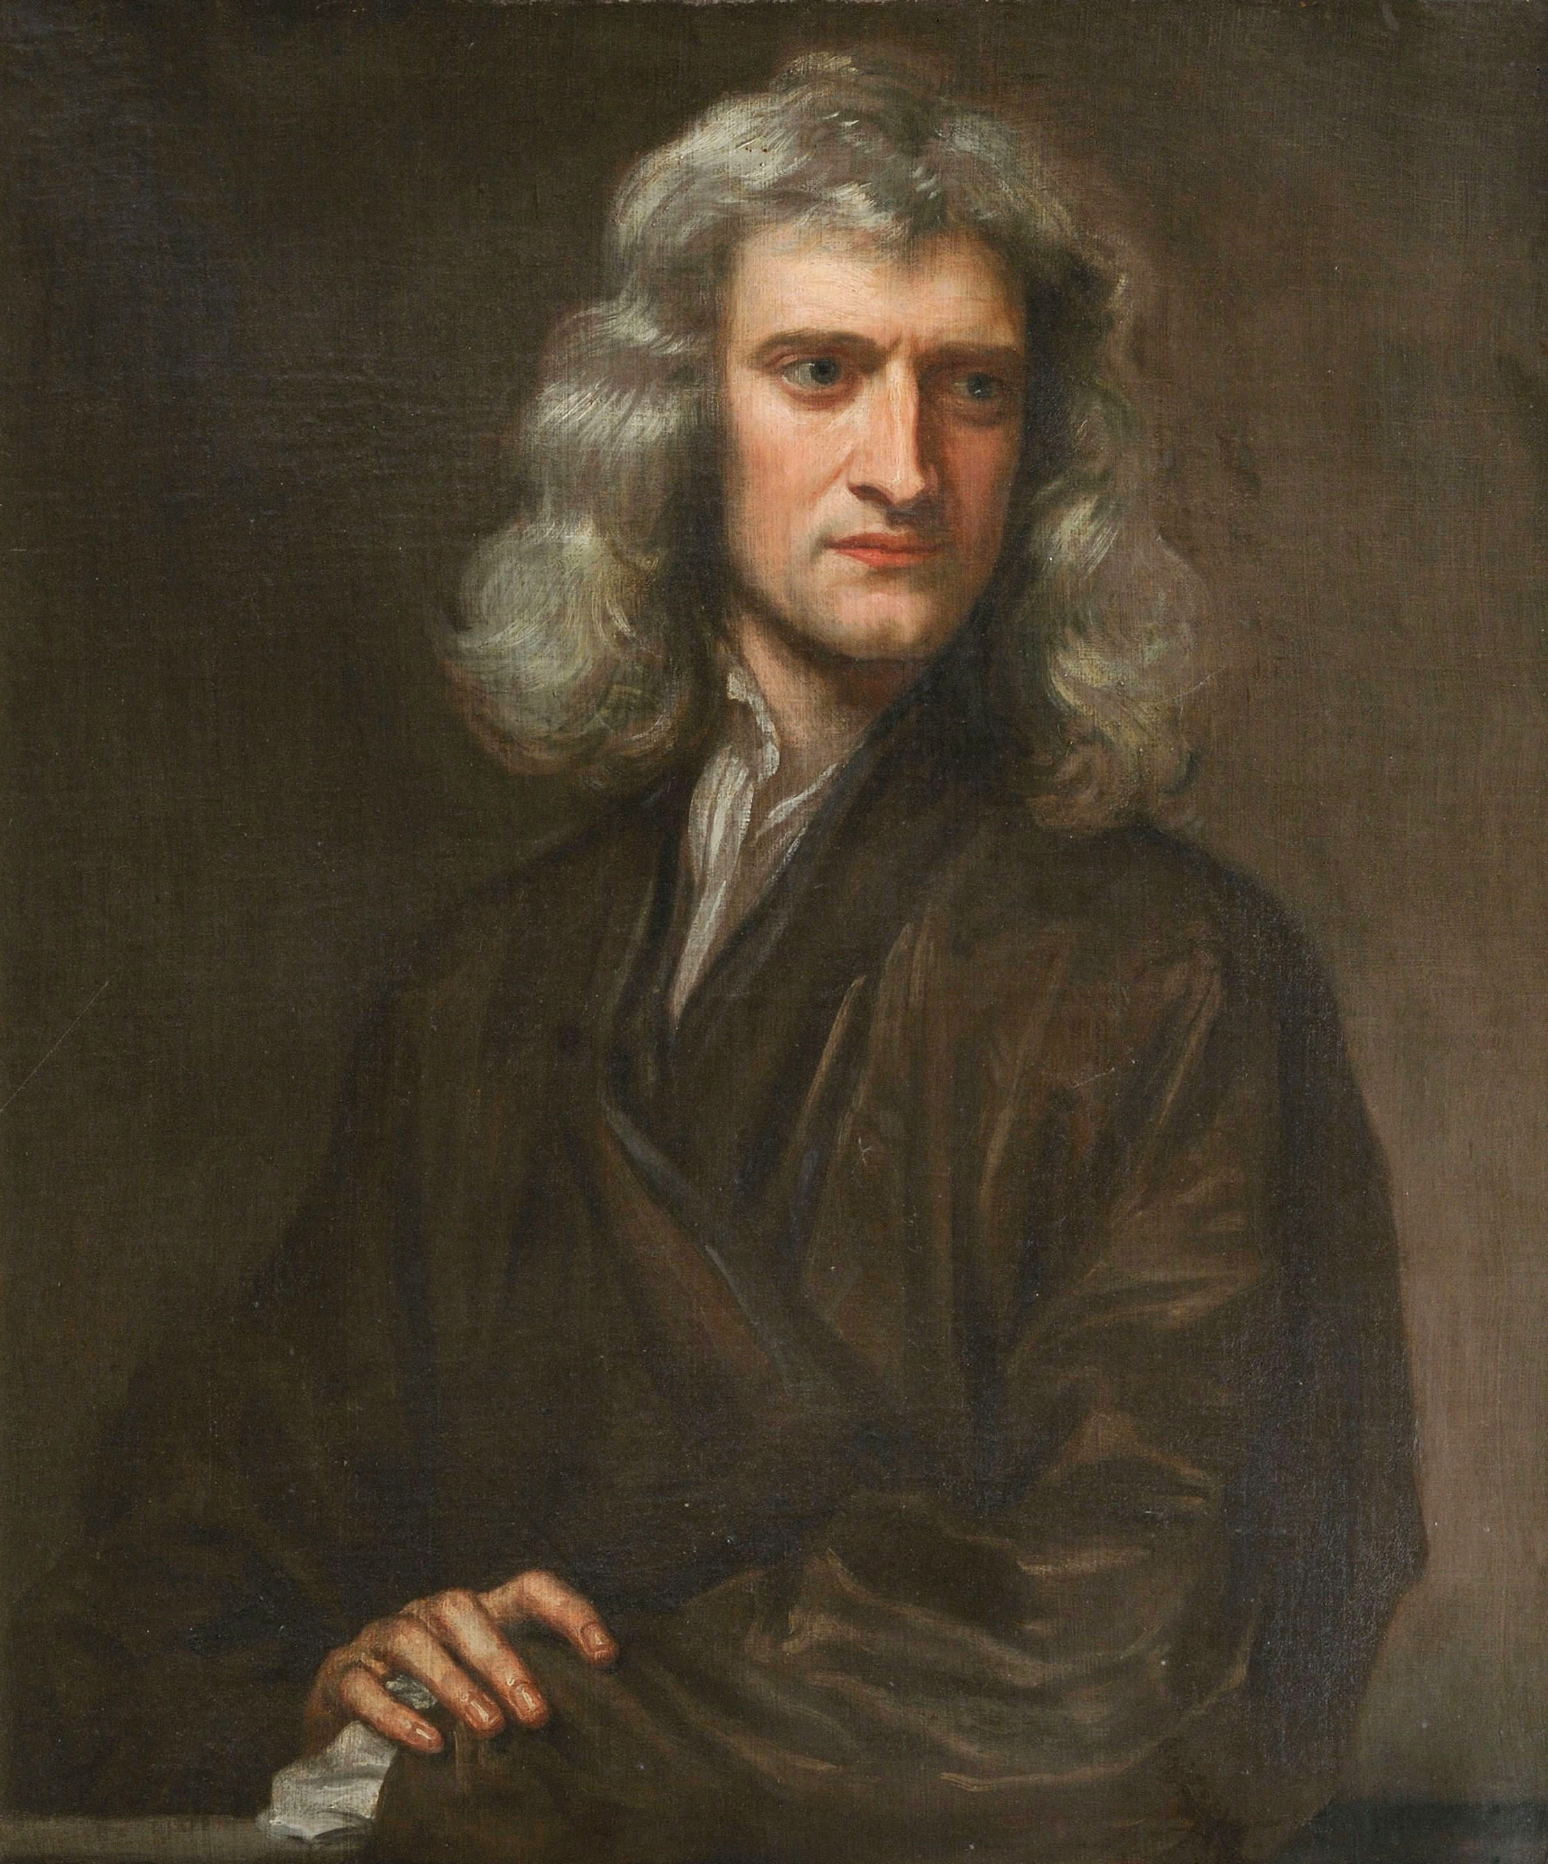
What Galileo Worked on
Kinematics: Describe the motion of a system in space and time (position, velocity, acceleration)
Dynamics: Describe the cause of motion (Force, mass, momentum, energy)
What Newton Worked on
Notes:
The kinematics is not enough to reconstruct the dynamics
Lagrangian hides the connection
Kinematics: what Galileo did, Newton did
Image sources: https://en.wikipedia.org/wiki/Galileo_Galilei
https://en.wikipedia.org/wiki/Isaac_Newton

Slide 4


Newtonian Mechanics:
State of the system is given by position $x^{i}$ and velocity $v^{i}$
Dynamics specified by: ${F^{i}(x}^{j},v^{k},t)$
Evolution of the system: $F^{i}\left(x^{j},v^{k},t\right)=d_{t}mv^{i}$
Lagrangian Mechanics:
State of the system is given by position $x^{i}$ and velocity $v^{i}$
Dynamics specified by a single function: ${L(x}^{i},v^{j},t)$
Evolution of the system: $∂_{x^{i}}L=d_{t}∂_{v^{i}}L$ (Euler-Lagrange equations)
Hamiltonian Mechanics:
State of the system is given by position $q^{i}$ and conjugate momentum $p_{i}$
Dynamics specified by a single function: ${H(q}^{i},p_{j},t)$
Evolution of the system:
$$d_{t}q^{i}=∂_{p^{i}}H$$
$$d_{t}p^{i}=∂_{q^{i}}H$$

Slide 5




1)
Newtonian
Mechanics
$$F^{i}\left(x^{j},v^{k},t\right)=d_{t}v^{i}$$
2)
Lagrangian
Mechanics
$$∂_{x^{i}}L=d_{t}∂_{v^{i}}L$$
$$d_{t}q^{i}=∂_{p^{i}}H$$
3)
Hamiltonian
Mechanics
$$d_{t}p^{i}=∂_{q^{i}}H$$

Slide 6

Particle under linear drag:
Suppose we have a system described by the equation $ma=−bv$
Velocity:
Drag:

Slide 7



Newtonian Mechanics:
$$x\left(t\right)=x_{0}+v_{0}\frac{m}{b}\left(1−e^{−\frac{k}{m}t}\right), v\left(t\right)=v_{0}e^{−\frac{k}{m}t}, a\left(t\right)=−v_{0}\frac{b}{m}e^{−\frac{k}{m}t}$$
Lagrangian Mechanics:
$$\text{We} \text{set} L=\frac{1}{2}mv^{2}e^{\frac{k}{m}t} ∂_{x}L=0=d_{t}\left(mve^{\frac{k}{m}t}\right)=mae^{\frac{b}{m}t}+\frac{b}{m}mve^{\frac{b}{m}t}=e^{\frac{b}{m}t}(ma+bv)$$
So, $0=e^{\frac{b}{m}t}\left(ma+bv\right)$, so $ma=−bv$
Hamiltonian Mechanics:
We have: $p=mve^{\frac{b}{m}t}$and $v=\frac{p}{m}e^{−\frac{k}{m}t}, H=pv−L=\frac{1}{2}\frac{p^{2}}{m}e^{−\frac{b}{m}t}$
$d_{t}q=$ $∂_{p}H=\frac{p}{m}e^{\frac{b}{m}t}→q\left(t\right)=q_{0}+\frac{p_{0}}{b}\left(1−e^{\frac{k}{m}t}\right), d_{t}p=−∂_{p}H=0 →p\left(t\right)=p_{0}$
We expect $p\left(t\right)=mv\left(t\right)=mv_{o}e^{−\frac{b}{m}t}$ but it stays constant
we also expect to find:$E(t)=\frac{1}{2}mv^{2}\left(t\right)=\frac{1}{2}mv_{o}^{2}e^{−2\frac{b}{m}t}$
But instead we find: $H\left(t\right)=\frac{1}{2}\frac{p^{2}}{m}e^{−\frac{b}{m}t}=\frac{1}{2}mv_{o}^{2}e^{−\frac{b}{m}t}$

Slide 8

















Particle Under Linear Drag For Newtonian Mechanics:
$$x\left(t\right)=x_{0}+v_{0}\frac{m}{b}\left(1−e^{−\frac{k}{m}t}\right)$$
$$v\left(t\right)=v_{0}e^{−\frac{k}{m}t}$$
$$a\left(t\right)=−v_{0}\frac{b}{m}e^{−\frac{k}{m}t}$$
$$x$$
$$v$$
$$a$$
$$x_{0}+\frac{m}{b}v_{0}$$
$$v_{0}$$
$$t$$
$$x_{0}$$
$$−\frac{b}{m}v_{0}$$
$$t$$
$$t$$
$$E$$
$$E\left(t\right)=\frac{1}{2}mv_{0}^{2}e^{−2\frac{b}{m}t}$$
$$\frac{1}{2}mv_{0}^{2}$$
$$E(t)$$
$$t$$
Notes:
To Soon: create visual of the example (do with all)
make clear these are Newtonian

Slide 9














Particle Under Linear Drag for Lagrangian and Hamiltonian Mechanics:
$$L=\frac{1}{2}mv^{2}e^{\frac{k}{m}t}$$
$$H=\frac{1}{2}\frac{p^{2}}{m}e^{−\frac{b}{m}t}$$
$$x$$
$$v$$
$$E$$
$$x_{0}+\frac{m}{b}v_{0}$$
$$p(t)$$
$${\frac{p_{0}^{2}}{2m}}_{0}$$
$$v_{0}$$
$$mv(t)$$
$$H(t)$$
$$x_{0}$$
$$t$$
$$E(t)$$
$$t$$
$$t$$
We can see that the dynamics of the system are different what we expect, with the momentum being constant and the energy not decreasing as fast as we expect it to
$⇒$This system can not be currently be described by Lagrangian or Hamiltonian mechanics
Notes:
To Soon: create visual of the example (do with all)
make clear these are Newtonian

Slide 10



Variable Mass System:
Velocity:
Mass:
Next, Suppose we have the same system, but let's assume that m is a constant and define the actual mass of the system as the ratio between conjugate momentum and velocity
$$\hat{m}\left(t\right)=\frac{p\left(t\right)}{v\left(t\right)}=me^{\frac{b}{m}t }$$
Notes:
Add picture of a variable mass system

Slide 11





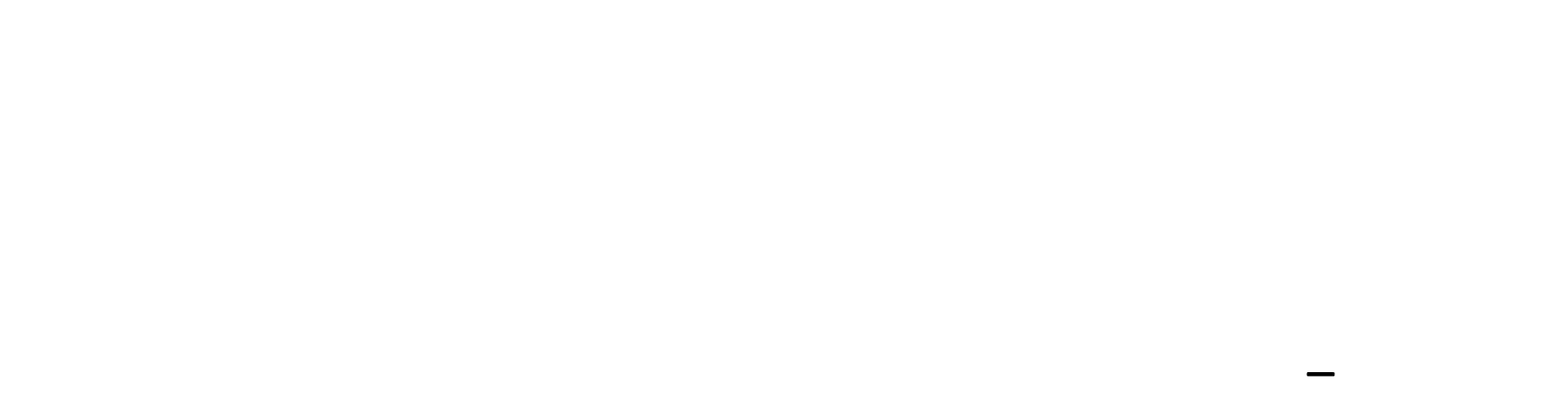




Variable Mass System:
For the Hamiltonian we now have:
$p\left(t\right)=mv\left(t\right)e^{\frac{b}{m}t}=$ $\hat{m}\left(t\right)v(t)$
$H\left(t\right)=\frac{1}{2}\frac{p^{2}}{m}e^{−\frac{b}{m}t}=\frac{1}{2}\frac{p^{2}}{\hat{m}}e^{−\frac{b}{m}t}=\frac{1}{2}\hat{m}v^{2}\left(t\right)=E(t)$_
$$\hat{m}$$
$$p$$
$$E$$
$$p\left(t\right)=\hat{m}(t)v(t)$$
$${\frac{p_{0}^{2}}{2m}}_{0}$$
$$p_{0}$$
$$H(t)=E(t)$$
$$m$$
$$t$$
$$t$$
$$t$$

Slide 12

Variable Mass System:
How and why does this work?
$F^{i}=d_{t}\left(\hat{m}v^{i}\right)=d_{t}\hat{m}v^{i}$+ $\hat{m}a^{i}→\hat{m}a^{i}=F^{i}−d_{t}\hat{m}v^{i}$
In the one dimensional case, if we set $F=0$ and substitute $\hat{m}$
$$me^{\frac{b}{m}t}a=0−d_{t}me^{\frac{b}{m}t}v=−\frac{b}{m}me^{\frac{b}{m}t}v→ma=−bv$$
The same kinematics apply to a system where instead of slowing down due to friction, the body is slowing down due to the conservation of Momentum

Slide 13
Takeaways:
The same kinematics can apply to a a linear drag system as that of a system in which mass increases over time.
In Newtonian mechanics, we can readily distinguish between the two cases, but with Lagrangian and Hamiltonian mechanics the dynamic quantities will be different in different cases.
With Lagrangian mechanics, these distinctions become even more difficult to see as we know that the kinematics of a Lagrangian system is sufficient to reconstruct its dynamics and vice-versa

Slide 14





Non-Inertial Frame:
Let’s compare the motion of a particle traveling in an inertial frame with time t, to the motion of a particle decelerating exponentially with $\hat{t}$ as the time variable
$$x\left(t\right)=x_{0}+v_{0}t$$
$$x\left(\hat{t}\right)=x_{0}+v_{0}\frac{m}{b}\left(1−e^{\frac{b}{m}\hat{t}}\right)→t=\frac{m}{b}(1−e^{\frac{−b}{m}\hat{t}})$$
$$q$$
$$q$$
$$t$$
$$\hat{t}$$
Notes:
Image: draw a map of t to t^ (play around with t vs q and t^ vs q

Slide 15

Non-Inertial Frame:
Next, if we set $\hat{t}=\hat{t}(t)$ and express it as a Newtonian we get:
$F^{i}=d_{t}\hat{t}d_{\hat{t}}\left(mv^{i}\right)=$ $d_{t}\hat{t}d_{\hat{t}}(md_{t}\hat{t}d_{\hat{t}}x^{i}$)
If we set $\hat{m}=md_{t}\hat{t}$ then we get
$$F^{i}=d_{t}\hat{t}d_{\hat{t}}(\hat{m}d_{\hat{t}}x^{i})=d_{t}\hat{t}{\hat{F}}^{i}$$
If we look at the problem in this manner, we do not have a true variable mass, but rather a variable effective mass due to a slowing down of time.

Slide 16

Non-Inertial Frame:
We can verify that this gives us the correct effective mass and force:
$$d_{\hat{t}}t=d_{\hat{t}}\left(\frac{m}{b}\left(1−e^{\frac{−b}{m}\hat{t}}\right)\right)=\frac{−m}{b}d_{\hat{t}}e^{\frac{−b}{m}\hat{t}}=\frac{m}{b}\frac{b}{m}e^{\frac{−b}{m}\hat{t}}=e^{−\frac{b}{m}\hat{t}}$$
$$\hat{m}=md_{t}\hat{t}=m{(d}_{\hat{t}}{t)}^{−1 }=me^{\frac{b}{m}\hat{t}}$$
If we set force equal to $0$:
$$0=d_{t}\left(mv\right)=d_{t}\left(md_{i}x\right)=d_{t}\hat{t}d_{\hat{t}}\left(md_{t}\hat{t}d_{i}x\right)$$
$=e^{\frac{b}{m}\hat{t}}d_{i}\left(e^{\frac{b}{m}\hat{t}}\hat{v}\right)=$ $e^{\frac{b}{m}\hat{t}}(m\frac{b}{m}e^{\frac{b}{m}\hat{t}}\hat{v}+me^{\frac{b}{m}\hat{t}}\hat{a})$
$$=e^{2\frac{b}{m}\hat{t}}\left(b\hat{v}+m\hat{a}\right)→m\hat{a}=−b\hat{v}$$

Slide 17

This case demonstrates that we can have the same kinematics for different systems and that having the expression $x\left(t\right)$ is not enough for one to know what $x$ and $t$ represent physically
Big Picture: We have seen that looking at the kinematics of a system is not enough for us to understand its causes of motion, with the different formulations having different ways of relating dynamics and kinematics

