Slide 1
Multiple degrees of Freedom
Gabriele Carcassi

Slide 2
First show the relationships that stay the same
Then show the relationships that change/generalize (are different arguments, difficult to make a parallel)
Recap that the one that changes is “complete” and implies the lesser (one about surfaces/lines, other about volumes)
Orthogonality of DOF = independence
Area cons + ortho => volumes (to explain previous finding)

Slide 3






Hamilton’s Equations for Multiple Degrees of Freedom
$$d_{t}q^{i}=∂_{p_{i}}H$$
$$d_{t}p_{i}=−∂_{q^{i}}H$$
(HM-ND)
$$ξ^{a}=[q^{i}, p^{i}]$$
$$S^{a}=d_{t}ξ^{a}=[d_{t}q^{i},d_{t}p^{i}]$$
$$S^{q^{i}}=∂_{p_{i}}H$$
$$S^{p_{i}}=−∂_{q^{i}}H$$

Slide 4












Hamilton’s Equations
Multiple Degrees of Freedom
Single Degree of Freedom
$$d_{t}q^{i}=∂_{p_{i}}H$$
$$d_{t}p_{i}=−∂_{q^{i}}H$$
$$d_{t}q=∂_{p}H$$
$$d_{t}p=−∂_{q}H$$
(HM-ND)
(HM-1D)
$$ξ^{a}=[q^{i}, p_{i}]$$
$$ξ^{a}=[q, p]$$
$$S^{a}=d_{t}ξ^{a}=[d_{t}q,d_{t}p]$$
$$S^{a}=d_{t}ξ^{a}=[d_{t}q^{i},d_{t}p_{i}]$$
$$S^{q}=∂_{p}H$$
$$S^{q^{i}}=∂_{p_{i}}H$$
$$S^{p_{i}}=−∂_{q^{i}}H$$
$$S^{p}=−∂_{q}H$$

Slide 5
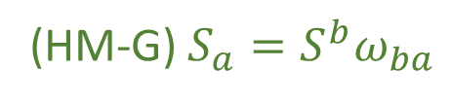
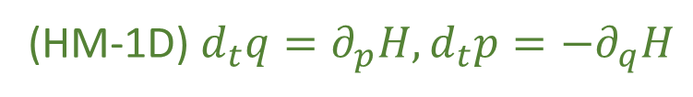
We have found twelve equivalent characterizations for a single degree of freedom
(HM-1D) $d_{t}q=∂_{p}H,d_{t}p=−∂_{q}H$
(HM-G) $S_{a}=S^{b}ω_{ba}$
(DR-DIV) The displacement field for a one dimensional Hamiltonian is divergenceless: $∂_{a}S^{a}=0$
(DR-JAC) The Jacobian of the time evolution is unitary: $\left|∂_{b}{\hat{ξ}}^{a}\right|=1$
(DR-VOL) Volumes are conserved through the evolution: $d{\hat{ξ}}^{1}…d{\hat{ξ}}^{n}=dξ^{1}…dξ^n$
(DR-DEN) Densities are conserved through the evolution: $\hat{ρ}\left({\hat{ξ}}^{a}\right)=ρ\left(ξ^{b}\right)$
(DI-SYMP) The evolution leaves $ω_{ab}$ invariant: ${\hat{ω}}_{ab}=ω_{ab}$
(DI-POI) The evolution leaves the Poisson brackets invariant
(DI-CURL) The rotated displacement field is curl free: $∂_{a}S_{b}−∂_{b}S_{a}=0$
(DR-EV) The evolution is deterministic and reversable
(DR-THER) The evolution is deterministic and thermodynamically Reversible
(DR-INFO) The evolution conserves information entropy
(DR-UNC) The evolution conserves the uncertainty of peaked distributions

Slide 6








$$H(q,p)$$
$$p$$
$H=\frac{p^{2}}{2m}+kq^{2}$
$$4$$
$$3$$
$$2$$
$$H=1$$
$$q$$

Slide 7




$\vec{∇}H\left(q,p\right)=\left[\begin{matrix}∂_{p}H \\ ∂_{q}H\end{matrix}\right]$
$$\vec{∇}H\left(q,p\right)$$
$$p$$
$$4$$
$$3$$
$=\left[\begin{matrix}\frac{p}{m} \\ 2kq\end{matrix}\right]$
$$2$$
$$H=1$$
$$q$$
$H=\frac{p^{2}}{2m}+kq^{2}$

Slide 8




$\vec{S}\left(q,p\right)=\left[\begin{matrix}S^{q} \\ S^{p}\end{matrix}\right]$
$$\vec{S}\left(q,p\right)$$
$$p$$
$$4$$
$$=\left[\begin{matrix}d_{t}q \\ d_{t}p\end{matrix}\right]=\left[\begin{matrix}∂_{p}H \\ −∂_{q}H\end{matrix}\right]$$
$$3$$
$$2$$
$$H=1$$
$$q$$
$$={\text{P}}_{}^{90°}\left(\vec{∇}H\right)$$
Notes:
TODO: field should be the previous rotated (with the same origin for the vectors)

Slide 9














Multiple Degrees of Freedom
Single Degree of Freedom
$$ω=\left[\begin{matrix}0 & 1 \\ −1 & 0\end{matrix}\right]⊗I_{n}$$
$$\left[ω_{ab}\right]=\left[\begin{matrix}ω_{q^{i}q^{j}} & ω_{q^{i}p_{j}} \\ ω_{p_{i}q^{j}} & ω_{p_{i}p_{j}}\end{matrix}\right]$$
$$ω=\left[\begin{matrix}0 & 1 \\ −1 & 0\end{matrix}\right]$$
$$\left[ω_{ab}\right]=\left[\begin{matrix}ω_{qq} & ω_{qp} \\ ω_{pq} & ω_{pp}\end{matrix}\right]$$
$$\vec{S}=ω \vec{∇}H$$
$$\vec{S}=ω \vec{∇}H$$
$$\left[\begin{matrix}S^{q^{i}} \\ S^{p_{i}}\end{matrix}\right]=\left[\begin{matrix}0 & I_{n} \\ −I_{n} & 0\end{matrix}\right]\left[\begin{matrix}∂_{q^{i}}H \\ ∂_{p_{i}}H\end{matrix}\right]=\left[\begin{matrix}∂_{p_{i}}H \\ −∂_{q^{i}}H\end{matrix}\right]$$
$$\left[\begin{matrix}S^{q} \\ S^{p}\end{matrix}\right]=\left[\begin{matrix}0 & 1 \\ −1 & 0\end{matrix}\right]\left[\begin{matrix}∂_{q}H \\ ∂_{p}H\end{matrix}\right]=\left[\begin{matrix}∂_{p}H \\ −∂_{q}H\end{matrix}\right]$$
$$S_{a}=S^{b}ω_{ba}=∂_{a}H$$
$$S_{a}=S^{b}ω_{ba}=∂_{a}H$$
$$S^{q}ω_{qp}=∂_{p}H$$
$$S^{q^{i}}ω_{q^{i}p_{i}}=∂_{p_{i}}H$$
$$S^{p_{i}}ω_{p_{i}q^{i}}=∂_{q^{i}}H$$
$$S^{p}ω_{pq}=∂_{q}H$$
(SF-ND)
(HM-G)

Slide 10


$ω_{ab}$preforms a $90$ degree rotation within each degree of freedom,
switching components between position and momentum
Given: $v^{a}=[{v^{q}}^{i},v^{p_{i}}]$ then $v_{a}=v^{b}ω_{ba}=[−v^{p_{i}},v^{q^{i}}]$
Insight: the displacement field is still equal to the gradient of $H$ rotated $90$ degrees,
except there are now multiple ways to preform this rotation
It is only the rotation defined by $ω_{ab}$ that works

Slide 11








$$p_{2}$$
$$p_{1}$$
$$q^{2}$$
$$q^{1}$$
$$p_{2}$$
$$p_{1}$$
$$q^{2}$$
$$q^{1}$$

Slide 12








$$ω=\left[\begin{matrix}0 & 1 \\ −1 & 0\end{matrix}\right]⊗I_{n}$$
$$\left[ω_{ab}\right]=\left[\begin{matrix}ω_{q^{i}q^{j}} & ω_{q^{i}p_{j}} \\ ω_{p_{i}q^{j}} & ω_{p_{i}p_{j}}\end{matrix}\right]$$
$$\vec{S}=ω \vec{∇}H$$
$$S^{b}ω_{ba}=∂_{a}H$$
Same as single degree of freedom,
except that now there are multiple
ways to do the rotation, but only the
one defined by $ω_{ab}$ works
$$\left[\begin{matrix}S^{q^{i}} \\ S^{p_{i}}\end{matrix}\right]=\left[\begin{matrix}0 & I_{n} \\ −I_{n} & 0\end{matrix}\right]\left[\begin{matrix}∂_{q^{i}}H \\ ∂_{p_{i}}H\end{matrix}\right]$$
$$=\left[\begin{matrix}∂_{p_{i}}H \\ −∂_{q^{i}}H\end{matrix}\right]$$
$$S^{q^{i}}ω_{q^{i}p_{i}}=∂_{p_{i}}H$$
$$S^{p_{i}}ω_{p_{i}q^{i}}=∂_{q^{i}}H$$
(SF-ND)

Slide 13






Multiple Degrees of Freedom
Single Degree of Freedom
$$∂_{a}S^{a}=∂_{q^{i}}S^{q^{i}}+∂_{p_{i}}S^{p_{i}}$$
$$∂_{a}S^{a}=∂_{q}S^{q}+∂_{p}S^{p}$$
$$=∂_{q}∂_{p}H−∂_{p}∂_{q}H$$
$$=∂_{q^{i}}∂_{p_{i}}H−∂_{p_{i}}∂_{q^{i}}H$$
$$=0$$
$$=0$$
The displacement field is
divergenceless

Slide 14
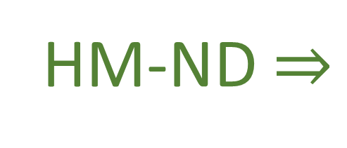

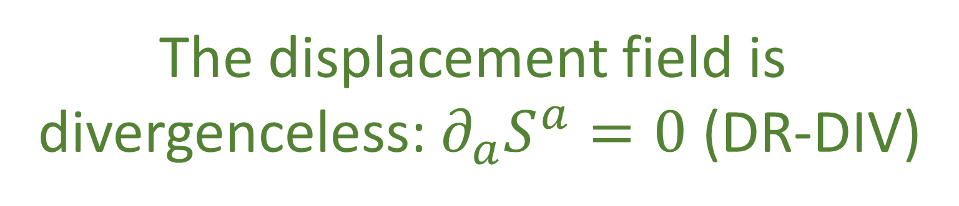




Single DOF
$$∂_{a}S^{a}=∂_{q^{i}}S^{q^{i}}+∂_{p_{i}}S^{p_{i}}$$
$$∂_{a}S^{a}=∂_{q}S^{q}+∂_{p}S^{p}$$
$$=∂_{q}∂_{p}H−∂_{p}∂_{q}H$$
$$=∂_{q^{i}}∂_{p_{i}}H−∂_{p_{i}}∂_{q^{i}}H=0$$
$$=0$$
HM-ND $⇒$
The displacement field is
divergenceless: $∂_{a}S^{a}=0$ (DR-DIV)

Slide 15



$$∂_{a}S^{a}=∂_{q^{i}}S^{q^{i}}+∂_{p_{i}}S^{p_{i}}=∂_{q^{i}}∂_{p_{i}}H−∂_{p_{i}}∂_{q^{i}}H$$
$$∂_{a}S^{a}=0$$
HM-ND $⇒$
The displacement field is
divergenceless: $∂_{a}S^{a}=0$ (DR-DIV)

Slide 16













Let $\hat{q}$and $\hat{p}$ represent the evolution of q and p after an infinitesimal time step $δt$
Multiple Degrees of Freedom
Single Degree of Freedom
$${\hat{p}}_{i}=p_{i}+S^{p_{i}}δt$$
$${\hat{q}}^{i}=q^{i}+S^{q^{i}}δt$$
$$\hat{p}=p+S^{p}δt$$
$$\hat{q}=q+S^{q}δt$$
$$∂_{b}{\hat{ξ}}^{a}=\left[\begin{matrix}δ_{j}^{i}+∂_{q^{j}}S^{q^{i}}δt & ∂_{p_{j}}S^{q^{i}}δt \\ ∂_{q^{j}}S^{p_{i}}δt & δ_{i}^{j}+∂_{p_{j}}S^{p_{i}}δt\end{matrix}\right]$$
$$∂_{b}{\hat{ξ}}^{a}=\left[\begin{matrix}1+∂_{q}S^{q}δt & ∂_{p}S^{q}δt \\ ∂_{q}S^{p}δt & 1+∂_{p}S^{p}δt\end{matrix}\right]$$
$$\left|∂_{b}{\hat{ξ}}^{a}\right|=\left|δ_{j}^{i}+∂_{q^{j}}S^{q^{i}}δt\right|\left|δ_{i}^{j}+∂_{p_{j}}S^{p_{i}}δt\right|$$
$$−\left|∂_{p_{j}}S^{q^{i}}δt\right|\left|∂_{q^{j}}S^{p_{i}}δt\right|$$
$$\left|∂_{b}{\hat{ξ}}^{a}\right|=\left(1+∂_{q}S^{q}δt\right)\left(1+∂_{p}S^{p}δt\right)$$
$$−∂_{q}S^{p}∂_{q}S^{q}δt^{2}$$
$$=1+\left(∂_{q^{i}}S^{q^{i}}+∂_{p_{i}}S^{p_{i}}\right)δt+O(δt^{2})$$
$$=1+\left(∂_{q}S^{q}+∂_{p}S^{p}\right)δt$$
$$+O(δt^{2})$$
$∂_{a}S^{a}$!!!
$∂_{a}S^{a}$!!!
$∂_{a}S^{a}$!!!

Slide 17








$$\text{Let} \hat{q} \text{and} \hat{p} \text{represent} \text{the} \text{evolution} \text{of} q \text{and} p$$
$$p$$
$$\text{after} \text{an} \text{infinitesimal} \text{time} \text{step} δt\text{:}$$
$${\hat{p}}_{i}=p_{i}+S^{p_{i}}δt$$
$${\hat{q}}^{i}=q^{i}+S^{q^{i}}δt$$
$$∂_{b}{\hat{ξ}}^{a}=\left[\begin{matrix}δ_{j}^{i}+∂_{q^{j}}S^{q^{i}}δt & ∂_{p_{j}}S^{q^{i}}δt \\ ∂_{q^{j}}S^{p_{i}}δt & δ_{i}^{j}+∂_{p_{j}}S^{p_{i}}δt\end{matrix}\right]$$
$$q$$
$$\left|∂_{b}{\hat{ξ}}^{a}\right|=\left|δ_{j}^{i}+∂_{q^{j}}S^{q^{i}}δt\right|\left|δ_{i}^{j}+∂_{p_{j}}S^{p_{i}}δt\right|−\left|∂_{p_{j}}S^{q^{i}}δt\right|\left|∂_{q^{j}}S^{p_{i}}δt\right|$$
$$=1+\left(∂_{q^{i}}S^{q^{i}}+∂_{p_{i}}S^{p_{i}}\right)δt+O(δt^{2})$$
$$=1$$
$∂_{a}S^{a}$!!!

Slide 18
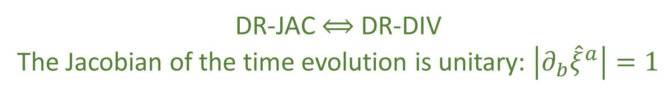



$\left|∂_{b}{\hat{ξ}}^{a}\right|=1$ $⟺$ $∂_{a}S^{a}=0$
DR-JAC $⟺$ DR-DIV
The Jacobian of the time evolution is unitary: $\left|∂_{b}{\hat{ξ}}^{a}\right|=1$
The Jacobian is still the multiplicative factor between past and future areas and densities
$$⇒$$
Volumes are conserved through the evolution: $d{\hat{ξ}}^{1}…d{\hat{ξ}}^{n}=dξ^{1}…dξ^n$ (DR-VOL)
Densities are conserved through the evolution: $\hat{ρ}\left({\hat{ξ}}^{a}\right)=ρ\left(ξ^{b}\right)$ (DR-DEN)
DR-DIV $⟺$DR-JAC $⟺$ DR-VOL $⟺$ DR-DEN

Slide 19





The displacement field $S^{a}$ has $2n$ components
Conditions DR-DIV, DR-JAC, DR-VOL, and DR-DEN all specify a single restraint giving
$2n−1$ components
The choice of Hamiltonian provides another constraint, leaving $2n−2$ choices
Single Degree of Freedom:
$$n=1$$
$$2n−2=0$$
no choices remain
Multiple Degrees of Freedom:
$$n>1$$
$$2n−2≠0$$
choices remain
HM-ND $⇒$ DR-DIV $⟺$DR-JAC $⟺$ DR-VOL $⟺$ DR-DEN
DR-DIV $⟺$DR-JAC $⟺$ DR-VOL $⟺$ DR-DEN $⇏$ HM-ND

Slide 20




$$p_{2}$$
$$p_{1}$$
$$q^{2}$$
$$q^{1}$$
$$p_{2}$$
$$p_{1}$$
$$q^{2}$$
$$q^{1}$$
Notes:
TODO: potato diagram is for divergencelessness; Line diagram is for curllessness

Slide 21






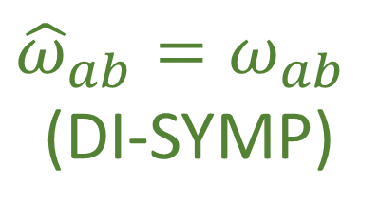

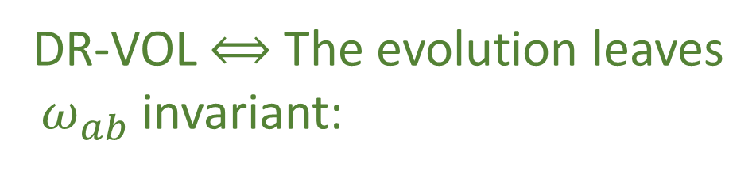



Multiple Degrees of Freedom
Single Degree of Freedom
$${\hat{ω}}_{ab}=∂_{a}\hat{ξ}ω_{cd}∂_{b}{\hat{ξ}}^{d}$$
Area$\left(v^{a},w^{a}\right)=v^{q}w^{p}−v^{p}w^{q}=v^{a}ω_{ab }w^{b}$
$$=\left(δ_{a}^{c}+∂_{a}S^{c}δt\right)ω_{cd}\left(δ_{b}^{d}+∂_{b}S^{d}δt\right)$$
$$=ω_{ab}+\left(∂_{a}S^{c}ω_{cb}+ω_{ad}∂_{b}S^{d}\right)δt+O\left(δt^{2}\right)$$
$$=ω_{ab}+\left(∂_{a}{(S}^{c}ω_{cb})+∂_{b}(S^{d}ω_{ad})\right)δt+O\left(δt^{2}\right)$$
$$=ω_{ab}+\left(∂_{a}{(S}^{c}ω_{cb})−∂_{b}(S^{d}ω_{da})\right)δt+O\left(δt^{2}\right)$$
$${\hat{v}}^{a}=∂_{b}{\hat{ξ}}^{a}v^{b}$$
Area is conserved if
$${\hat{ω}}_{ab}=ω_{ab}$$
$${\hat{w}}^{a}=∂_{b}{\hat{ξ}}^{a}w^{b}$$
${\hat{v}}^{c}ω_{cd }{\hat{w}}^{d}={v^{a}∂}_{a}{\hat{ξ}}^{c}ω_{cd}∂_{b}{\hat{ξ}}^{d}w^{b}=v^{a}{\hat{ω}}_{ab }w^{b}$
Invariance of $ω_{ab}$:
DR-VOL $⟺$ The evolution leaves
$ω_{ab}$ invariant:
$$∂_{a}{(S}^{c}ω_{cb})−∂_{b}\left(S^{d}ω_{da}\right)=0$$
$$∂_{a}S_{b}−∂_{b}S_{a}=0$$
${\hat{ω}}_{ab}=ω_{ab}$
(DI-SYMP)
DI-SYMP $⟺$ DI-CURL

Slide 22


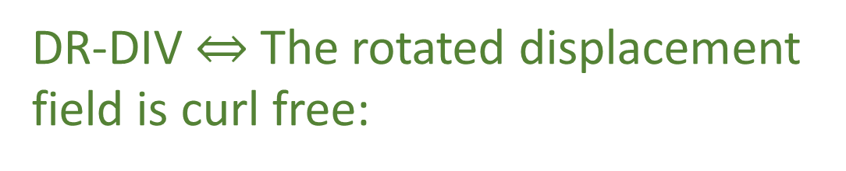
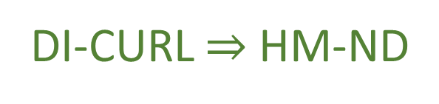

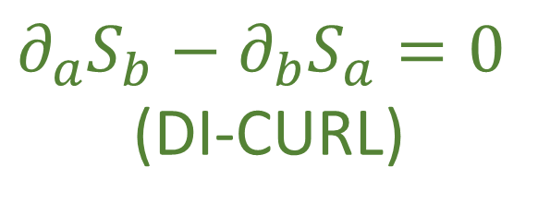





Multiple Degrees of Freedom
Single Degree of Freedom
Flow THROUGH the curve
$$\int{S^{a}×dξ^{b}}=\int{{(S}^{q}dp−S^{p}dq)}$$
$$∂_{a}S_{b}−∂_{b}S_{a}=∂_{a}\left(S^{c}ω_{cb}\right)−∂_{b}(S^{c}ω_{ca})$$
${90}^{∘}$ rotation
Flow ALONG the curve
$$=∂_{a}∂_{b}H−∂_{b}∂_{a}H=0$$
$$\int{S^{a}ω_{ab}dξ^{b}}=\int{S_{b}⋅dξ^{b}}$$
HM-ND $⇒$ DI-CURL
Conversely: given $S_{a}$ is curl free
DR-DIV $⇔$ The rotated displacement
field is curl free:
$$S_{a}=S^{b}ω_{ba}=∂_{a}H$$
$$∂_{a}S_{b}−∂_{b}S_{a}=0$$
(DI-CURL)
DI-CURL $⇒$ HM-ND

Slide 24



Insight: HM-ND $⟺$ DI-SYMP $⟺$ DI-CURL $⟺$ DI-POI
The relationship between Poisson brackets and $ω^{ab}$
is the same in the general case
DI-SYMP $⟺$ DI-POI
HM-ND $⟺$ DI-SYMP $⟺$ DI-CURL $⟺$ DI-POI

Slide 25

So far for the general case we have:
HM-ND $⟺$ DI-SYMP $⟺$ DI-CURL $⟺$ DI-POI
fully characterize Hamiltonian mechanics
HM-ND $⇒$ DR-DIV $⟺$DR-JAC $⟺$ DR-VOL $⟺$ DR-DEN
DR-DIV $⟺$DR-JAC $⟺$ DR-VOL $⟺$ DR-DEN $⇏$ HM-ND
Conditions DR-DIV, DR-JAC, DR-VOL, and DR-DEN
are weaker and don’t fully recover Hamiltonian
mechanics.

Slide 26



HM-ND
DR-DIV
DI-CURL
$$⟺$$
$$⇒$$
$$⟺$$
DI-POI
DI-SYMP

Slide 27
We need to build a stronger geometrical intuition for
DI-SYMP, DI-CURL, and DI-POI
which are the more fundamental set of assumptions

Slide 28

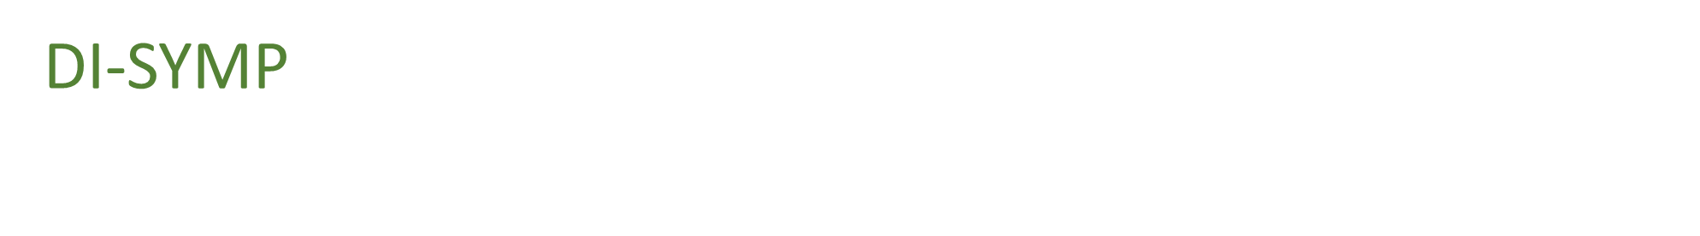




DI-SYMP tells us that $v^{a}ω_{ab}ω^{b}$ is a conserved quantity,
no matter what vectors $v^{a}$and $w^{b}$ we choose
$$p$$
For a single degree of freedom,
this represented the area
of the parallelogram formed
by the two vectors
$$v$$
$$ω(v,w)$$
$$w$$
$$q$$
Notes:
Area is also the volume

Slide 29




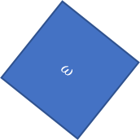


DI-SYMP tells us that $v^{a}ω_{ab}ω^{b}$ is a conserved quantity,
no matter what vectors $v^{a}$and $w^{b}$ we choose
$$p_{2}$$
$$p_{1}$$
$$q^{2}$$
$$v$$
For a single degree of freedom,
this represented the area
of the parallelogram formed
by the two vectors
$$ω(v,w)$$
$$w$$
$$q^{1}$$
$$ω$$
$$dq^{2}dp_{2}$$
$$dq^{1}dp_{1}$$
WARNING: analogy!!!
Notes:
TODO: in the 4d diagram, add projections on q1p1

Slide 30

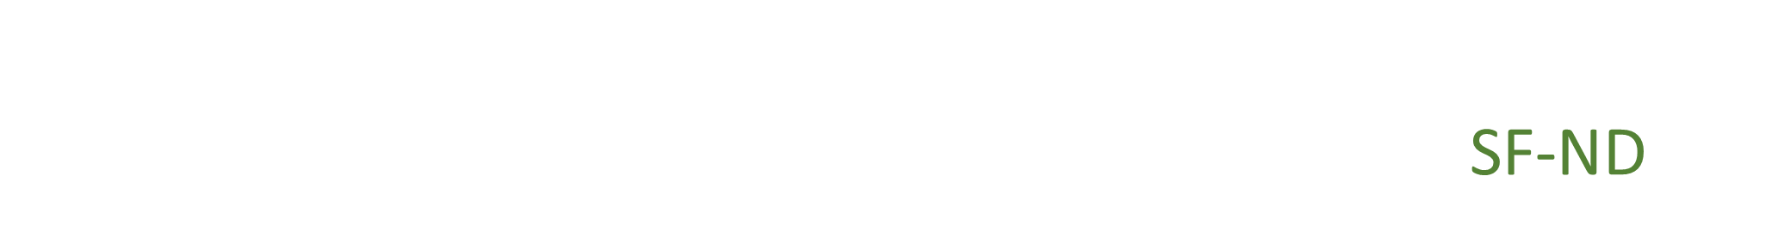

To understand this for the general case we can look at the
outer product decomposition for $ω_{ab}$ we saw in SF-ND
$$ω=\left[\begin{matrix}0 & 1 \\ −1 & 0\end{matrix}\right]⊗I_{n}$$
$$\left[ω_{ab}\right]=\left[\begin{matrix}ω_{q^{i}q^{j}} & ω_{q^{i}p_{j}} \\ ω_{p_{i}q^{j}} & ω_{p_{i}p_{j}}\end{matrix}\right]$$
SF-ND
Insight: what happens within a degree of
freedom is different from what happens
across degrees of freedom

Slide 31















Two Degrees of Freedom
Single Degree of Freedom
$$1≤y≤n$$
$$1≤x≤n$$
$$1≤x≤n$$
$v=v^{q}e_{q^{x}}+v^{p}e_{p_{x}}$ and $w=w^{q}e_{q^{x}}+w^{p}e_{p_{x}}$
$v=v^{q}e_{q^{x}}+v^{p}e_{p_{x}}$ and $w=w^{q}e_{q^{y}}+w^{p}e_{p_{y}}$
Stretching along the degree of freedom:
$$v^{a}ω_{ab}ω^{b}=0$$
$$v^{a}ω_{ab}ω^{b}=v^{q}ω^{p}−v^{p}w^{q}$$
Orthogonality between different degrees of freedom!
Within each degree of freedom, $ω_{ab}$ computes the area
of the parallelogram.
Since $ω_{ab}$ is conserved, orthogonality is preserved
during the evolution.
Since $ω_{ab}$ is conserved, parallelograms within any degree
of freedom will be mapped to parallelograms
of the same size.
In general relativity and Riemannian geometry, the metric tensor $g_{ij}$
defines the geometry by defining the scalar product between vectors.
Given: $v^{i}$ and $w^{j}$
$$v^{i}g_{ij}w^{j}=\left|v\right|\left|w\right|cosθ_{vw}$$
The metric tensor $g_{ij}$ defines lengths and angles
The form $ω_{ab}$ defines areas within different degrees of
Freedom and the angles between them
Notes:
TODO: add the typical scalar product with two vectors, and angles; move metric tensor on separate slide

Slide 32

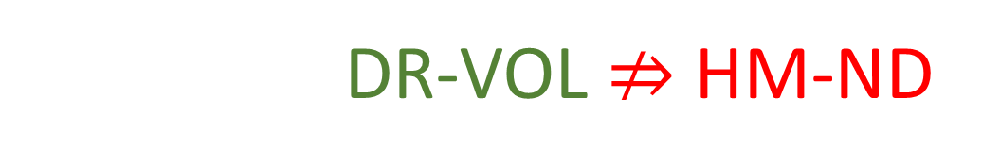
Since areas and orthogonality are preserved,
volumes are also preserved
This shows us why HM-ND $⇒$ DR-VOL
And why DR-VOL $⇏$ HM-ND
Since an evolution could stretch one degree of
freedom while shrinking another by the
same amount, conserving volumes, but not
the areas of each degree of freedom
Notes:
TODO: add picture

Slide 33




For example, take the system of equations:
$$d_{t}q^{1}={S^{q}}^{1}=\frac{p_{1}}{m}$$
Particle under linear drag
$$d_{t}p_{1}=S^{p_{1}}=−bp_{1}$$
a particle accelerated proportionally
to its momentum
$$d_{t}q^{2}={S^{q}}^{2}=\frac{p_{2}}{m}$$
$$d_{t}p_{2}=S^{p_{2}}=bp_{2}$$
$$∂_{a}S^{a}=∂_{q^{1}}\frac{p_{1}}{m}+∂_{p_{1}}\left(bp_{1}\right)+∂_{q^{2}}\frac{p_{2}}{m}+∂_{p_{2}}\left(bp_{2}\right)=−b+b=0$$
Divergence is zero: DR-DIV and DR-VOL are satisfied
Notes:
TODO: picture where you stretch one DOF and compress the other

Slide 34


However:
$$∂_{q^{1}}S_{p_{1}}−∂_{p_{1}}S_{q^{1}}=∂_{q^{1}}S^{q^{1}}ω_{q^{1}p_{1}}−∂_{p_{1}}S^{p_{1}}ω_{p_{1}q^{1}}$$
$$=∂_{q^{1}}\frac{p_{1}}{m}\left(1\right)−∂_{p_{1}}(−bp_{1})(−1)$$
$$=−b$$
Curl of $S_{a}$is not zero: DI-CURL is not satisfied, nor are DI-SYMP and HM-DM
This system is not Hamiltonian because we are
not preserving the Areas within each
independent degree of freedom

Slide 35
Notes:
TOTHINK: Show that scalar product is the area with one vector rotated?

Slide 37




Math Bank
$${\hat{ω}}_{ab}=∂_{a}\hat{ξ}ω_{cd}∂_{b}{\hat{ξ}}^{d}=\left(δ_{a}^{c}+∂_{a}S^{c}δt\right)ω_{cd}\left(δ_{b}^{d}+∂_{b}S^{d}δt\right)$$
$$=ω_{ab}+\left(∂_{a}S^{c}ω_{cb}+ω_{ad}∂_{b}S^{d}\right)δt+O\left(δt^{2}\right)$$
$$=ω_{ab}+\left(∂_{a}{(S}^{c}ω_{cb})+∂_{b}(S^{d}ω_{ad})\right)δt+O\left(δt^{2}\right)$$
$$=ω_{ab}+\left(∂_{a}{(S}^{c}ω_{cb})−∂_{b}(S^{d}ω_{da})\right)δt+O\left(δt^{2}\right)$$
Invariance of $ω_{ab}$: $∂_{a}{(S}^{c}ω_{cb})−∂_{b}(S^{d}ω_{da})$
In terms of the rotated displacement field $S_{a}$ we have the more compact form $∂_{a}S_{b}−∂_{b}S_{a}=0$
the rotated displacement field is the gradient of the Hamiltonian
$$∂_{a}S_{b}−∂_{b}S_{a}=∂_{a}\left(S^{c}ω_{cb}\right)−∂_{b}\left(S^{c}ω_{ca}\right)=∂_{a}∂_{b}H−∂_{b}∂_{a}H=0$$
$$S_{a}=S^{b}ω_{ba}=ω_{a}H$$

Slide 38






$v=v^{q}e_{q^{x}}+v^{p}e_{p_{x}}$ and $w=w^{q}e_{q^{x}}+w^{p}e_{p_{x}}$
One degree of freedom:
$$v^{a}ω_{ab}ω^{b}=v^{q}ω^{p}−v^{p}w^{q}$$
Two degrees of freedom:
$$v^{a}ω_{ab}ω^{b}=0$$
$$v^{i}g_{ij}w^{j}=\left|v\right|\left|w\right|cosθ_{vw}$$
$$d_{t}q^{1}={S^{q}}^{1}=\frac{p_{1}}{m}$$
$$d_{t}p_{1}=S^{p_{1}}=−bp_{1}$$
$$d_{t}q^{2}={S^{q}}^{2}=\frac{p_{2}}{m}$$
$$d_{t}p_{2}=S^{p_{2}}=bp_{2}$$

Slide 39

$$∂_{a}S^{a}=∂_{q^{1}}\frac{p_{1}}{m}+∂_{p_{1}}\left(bp_{1}\right)+∂_{q^{2}}\frac{p_{2}}{m}+∂_{p_{2}}\left(bp_{2}\right)=−b+b=0$$
$$∂_{q^{1}}S_{p_{1}}−∂_{p_{1}}S_{q^{1}}=∂_{q^{1}}S^{q^{1}}ω_{q^{1}p_{1}}−∂_{p_{1}}S^{p_{1}}ω_{p_{1}q^{1}}=∂_{q^{1}}\frac{p_{1}}{m}\left(1\right)−∂_{p_{1}}(−bp_{1})(−1)=−b$$
$$ω_{ab}=\left[\begin{matrix}0 & 1 \\ −1 & 0\end{matrix}\right]⨂\left[\begin{matrix}a_{1} & 0 & \text{⋯} & 0 \\ 0 & a_{2} & \text{⋯} & 0 \\ \text{⋮} & … & \text{⋱} & \text{⋮} \\ 0 & 0 & \text{⋯} & a_{4}\end{matrix}\right]$$

Slide 40
Image/images
Notes:
Look at foundations 2016 slides and others for images

Slide 41




Total number of states is the product between the cases in each d.o.f volume is product of the areas→ d.o.f. orthogonal in phase space
$$(y,p_{y})$$
$$(y′,{p′}_{y})$$
$$(x,p_{x})$$
$$(x′,{p′}_{x})$$
Number of cases on each d.o.f. remains the same (area of each d.o.f)
Total number of cases product of all cases (orthogonal d.o.f.)

Slide 42






Relationships within degrees of freedom
Motion preserves area of each independent d.o.f (uncertainty,
entropy and number of states)
$$p_{i}$$
$${p′}_{i}$$
$$x_{i}$$
$$V^{i}×W^{i}=V^{i^{′}}×W^{i^{′}}$$
$${x′}_{i}$$
$$V^{i}\left[\begin{matrix}0 & 1 \\ −1 & 0\end{matrix}\right]W^{i}$$

Slide 43


Relationships within degrees of freedom
Motion preserves area of each independent d.o.f (uncertainty,
entropy and number of states)
$$p_{i}$$
$${p′}_{i}$$
$$x_{i}$$
$$V^{i}×W^{i}=V^{i^{′}}×W^{i^{′}}$$
$${x′}_{i}$$
$$V^{i}\left[\begin{matrix}0 & 1 \\ −1 & 0\end{matrix}\right]W^{i}$$

Slide 44






Relationships across degrees of freedom
Independent d.0.f.
remain perpendicular (remain independent)
$$x_{i}$$
$${x′}_{i}$$
$$V^{i}∙W^{j}=0=V^{i^{′}}∙W^{j^{′}}$$
$$x_{j}$$
$${x′}_{j}$$
$$V^{i}\left[\begin{matrix}… & 0 & 0 \\ 0 & … & 0 \\ 0 & 0 & …\end{matrix}\right]W^{j}$$

Slide 45
















Reversing phase-space
Hamiltonian Privilege, Erkenn (2023)
Stud Hist Phil 71, 082020, 60-71 (2020)
Each unit variable (i.e. coordinate) paired with a conjugate of inverse units: number of states $ΔqΔk$is invariant
$\hat{q}=100 cm/m q$
$$x↦x^{3}$$
$$1$$
$Δk=1 m^{−1}$
$$1$$
$Δ\hat{k}=0.01 cm^{−1}$
$$x$$
$$x^{3}$$
$Δ\hat{q}=100 cm$
$Δq=1 m$
Density, entropy, uniform distributions NOT in general coordinate invariant
Phase space (symplectic) structure is the only one that supports coordinate invariant density, entropy, state count
Only 3 spatial dimensions are possible
Independence of DOFs $⇒$ independence of units $⇒$ orthogonality in phase-space $⇒$ invariant marginals (for density, entropy, state count)
Hamiltonian mechanics preserves count of states and DOF independence over time
2-sphere the only symplectic manifold
$$(q^{y},k_{y})$$
$$ω_{ab}=\left[\begin{matrix}0 & 1 \\ −1 & 0\end{matrix}\right]⊗δ_{j}^{i}$$
Directional DOF
$$(q^{x},k_{x})$$
Orthogonality/independence across DOFs
Total number of states $=$ product of number of cases in each independent DOF
Symplectic form (geometric structure of phase space)
Areas/possibilities in each DOF
Invariance at equal time (relativity) gives us the structure of phase space

Slide 46





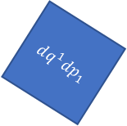
Relativistic mechanics
Lorentzian relativity is the only “correct” one
Minkowski signature appears on the extended phase space
$$ω=dq^{1}dp_{1}+dq^{2}dp_{2}$$
$$ω=dq^{1}dp_{1}−dtdE$$
$$ω$$
$$dq^{1}dp_{1}=ω+dtdE$$
$$dq^{2}dp_{2}$$
$$dq^{1}dp_{1}$$
$$dq^{1}dp_{1}$$
$$dtdE$$
$$ω$$
Indep DOF are orthogonal

