Slide 1
Automatic Probe Detection, Registration and Labelling Pipeline
3D head model
Probe mask
Mean curvature computation
Curvature thresholding
Detected probe points
ICP → MNI template
Assign Labels
Labels correct?
Retry ICP → MNI
Assign Label
Delete false detections
NO
YES
Recover missing probes
icp2_transformed_MNI_probes_FCP.probej
FALLBACK
Labels correct?
icp2_transformed_MNI_probes_FCP.probej
Manual Labelling
NO
YES
detected_recovered_probes_noSS_nXX_iterXXX.probej
Matched ICP
Matched template
Assign Labels
icp2_transformed_template_probes_FCP.probej
Primary route: detected points → ICP*-to-MNI assign labels → recover missing probes.
If labels are wrong: delete false detections and retry.
If still wrong: manual labelling + matched ICP* → assign labels from the matched template → recover missing probes.
[*ICP: Iterative Closest Point]
Intermidiate results
Manual steps
Final results

Slide 2
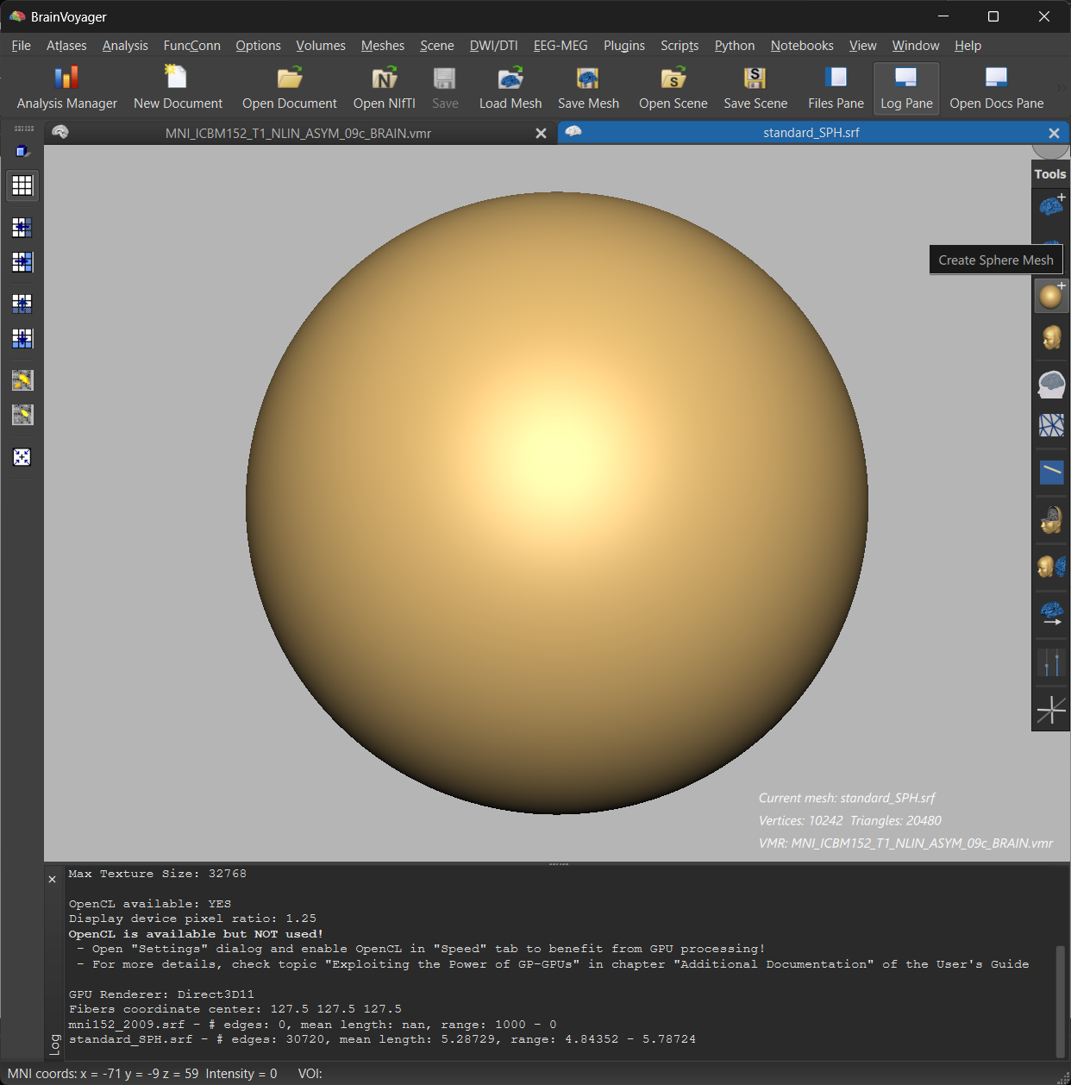
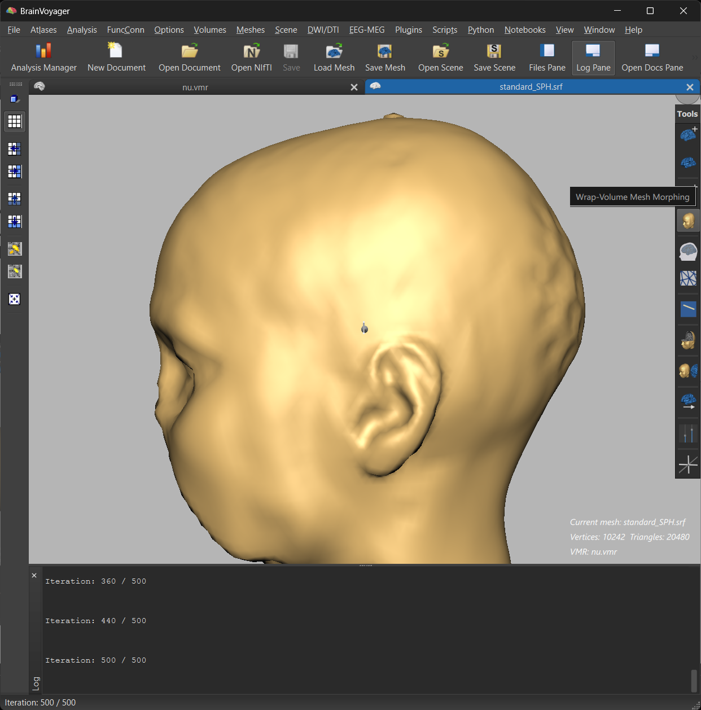
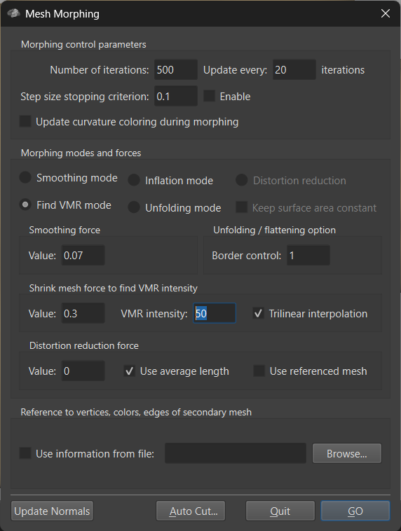
3D head model preparation
Load nu.mgz volume in BV
Switch to mesh view (3D Viewer button in the Volume tools) and create a Sphere mesh
Morph the Sphere to the head using intensity thresholding *
Delimit the probe area using a POI
* Eventually change the VMR intensity in the Mesh Morphing options if needed. Higher values move the mesh more inside to the head
The 3D model creation step is scriptable in python
2
3
3*

Slide 3
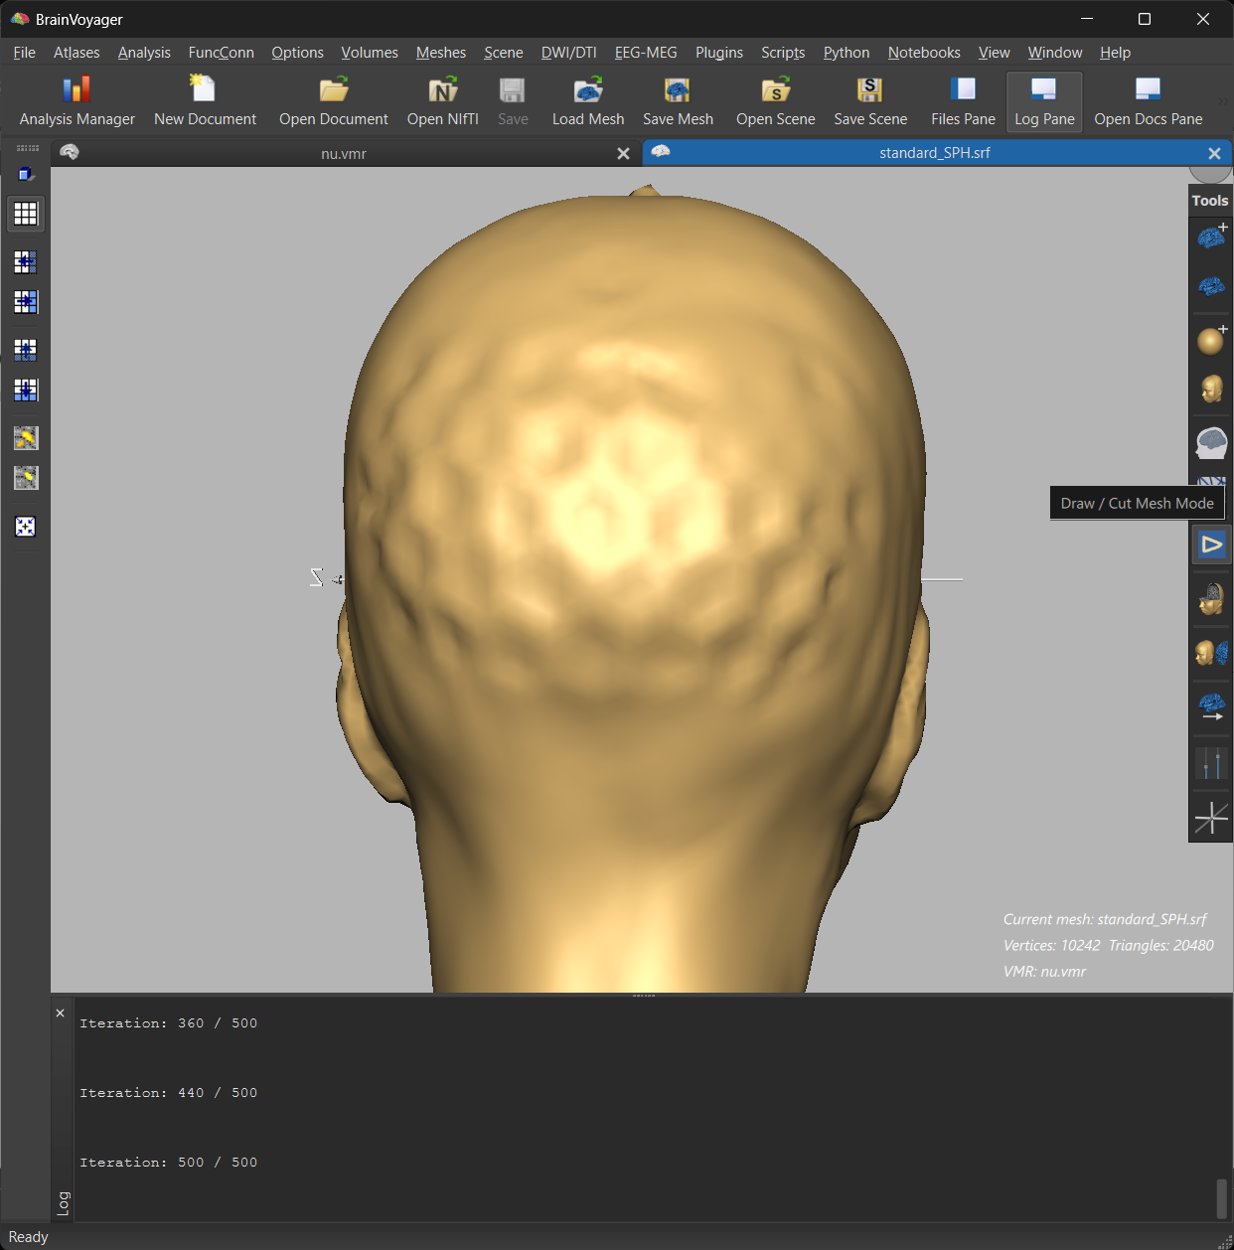
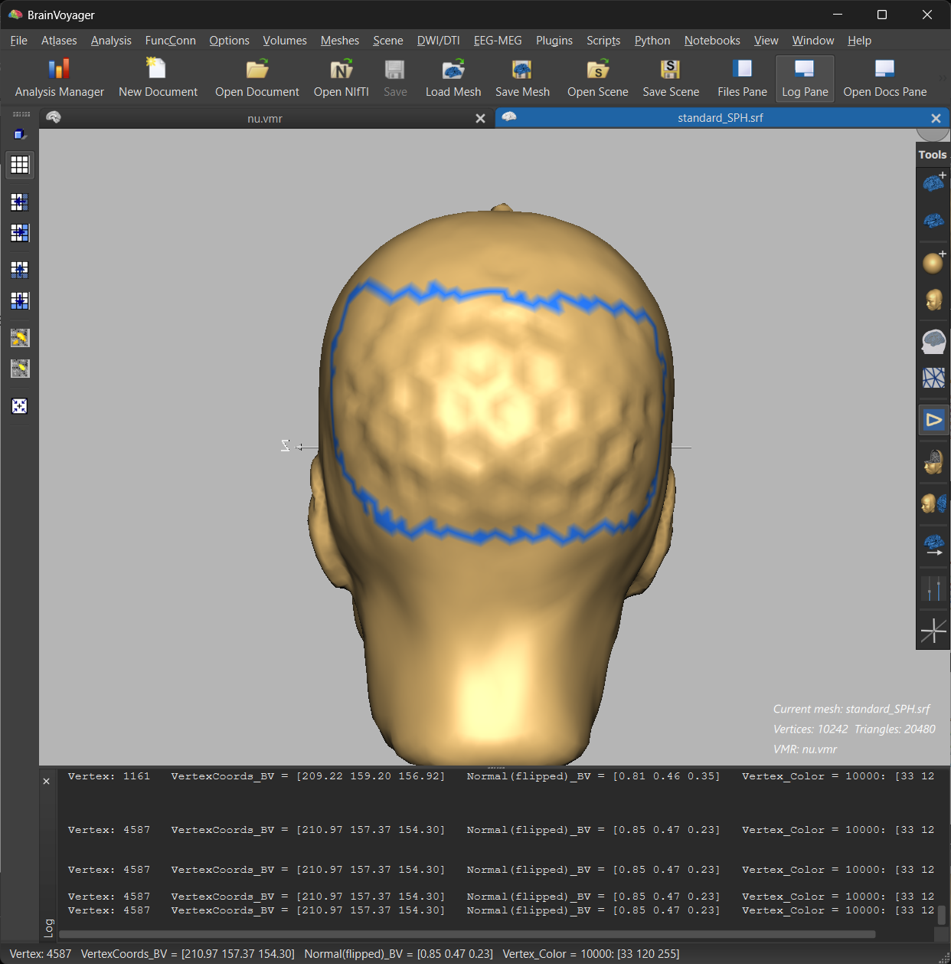
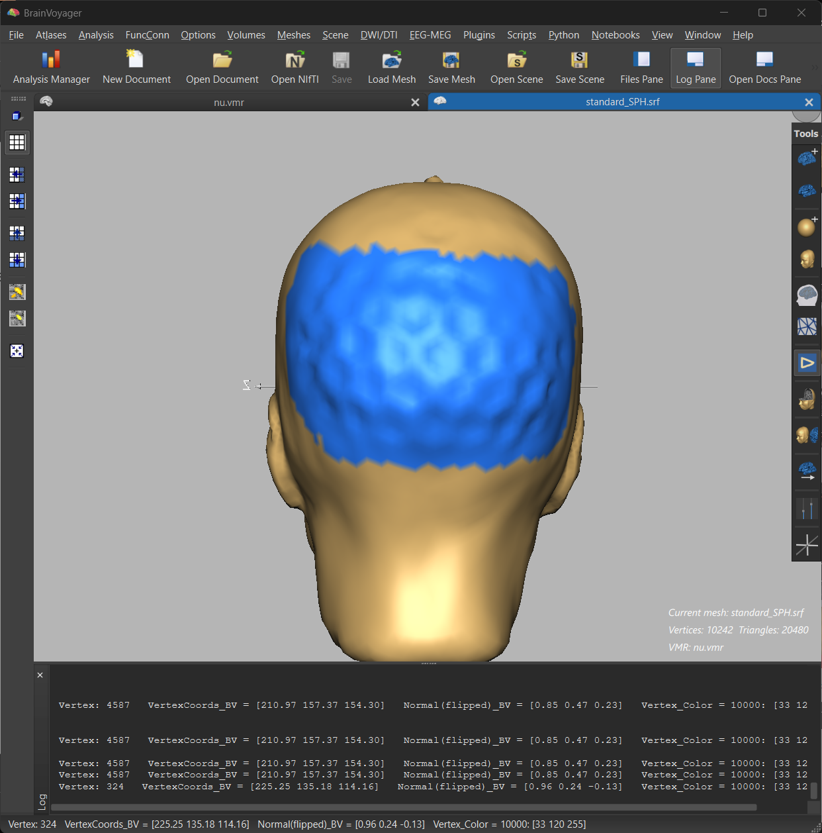
3D head model preparation
4a. Enable POI drawing in the 3D Viewer
4b. Hold CTRL down while drawing a closed line on the surface
4c. Holde CTRL + SHIFT down while clicking inside the drawed line to fill the patch
4d. Save to define POI by pressing again on the POI drawing button
4a
4b
4c

Slide 4
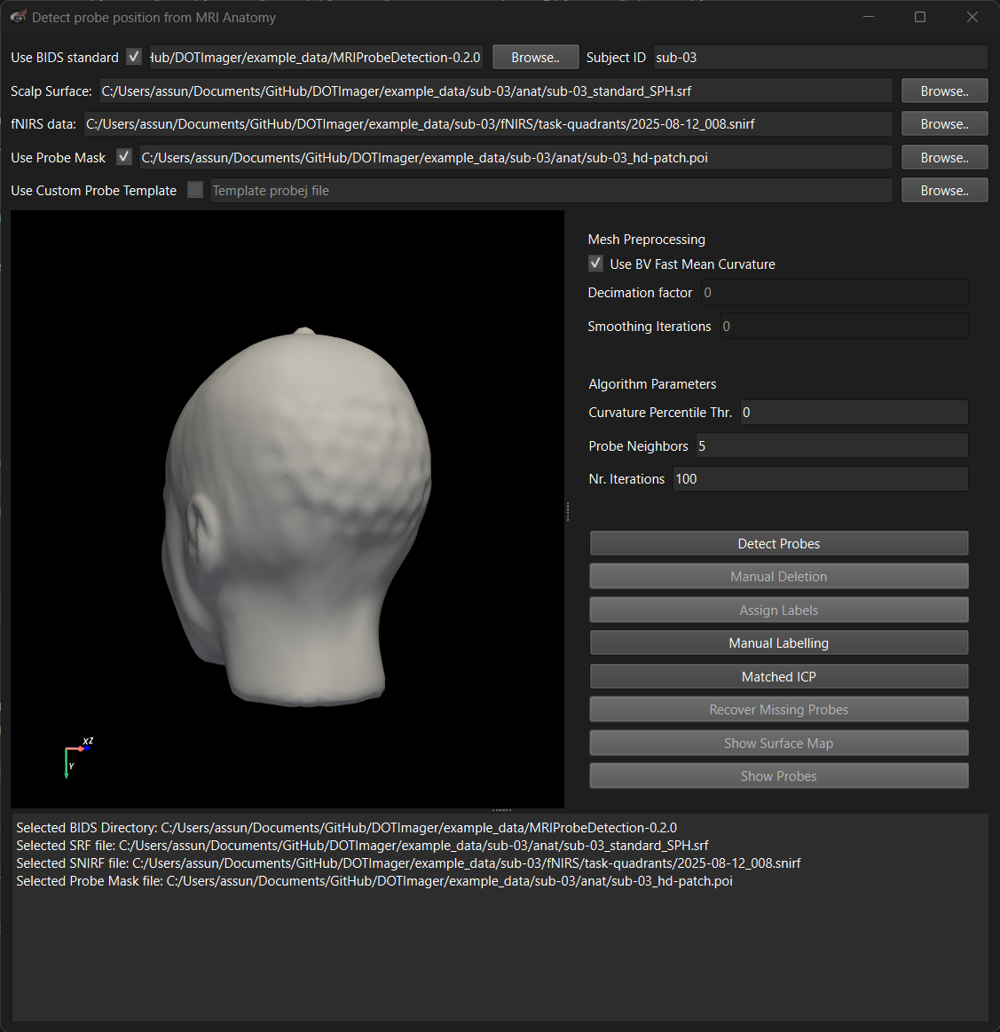
MNI probe detection GUI
If the ‘Use BIDS standard’ option is checked, the results will be saved at the specified location in the subfolder indicating the subject ID. If the BIDS option is unchecked, results are saved under DOTImager/MRI in the .snirf file folder.
It is recommended to use the BV fast mean curvature computation. This is an approximation of the mean curvature which is intrinsecally smoother so it avoids the need for additional mesh preprocessing steps.
These are the algorithm options. Default settings should work fine. The user will be asked to decide whether to use the define number of probe neighbors to perform probe recovery or whether to use all available neighbors (recommended).
It is recommended to use a patch to restrict the probe detection area.
Call for the manual labelling GUI (can be used asynchronousy from the rest of the pipeline).
Call to perform matched ICP between MNI probes (from .snirf file) and selected .probej file (can be used asynchronousy from the rest of the pipeline).

Slide 5
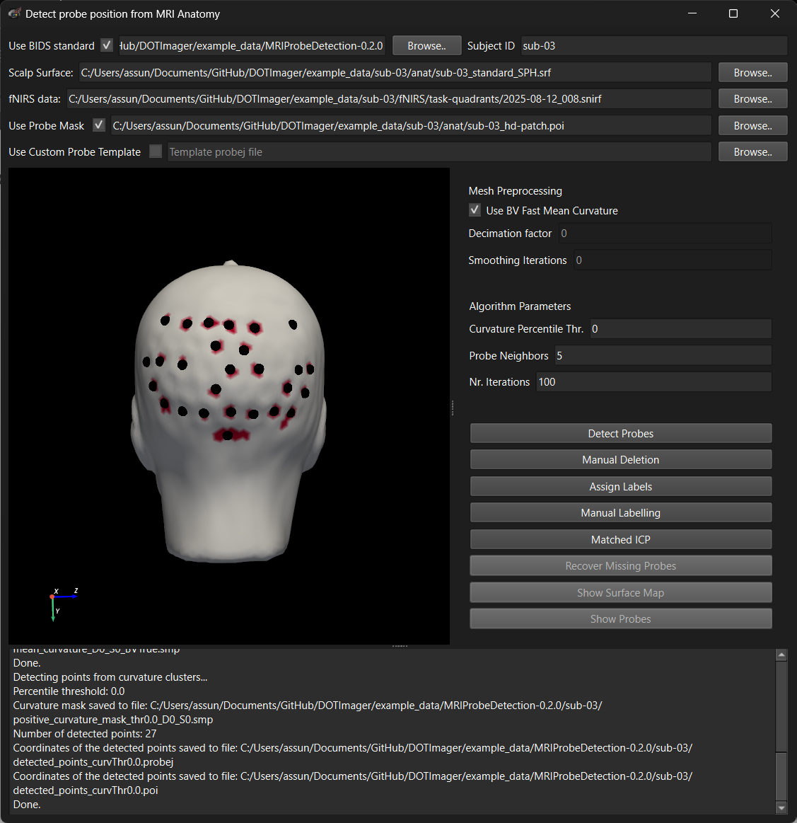
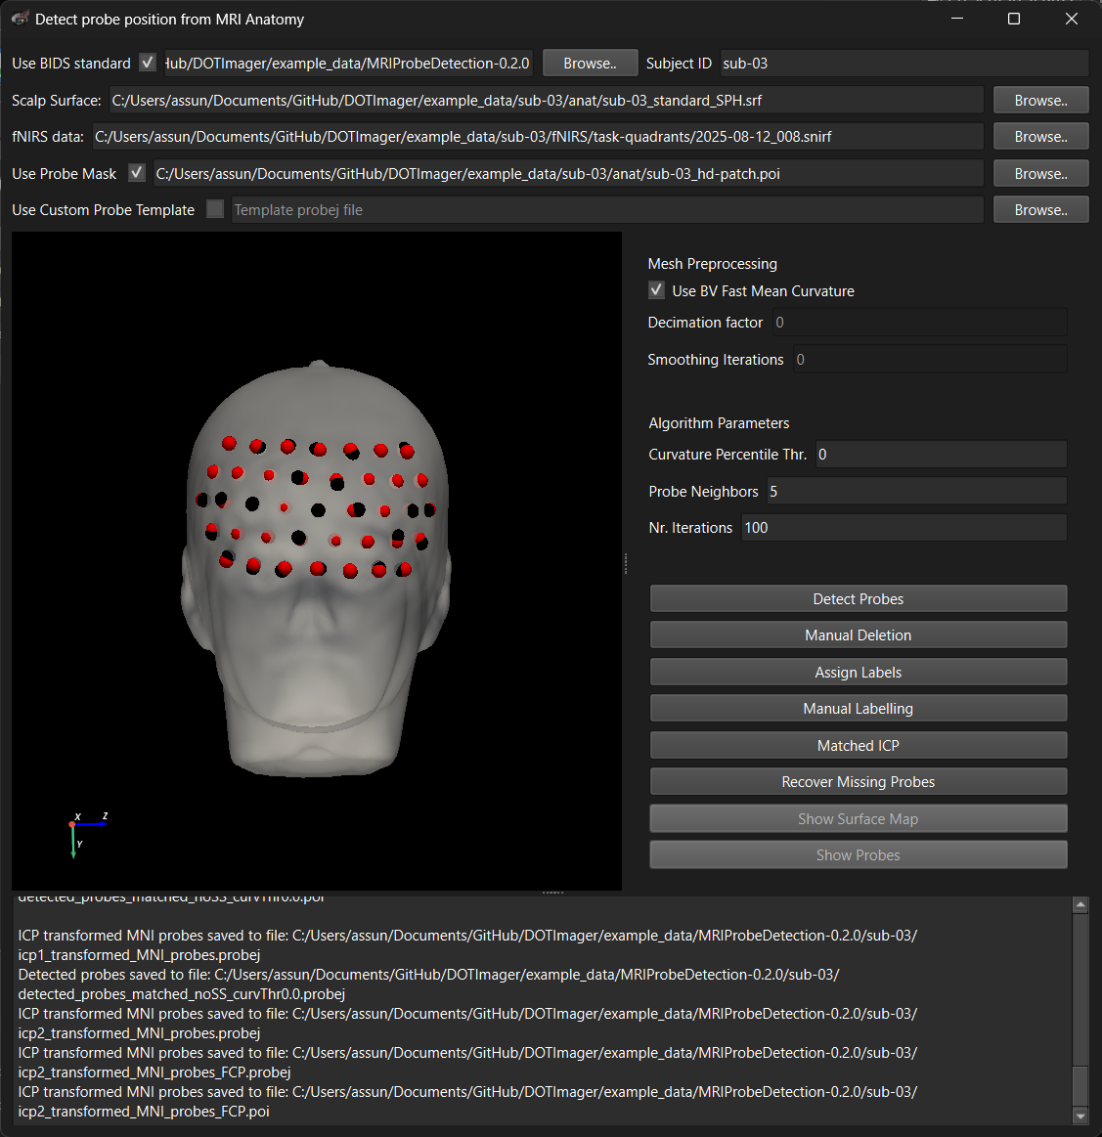
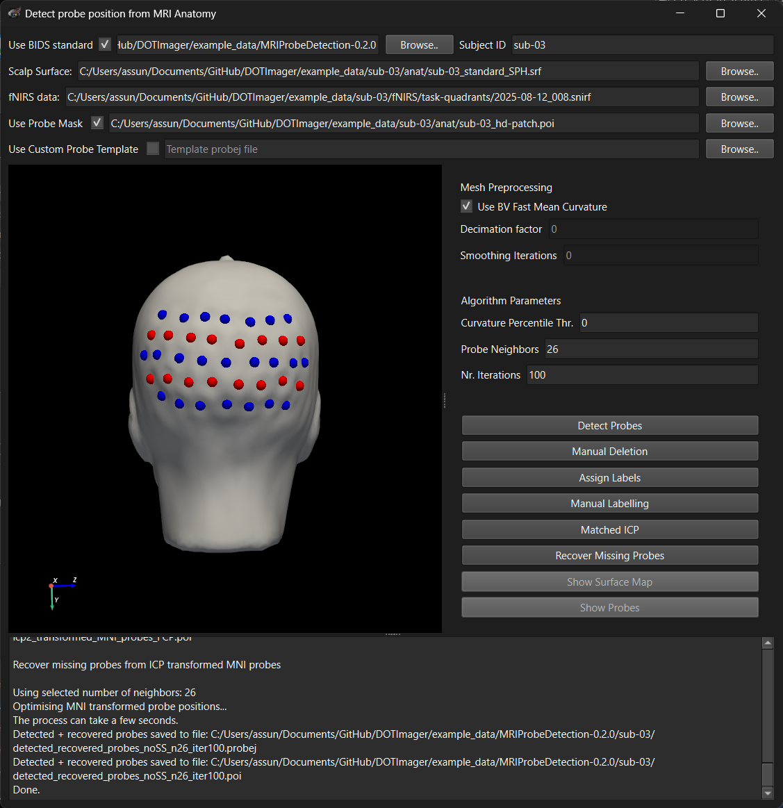
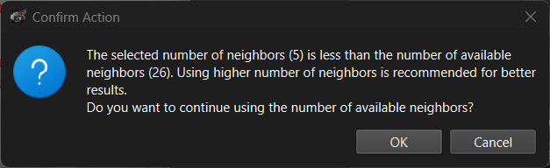
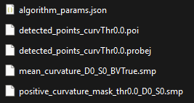
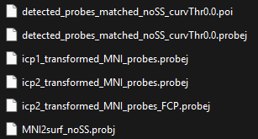
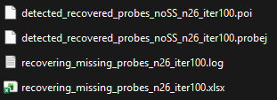
Primary route: detected points → ICP-to-MNI assign labels → recover missing probes.
1
2
3
OUTPUTS

Slide 6
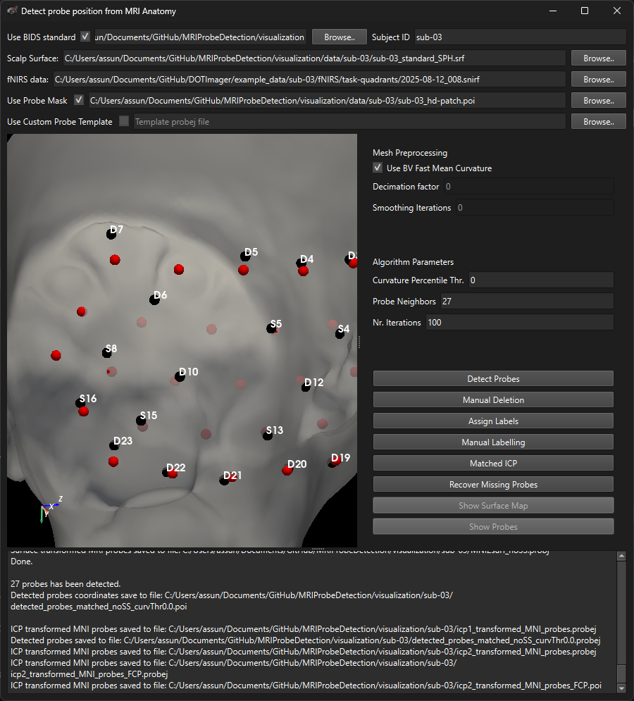
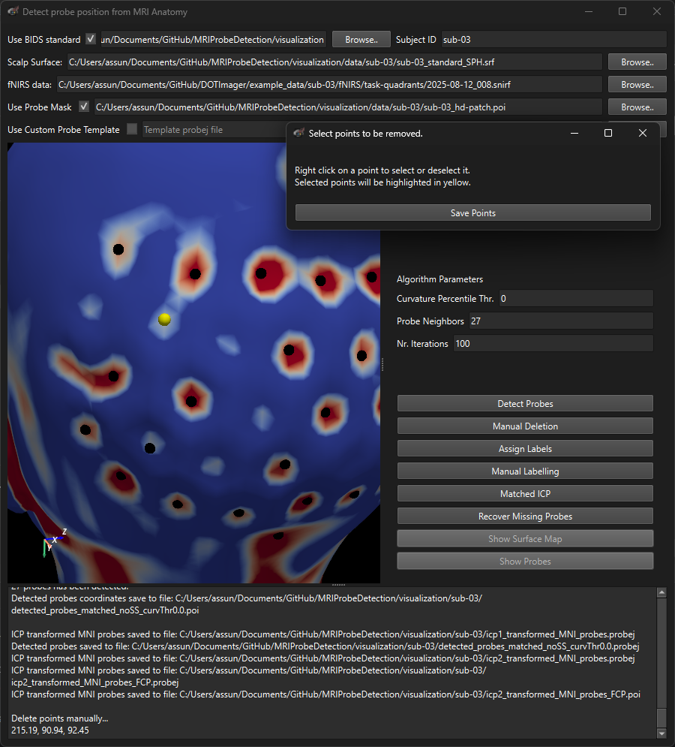
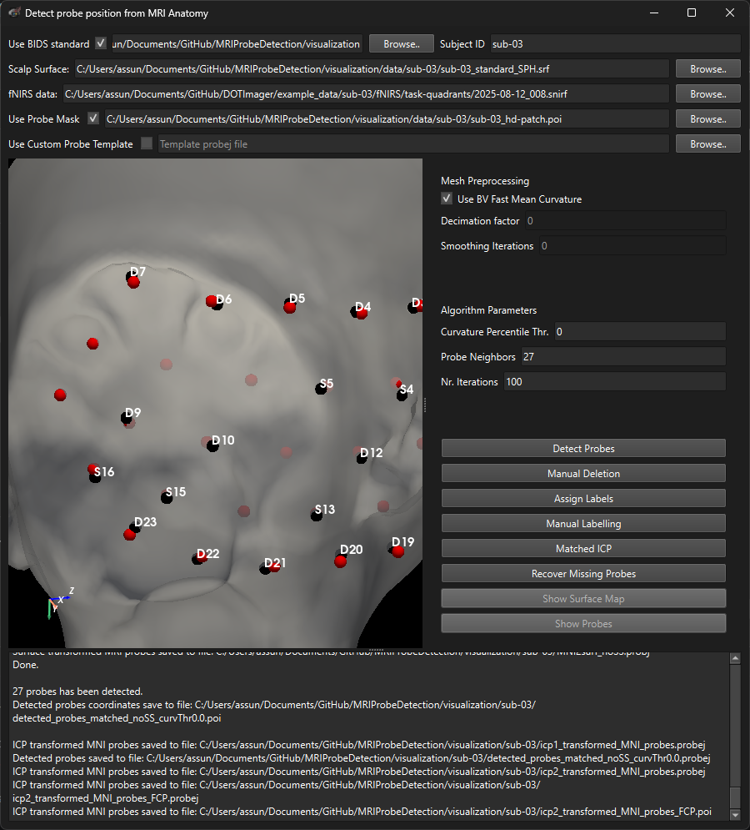

If labels are wrong: delete false detections and retry.
If after running step 1 and 2 as previously described the label assignment is wrong. Run step 1 again, identify problematic points and delete them. Then, continue with step 2 and 3 as before.
2
Wrong labels
Problematic point
OUTPUTS

Slide 7
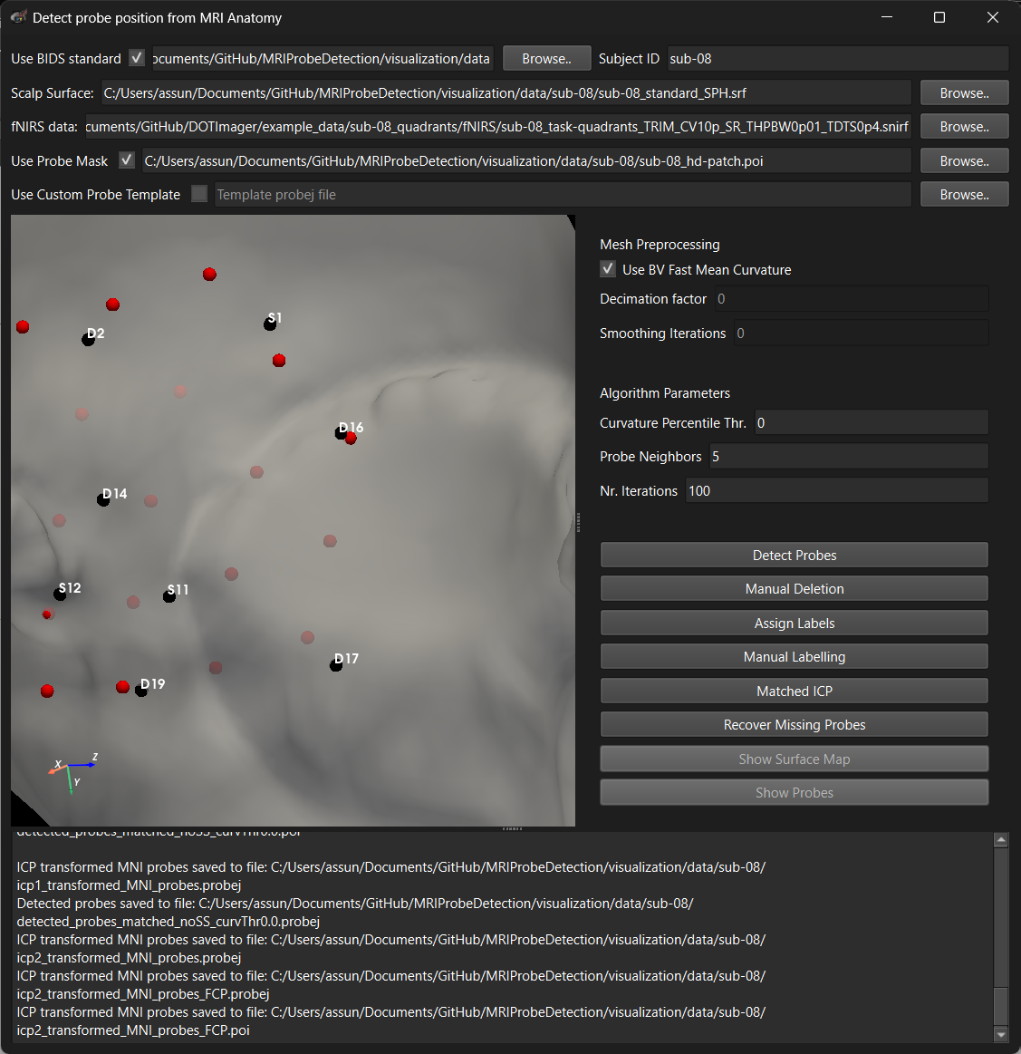
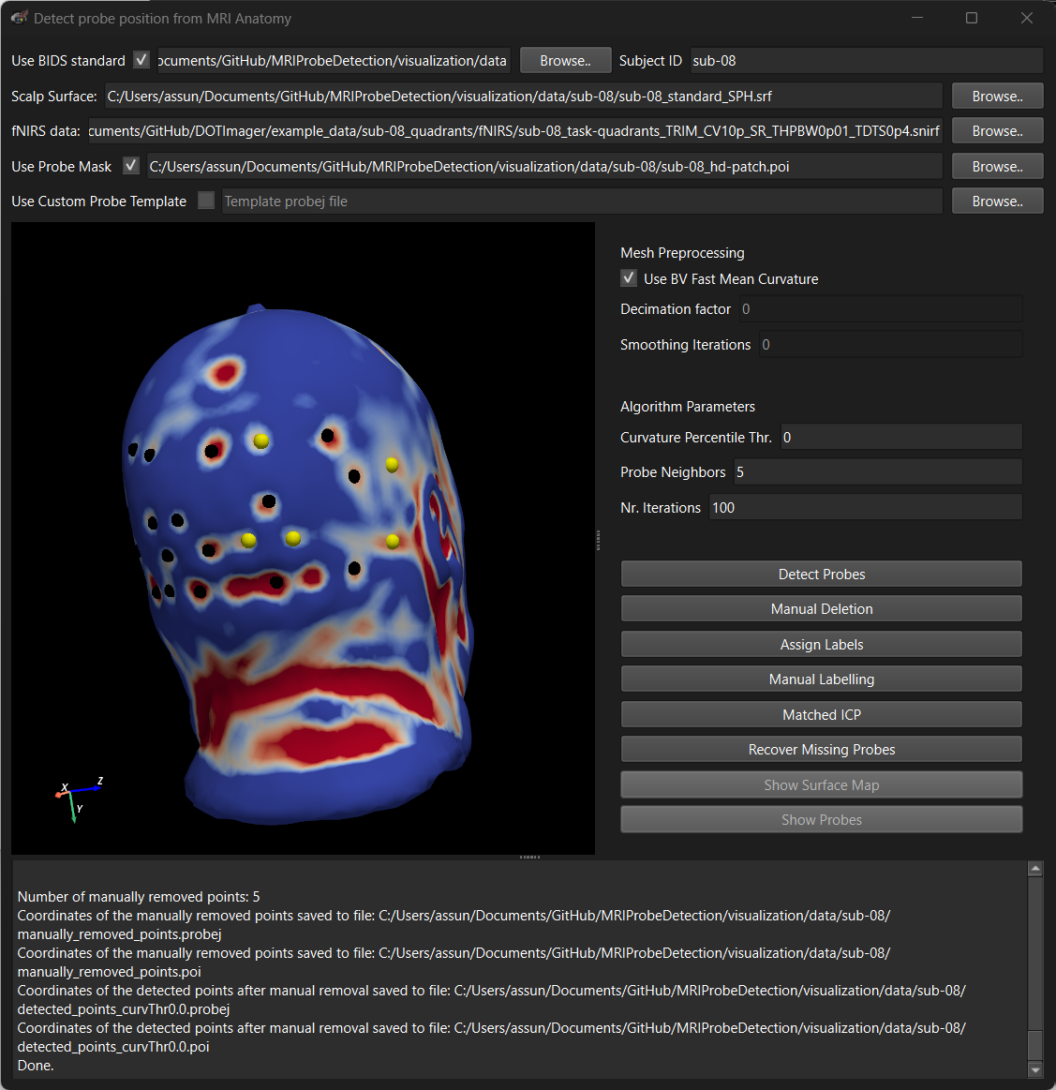
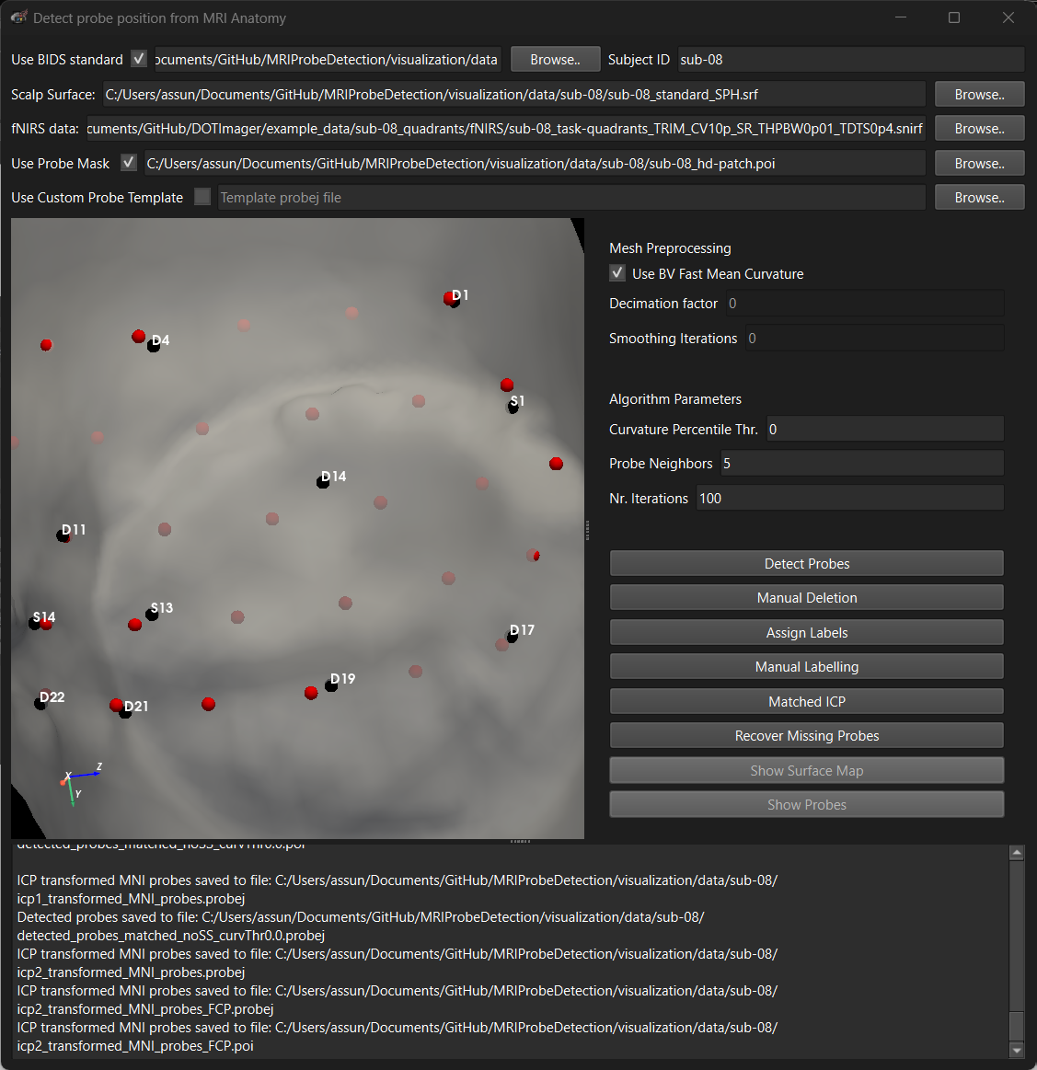
If still wrong: manual labelling + matched ICP → assign labels from the matched template → recover missing probes.
Wrong labels
2
correct
Problematic point
wrong
User can checked iteratively which point to delete, running labelling assignment multiple times with different deleted points.
It’s still wrong, so better to move to manual labelling.

Slide 8
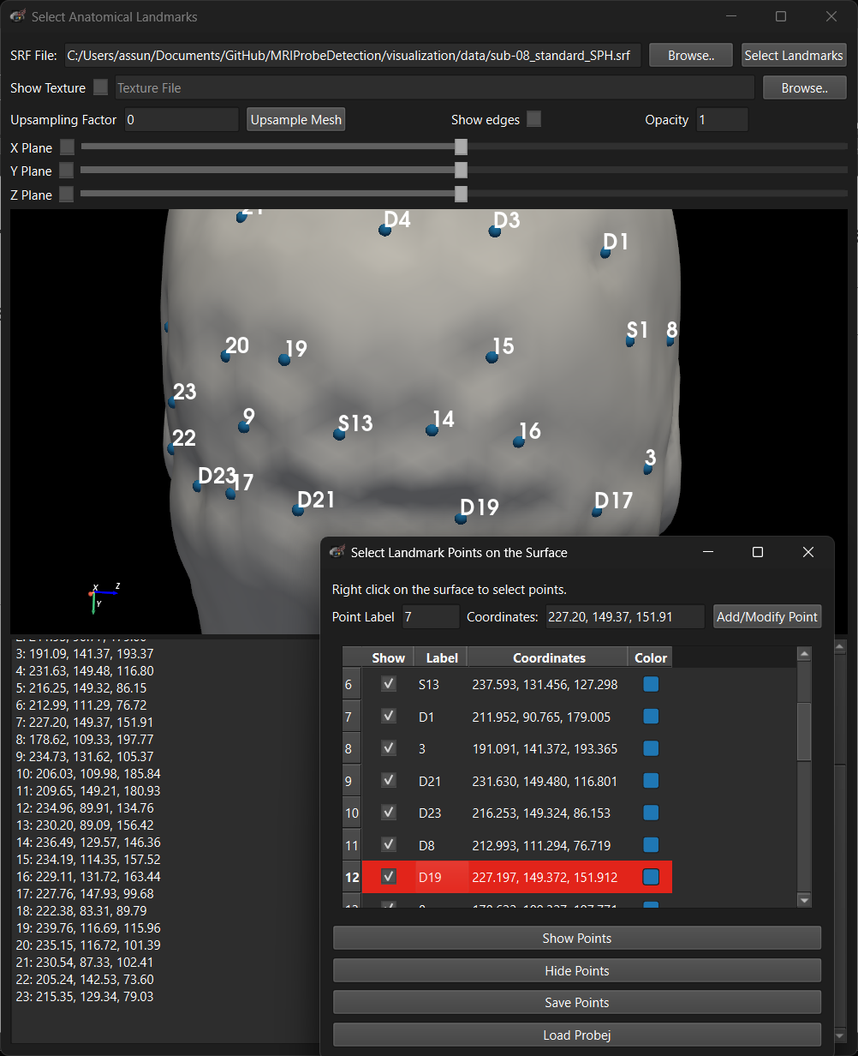
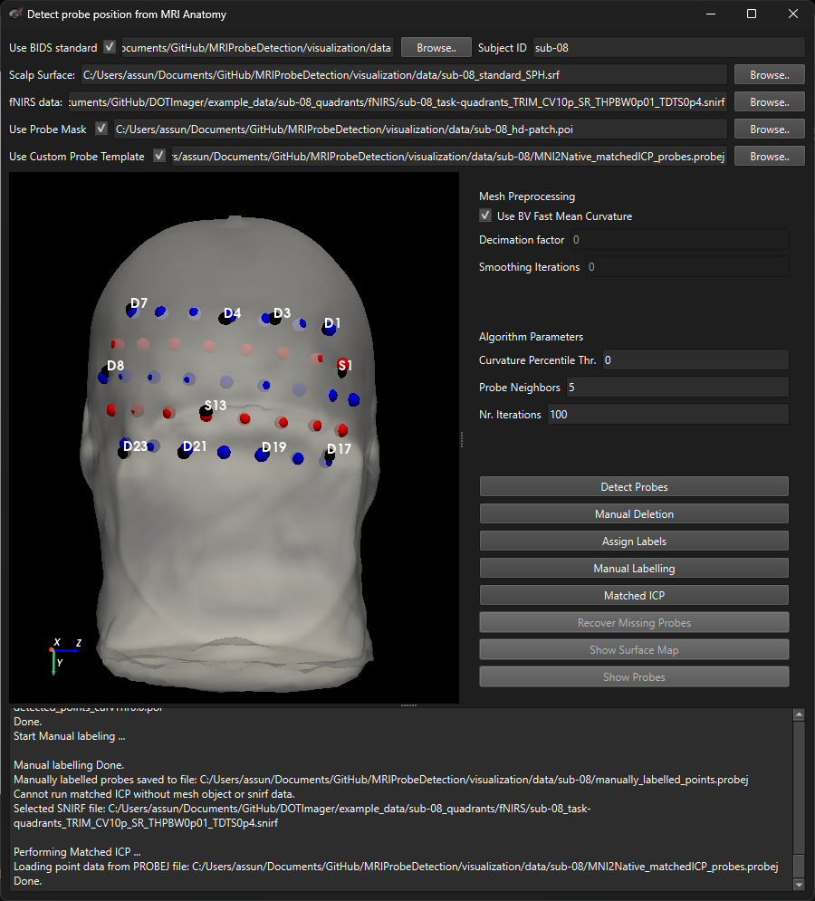
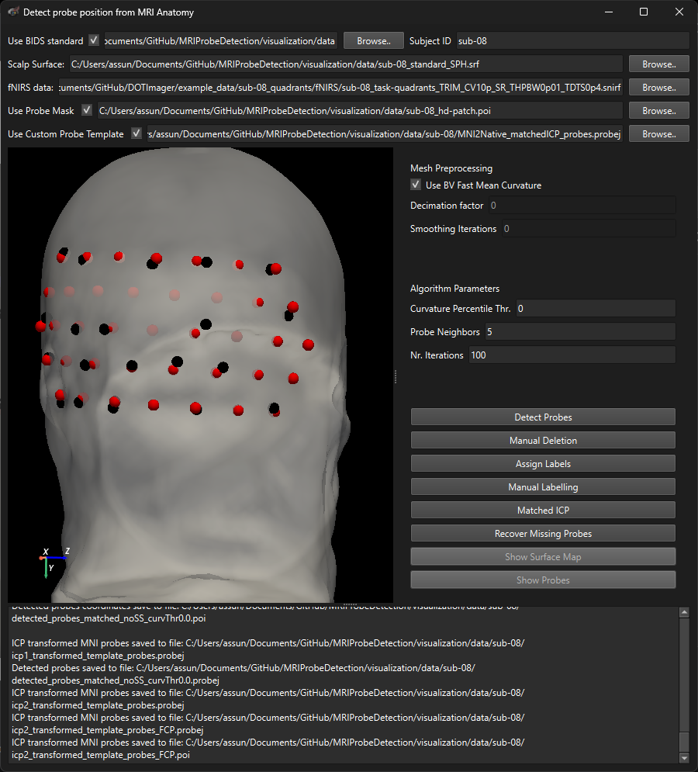



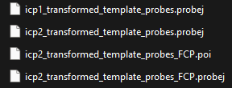
If still wrong: manual labelling + matched ICP → assign labels from the matched template → recover missing probes.
Rerun step 1 if you want to clean the output folder first. Proceed with manual labelling and matched ICP. Then run step 2 and 3 with the ‘Use Custom Probe Template’ option checked.
2
OUTPUTS
Matched template is saved and loaded automatically
User defined name

Slide 9
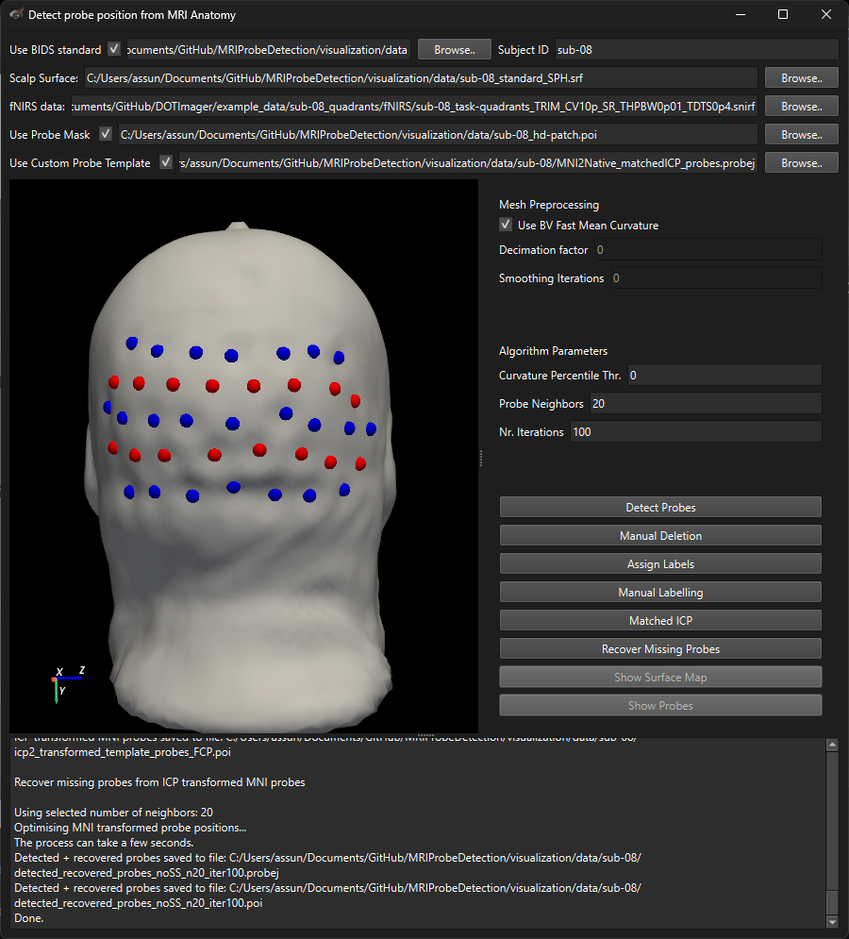
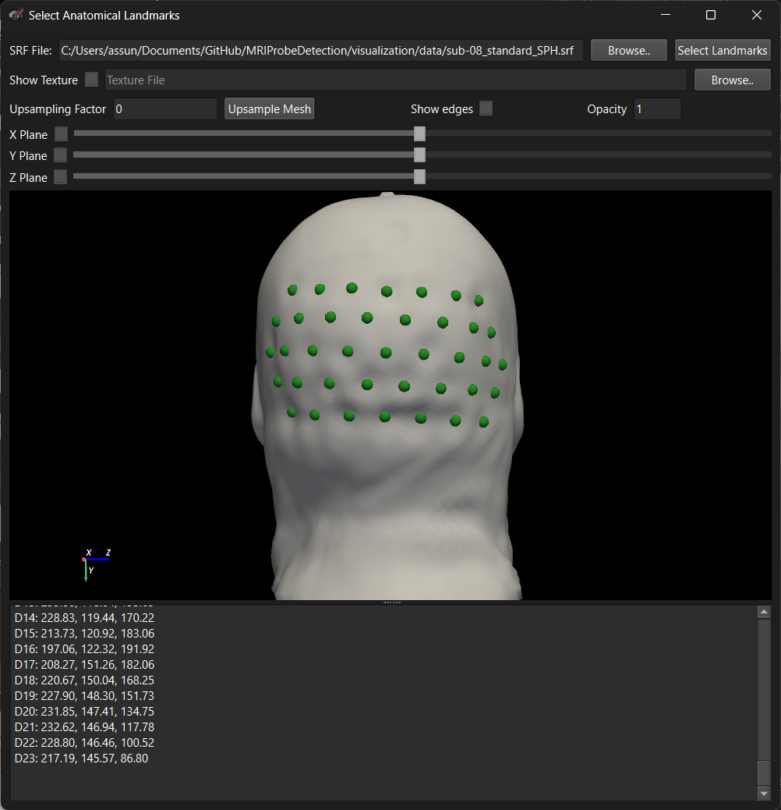
Which output to choose?
If the montage geometry if more distrorted, the automatic recovery procedure might not lead to perfect results in all locations.
In these cases, the user might choose to select one of the intermediate results:
icp2_transformed_MNI_probes_FCP.probej or better icp2_transformed_template_probes_FCP.probej if matched ICP was performed.
icp2_transformed_template_probes_FCP.probej

Slide 10
Results: Detect probes step
BrainVoyager SMP file cointaining mean curvature values for each mesh vertex
This json files stores the settings and source files used in the probe detection procedure. They are updated after every change in the GUI.
BrainVoyager SMP file cointaining a mask of the mesh patches with positive curvature
Probej json file containing all detected points coordinates in BrainVoyager coordinate system (RAS) and BrainVoyeger POI file with the index of the closest vertex.
Results: Assign label step
Probej json file containing ICP transformed MNI probe coordinates in BrainVoyager coordinate system (RAS) as obtained after label assignment (better fit than ICP1). In the _FCP version, the transformed coordinates are further projected onto the surface using Fast Continuous Projection.
Probej json file containing all labelled probe coordinates in BrainVoyager coordinate system (RAS) and BrainVoyeger POI file with the index of the closest vertex.
Probej json file containing ICP transformed MNI probe coordinates in BrainVoyager coordinate system (RAS), registered to the detected points for label assignment.
Probej json file containing MNI probe coordinates (from .snirf file) transformed to surface space, in BrainVoyager coordinate system (RAS).

Slide 11
Results: Recover missing probes step
Probej json file containing all detected probe coordinates, including detected and recoverd probes, in BrainVoyager coordinate system (RAS) and BrainVoyeger POI file with the index of the closest vertex.
Log files of the probe recovery step, useful for disgnosys.
Results: Manual Deletion (optional)
Probej json file containing allmanually removed point coordinates, in BrainVoyager coordinate system (RAS) and BrainVoyeger POI file with the index of the closest vertex.
Results: Manual Labelling – Matched ICP (optional)
Probej json file containing all manually labelled point coordinates, in BrainVoyager coordinate system (RAS) and BrainVoyeger POI file with the index of the closest vertex.
Same results after label assignment but starting from the matched template instead of MNI coordinates.
Probej json file containing MNI probe coordinates (from .snirf file) registered to the detected points using matched ICP, in BrainVoyager coordinate system (RAS).

