Slide 1
State bank of India & Punjab national Bank
Presented by-Aditya Indulkar 256203
Athrav Kadam 256208
Kartik Naik 256225

Slide 2
Introduction
State Bank of India (SBI)
In contrast, SBI's portal is a focused functional gateway. The design is minimalist and built for a single task: getting the user to log in securely and efficiently. By removing distractions, the design prioritizes a streamlined, task-oriented user journey. This approach is modern and security-focused.
Punjab National Bank (PNB)
PNB's website is designed as a comprehensive informational portal. Its homepage is dense, featuring numerous links, product showcases, and mega-menus. The core goal is discovery, exposing users to the full breadth of the bank's services at once. This approach is traditional and information-rich.

Slide 3
Feature | SBI Bank(HomePage) | PNB Bank(HomePage)
Input Controls | Online banking login form, search bar for services, add beneficiary, OTP, checkboxes, sliders (loan/EMI calculators). | NetBanking login, quick fund transfer forms, add beneficiary, OTP, checkboxes, EMI sliders.
Navigation Components | <header> with logo, navigation bar (Personal, Corporate, NRI, Loans, Cards), drop-down menus, hamburger menu in mobile. | <header> with logo, navigation bar (Personal, Corporate, MSME, Agriculture), drop-down menus, quick links
Information Components | Service cards with account info, loan details, offers, interest rates, product highlights, security alerts. | Service cards with account info, loan products, schemes, offers, interest rates, government subsidy info.
UI Design | Modern, structured, blue-themed interface, easy navigation, mobile-friendly, accessible with SBI YONO integration | Traditional but updated design, maroon-gold theme, simpler layout, mobile-friendly with PNB One app integration.
Security Features | 2FA with OTP, biometric login (YONO), end-to-end encryption, device binding, secure logout reminders | 2FA with OTP, PNB One biometric login, encryption, session timeout, secure image authentication.

Slide 4
NAVIGATION BAR | Global navigation bar provides quick access to Retail Banking, Corporate Banking, About Us, Services, and Help. | Global navigation bar includes logo, search, net banking login, and important service links.
SEARCH FUNCTIONALITY | Acts as a support tool, helping customers directly find relevant banking information, forms, or service pages. | Works as a primary navigation aid, guiding users directly to service details, product information, and online portals.

Slide 5
State Bank of India

Slide 6

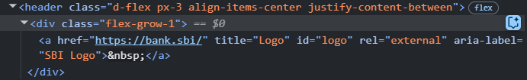

Slide 7
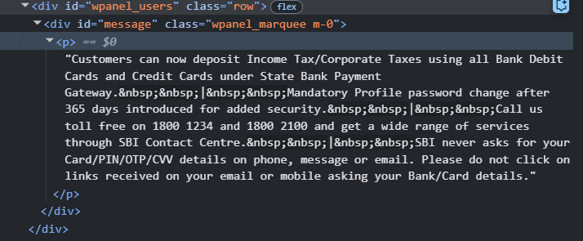

Slide 8
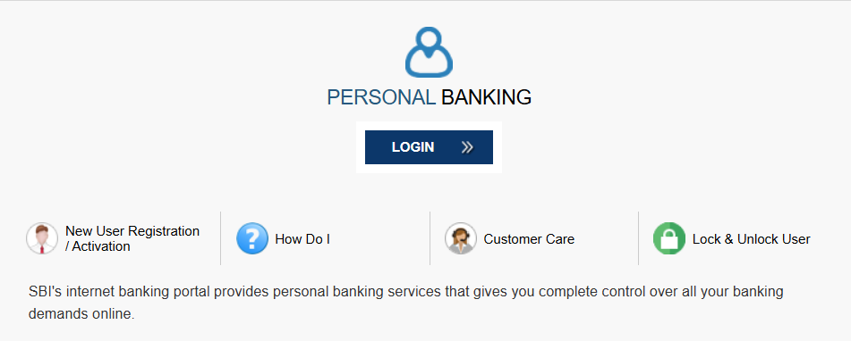
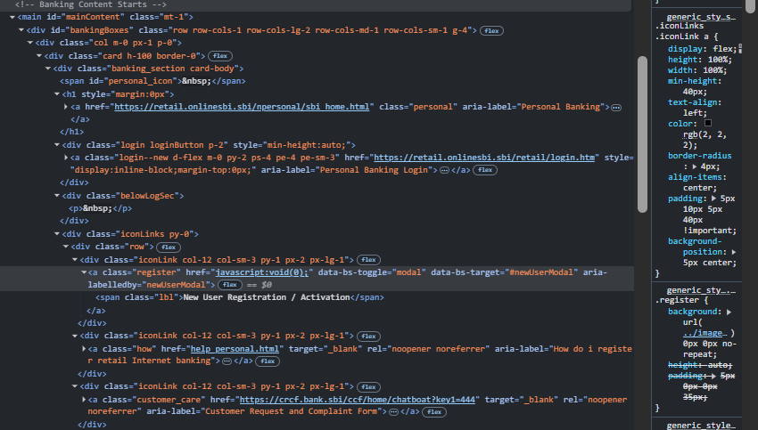

Slide 9
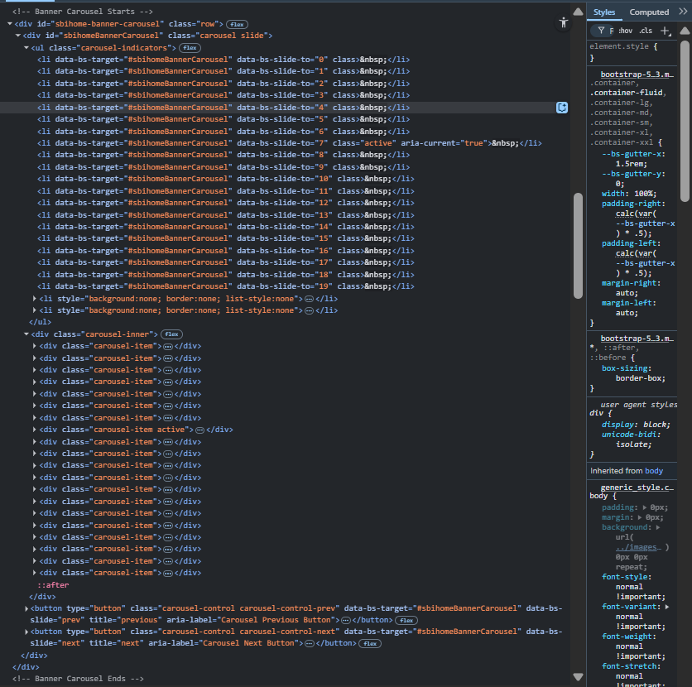


Slide 10
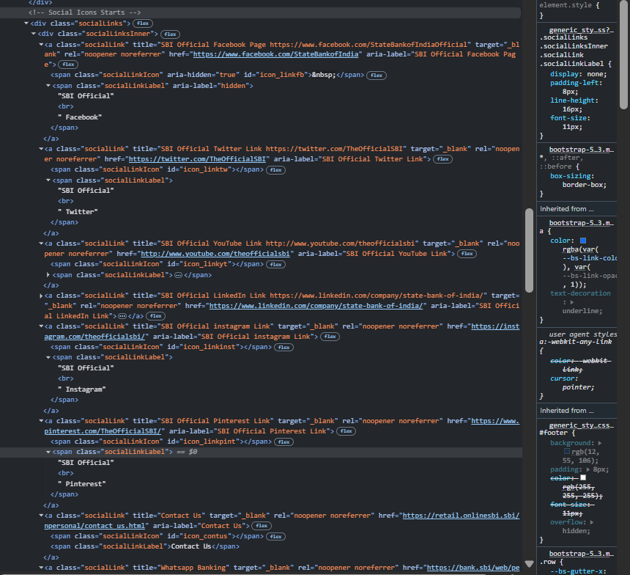
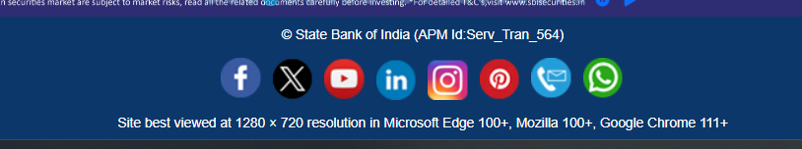

Slide 11
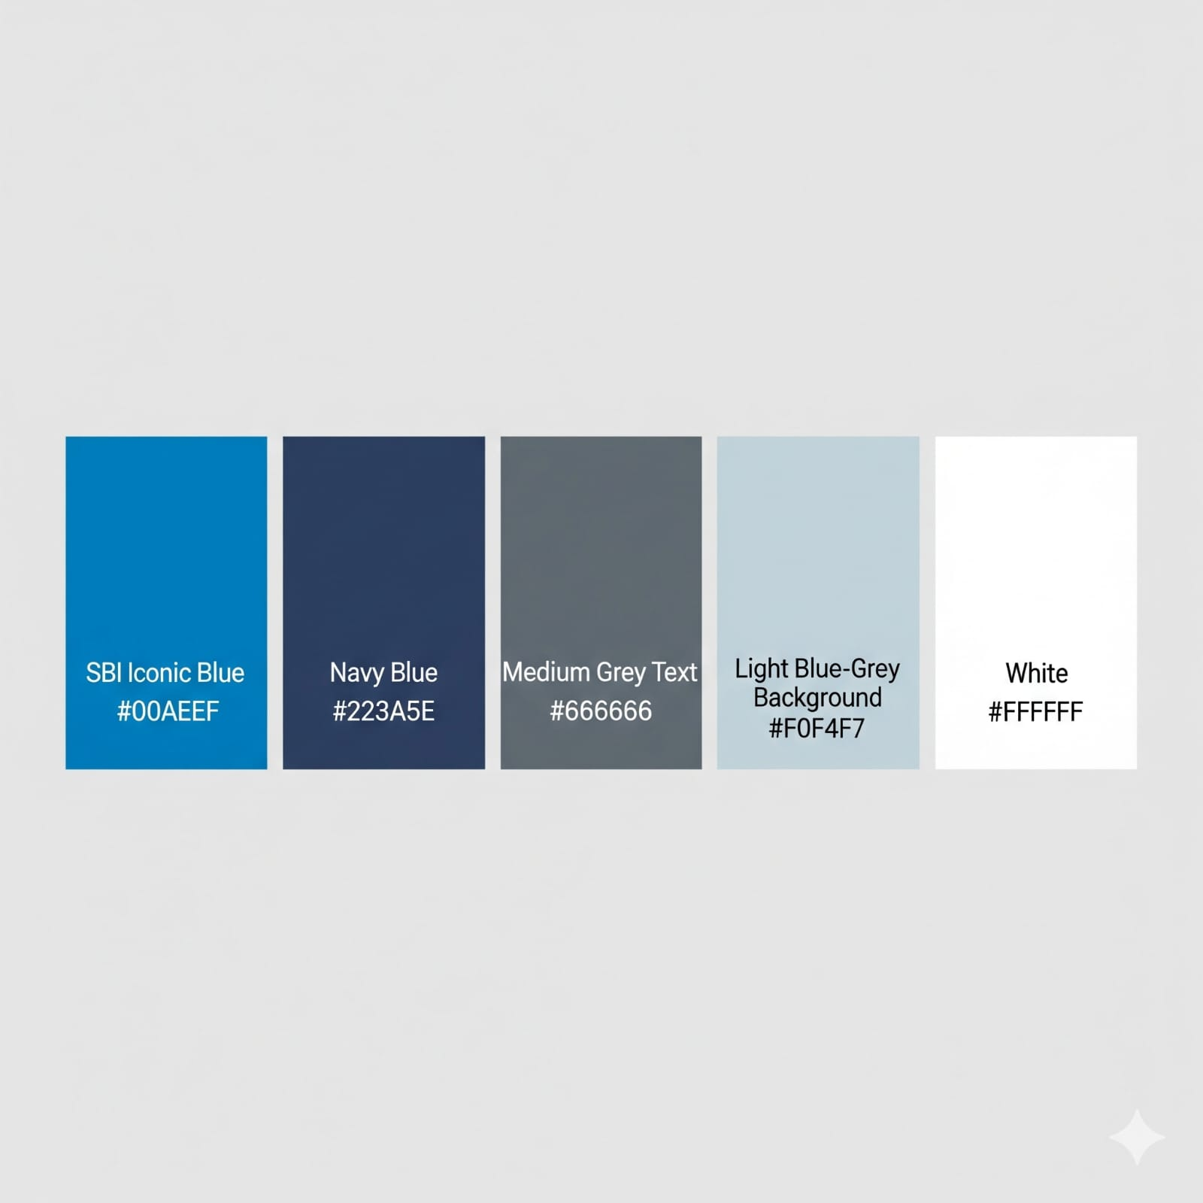
Color Grading for SBI

Slide 12
Punjab National Bank

Slide 13
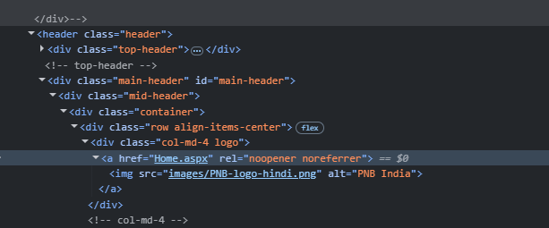
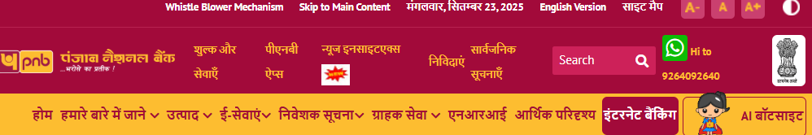
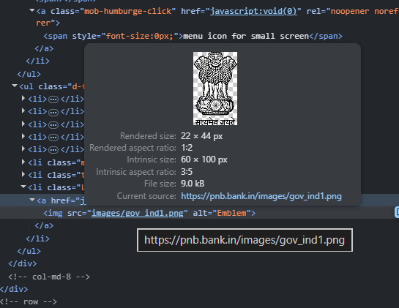

Slide 14
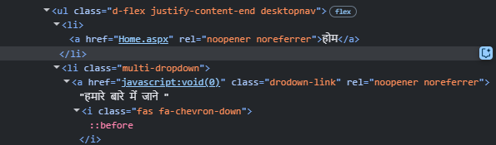

Slide 15
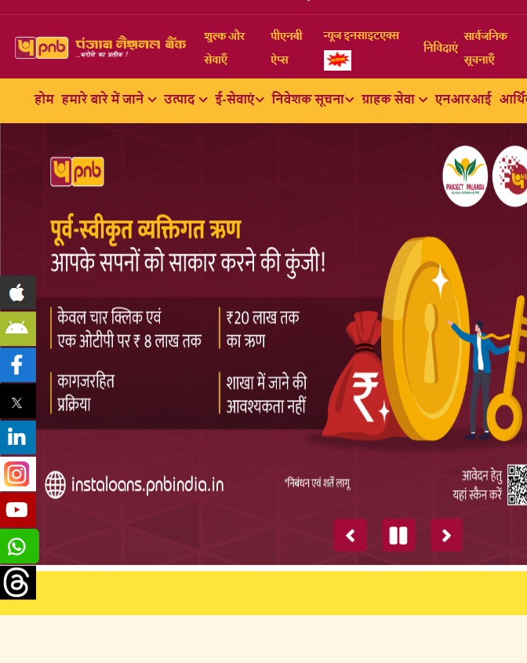
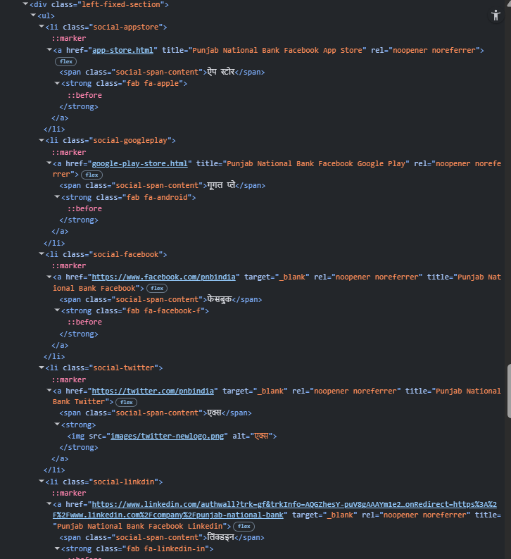

Slide 16
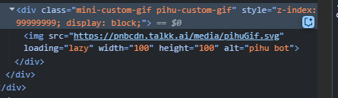
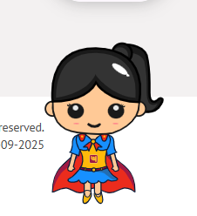
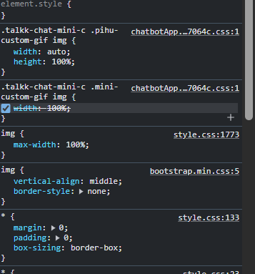

Slide 17


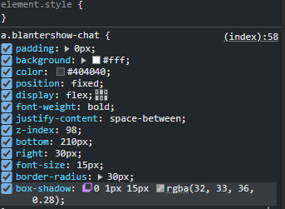

Slide 18
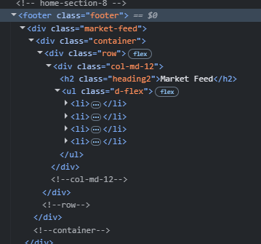
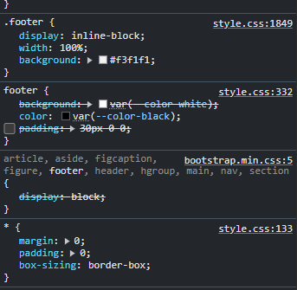
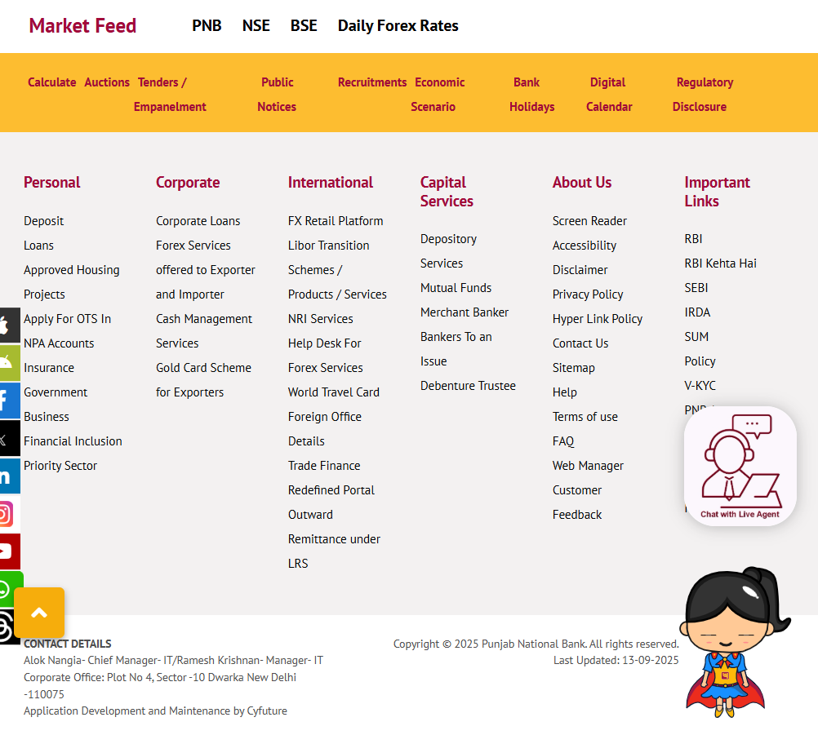
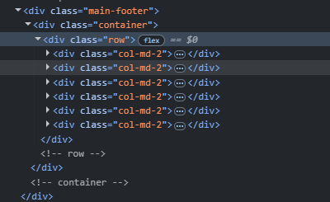
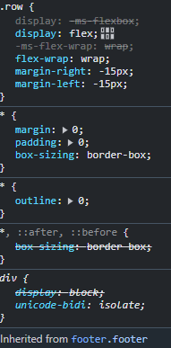
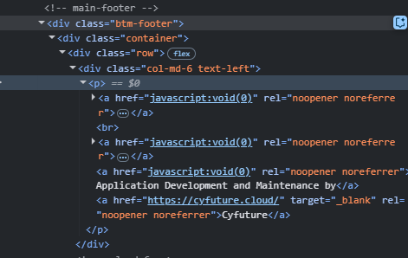

Slide 19
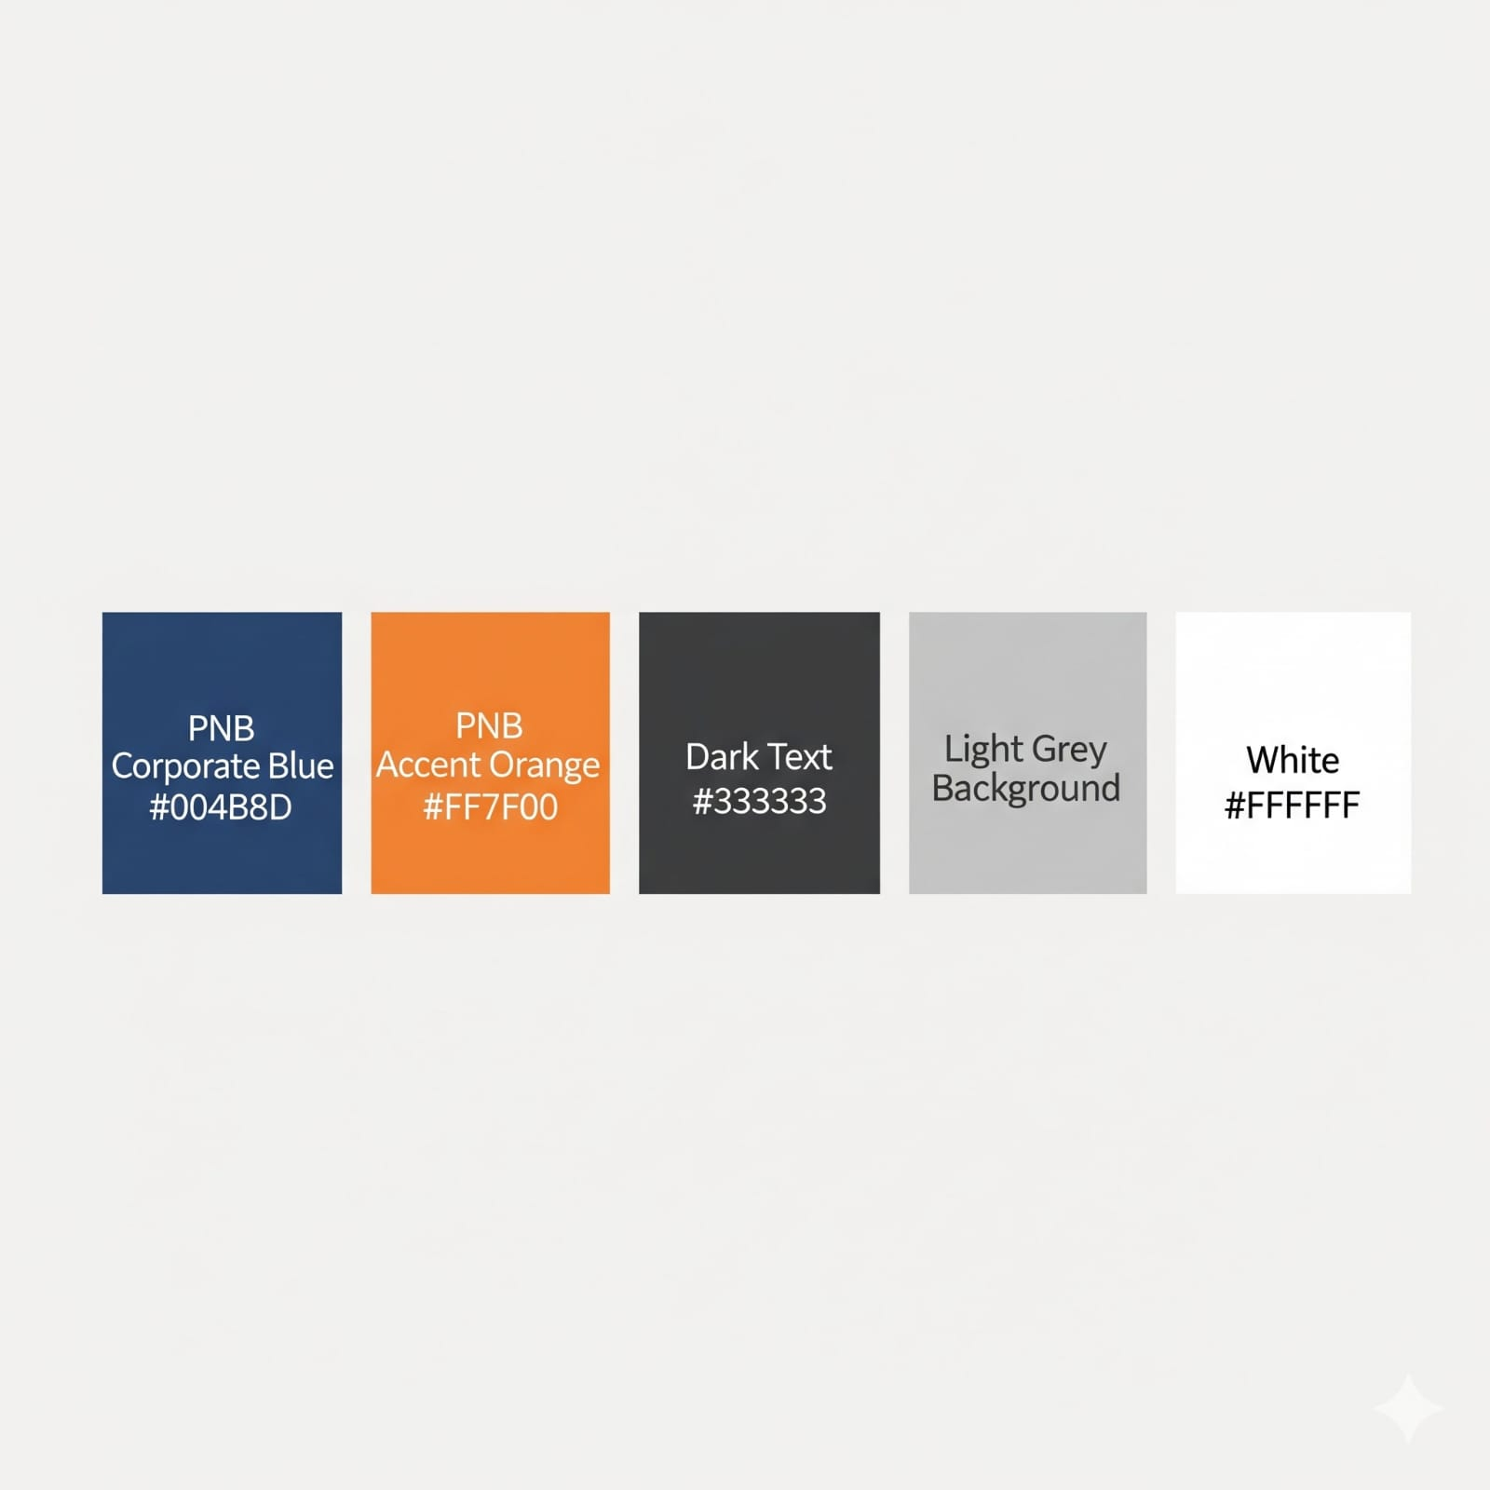
Color grading for Punjab National Bank

Slide 20
Thank You!!

