Slide 1
Rockbuster Stealth Business insights
Asta Hansen

Slide 2
AGENDA
Introduction
Film Performance
Film Genres
Top Customers
Global Customer Numbers
Local Revenue
Regional Revenue
Summary
Recommendations

Slide 3
INTRODUCTION
Amongst growing competition from streaming services, store-based video rental business has been declining.
In response we want to use our existing license catalogue for online rental.
We expect that the markets with the greatest number of customers are also the most profitable and that our most profitable films will be of the most popular genres.
Therefore, we will look at our films’ performances, customer distribution and regional revenue to identify the strongest market and product portfolio for online rental.
Current situation
Number of customers: 599
Number of film licenses: 1000
Average rental duration: 5 days
Notes:
Problem statement still not clear. Also include

Slide 4
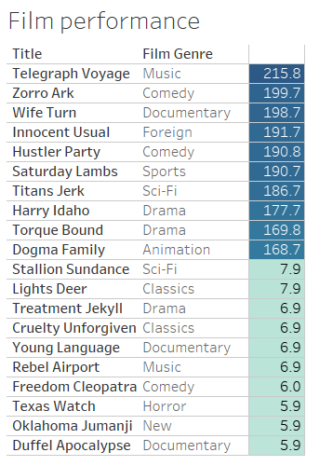
FILM PERFORMANCE
Although some genres appear more than once, there is no clear trend for a specific genre in the best and worst performing films.
However, the difference between the revenue the top 10 versus the bottom 10 generate is quite significant. More focus should be given to the top performing films.

Slide 5
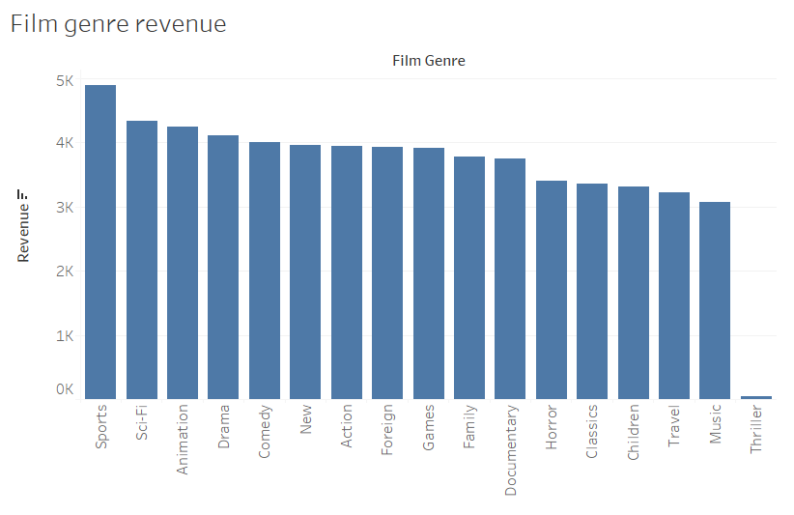
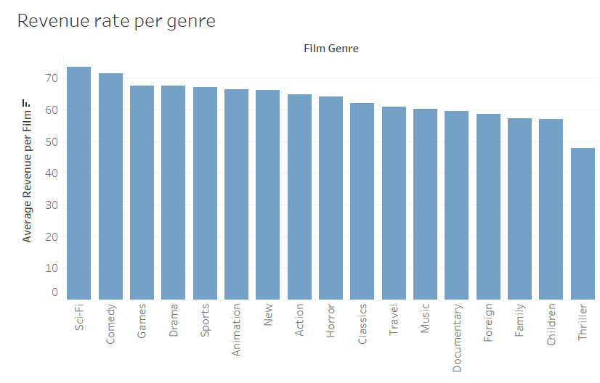
Film genres
Although the Sports genre generates the highest revenue overall, the most profitable genre per film is Sci-Fi, which also generated the second highest overall revenue. Thriller and Children’s films are at the lower end in both cases. However, the difference between the genres is not significant enough to warrant focus on any one over the others.

Slide 6
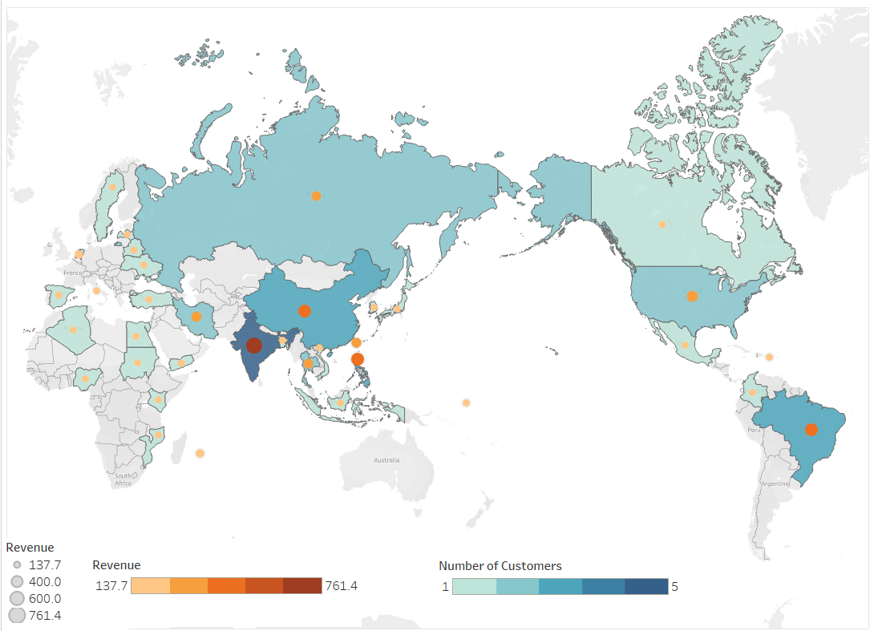
Top Customers
The map illustrates the location of the top 50 customers and the total revenue they generated in their respective countries.
The highest number is located in India, where they also generate the highest revenue amongst the top 50. Followed by China, Brazil and the Philippines.
Although there is a slightly higher concentration in Asia, there is no specific regional trend within this group.

Slide 7
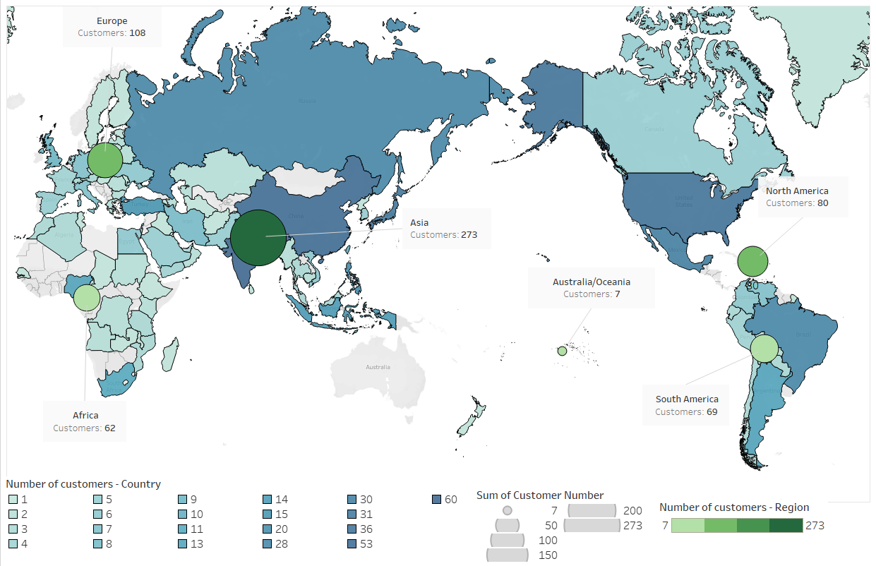
Global Customer numbers
Our customers are spread around the globe with the highest concentration in Asia, specifically India and China. Followed by Europe, North America, South America, Africa and Australia/Oceania.
The number of countries we service in each of these regions will have an impact on the overall region size in terms of customers.
e.g. 34 countries in Asia compared to 6 for Australia/Oceania.

Slide 8
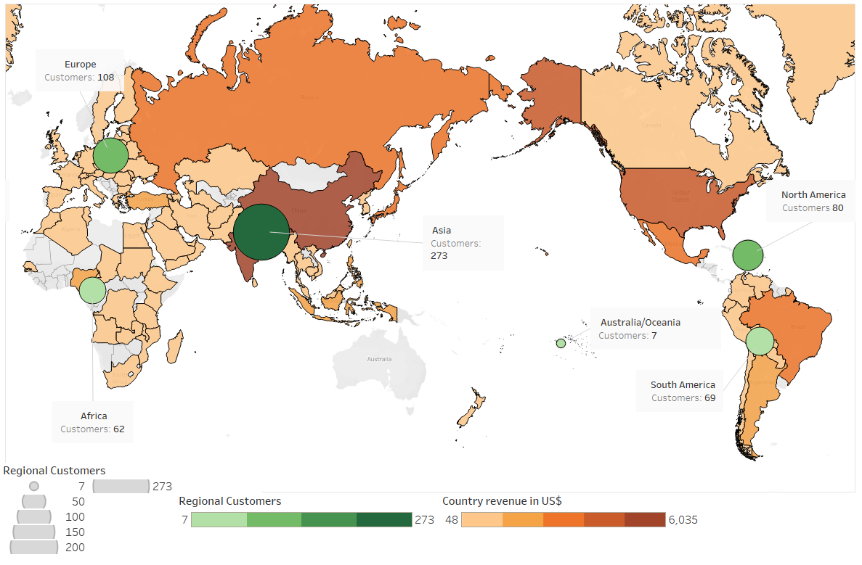
Local Revenue
For the most part revenue in each country follows the number of customers.
With India and China leading the revenue table. Followed by the US, Mexico and Brazil.
Number of customers could therefore be used as a good indicator of potential revenue.

Slide 9
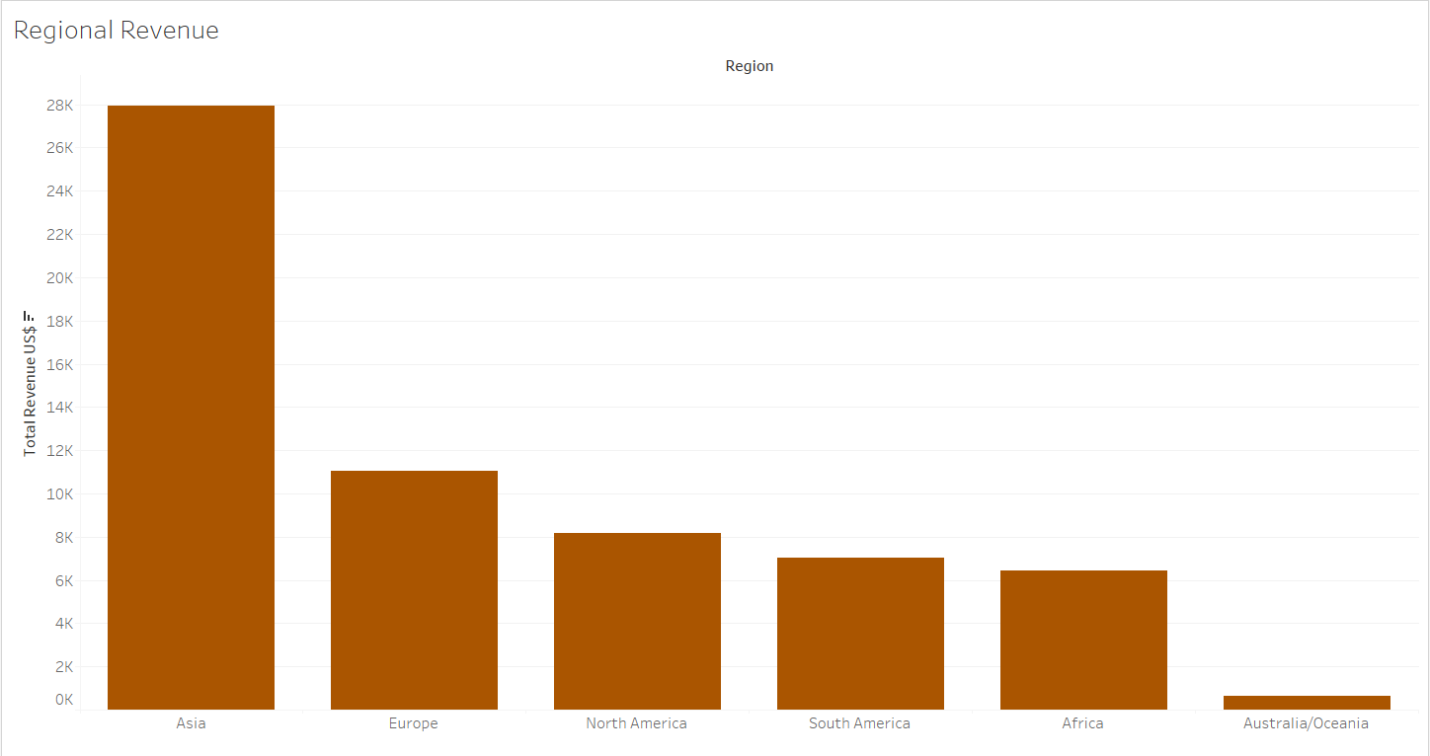
Regional Revenue
As the high number of customers suggest Asia by far generates the highest revenue overall.
For the remaining regions, the size of revenue is relatively similar and also in line with their customer numbers.

Slide 10
SUMMARY
With a customer base across the globe and a variety of film licenses we are in a good position to explore the option of online rentals.
Our strongest market is Asia with a solid customer base in India and China.
Our film catalogue is well spread across the different genres and they generate a similar level of revenue.
All visualisations can be found here: https://public.tableau.com/app/profile/asta.hansen/viz/MovieRental_16509979874880/GlobalCustomers?publish=yes

Slide 11
Recommendations
REGION
GENRES
FILMS
Most of our customers are based in Asia with many high value customers also located in this region, which makes this our most profitable market. Therefore, it would make sense to focus on this region first for the online business.
In light of this internet availability in the specific counties should also be taken into account.
​​​With none of the genres generating outstanding revenue, their impact can be neglected in favour of a more film specific approach.
With the large disparity between films when it comes to revenue, it would make sense to use the highest performing film licenses for the online business, as they can be expected to generate the highest profits.

