Slide 1
VeriML
A language-based, dependently-typed, user-extensible approach to proof assistants
Dissertation Defense
Antonis Stampoulis
October 1st, 2012
Advisor: Zhong Shao

Slide 2
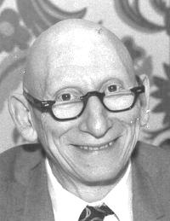
A programming language is low-level when its programs require attention to the irrelevant.
proof assistant
“
proofs
”
- Alan J. Perlis

Slide 3
Software certification
Large formal proofs are possible and useful!
require huge manual effort
Proof – to – code size ratio: ~ 8 lines – to - 1
CompCert [Leroy et al]
seL4 microkernel [Klein et al]
20 p.y. of proof for 2 p.y. of development
Mathematical theorems
Started May 2006 Finished last week! ~1.3 weeks per page
Four-color theorem [Gonthier et al]
Feit-Thompson (Odd Order Theorem) [same team]

Slide 4
Informal proofs
use “trivially”, “similarly”, omit unnecessary details
require domain-specific intuition
validity extensible
Formal proofs
can use domain-specific automation
yet automation reconstructs full details
validity fixed
proofs and automation hard to write
calculus
reals
basic reasoning

Slide 5
My system
easy to develop new automation and extend background reasoning with it
safely!
extensible notion of formal proof
leads to proofs without trivial details
simplifies development of further automation
calculus
reals
basic reasoning
through proper layering!

Slide 6
VeriML
novel programming language
focus on writing automation procedures
more generally: programs that construct proofs
Safety
Rich types Rich programming model First-class support for logic
Expressiveness
Convenience

Slide 7
Thesis statement
A type-safe effectful language for manipulating logical terms is
… theoretically possible
… practically implementable
… viable architecture for proof assistants
… with novel features
metatheory
prototype implementation
examples of proofs and automation
demonstrate existing features + generalizations + safe user-extensible static checking

Slide 8
Technical contributions
Metatheory:
Orthogonality between logic language and computational language
Hybrid deBruijn variables representation
Novel way to present pattern matching
Clean “recipe” for mixing typed object language with typed meta language
Extensible conversion rule (open problem)
Proof certificate format allowing post-hoc choice between trust & resources

Slide 9
Informal overview of the language
or the world’s fastest tutorial on constructive formal logic, tactic development through VeriML and the basic architecture of modern proof assistants.

Slide 10
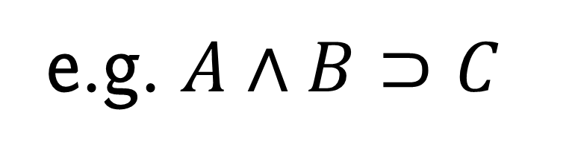
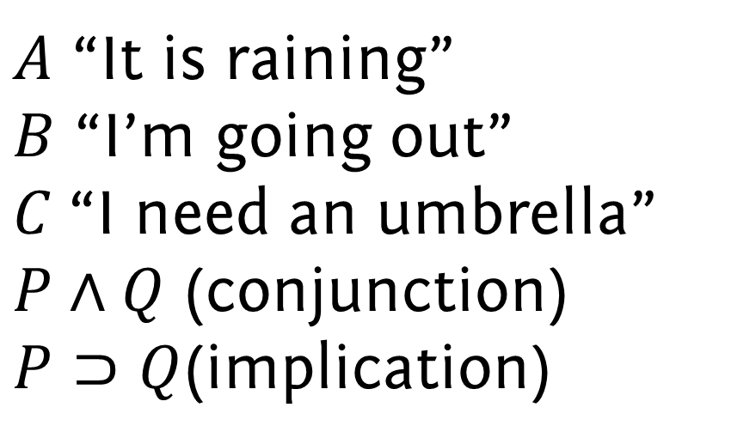
A simple logic
Propositions
(P, Q)
$A$ “It is raining”
$B$ “I’m going out”
$C$“I need an umbrella”
$P∧Q$ (conjunction)
$P⊃Q$(implication)
e.g. $A∧B⊃C$

Slide 11
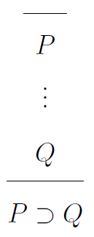
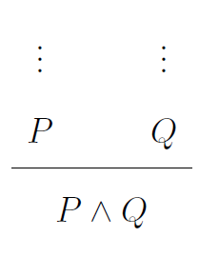
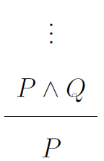
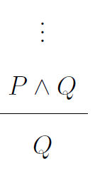
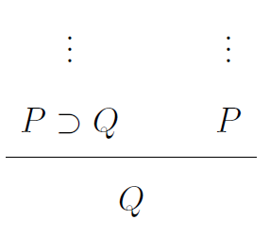
A simple logic: Rules and proofs
Rules describe how to form proofs.
Proof object: computer representation of proof.

Slide 12



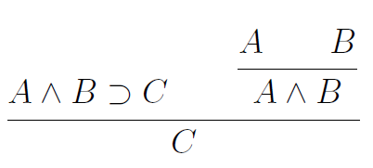
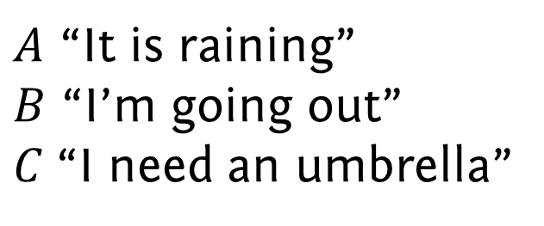
A simple logic: Creating proofs
Propositions
Hypotheses
$A$ “It is raining”
$B$ “I’m going out”
$C$“I need an umbrella”
Proof

Slide 13
A simple logic: Checking proofs
Hypotheses
If valid, write
Proof : [Hypotheses]Consequence
: [ ] C
Consequence
Proof checker

Slide 14

Tactics
Functions that take logical data as input and produce proofs as output
Hypotheses
“Auto”
tactic
Hypotheses
Goal
Goal
Proof scripts
Programs combining tactics to yield proofs e.g. Auto + Arithmetic

Slide 15
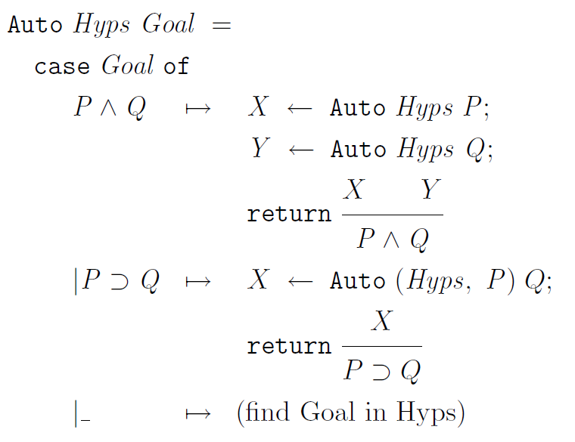
Coding “Auto” in VeriML

Slide 16



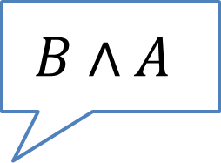



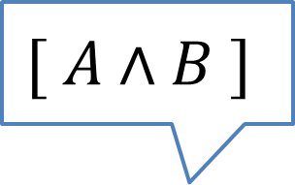

Running “Auto”
$$[ A∧B ]$$
$$B∧A$$
$$\frac{A∧B}{B}$$
$$B$$
$$\frac{A∧B}{A}$$
$$A$$
$$\frac{A∧B}{B}$$
$$\frac{A∧B}{A}$$
$$B∧A$$

Slide 17

Proof scripts
Programs that compose tactics to yield proof objects
Example: Auto $(A∧B∧C⊃B∧C∧A)$

Slide 18
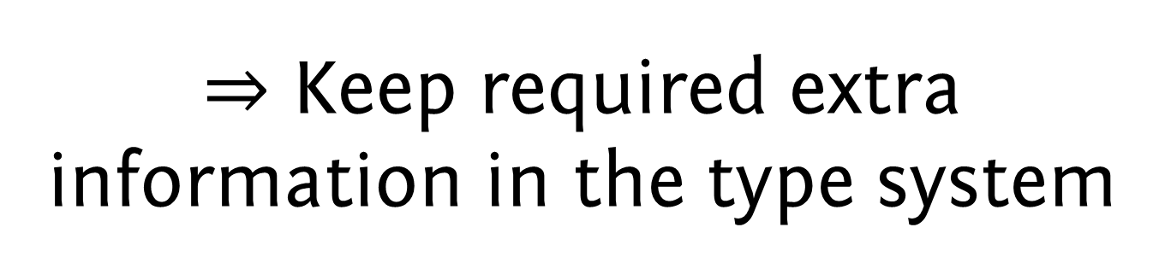
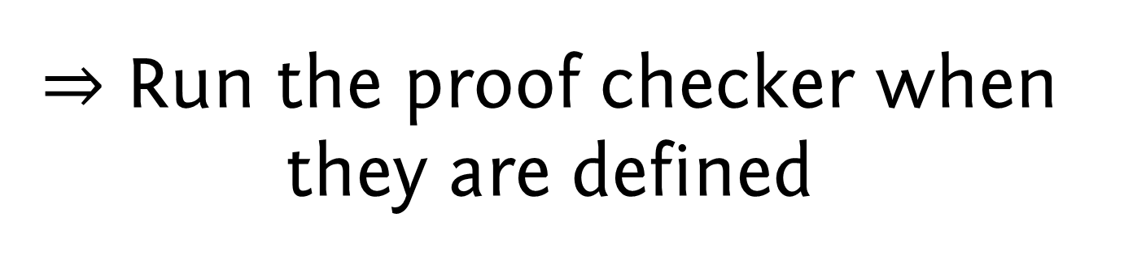
Main VeriML idea
Tactics should be verified
$⇒$ Run the proof checker when they are defined
Hypotheses
“Auto”
tactic
Hypotheses
$⇒$ Keep required extra information in the type system
Goal
Proof checker
Goal
[Hypotheses] Consequence
?

Slide 19
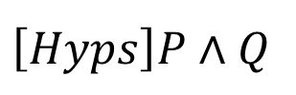

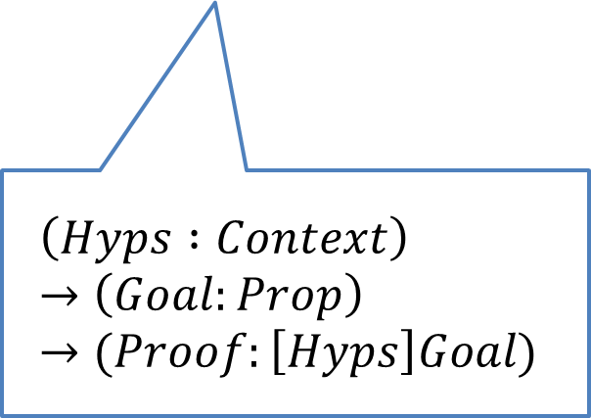
Main VeriML idea
$$\left[Hyps\right]P∧Q$$
$$\left(Hyps :Context\right)→\left(Goal:Prop\right)→(Proof:\left[Hyps\right]Goal)$$
Proof checker
Determined based on typing information
Determined based on typing information
Proof checker
$$\left[Hyps\right]P⊃Q$$

Slide 20

Why is this a good idea?
Proof scripts invoke tactics
Tactics contain proof scripts
Every invocation can fail!
“proof by juxtaposition”
Traditional proof assistants
Tactic definition
ML type- checking
HOL4, HOL-Light
Isabelle
Coq
NuPRL
Tactic invocation
Run
?
PVS, ACL2
don’t do that! (unsafe)
Proof object
Proof checking

Slide 21
Why is this a good idea?
“proof by juxtaposition”
Traditional proof assistants
VeriML
Tactic definition
ML type-checking
Tactic invocation
Run
?
Proof object
Proof checking
Proof checking

Slide 22
Why is this a good idea?
“proof by juxtaposition”
Traditional proof assistants
VeriML
Tactic definition
Reduce possibility of error
Leverage information to help user while writing tactic
Extend traditional interactivity model
Don’t need to produce proof objects
Tactic definition
ML type-checking
VeriML type checking
Tactic invocation
Proof checking
Run
?
Proof object
Tactic invocation
This is why VeriML metatheory is needed
Run
Proof checking
OK!
Proof object

Slide 23
Extensible background reasoning
calculus
reals
basic reasoning
Remember this?

Slide 24
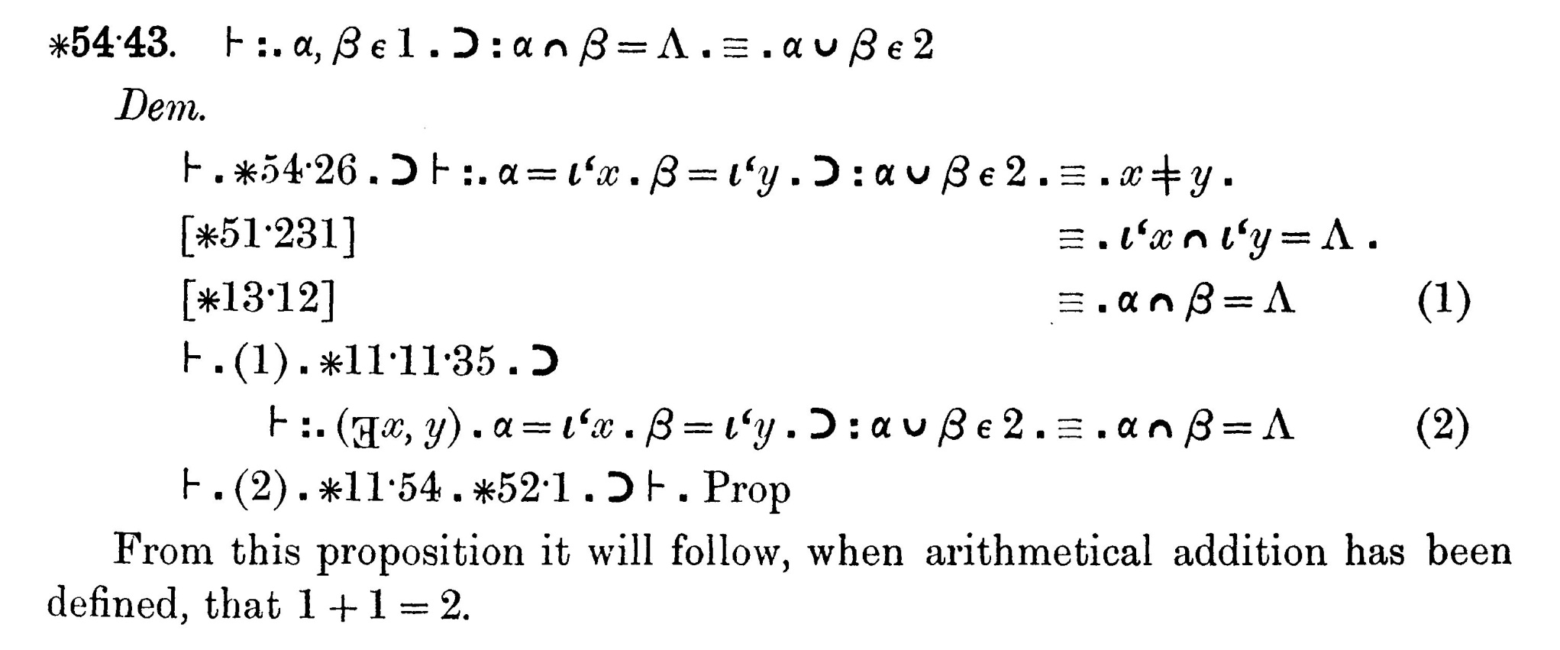
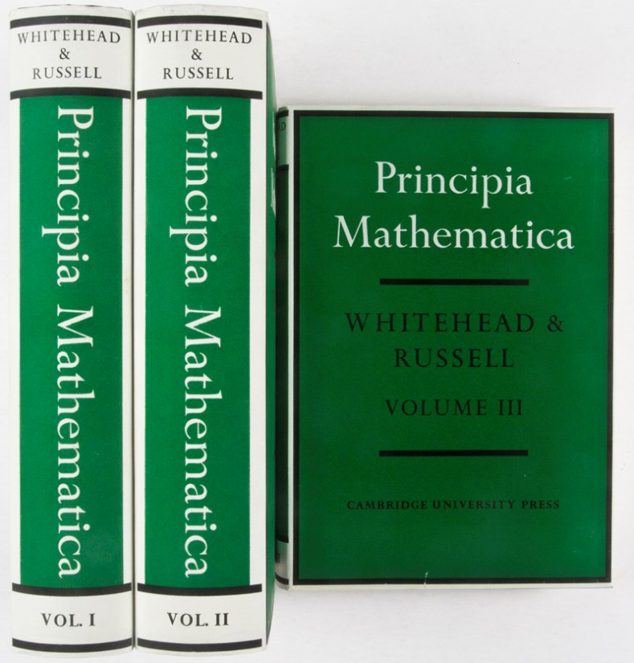
Trivial details in formal proofs
Actually proved in the second volume. Relies on ~340 pages of proof.
1+1=2
Proof object
Proof object?
Proof checking

Slide 25
Trivial details in formal proofs
1+1=2
Yet these arguments are trivial
Based solely on computation!
Yet these arguments are trivial
Based solely on computation!
Proof object
➔ Proof object with 1 rule application
Proof checking
10000+1=10001
➔ Proof object with 10000 rule applications

Slide 26

Conversion rule: background reasoning in logic
1+1=2
Proof object
Coq Solution
Add limited programming language in propositions
“+” is a function in this language
Proof checker checks propositions up to computation
Proof omitted!
Proof checking
conversion

Slide 27


Extensions to conversion?
1+1=2
$$x=1⊃x+x=2$$
OK
$$x+y=y+x$$
?
Proof object
CoqMT solution
Add extensions to conversion
Must be careful!
Trusted base & soundness
➔ No user extensions possible
Proof checking
conversion

Slide 28
Extensions to conversion?
1+1=2
$$x=1⊃x+x=2$$
OK
$$x+y=y+x$$
?
Proof object
Proof-by-reflection solution
Code verified tactics
As a function in the logic!
Very large overhead (develop FFI anew)
Limited programming model
Proof checking
conversion

Slide 29
Conversion rule in VeriML
Eq. tactic
Key insight:
conversion is just a hardcoded trusted tactic
VeriML proof
Arith tactic
VeriML + Proof checking
conversion
but we can trust any tactic with the right type
user-defined conversion

Slide 30
Conversion rule in VeriML
Key insight:
conversion is just a hardcoded trusted tactic
VeriML proof
VeriML + Proof checking
user-defined conversion
but we can trust any tactic with the right type
none of them needs to be hardcoded!

Slide 31
Conversion rule in VeriML
smaller proof checker
can still generate full proof objects
soundness guaranteed
extensions to conversion are cheap
extensible static checking for proofs and tactics as well!
VeriML proofs, tactics, etc.
Normal type-checking
VeriML Type- & Proof- checking
arithmetic simplification
equational reasoning
base VeriML typing
normal conversion
Stage one
evaluation without producing proof objects
user-defined conversion
Run
Normal
evaluation

Slide 32
Formal details

Slide 33

The Logic Language ..........
constructive higher-order logic with inductive definitions
minimal shared core logic of most proof assistants
CIC/MLTT minus the complexities (dependency, universes)

Slide 34
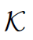
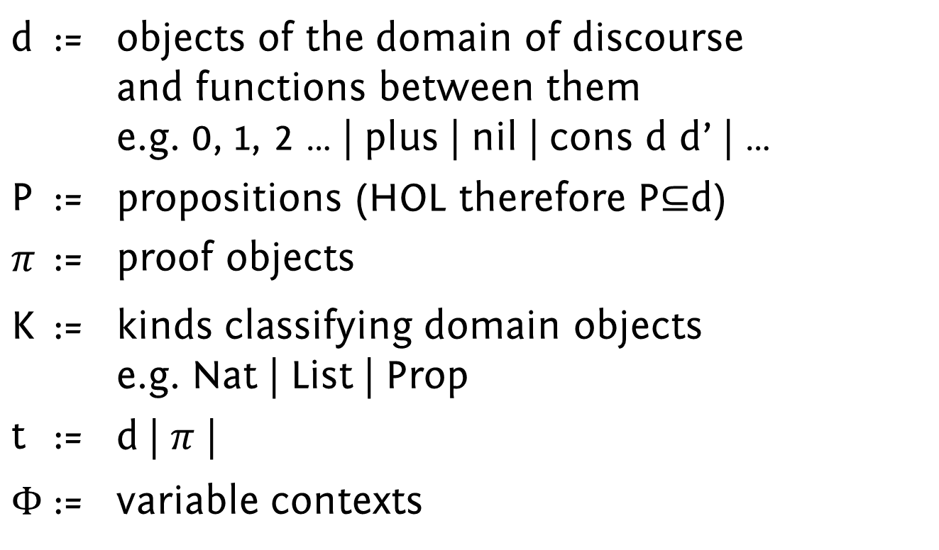
The Logic Language ..........
d | := | objects of the domain of discourse and functions between them e.g. 0, 1, 2 … | plus | nil | cons d d’ | …
P | := | propositions (HOL therefore P$⊆$d)
$$π$$ | := | proof objects
K | := | kinds classifying domain objects e.g. Nat | List | Prop
t | := | d | $π$ |
$$Φ$$ | := | variable contexts

Slide 35
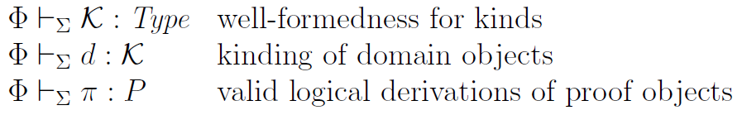
The Logic Language .......... Typing judgements

Slide 36
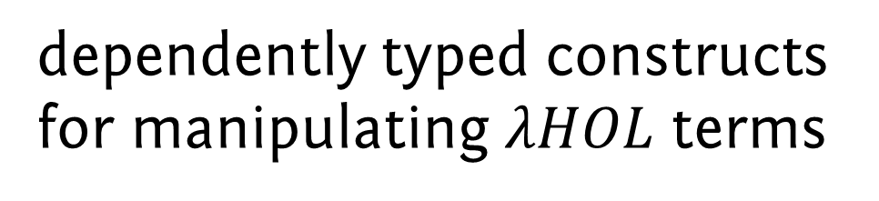
VeriML
keep logical types at the computational level
(embedding typed object lang. in typed meta lang.)
ML core (recursion, strict evaluation, algebraic data types, higher-order functions, polymorphism, mutable references, I/O)
dependently typed constructs for manipulating $λHOL$ terms

Slide 37

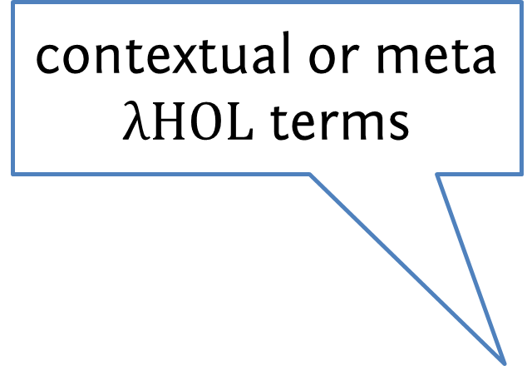
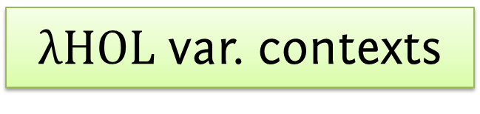
VeriML
ML core (recursion, strict evaluation, algebraic data types, higher-order functions, polymorphism, mutable references, I/O)
contextual or meta $λHOL$ terms
dependently typed constructs for manipulating $λHOL$ terms
proofs with hypotheses, propositions with free variables
open $λHOL$ terms
proofs with hypotheses, propositions with free variables
, hypotheses lists
$λHOL$ var. contexts

Slide 38
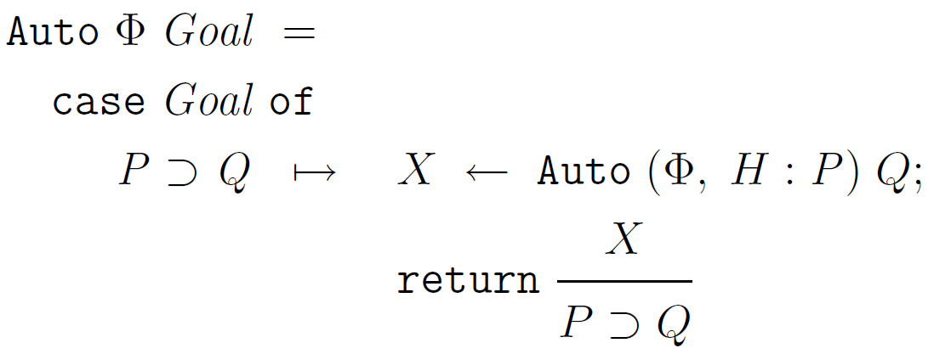

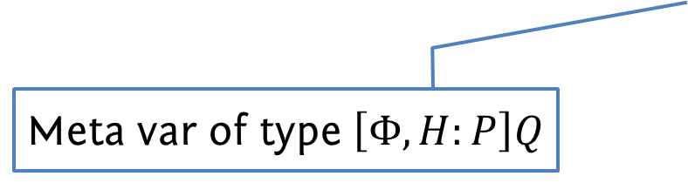
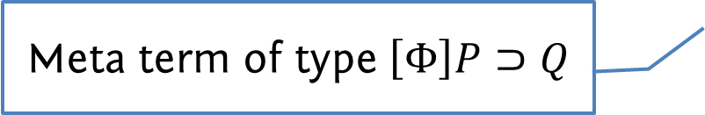

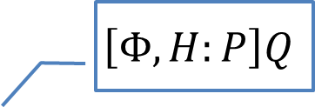
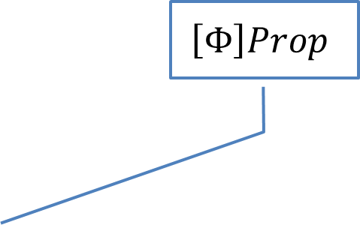
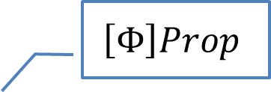
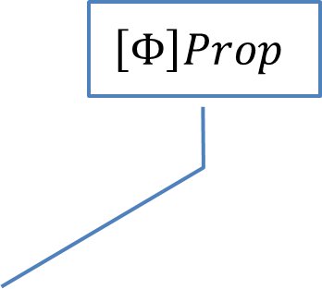
Meta $λHOL$ terms and types, meta $λHOL$ variables
context
$$\left[Φ\right]Prop$$
$$\left[Φ\right]Prop$$
$$\left[Φ\right]Prop$$
$$\left[Φ, H:P\right]Q$$
Meta term of type $\left[Φ\right]P⊃Q$
Meta var of type $\left[Φ, H:P\right]Q$

Slide 39
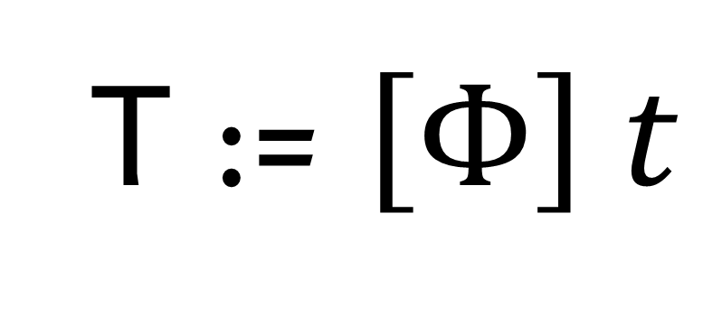

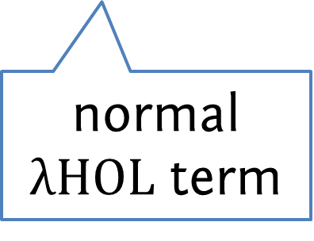
Meta $λHOL$ terms
T := $\left[Φ\right] t$
meta term
context information
normal $λHOL$ term

Slide 40
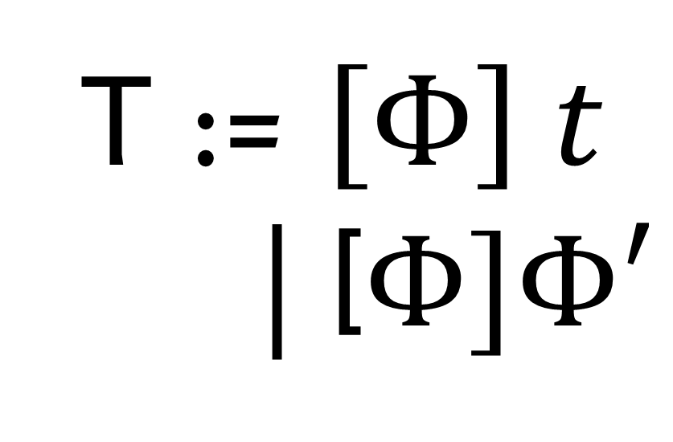
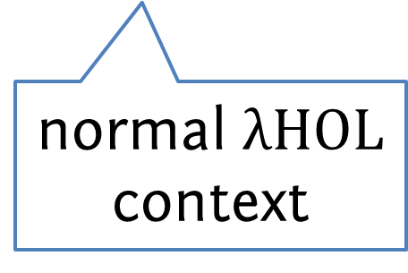
Meta $λHOL$ terms
T := $\left[Φ\right] t$
| [$Φ]Φ′$
context information (usually empty)
normal $λHOL$ context

Slide 41
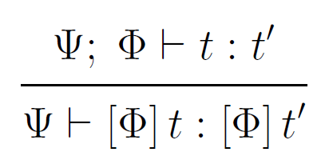
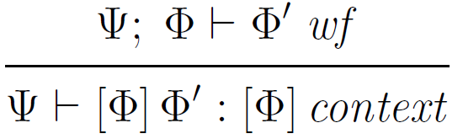
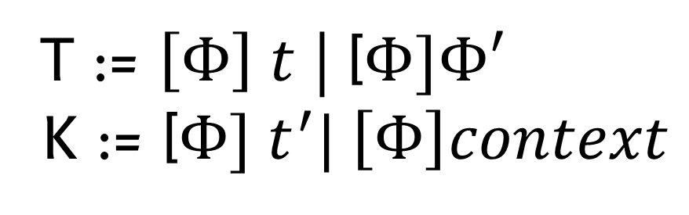

Meta $λHOL$ typing
T := $\left[Φ\right] t$ | [$Φ]Φ′$
K := [$Φ] t^{′}| \left[Φ\right]context$

Slide 42
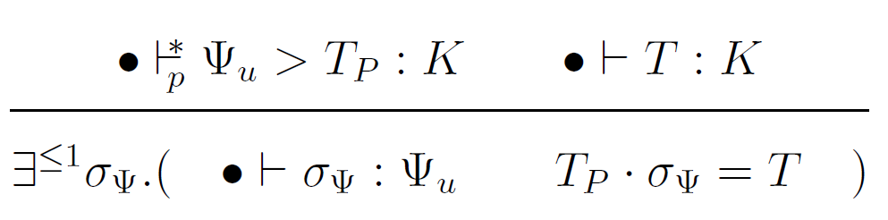
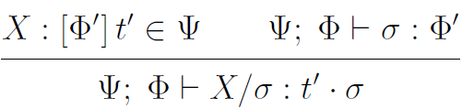

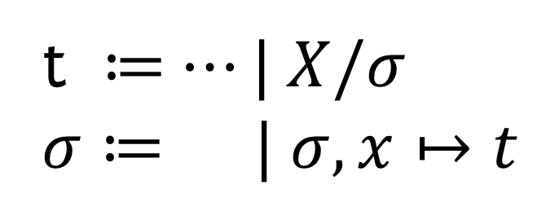

Meta $λHOL$ variables
t ≔$⋯| X/σ$
$σ$ ≔$| σ, x↦t$

Slide 43

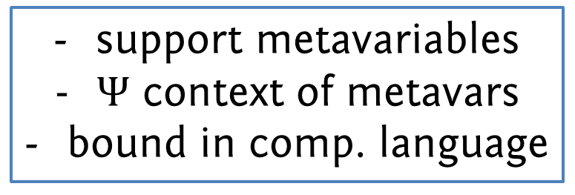
Extending $λHOL$ with meta terms
support metavariables
$Ψ$ context of metavars
bound in comp. language
metaterms are derived form
the extensions are syntactic ➔ soundness unaffected

Slide 44
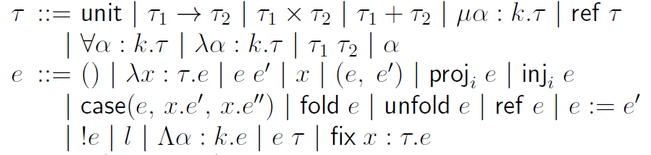
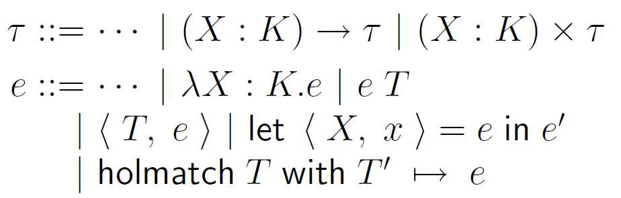

VeriML = ML
… + dependent $λHOL$ constructs

Slide 45
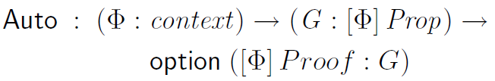
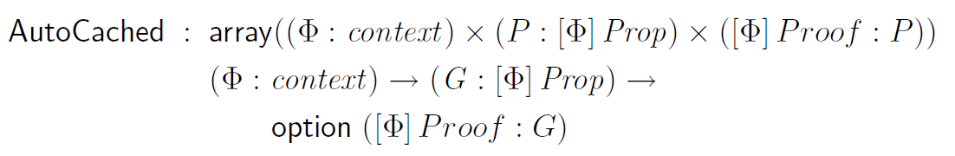

VeriML = ML + dependent $λHOL$ constructs
example:

Slide 46

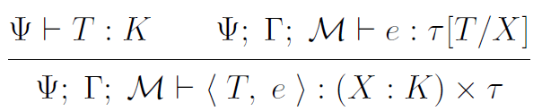
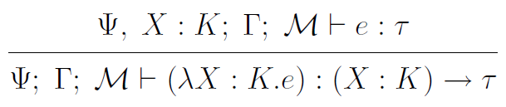


VeriML typing
$λHOL$ μmetacontext
store typing
Computational variables context

Slide 47




Extensible static checking
Two new ingredients:
Staging in VeriML
Transformation from $λHOL$ meta terms to normal terms
$$e⟶_{s}e_{r}⟶v$$
$$Ψ⊢T :K$$
$$⇄∃t,σ.$$
$$Φ⊢t :t^{′}$$
$$t⋅σ=T$$
Simplify goal and return proof of equivalence
Want to generate and check equivalence proofs statically!
Through already-defined tactics

Slide 48
Metatheory

Slide 49
Description of type safety
Type safety = progress + preservation
Basically: substitution lemma for ctxterms
And pattern matching determinacy
Proof erasure semantics
Collapsing transformation → staging (meta terms become object terms)

Slide 50
Metatheoretic results
Metatheory result 1. Type safety
If evaluation succeeds,
the returned proof object is valid
Metatheory result 2. Proof erasure
If evaluation succeeds, a valid proof object exists even if it’s not generated

Slide 51


Basic recipe
Starting from a typed language with well-behaved binding
Internalize substitution and weakening as metavars; show meta-terms well-behaved
Show that meta-terms admit well-behaved patterns

Slide 52

The two key theorems
Meta-substitution theorem
Pattern matching determinism & decidability

Slide 53
Implementation + Examples

Slide 54
Implementation
http://www.cs.yale.edu/homes/stampoulis/
Written in OCaml
~10k lines of code
Version 0.5

Slide 55



Implementation Timeline
Version 0.2
Extensible Conversion
Winter 2010
Version 0.1
Initial
Spring 2010
Version 0.3
TypeInference
Summer 2011
Version 0.4
Compilation
Fall 2011
Version 0.5
Inductive defs
Jan 2012
Started
Nov 2009
$λHOL^{ind}$ with built-in conversion
VeriML type checker
VeriML interpreter
examples: tautology prover, equality with uninterpreted functions
Proof erasure
Practical pattern matching support (type refinement, simultaneous matching, context matching, etc.)
Initial support for collapsing transformation
Examples: user-defined $β−$conversion,
EUF as conversion, Dependent ML-like functions
100-page Metatheory TR break
Initial support for translation to Ocaml
VeriML AST → Well-typed VeriML AST → OCaml AST
Inductive definition support
Fully functional compilation through OCaml
Real Staging support
Better type inference
Examples: the same (Auto, EUF, Arithmetic) but readable code, no axioms, 10sec runtime!
Added type inference in $λHOL$ and VeriML
Ambient context to reduce verbosity
Implicit arguments
Tactic syntax, Proof General support
Examples: Layered conversion rule
Initial arithmetic simplification conversion
3mins 30sec for standard library

Slide 56

Example: Arithmetic simplification

Slide 57


Example: Arithmetic simplification

Slide 58
Examples implemented
About 2.5k lines of examples in total
Basic theory of natural numbers
Lists and insertion sort
Equality with Uninterpreted Functions
Arithmetic simplification (ring_simplify)
Both as conversion extensions
Minimal manual proof (~400 lines in total)
No proof-by-reflection, translation validation or metatheoretic extension needed
Contrast: 3.5k lines for ring_simplify (1k lines of manual proof)

Slide 59
Related work
Tactic programming
ML expressive, not safe/convenient
LTac convenient, not expressive/safe
Reflection/ safe, not convenient/expressive
Canonical Structures
Beluga, Delphin
dependently typed manipulation of contextual LF terms; language design similar yet different goals
Milawa
layering of verified proof checkers; similar to our conversion, yet restricted logic and PL used

Slide 60
Conclusion

Slide 61
Main ideas and contributions
VeriML = rich programming model + typed manipulation of logical terms
verified tactic development at lower cost than traditional approaches
novel alternative architecture for proof assistants
extensible static checking for proofs and tactics
A new PL Design, Metatheory, Implementation
Viewed as a new proof assistant

Slide 62
Technical contributions
Metatheory:
Orthogonality between logic language and computational language
Hybrid deBruijn variables representation
Novel way to present pattern matching
Clean “recipe” for mixing typed object language with typed meta language
Extensible conversion rule (open problem)
Proof certificate format allowing post-hoc choice between trust & resources

Slide 63
Future work
Develop VeriML into a realistic, high-level proof assistant.

Slide 64
Thank you.

