Slide 1
Static and User-Extensible Proof Checking
Antonis Stampoulis Zhong Shao
Yale University
POPL 2012

Slide 2
Proof assistants are becoming popular in our community
CompCert [Leroy et al.]
seL4 [Klein et al.]
Four-color theorem [Gonthier et al.]
… but they’re still hard to use
1 to 1.5 weeks per paper proof page
4 pages of formal proof per 1 page of paper proof
[Asperti and Coen ‘10]

Slide 3
Formal proofs
communicated to a fixed proof checker
must spell out all details
use domain-specific lemmas
Informal proofs
calculus
linear algebra
arithmetic
communicated to a person
rely on domain-specific intuition
use “obviously”

Slide 4
We need tactics to omit details
untyped
proofs within tactics can be wrong!
procedures that produce proofs
domain-specific tactics good in large developments
but difficult to write!

Slide 5
Proof assistants are hard to use because
1. cannot extend proof checker → lots of details
2. no checking for tactics → lots of potential errors
These are architectural issues

Slide 6
“intuition” stack
arithmetic
congruence
βι-conversion
full programming model
soundness guaranteed
Our contribution:
A new architecture for proof assistants
1. extensible proof checker → omit lots of details
1. cannot extend proof checker → lots of details
2. no checking for tactics → lots of potential errors
2. extensible checking for tactics → lots of errors avoided
More specifically:
a new language design
a new implementation
and a new metatheory
based on VeriML [ICFP’10]
static checking of contained proofs

Slide 7
Architecture of proof assistants

Slide 8
Architecture of proof assistants:
main notions
Proof object
Derivation in a logic
Proof checker
Checks proof objects
Tactic
Function producing proof objects
Proof script
Combination of tactics; program producing a proof object

Slide 9
Architecture of proof assistants:
Checking proof objects
Proof object
Conversion rule
Implicitly check equivalences
(proof omitted)
Proof checker
Conversion

Slide 10
Architecture of proof assistants:
Checking proof objects
Proof object
Coq
βι-conversion
Proof checker
Conversion

Slide 11
Architecture of proof assistants:
Checking proof objects
Proof object
CoqMT
βι-conversion +
linear arithmetic
Proof checker
Conversion

Slide 12
Architecture of proof assistants:
Checking proof objects
Proof object
rich static information
(de)composable
checking not extensible
Proof checker
Conversion

Slide 13
Architecture of proof assistants:
Validating proof scripts
Arithmetic tactic
Other tactic
User tactic
Proof script
extensible through tactics
rich programming model
no static information
not (de)composable
hidden proof state
evaluation
Proof object
Proof checker
use conversion for more robust scripts
Conversion

Slide 14
Moving to typed proof scripts
Arithmetic tactic
Other tactic
User tactic
Arithmetic tactic
Other tactic
User tactic
Proof script
Typed proof script
Type checker
evaluation
evaluation
Proof object
Proof checker
Proof checker
Conversion
Conversion

Slide 15
Moving to typed proof scripts +
extensible conversion
Arithmetic tactic
Typed proof script
Key insight:
conversion is just a hardcoded trusted tactic
User tactic
Other tactic
Type checker
Proof checker
but we can trust other tactics too if they have the right type
Conversion
User-defined Conversion
evaluation

Slide 16
Moving to typed proof scripts +
extensible conversion
Typed proof script
Key insight:
conversion is just a hardcoded trusted tactic
Type checker
Other tactic
Type checker
Proof checker
Proof checker
but we can trust other tactics too if they have the right type
User-specified Conversion
Conversion
User-defined Conversion
none of them needs to be hardcoded!
evaluation

Slide 17
Typed proof scripts +
extensible conversion
Typed proof script
Type checker
rich static information
user chooses conversion
extensible static checking
smaller proof checker
can generate proof objects
Proof checker
User-specified Conversion
evaluation

Slide 18
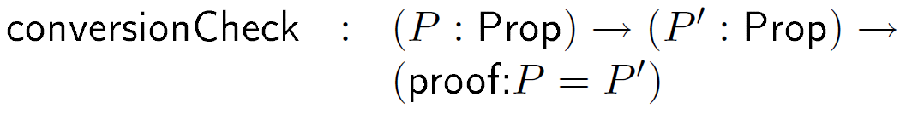
Type checking tactics: an example
Metatheory result 1. Type safety
If evaluation succeeds,
the returned proof object is valid
Metatheory result 2. Proof erasure
If evaluation succeeds, a valid proof object exists even if it’s not generated
check propositions for equivalence
return a proof if they are
raise an exception otherwise

Slide 19
Two modes of evaluation
Typed proof script
Type checker
Proof checker
proof
object
evaluation
User-specified Conversion
mode controlled per function
proof erasure
evaluation

Slide 20
Static checking = type checking + staging under proof-erasure
Typed proof script
typechecking
Type checker
Proof checker
stage-one evaluation
with proof erasure
User-specified Conversion
evaluation of residual
program
evaluation

Slide 21
A stack of conversion rules
arithmetic simplification
congruence closure
βι-conversion
ring_simplify for Nat
close to CoqMT
no additions to logic metatheory
actually, with reductions
no proof by reflection or translation validation
leveraging static proof scripts
makes most uses of rewrite/autorewrite unnecessary
conversion in Coq
removed from trusted base

Slide 22
A stack of conversion rules
arithmetic simplification
congruence closure
βι-conversion
naïve arithmetic conversion
naïve equality conversion
potentially non-terminating
reduce proving for “real” versions

Slide 23
Static proof scripts in tactics

Slide 24
Motivating Coq Example
Require Import Arith.
Variable x : Nat.
Theorem test1 : 0 + x = x.
trivial.
Qed.
Theorem test2 : x + 0 = x.
trivial.
Qed.

Slide 25

Motivating Coq Example
Require Import Arith.
Variable x : Nat.
Theorem test1 : 0 + x = x.
trivial.
Qed.
Theorem test2 : x + 0 = x.
trivial.
Qed.
Proof completed

Slide 26
Motivating Coq Example
Require Import Arith.
Variable x : Nat.
Theorem test1 : 0 + x = x.
trivial.
Qed.
Theorem test2 : x + 0 = x.
trivial.
Qed.
Attempt to save an incomplete proof

Slide 27
Motivating Coq Example
Require Import Arith.
Variable x : Nat.
Theorem test1 : 0 + x = x.
trivial.
Qed.
Theorem test2 : x + 0 = x.
trivial.
Qed.
Conversion rule can prove this
but can’t prove this

Slide 28
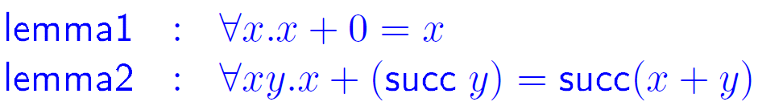
Let’s add this to our conversion rule!
write a rewriter based on these lemmas
register it with conversion
now it’s trivial; lemmas used implicitly

Slide 29
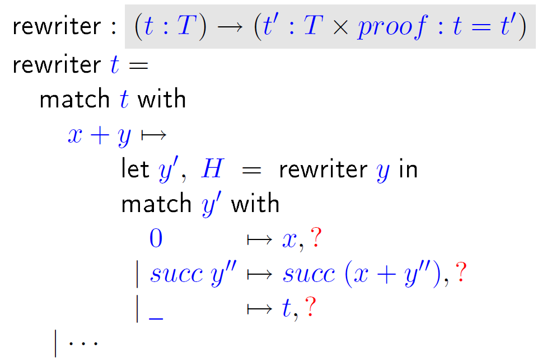
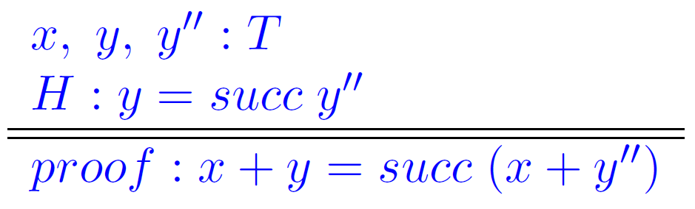


Slide 30
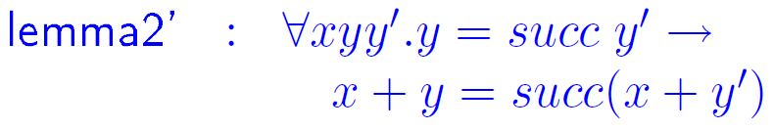


Slide 31
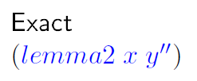
similar to trivial
uses conversion
P and P’ inferred
not checked statically
recomputed many times

Slide 32

checked at definition time
computed once
transformation of runtime arguments to constant arguments

Slide 33
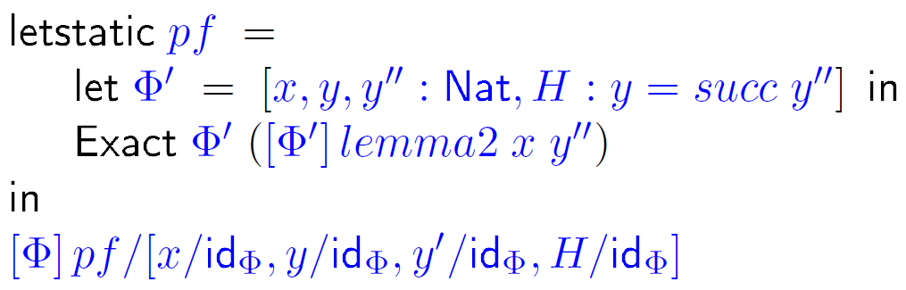
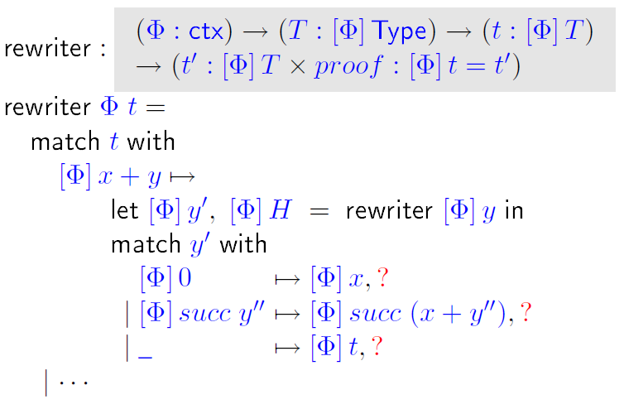
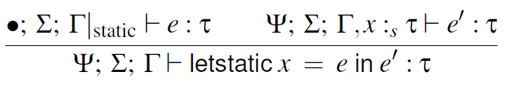
How does it work?

Slide 34
Implementation
http://www.cs.yale.edu/homes/stampoulis/
type inferencing and implicit arguments
compiler to OCaml
rewriter code generation
inductive types
Talk to me for a demo!

Slide 35
What’s in the paper and TR
Static and dynamic semantics
Metatheory: Type-safety theorem Proof erasure theorem Static proof script transformation
Implementation details and examples implemented
Typed proof scripts as flexible proof certificates

Slide 36
Related work
proof-by-reflection
restricted programming model (total functions)
tedious to set up
here: no need for termination proofs
automation through canonical structures / unification hints
restricted programming model (logic programming)
very hard to debug

Slide 37
Summary
a new architecture for proof assistants
user-extensible checking of proofs and tactics
minimal trusted core
reduce required effort for formal proofs
Thanks!
http://www.cs.yale.edu/homes/stampoulis/

Slide 39
Backup slides

Slide 40
Type checking proofs and tactics
manipulate proofs and propositions in a type-safe manner
dependent pattern matching on logical terms
logic and computation are kept separate
Beluga [Pientka & Dunfield ‘08]
Type checker
Proof checker
Delphin [Poswolsky & Schürmann ‘08]
VeriML [Stampoulis & Shao ‘10]

Slide 41
Related work
LCF family of proof assistants
no information while writing proof scripts/tactics
Coq / CoqMT
conversion rule is fixed
changing it requires re-engineering
NuPRL
extensional type theory and sophisticated conversion
here: user decides conversion (level of undecidability)
Beluga / Delphin
use as metalogic for LF
here: the logic is fixed; the language is the proof assistant

