Slide 1

Notes:
And as you can see here, our participants successfully recreated the YouTube video you saw earlier…
We think these images add to the quantitative data in showing that taking the Vegemite was not a behavior participants found pleasant or that they were intrinsically motivated to do.

Slide 2
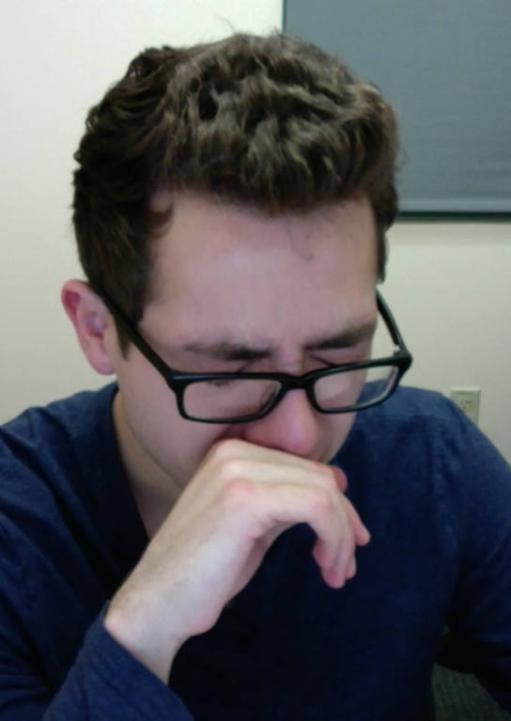
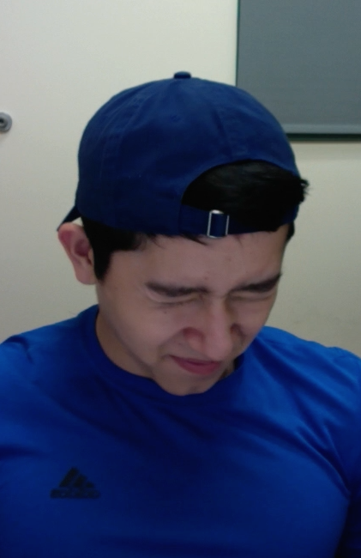
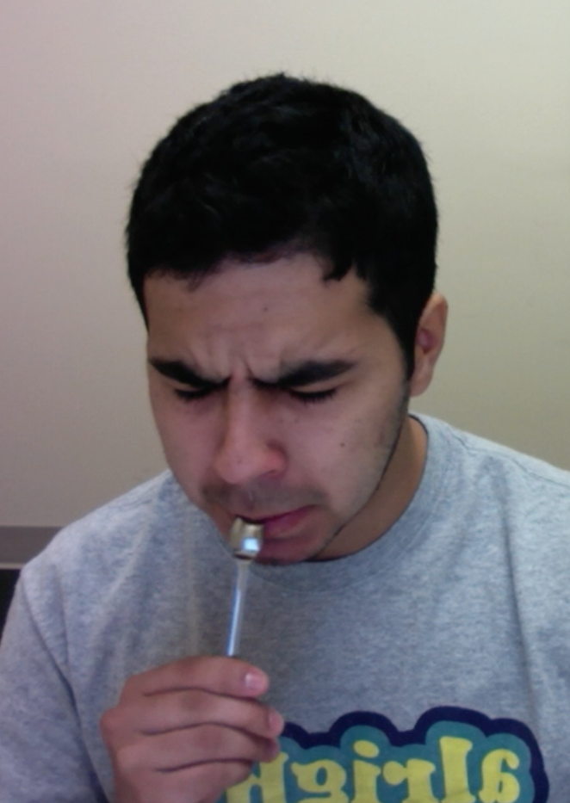
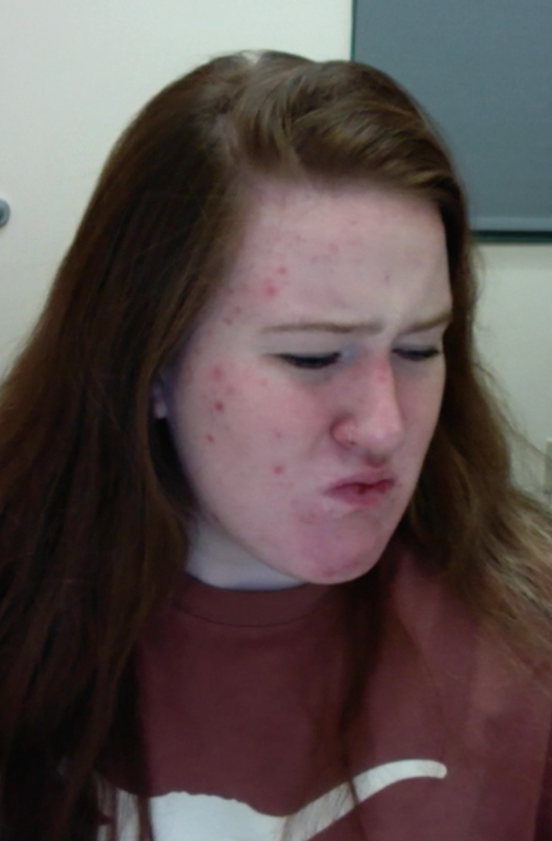


Notes:
And as you can see here, our participants successfully recreated the YouTube video you saw earlier…
We think these images add to the quantitative data in showing that taking the Vegemite was not a behavior participants found pleasant or that they were intrinsically motivated to do.

Slide 3

Study Procedure
0.1 g
0.4 g
Taste medicine
Watch video instructions
(Respectful or Not)
How much medicine did they eat?
Notes:
**
As soon as participants arrived in our lab, we had them sample 0.1 gram of the Vegemite.
We wanted them to see how it tasted before beginning our experiment, and as you might have predicted, they rated it as overwhelmingly bitter and unpleasant to take.
Then, we told participants they would be participating in two separate studies that had been bundled together for the sake of time.
**
In the first study, the researchers would be measuring the effects of testosterone administration on individual attitudes and preferences.
Under the guise of this study,
We collected a baseline salivary hormone sample.
Then we had participants self administer a nasal spray that contained 14 milligrams of either testosterone or a placebo control (participants and experimenters were both blind to drug condition, and were kept blind to drug condition throughout the experiment).
As we started waiting for the drug to absorb in their system, we had participants complete a few questionnaires.
**
After participants completed the questionnaires, we told them they would be beginning the second study. In this study, they believed we were helping the medical school develop a new protocol to evaluate medical students.
First, participants read medical magazines to “familiarize themselves with the medical field.” In reality, they were completing an innocuous tasks while we waited exactly 45 minutes for the drug to absorb in their system.
At exactly 45 minutes, participants were randomly assigned (via a Qualtrics survey) to receive status-enhancing or status-diminishing video instructions from a medical student to take another spoonful of .4 gram of the Vegemite, which was on the table in front of them.
Immediately after receiving these instructions, participants made a real choice about whether or not to take the spoonful of Vegemite, and then they reported how respected, autonomous, competent, and high status the medical student giving them the instructions made them feel.
We assessed these feelings with 8 items – 2 items for each construct. For example, one of the items to measure respect was “The person in the video made me feel respected.”

Slide 4
Video Instructions (2 Versions)
STATUS-ENHANCING STATUS-DIMINISHING
(autonomy/competence supportive) (autonomy/competence threatening)
Hello. My name is … and I'm a second year medical student finishing basic sciences at one of the UT system medical branches. I’m here to…
Ask whether you might consider taking this medicine.
Tell you that you should take this medicine.
You are a UT student, so I figured I would explain the scientific reason why it would be helpful for you to take it.
Based on what I know about medicine and disease, the smart thing to do is to take this medicine.
Some people have reported that this medicine is unpleasant to take because of the bitter taste…
You might find it helpful to think of that slight discomfort as doing your part to help others.
Try to ignore that.
Thank you for considering this request.
Thank you in advance for your cooperation.
(Maslow, 1943; Vansteenkiste, Lens, & Deci, 2006)
Notes:
The status-enhancing instructions were meant to convey *respect* – using insights from self-determination theory to honor participants’ autonomy, competence, and potential to contribute to the world beyond the self.
The status-diminishing instructions were meant to convey *disrespect* by compromising participants’ autonomy, competence, and potential to contribute.
In the enhancing condition, the medical student appealed to participants' high status as a student at an elite university,
Whereas in the diminishing condition, participants were made to feel like a mere undergraduate in comparison to a much more high status and elite medical student.
Further, in the enhancing condition, participants were provided with a reasonable rationale for why they might choose to take the medicine,
Whereas in the diminishing condition, they received no further explanation than, "I am the authority figure, I know what's best, and you should do this because this is what I'm telling you to do."
Immediately after receiving the instructions, participants made a real decision about whether or not to take spoonful of Vegemite.

