Slide 1
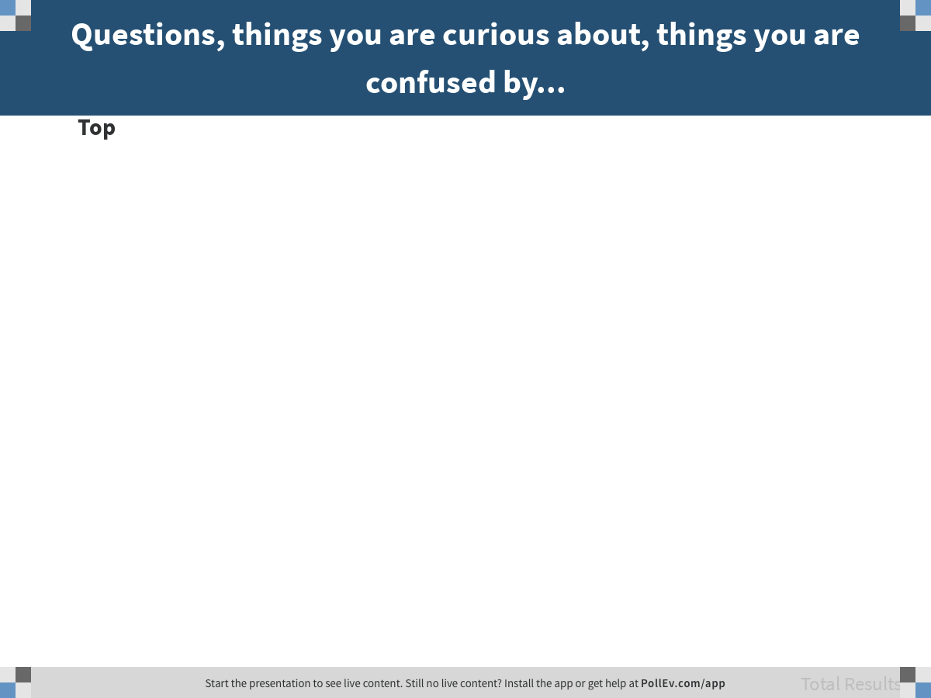
Notes:
Questions, things you are curious about, things you are confused by...
https://www.polleverywhere.com/discourses/twZs0dlKzEtBQ1as6yplj

Slide 2
Homework Due Dates are in the Syllabus:
Chapters 0-4 Due Sunday night April 7 11:30 pm

Slide 3
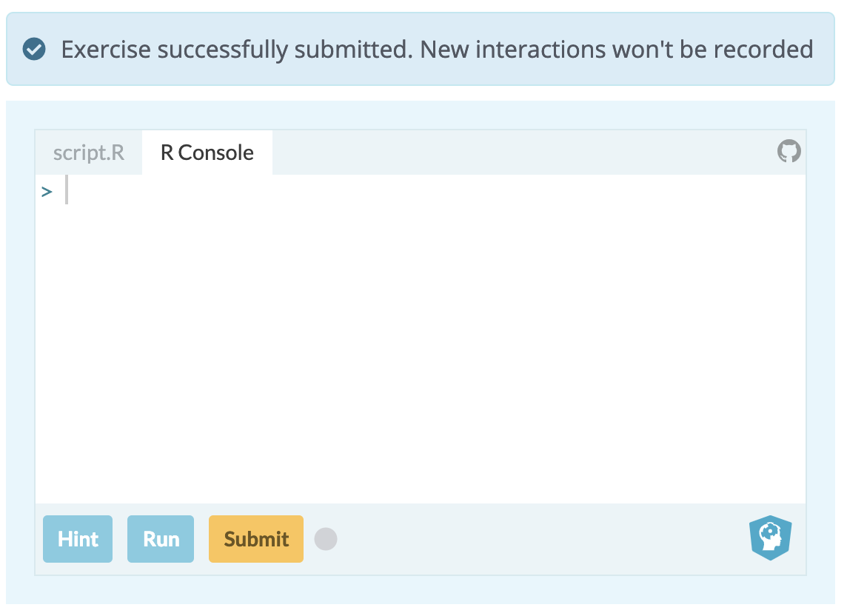
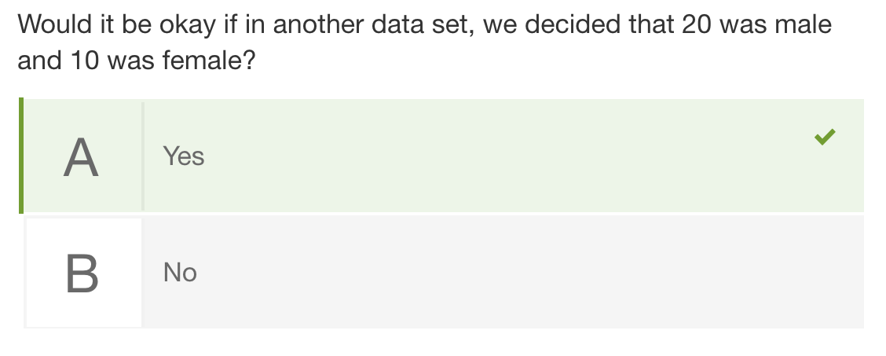

Online Homework
DataCamp
Learnosity Questions
Saves your answers for review
Think hard
Be sure to Submit
Won’t save your work, so you can practice again
Sole purpose is learning, not evaluation; mistakes won’t hurt you.

Slide 4
Wrong Answers
Wrong answers – on course pages or on practice quizzes – are a great study opportunity.
DON’T memorize the correct answer
DO find out why your answer was wrong…
Office hours
Study groups
Friday sections
Canvas discussion forum
Discuss with peers

Slide 5
R is picky; think like a coder
gf_histogram(..density.. ~ Thumb, data = Fingers, fill="orange”, color = "slategray”) %>% gf_density()
Why won’t this run?
Note the difference between these two characters:
" ”
This kind works in R
This kind won’t work!

Slide 6
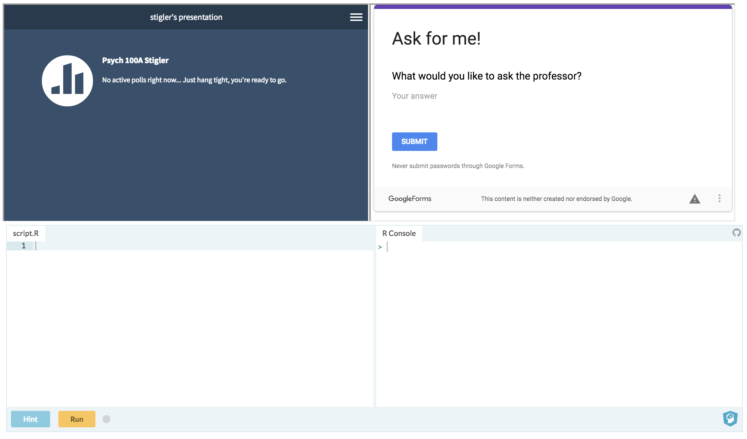
bit.ly/100Aclass

Slide 7
The Whole Thing
100A Spring 2019 - Stigler
Lecture 2

Slide 8
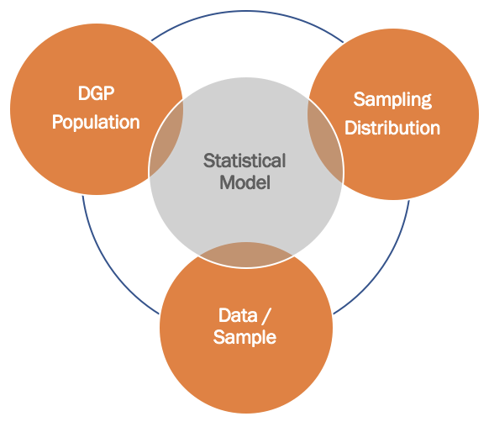
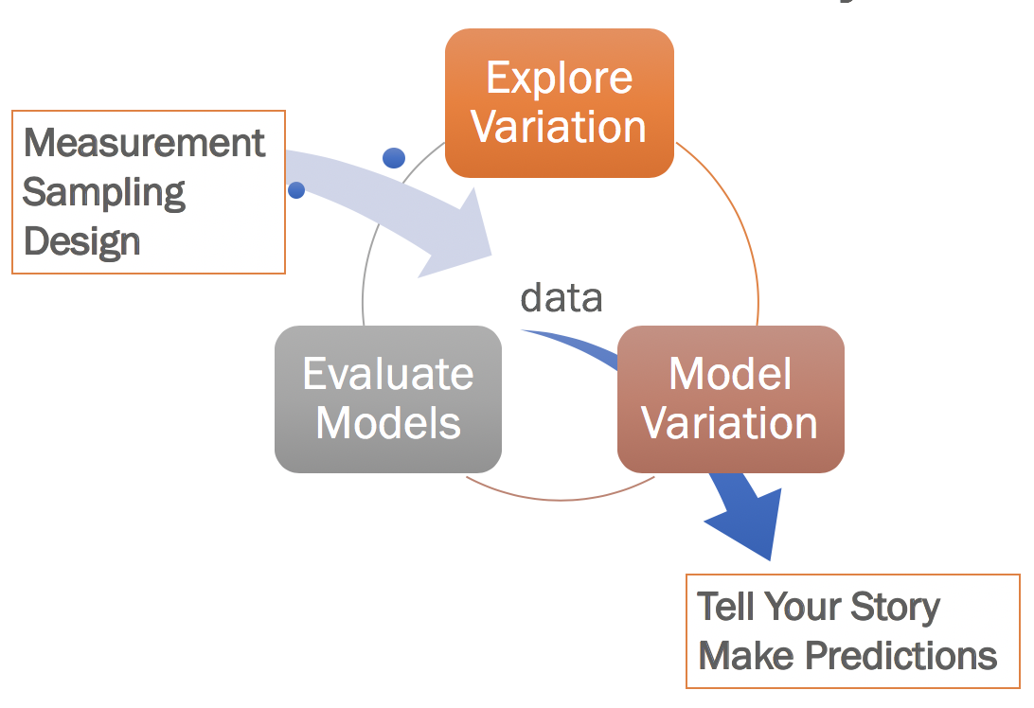
The Whole Thing
We will keep working with the same core ideas again and again. Understanding will come gradually.

Slide 9
Robert Martin was laid off from his job at Westvaco, Inc. soon after he turned 54 years old. He sued for age discrimination.
How do we evaluate his claim?
Martin v. Envelope Div. of Westvaco Corp.,
850 F. Supp. 83 (D. Mass. 1994)

Slide 10
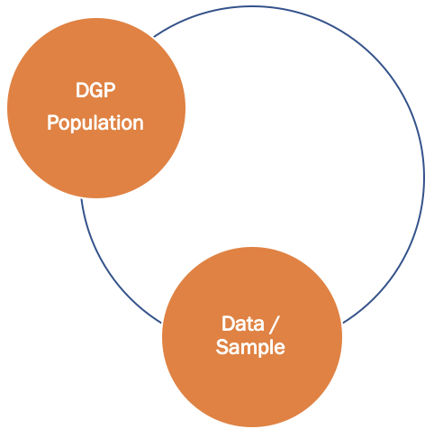
Data & DGP

Slide 11
What kind of data would we need to evaluate this claim?

Slide 12
Ages of Employees in One Department (Laid Off in Blue)
25, 33, 35, 38, 48,
55, 55, 55, 56, 64

Slide 13
Let’s get the data into R.

Slide 14
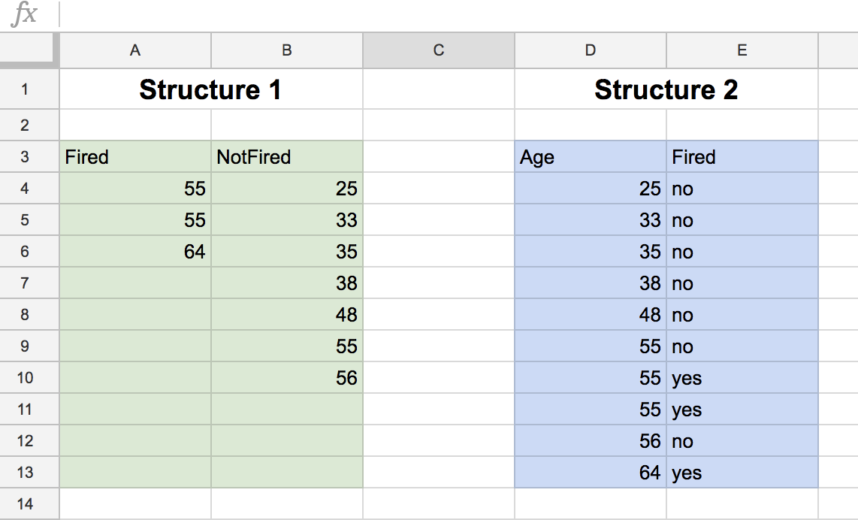

Which data structure is tidy? Why?

Slide 15
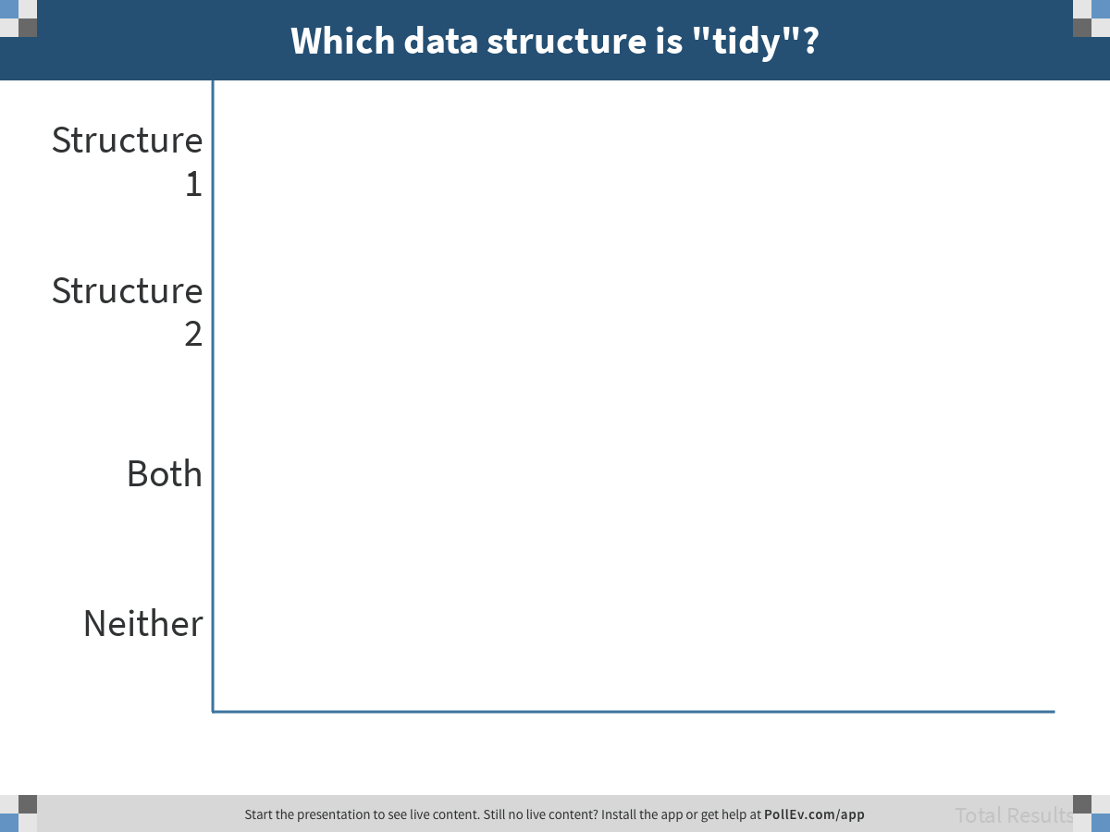
Notes:
Which data structure is "tidy"?
https://www.polleverywhere.com/multiple_choice_polls/DTq6MknmdNA1YNtumQ8rl

Slide 16
Make a data frame
Name it Westvaco
Hints:
Start with two vectors
data.frame()
Print out the data frame

Slide 17
Visualize the distributions
Make a histogram of age
Make a faceted histogram of age by fired
Make a boxplot of age by fired

Slide 18
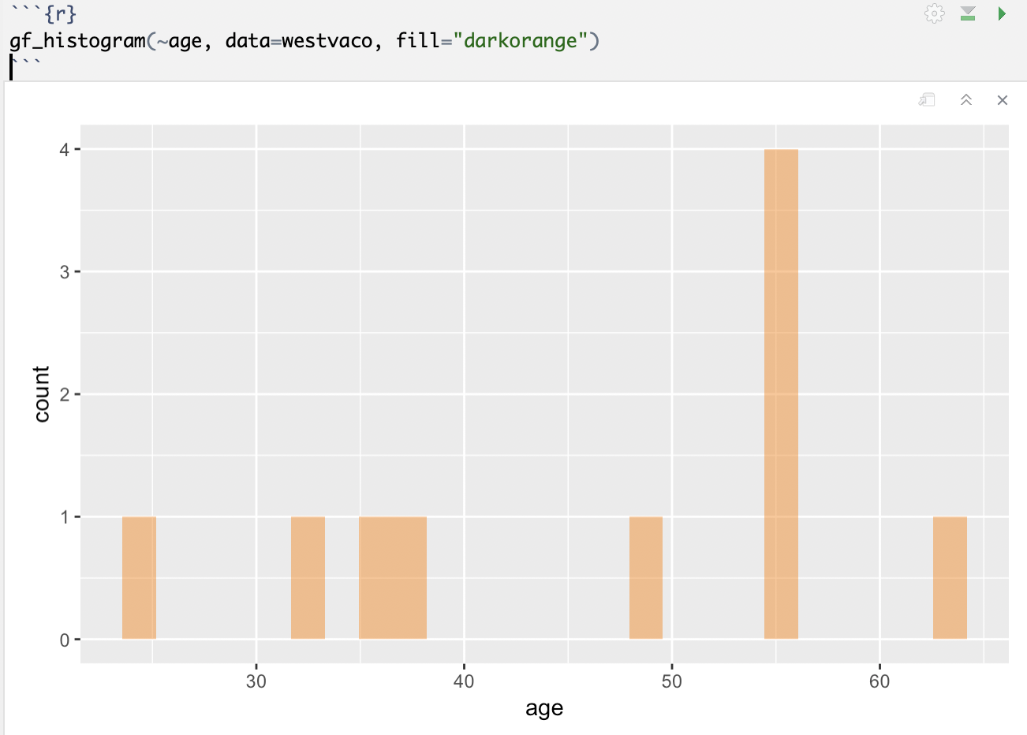

Slide 19
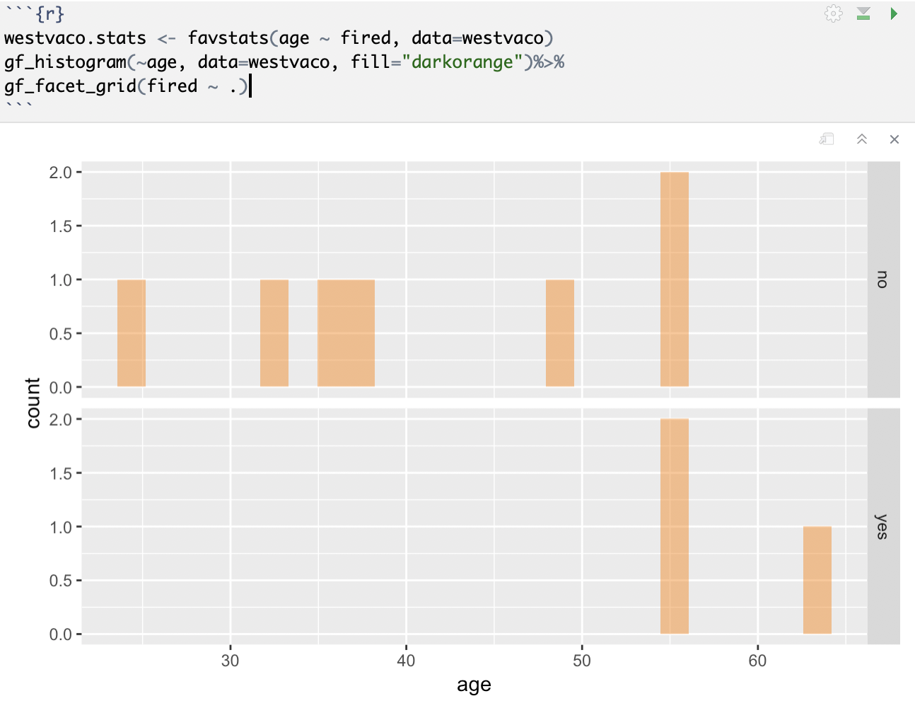

Slide 20
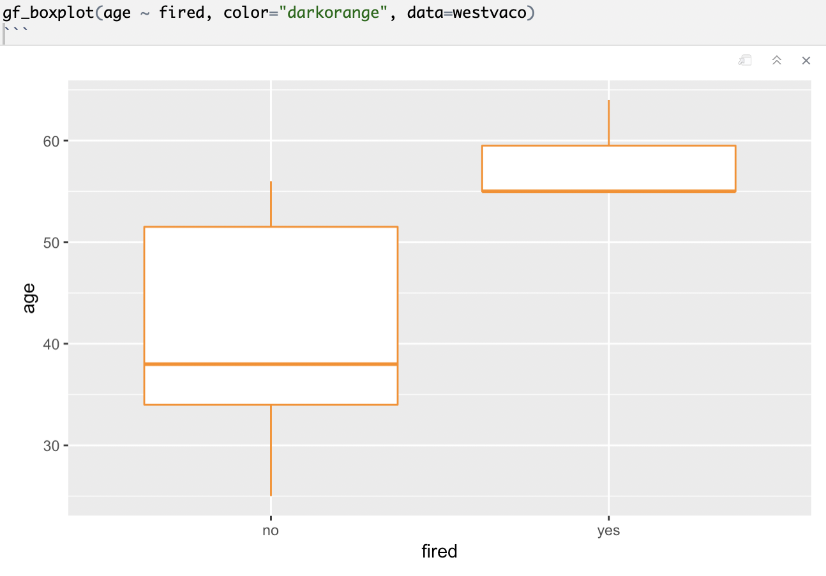

Slide 21
Ages of Employees in One Department (Laid Off in Blue)
25, 33, 35, 38, 48,
55, 55, 55, 56, 64
Do you think the data supports the claim of age discrimination?

Slide 22
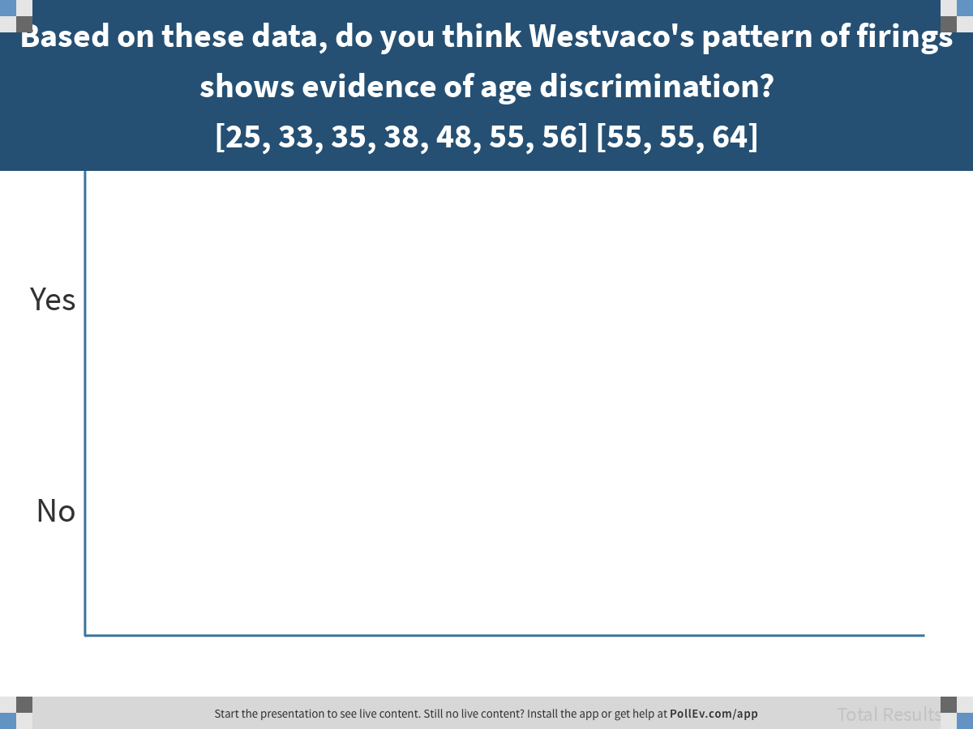
Notes:
Based on these data, do you think Westvaco's pattern of firings shows evidence of age discrimination? [25, 33, 35, 38, 48, 55, 56] [55, 55, 64]
https://www.polleverywhere.com/multiple_choice_polls/ODQcLa28dxI5xJe986z82

Slide 23
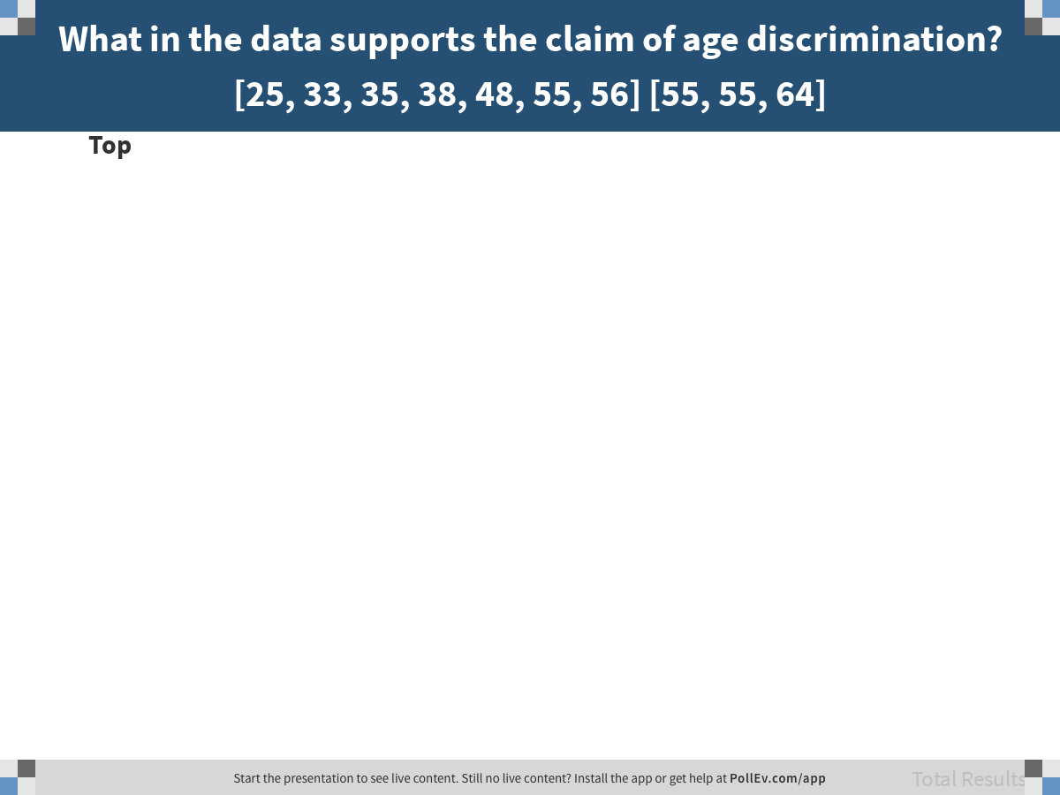
Notes:
What in the data supports the claim of age discrimination? [25, 33, 35, 38, 48, 55, 56] [55, 55, 64]
https://www.polleverywhere.com/discourses/yOwwDkCOElChbtr775oo7

Slide 24
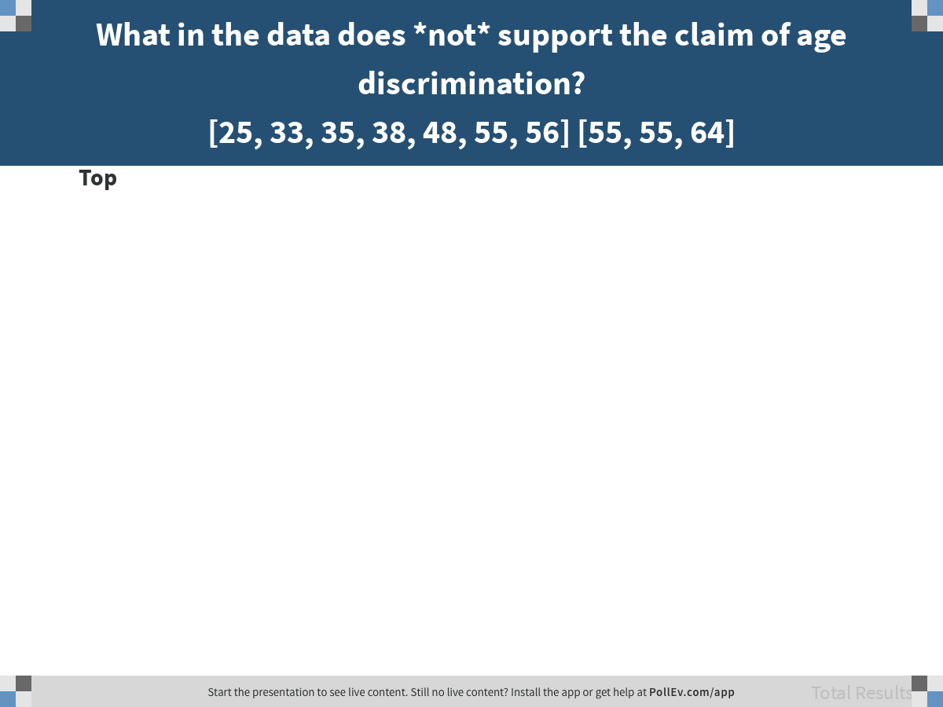
Notes:
What in the data does *not* support the claim of age discrimination? [25, 33, 35, 38, 48, 55, 56] [55, 55, 64]
https://www.polleverywhere.com/discourses/f2BfH8pczDV3u87XCdoJM

Slide 25
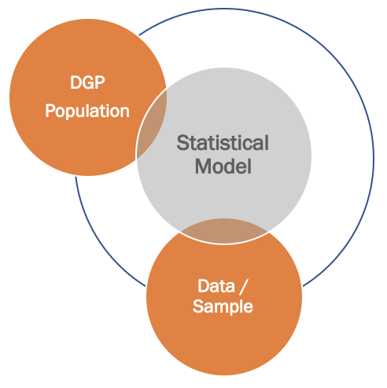
Modeling Data & DGP

Slide 26
Informal models: Word equations
What possible DGPs could have produced this distribution?
(let’s represent in word equations)

Slide 27
Model Variation
Fired = Age + Other Stuff
…
What are some other possible models?
DATA = MODEL + ERROR

Slide 28
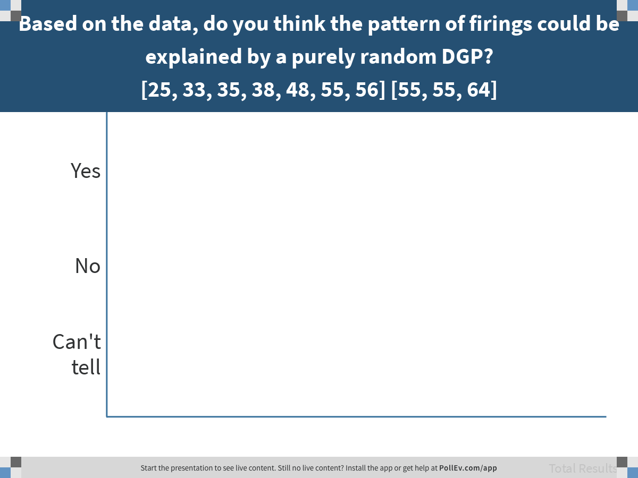
Notes:
Based on the data, do you think the pattern of firings could be explained by a purely random DGP? [25, 33, 35, 38, 48, 55, 56] [55, 55, 64]
https://www.polleverywhere.com/multiple_choice_polls/lyR7GWVBSlzkITSNnEQmn

Slide 29
Key point: you can’t see evidence of randomness by just looking at a single outcome.
(You have to flip a coin more than once to tell if it is fair.)
Notes:
On the spreadsheet called “Simulating Westvaco”

