Slide 1
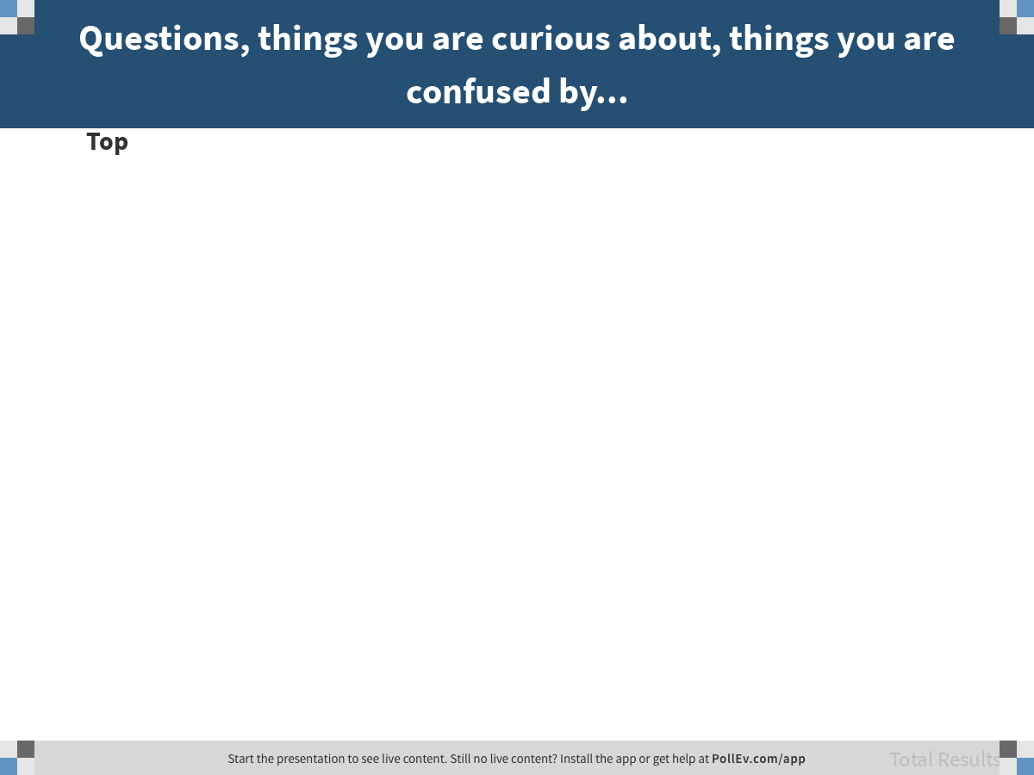
Notes:
Questions, things you are curious about, things you are confused by...
https://www.polleverywhere.com/discourses/ZxH8FpwQYFvAnE5fITvEF

Slide 2
Quiz #1 – Friday April 12
Look at all practice questions – not just the ones that require R.
Quiz link will come in email to your CCLE email address. Quiz is in this room, and you will get an assigned seat.
Bring device – preferably laptop – for taking quiz. Make sure it is charged!
Notes:
On the spreadsheet called “Simulating Westvaco”

Slide 3
Today
Look at a new data set
Explore variation
univariate
Bivariate
Discuss what it means to “explain” variation
Answer your questions

Slide 4
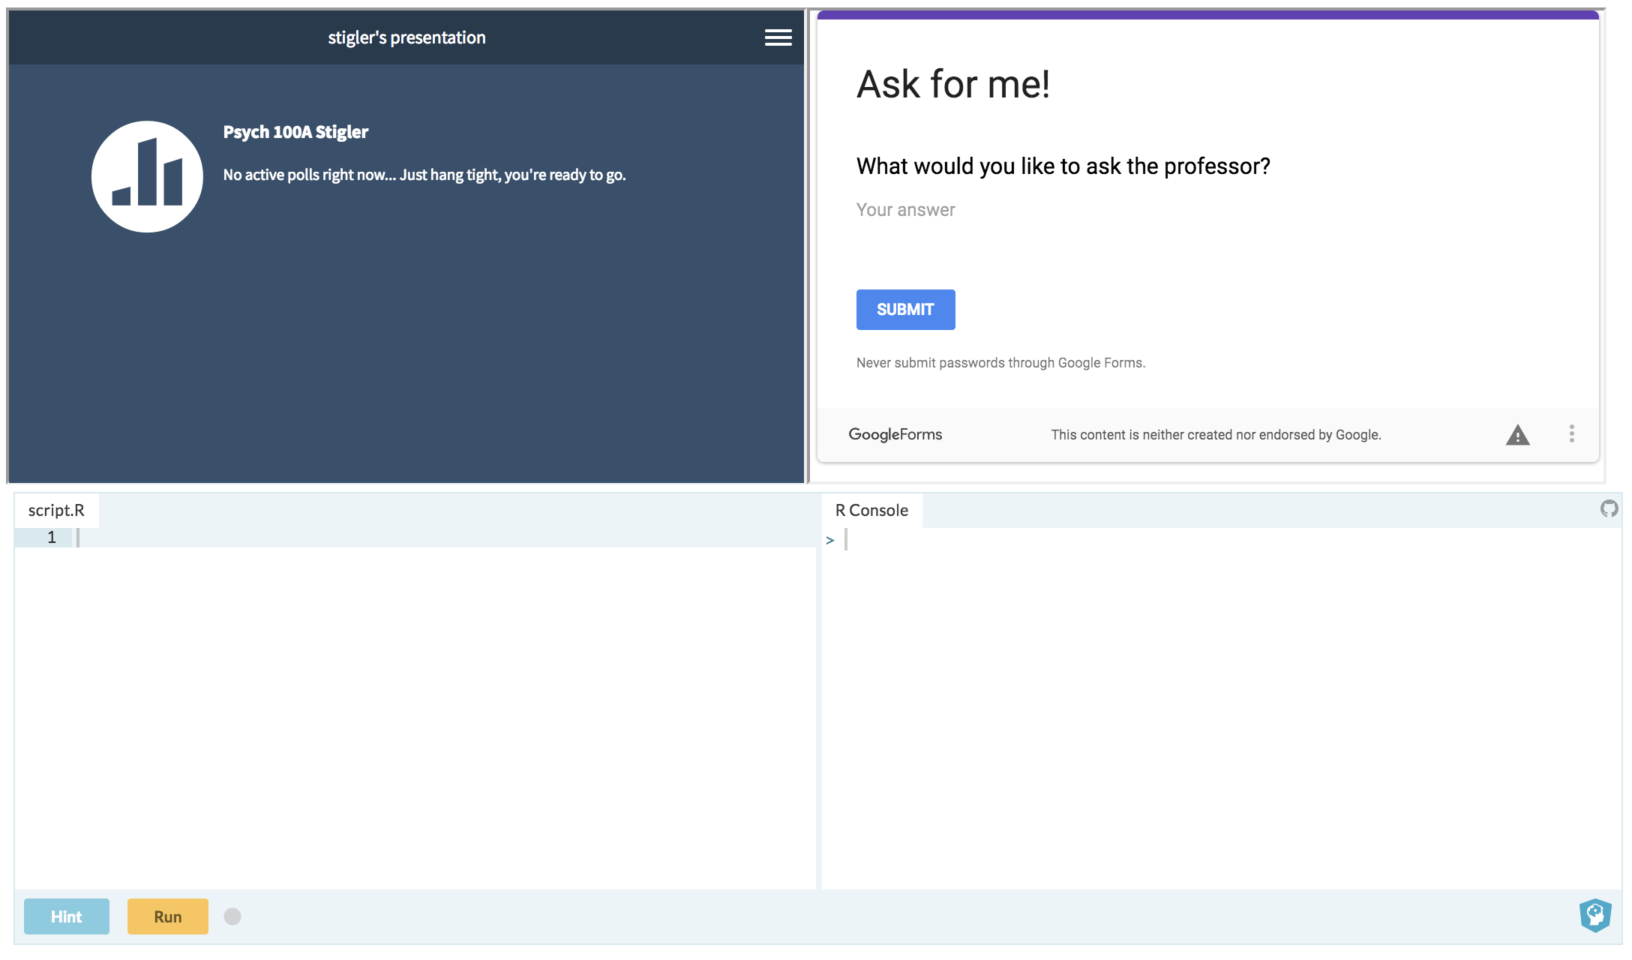
bit.ly/100Aclass

Slide 5
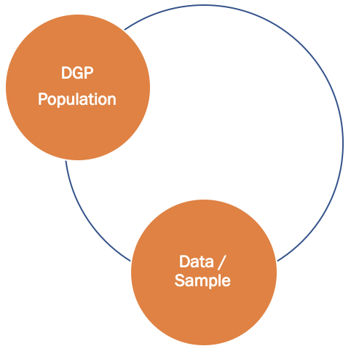
Exploring Variation in Data
100A Spring 2019 - Stigler
Lecture 3

Slide 6
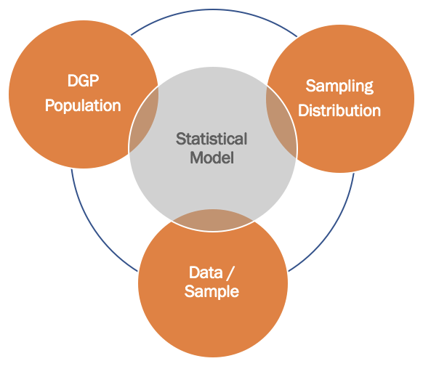
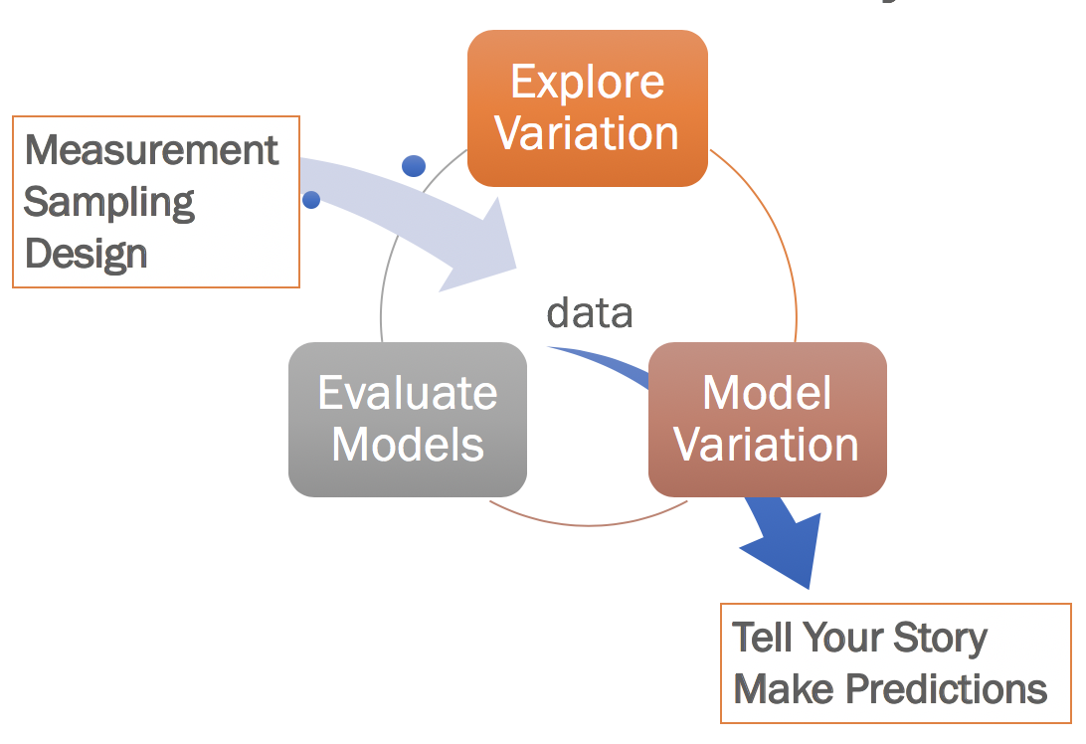
Core Connections
We will keep working with the same core ideas again and again. Understanding will come gradually.

Slide 7
Always start by looking at the distributions of variables.
Center, Shape, Spread,
and Weird Stuff

Slide 8
Package: okcupiddata
Data frame: profiles

Slide 9

Find out about the data frame profiles. How any observations? How many variables?

Slide 10
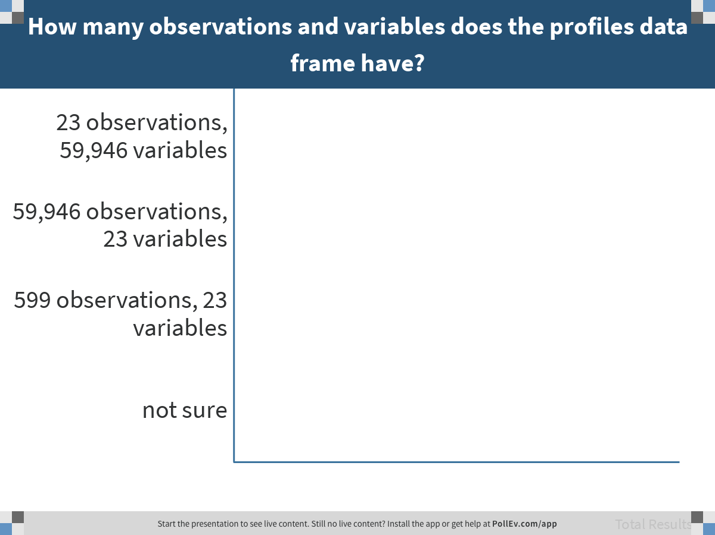
Notes:
How many observations and variables does the profiles data frame have?
https://www.polleverywhere.com/multiple_choice_polls/m3WOTEPRNp6ZDrZMDwe6N

Slide 11
Cleaning Data
Notes:
Do R stuff

Slide 12
Examine the distribution of the variable age in the data frame profiles.

Slide 13
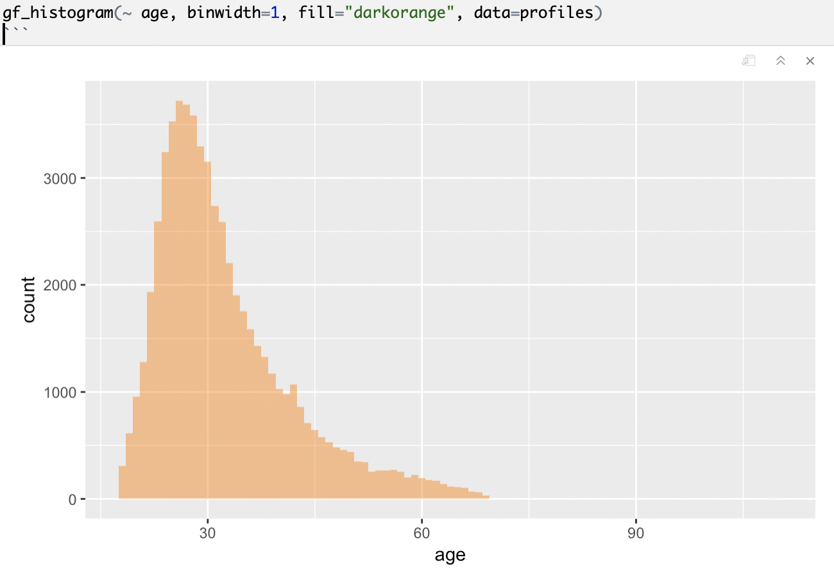
Why do you think this distribution has the shape it does?

Slide 14
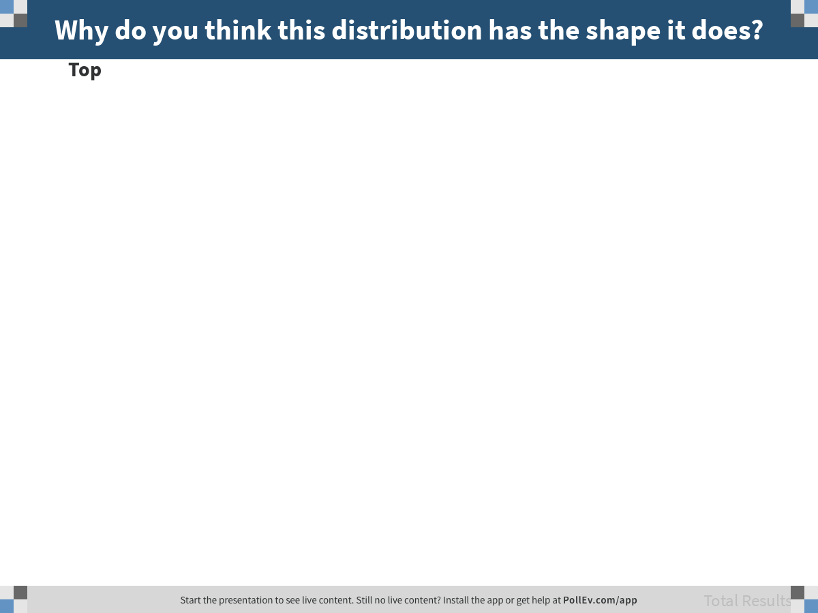
Notes:
Why do you think this distribution has the shape it does?
https://www.polleverywhere.com/discourses/0l3d90ncD3p31em7NQ08K

Slide 15
Run a favstats() on age.

Slide 16
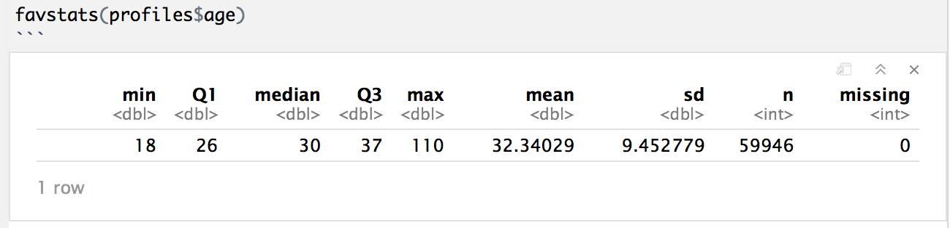
favstats()
What do you notice? Were there any clues in the histogram?

Slide 17
Suggest some ways to figure out what’s going on, and how to fix it.
Notes:
Do R stuff

Slide 18
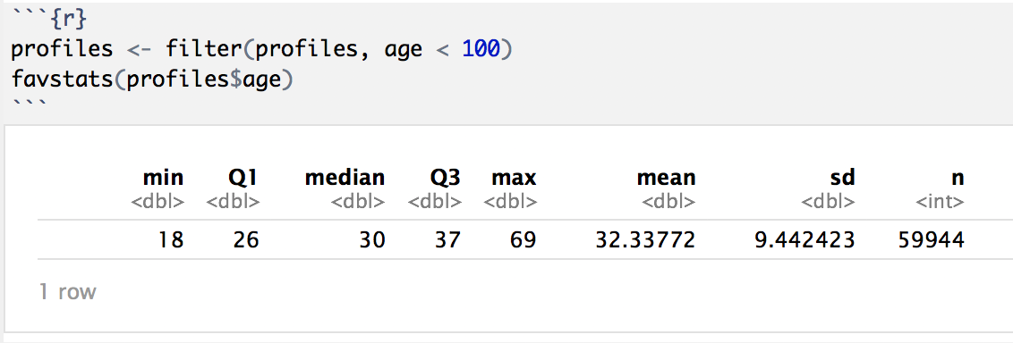

Slide 19
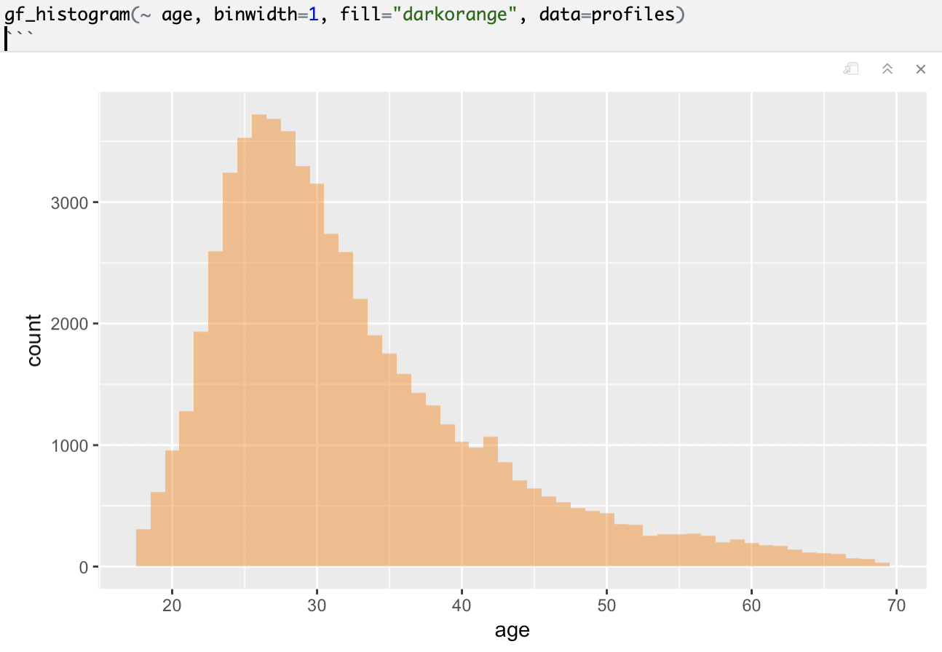
Clean Data

Slide 20
Clean Data
Before
After

Slide 21
The Five Number Summary
Notes:
Do R stuff

Slide 22
favstats(~age, data=profiles)
The Five Number Summary

Slide 23
Plot the Five Number Summary for Age on a Number Line – to Scale
min – Q1 – median – Q3 - max

Slide 24
Plot the Five Number Summary for Age on a Number Line – to Scale
(min)
Q0
(max)
Q4
Q1
Q2
Q3
10 20 30 40 50 60 70 80

Slide 25
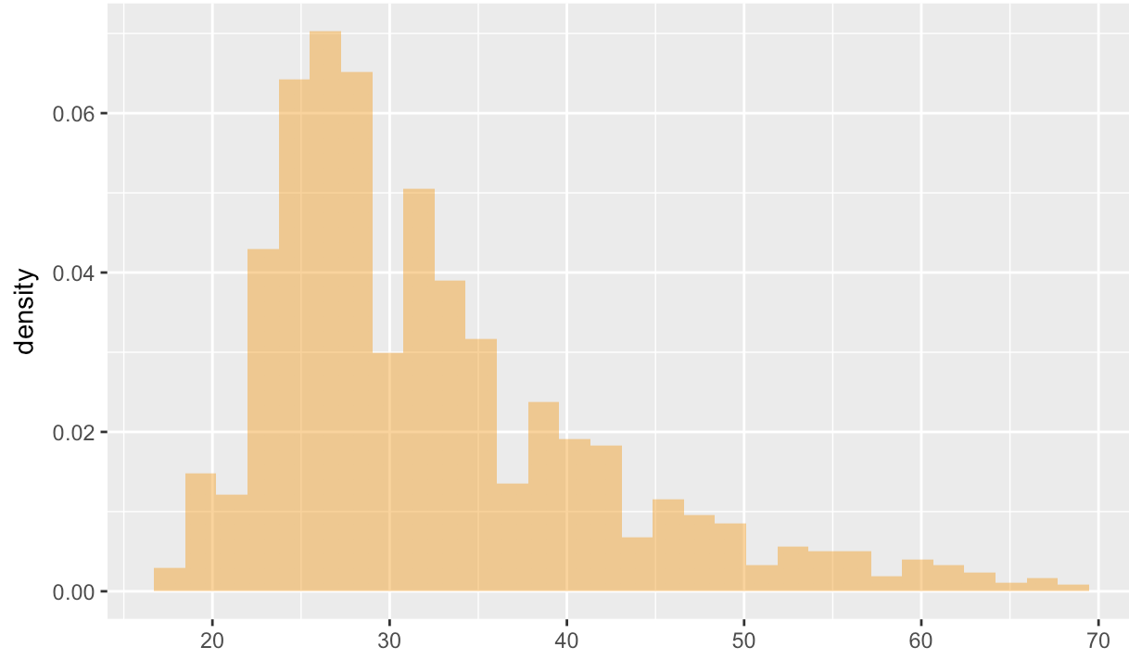
What is equal between these two intervals?
(min)
Q0
(max)
Q4
Q1
Q2
Q3
10 20 30 40 50 60 70 80
a
b

Slide 26
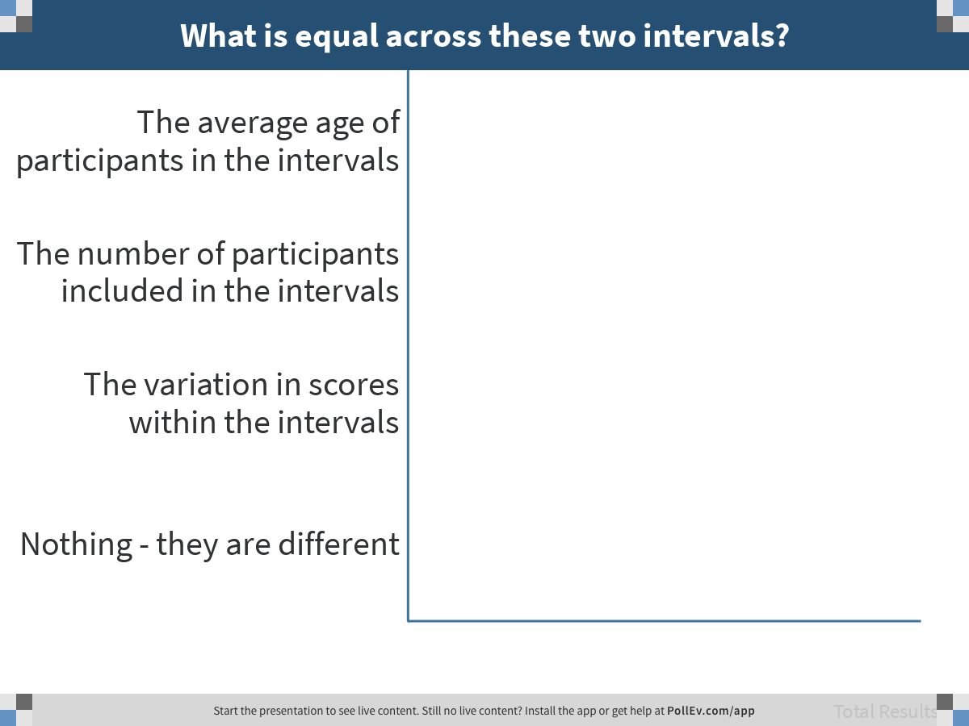
Notes:
What is equal across these two intervals?
https://www.polleverywhere.com/multiple_choice_polls/oBnad8h3rQ8guybJGenUZ

Slide 27
Why are the quartiles not equally spaced?
(min)
Q0
(max)
Q4
Q1
Q2
Q3
10 20 30 40 50 60 70 80

Slide 28
Sketch the boxplot of this distribution
(min)
Q0
(max)
Q4
Q1
Q2
Q3
10 20 30 40 50 60 70 80

Slide 29
Sketch the boxplot of this distribution
(min)
Q0
(max)
Q4
Q1
Q2
Q3
10 20 30 40 50 60 70 80

Slide 30
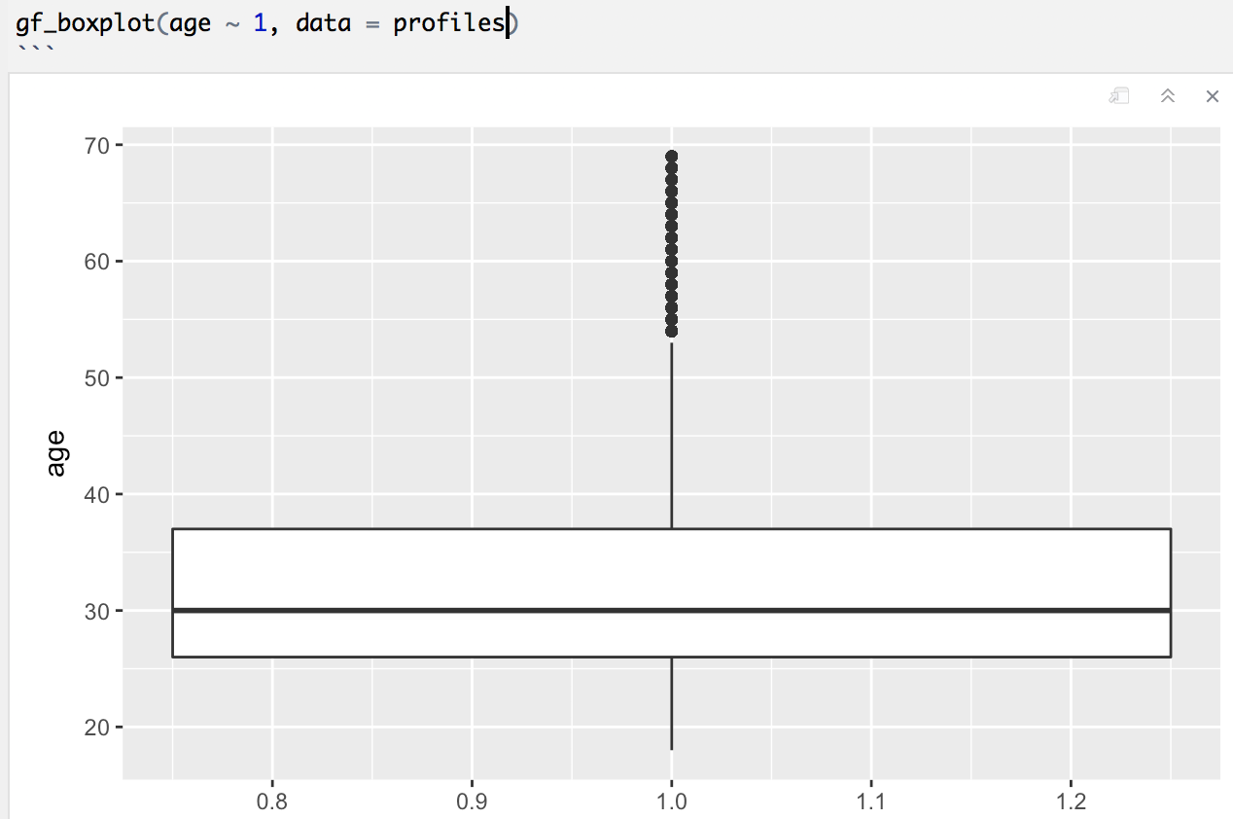

Slide 31
Pay Attention to Level of Measurement

Slide 32
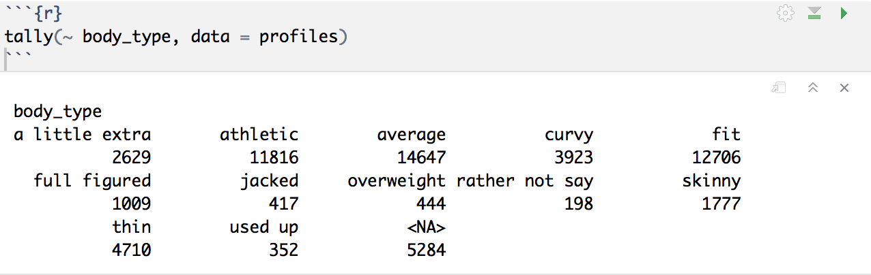

Slide 33
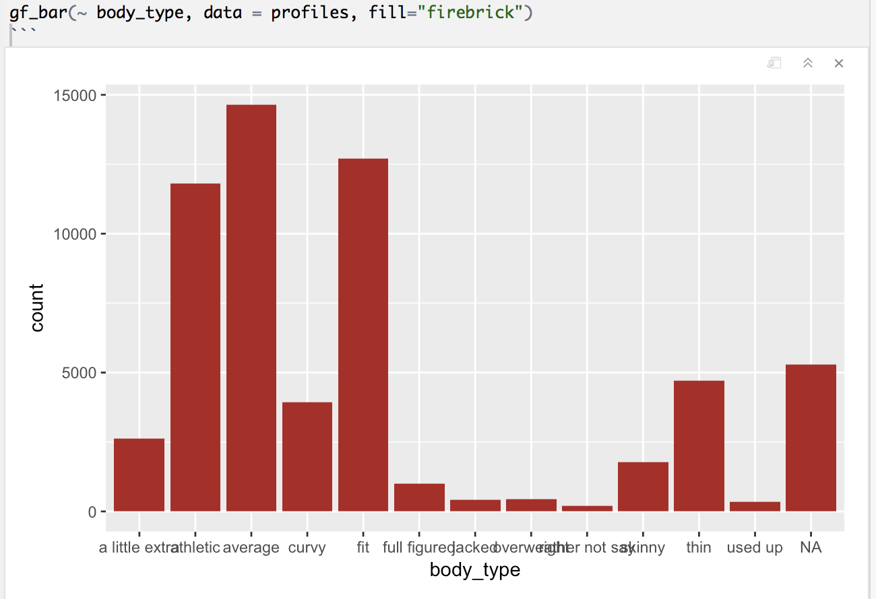
A little extra
Athletic
Average
Curvy
Fit
Full figured
Jacked
Overweight
Rather not say
Skinny
Thin
Used up
NA

Slide 34
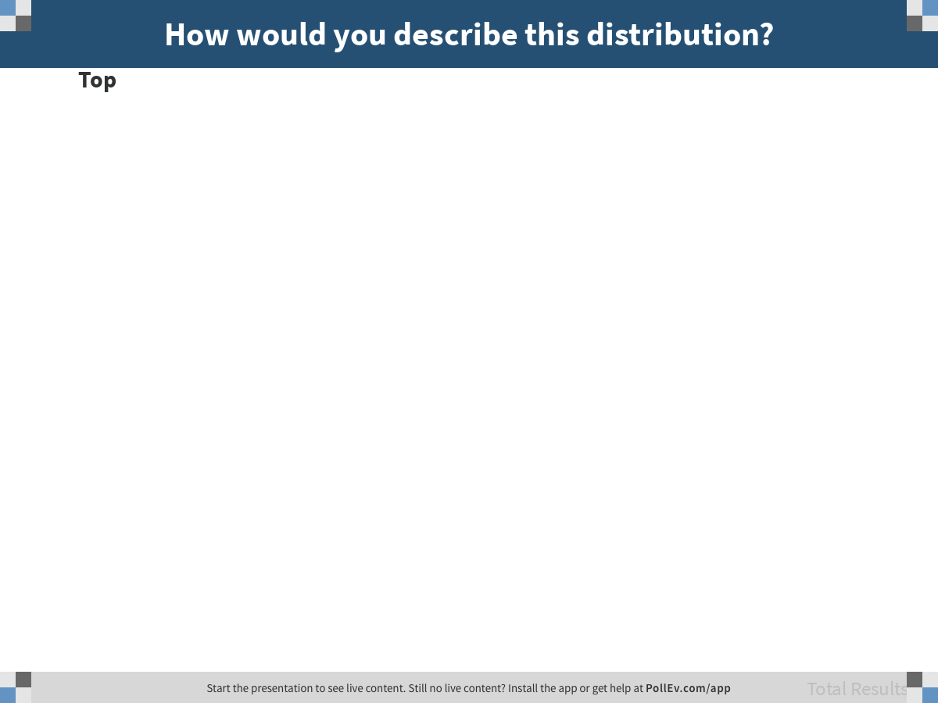
Notes:
How would you describe this distribution?
https://www.polleverywhere.com/discourses/uNguFd9gPLMptOZS9ib1o

Slide 35
A little extra
Athletic
Average
Curvy
Fit
Full figured
Jacked
Overweight
Rather not say
Skinny
Thin
Used up
NA

Slide 36
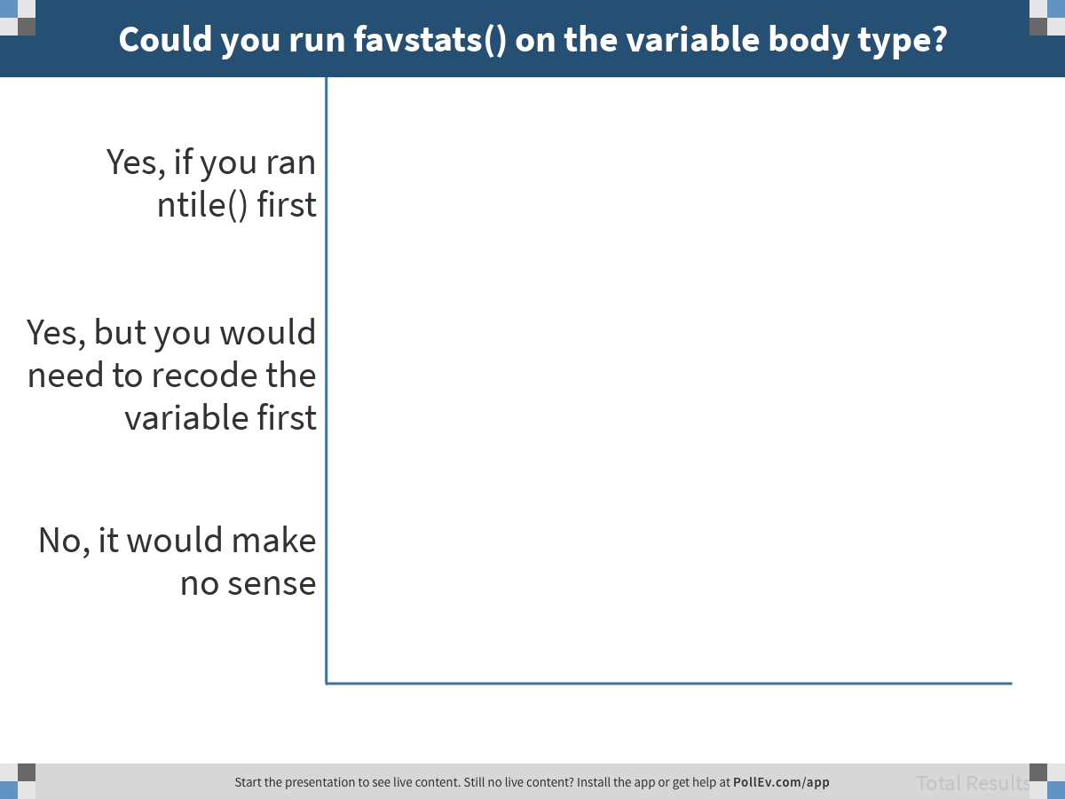
Notes:
Could you run favstats() on the variable body type?
https://www.polleverywhere.com/multiple_choice_polls/dEZ100HVAwsdhsRaqcP7C

Slide 37
Explaining Variation
Notes:
Do R stuff

Slide 38
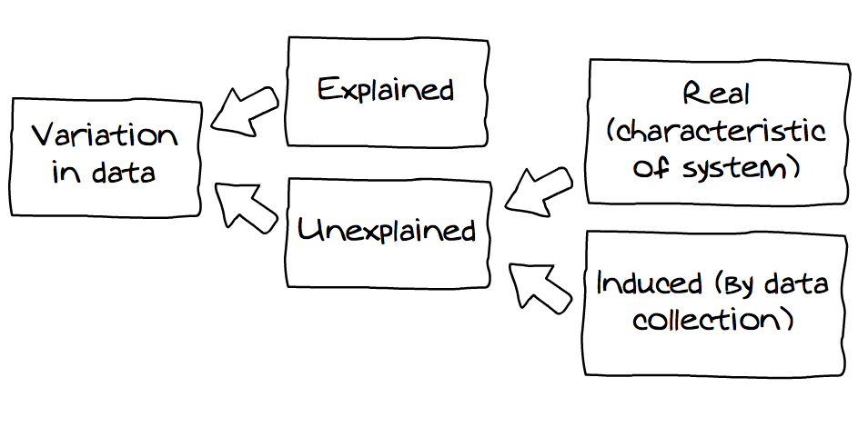
Explaining Variation
measured
unmeasured

Slide 39
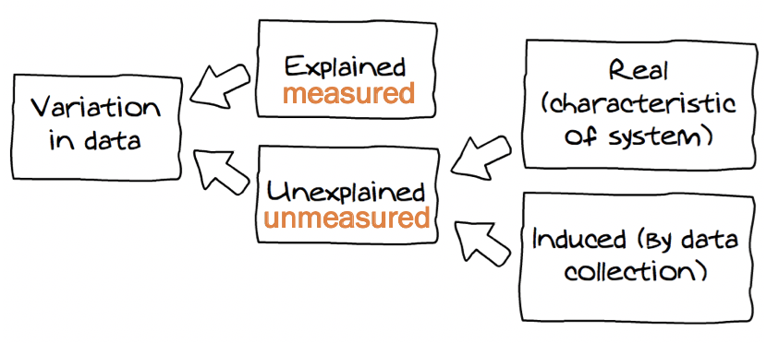
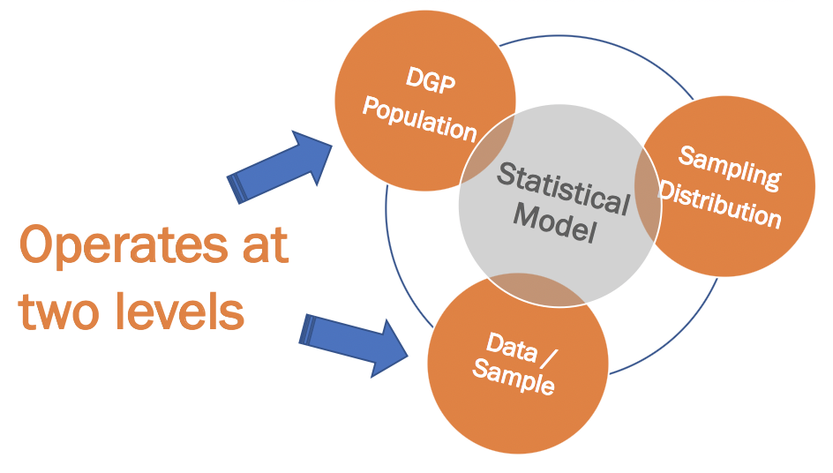
Explaining Variation

Slide 40
In the profiles data frame, does sex explain height?

Slide 41
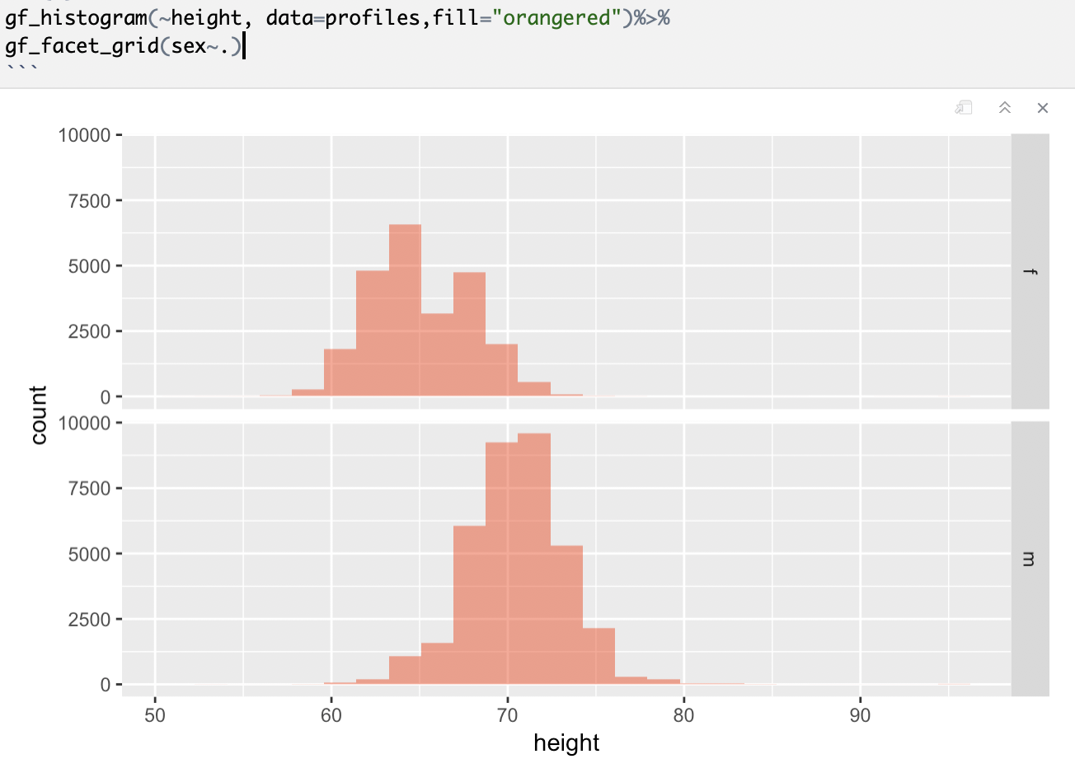
Does sex explain height? In what sense?
Any issues with this graph?

Slide 42
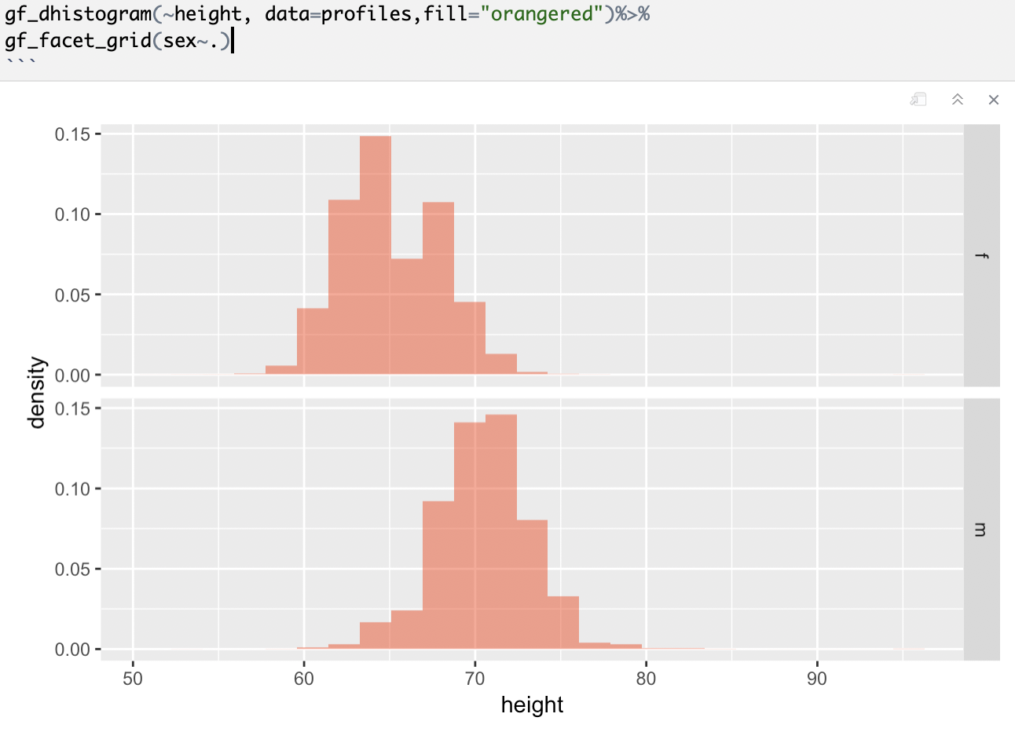
Using dhistogram:
Does sex explain height? In what sense?

Slide 43
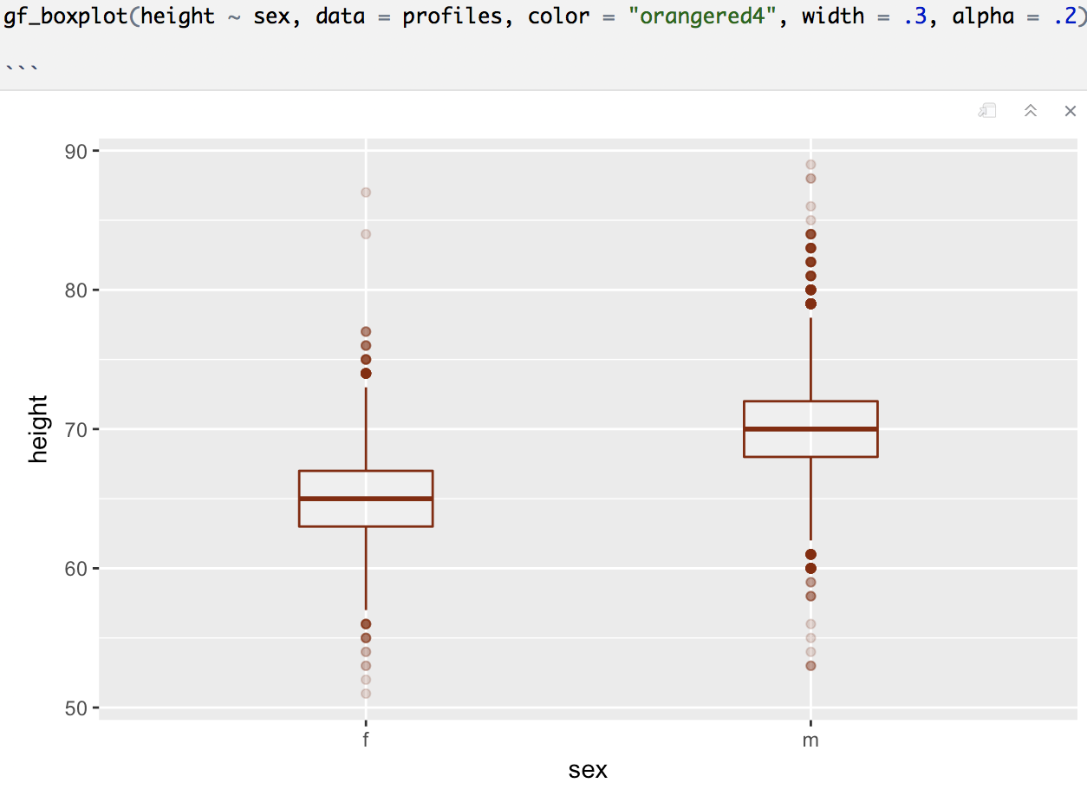

Slide 44
Explaining Variation: Working Definition
Knowing someone’s value on the explanatory variable helps you make a better guess about their value on the outcome variable.

