Slide 1
Getting started…
Please sit in rows A through J only
Form a group with 3-5 students and sit with your group
Learn each others’ names
Thanks!
bit.ly/100Aclass

Slide 2
Today
Pick up from last time – quantifying error
Sum of squares
Variance and standard deviation
Modeling error
Why we want to: predictions beyond the mean
What is a probability distribution
Using data as a probability model
Modeling error with the normal distribution
Answer your questions (use Ask For Me)

Slide 3
Error (Continued)

Slide 4

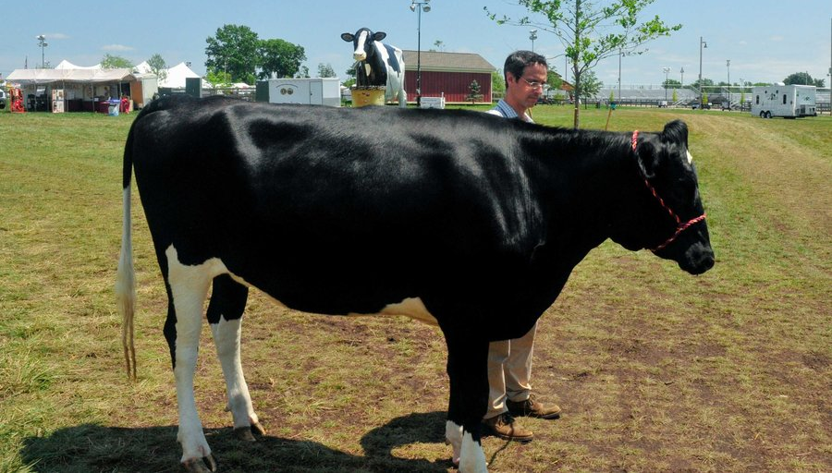
How much does Penelope (the cow) weigh?
Source: NPR, Planet Money, Episode 644, August 7, 2015

Slide 5
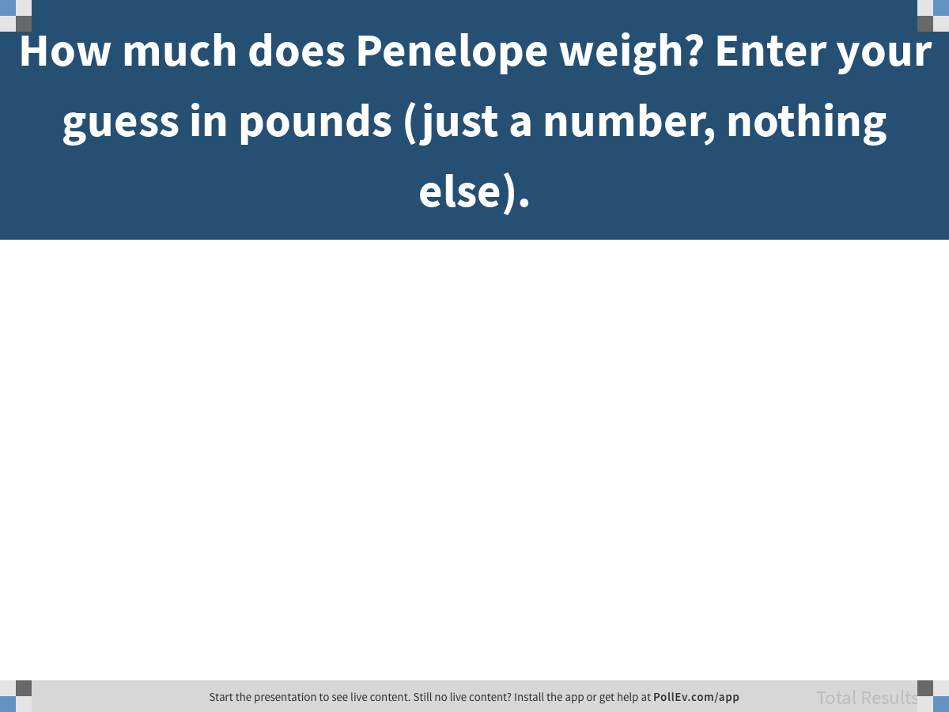
Notes:
How much does Penelope weigh? Enter your guess in pounds (just a number, nothing else).
https://www.polleverywhere.com/free_text_polls/N9G6zwjZYhz1gD9UQMQ1G

Slide 6
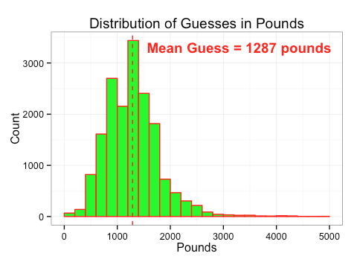
Distribution of 17,205 Guesses
What is the shape of this distribution? Why?

Slide 7
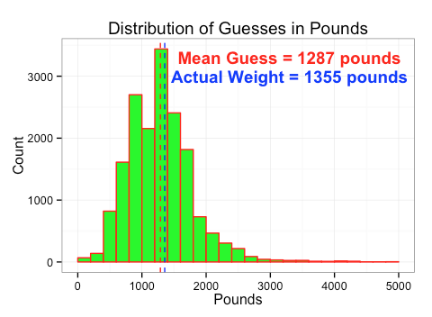
Distribution of 17,205 Guesses
Why do you think the mean guess is so close to Penelope’s actual weight?
Discuss in a group, post a consensus answer.

Slide 8
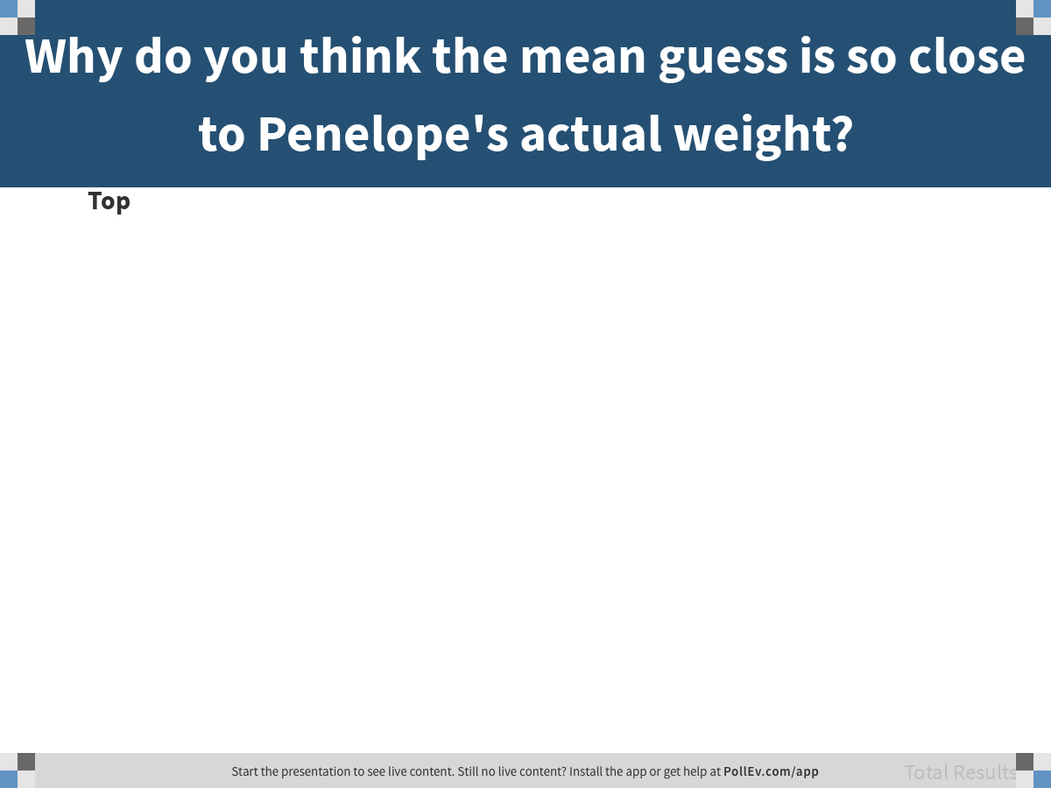
Notes:
Why do you think the mean guess is so close to Penelope's actual weight?
https://www.polleverywhere.com/discourses/eQFe8wY3mwxLVSsRg31qM

Slide 9
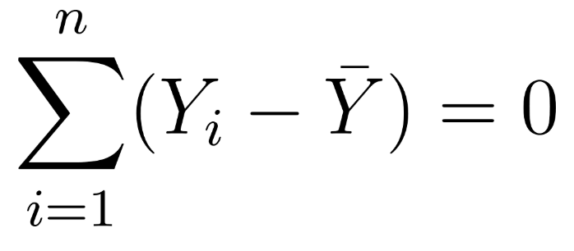
Distribution of 17,205 Guesses
Why do you think the mean guess is so close to Penelope’s actual weight?
Partitioning individual scores into model + error

Slide 10
Quantifying Error
Sum of Squares

Slide 11
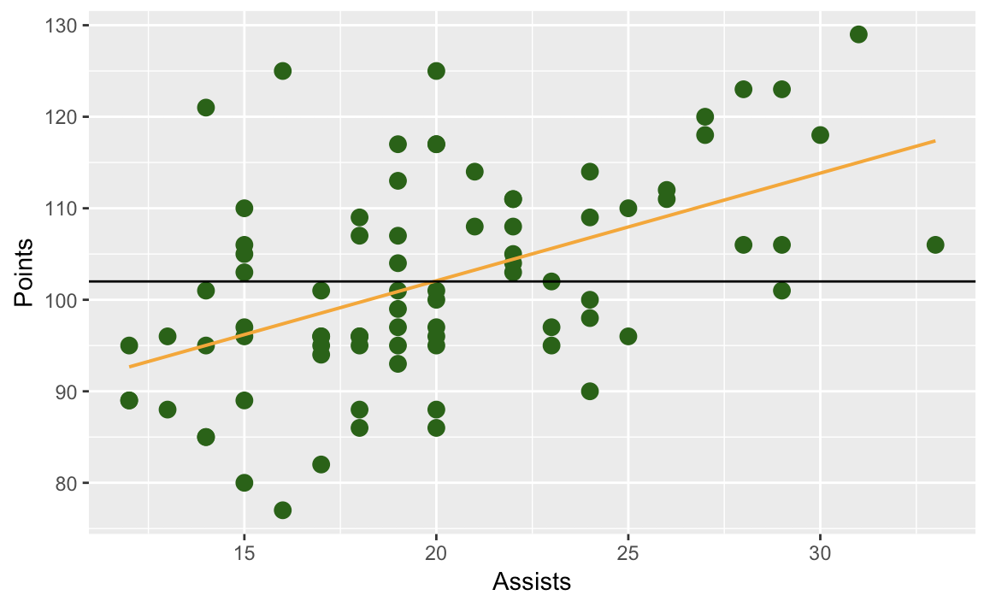
Points = mean + error
Points = Assists + error

Slide 12
Turn Assists into a Categorical Variable (Low, High)
Save the result in Assists.group
Make a graph to look at Points ~ Assists.group

Slide 13
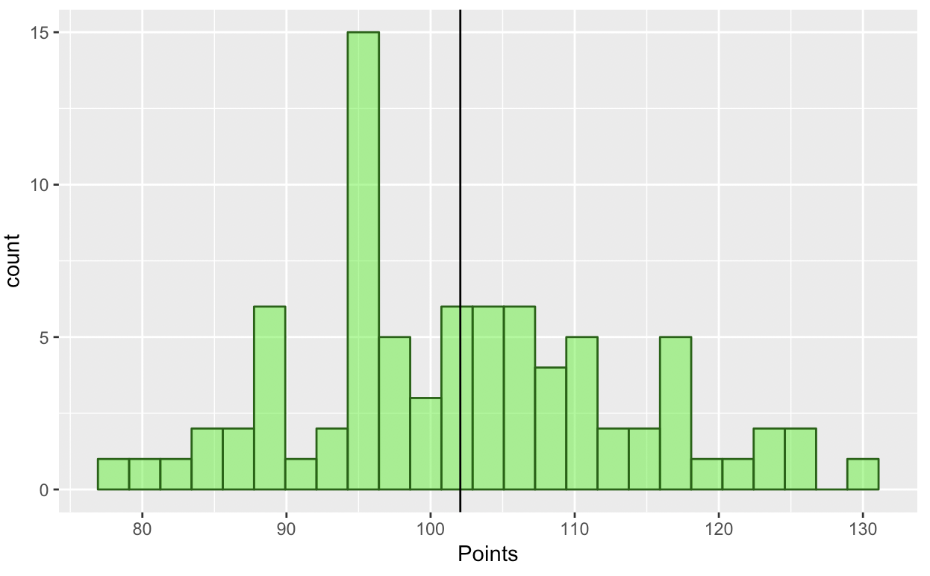
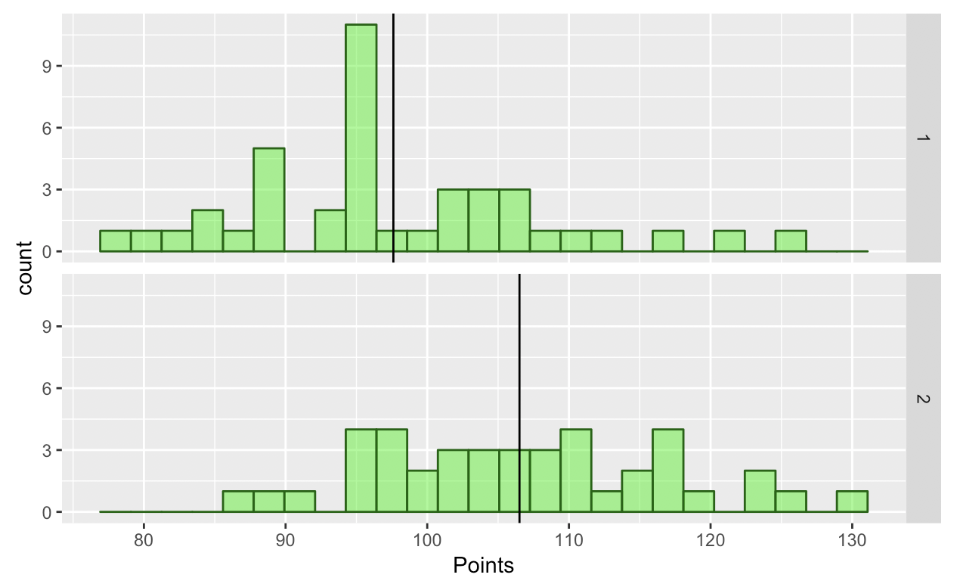
Points = mean
+ error
Points = Assists + error
Which model has more
total error?

Slide 14
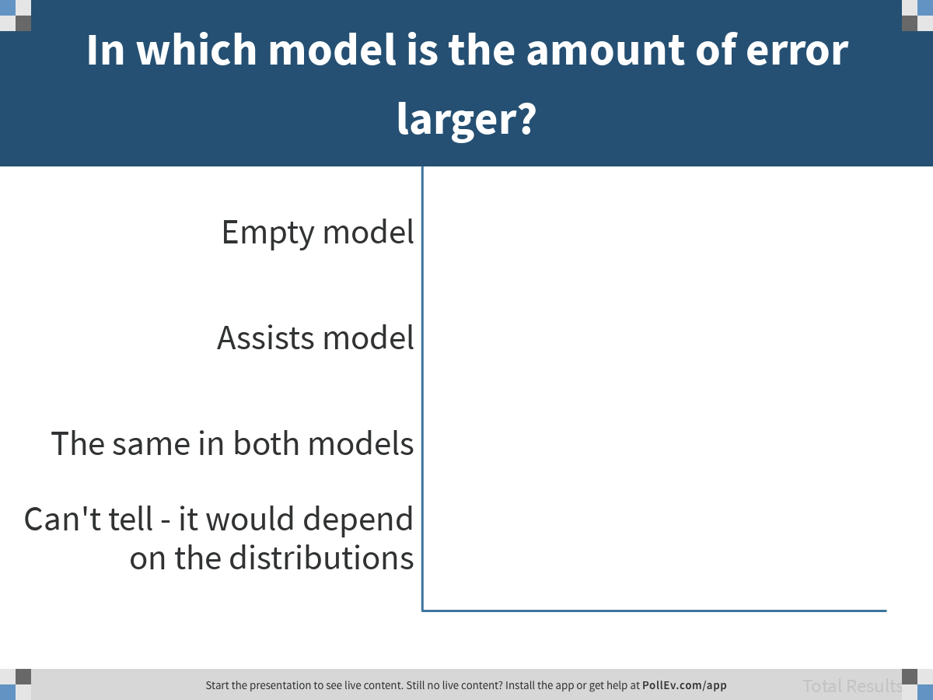
Notes:
In which model is the amount of error larger?
https://www.polleverywhere.com/multiple_choice_polls/tEj3sPGafFWDAKaPekGbs

Slide 15
Least squares estimation of best-fitting model:
Using estimators (such as the mean) at which the sum of squares is minimized

Slide 16
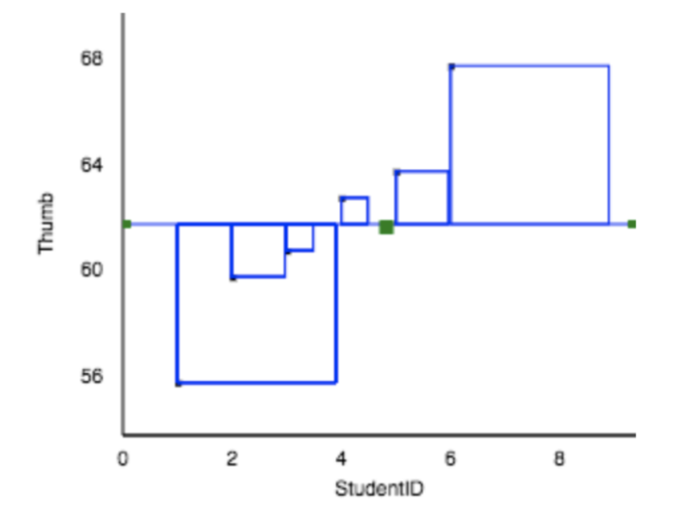
Sum of Squares

Slide 17
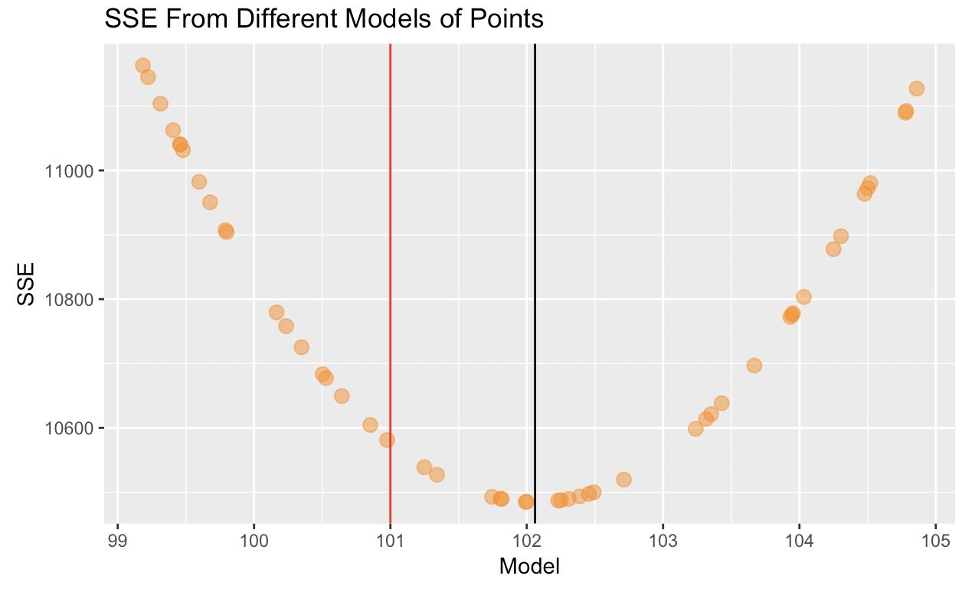
Sum of Squared Errors (SSE)

Slide 18
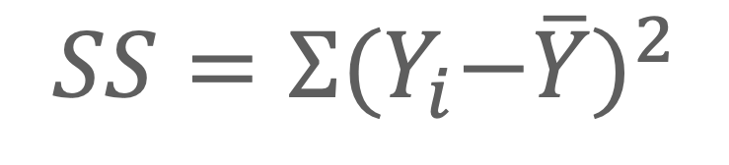
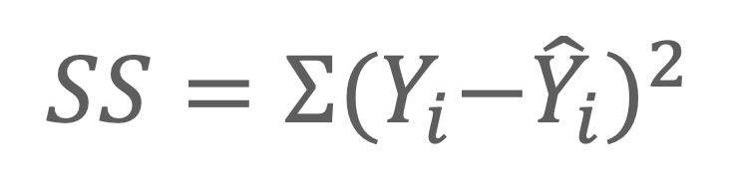
Least squares estimation of best-fitting model
Null model:
$$SS=Σ{{(Y}_{i}−\overline{Y})}^{2}$$
Any model:
$$SS=Σ{{(Y}_{i}−{\hat{Y}}_{i})}^{2}$$

Slide 19
Quantifying Error
Variance and Standard Deviation

Slide 20
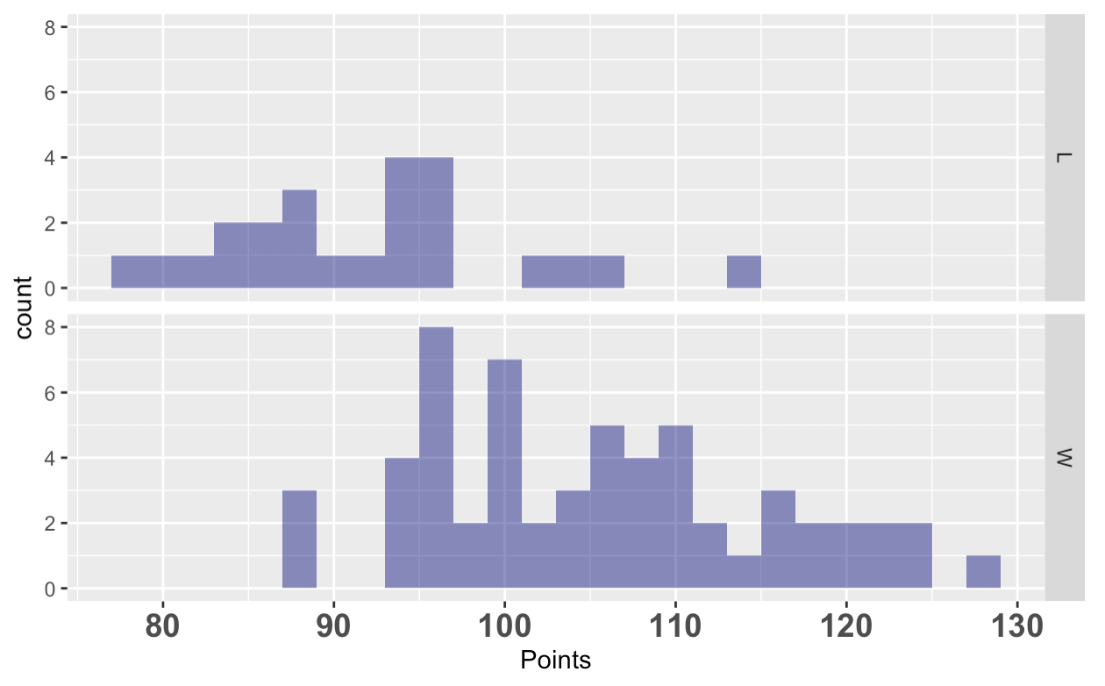
Limitations of SS
Where is Points more variable?
In Wins or in Losses?

Slide 21
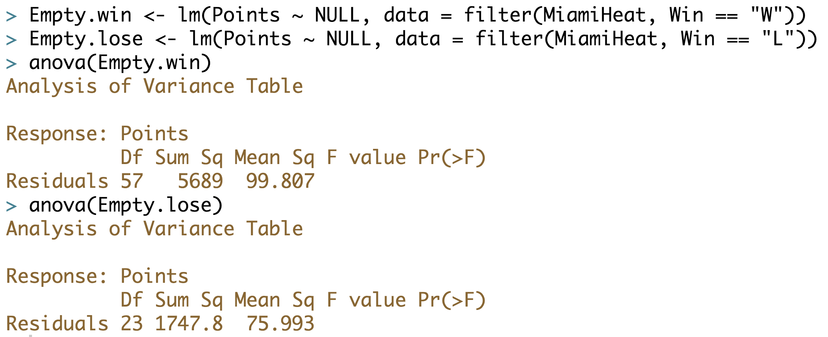
Sum of Squares
wins: 5689 losses: 1748
Why is SS for points so much larger for wins than for losses?

Slide 22
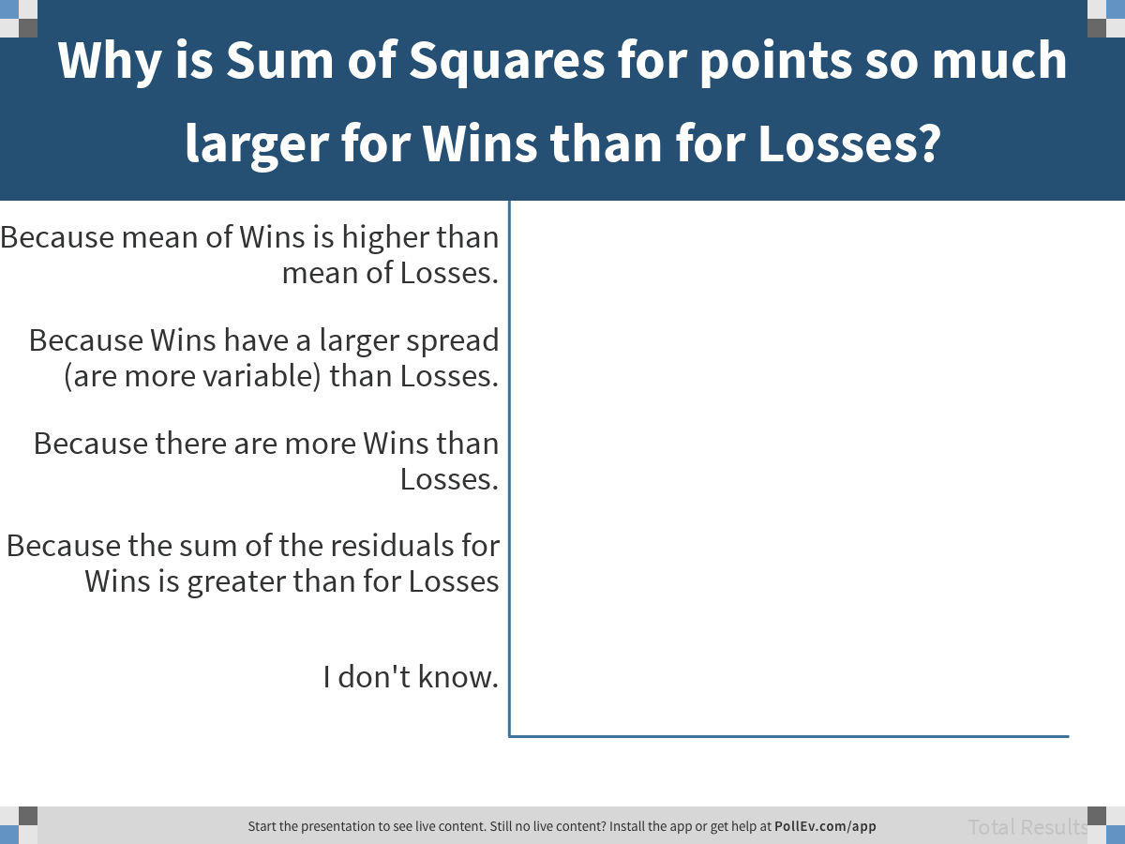
Notes:
Why is Sum of Squares for points so much larger for Wins than for Losses?
https://www.polleverywhere.com/multiple_choice_polls/8yitvNHF7vWjdhs7XRBha

Slide 23
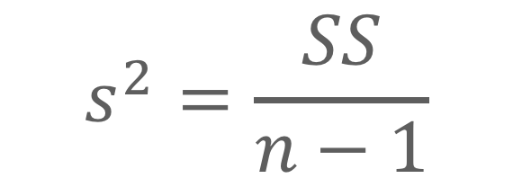
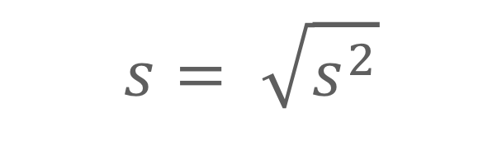
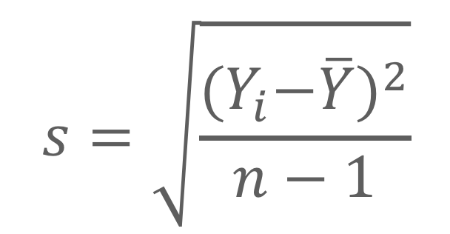
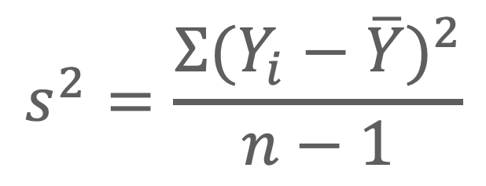
Variance and Standard Deviation
Standard Deviation
Variance
$$s^{2}=\frac{{{Σ(Y}_{i}−\overline{Y})}^{2}}{n−1}$$
$$s=\sqrt{\frac{{{(Y}_{i}−\overline{Y})}^{2}}{n−1}}$$
$$s^{2}=\frac{SS}{n−1}$$
$$s= \sqrt{s^{2}}$$
Variance is sum of squares per unit (or per df) in the sample.

Slide 24
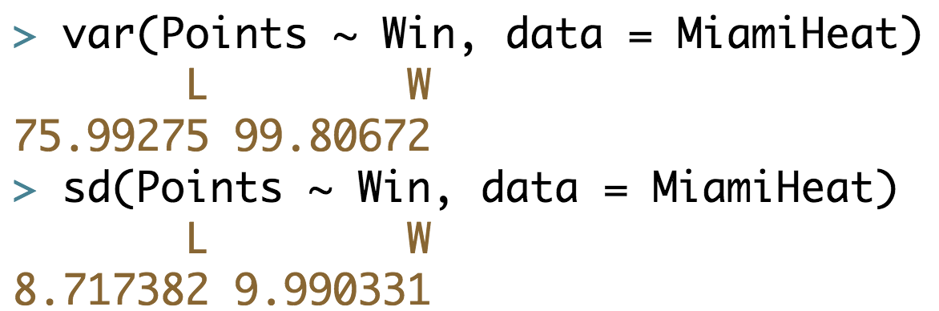
Calculating Variance and SD

Slide 25
Variance and Standard Deviation
SS = 1748
Var = 76
SD = 8.7
SS = 5689
Var = 100
SD = 10.0

Slide 26
But, Sum of Squares can be partitioned into Total, Model, and Error. Variance and Standard Deviation don’t add up the same way.
Notes:
Where does this fit into the California example?

Slide 27
Standard Deviation as a Unit of Measurement

Slide 28
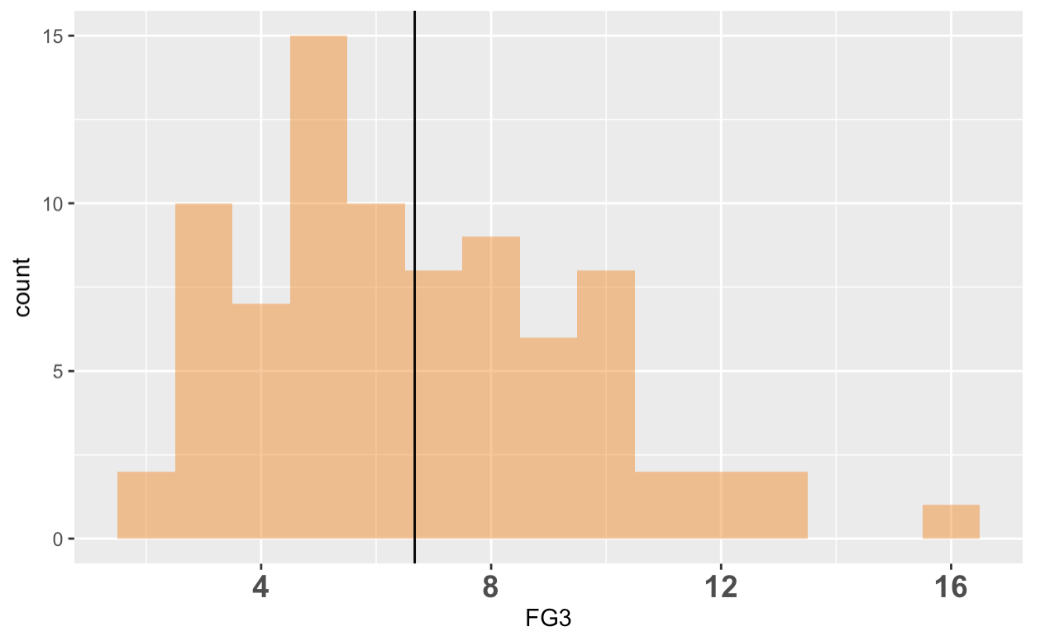
SD = 2.9
Where can you “see” the 2.9
in the histogram?

Slide 29
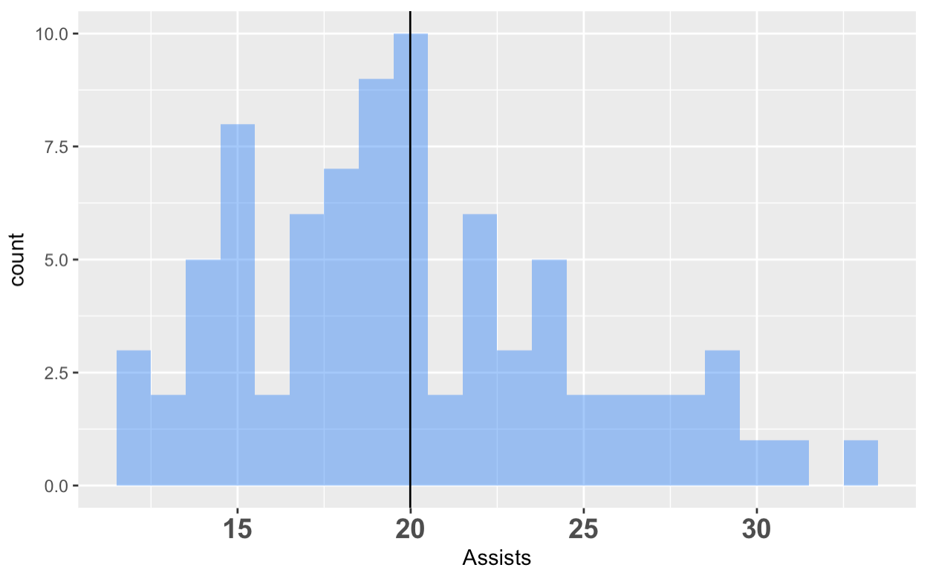
Test your strategy: Estimate the Standard Deviation of Assists

Slide 30
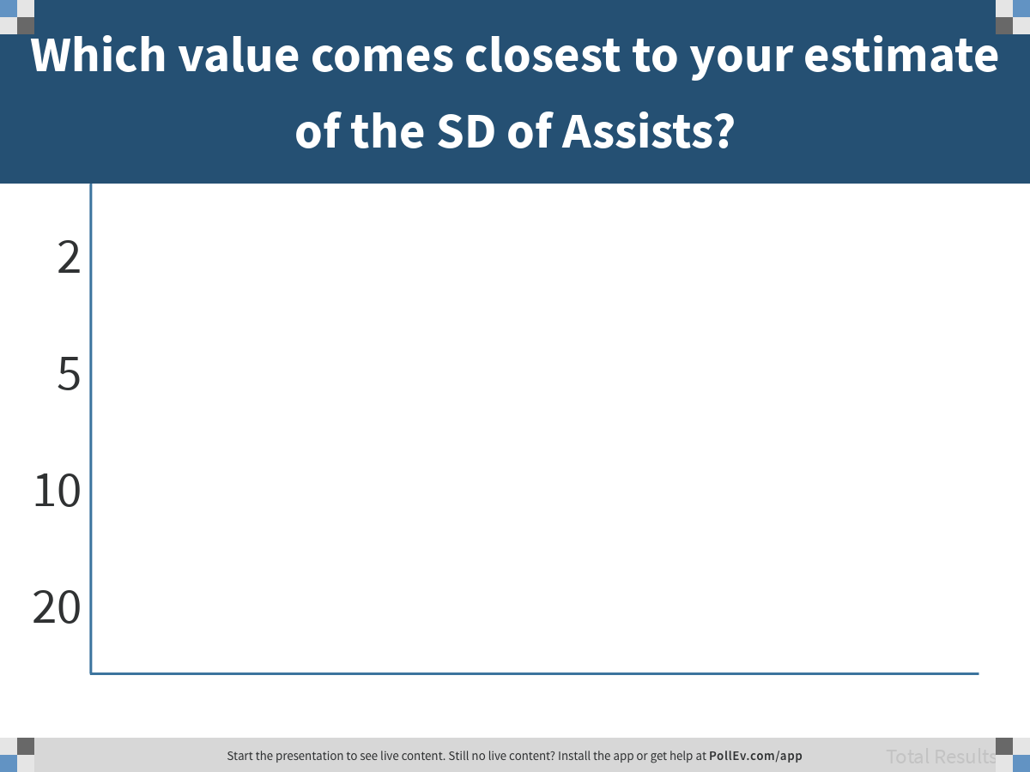
Notes:
Which value comes closest to your estimate of the SD of Assists?
https://www.polleverywhere.com/multiple_choice_polls/l1MlG0EufPfIFmt7xqjZr

Slide 31
SD = 4.9
Standard Deviation of Assists

Slide 32

SD = 4.9
Game 8
Describe Game 8
using SD as a measure

Slide 33
SD = 4.9
Game 8
Describe Game 8
using SD as a measure

Slide 34
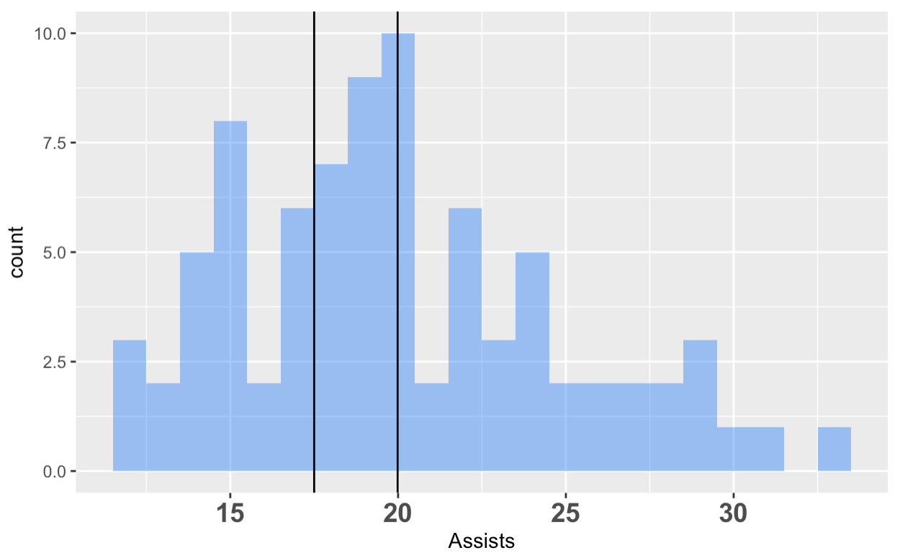
SD = 4.9
Game 20
Describe Game 20
using SD as a measure

Slide 35
SD = 4.9
Game 20
Describe Game 20
using SD as a measure

Slide 36

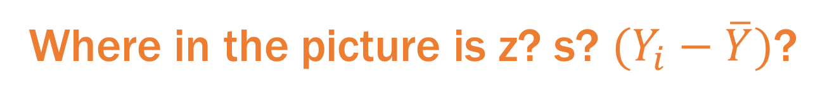
$$z=\frac{\left(Y_{i}−\overline{Y}\right)}{s}$$
Game 8
Where in the picture is z? s? $(Y_{i}−\overline{Y})$?

Slide 37
$$z=\frac{\left(Y_{i}−\overline{Y}\right)}{s}$$
Game 8
Plug in the numbers and see how it works

Slide 38
What’s the point of Z?
(power of division)
Notes:
Again, division helps us put a number in perspective…

Slide 39
Modeling Error

Slide 40
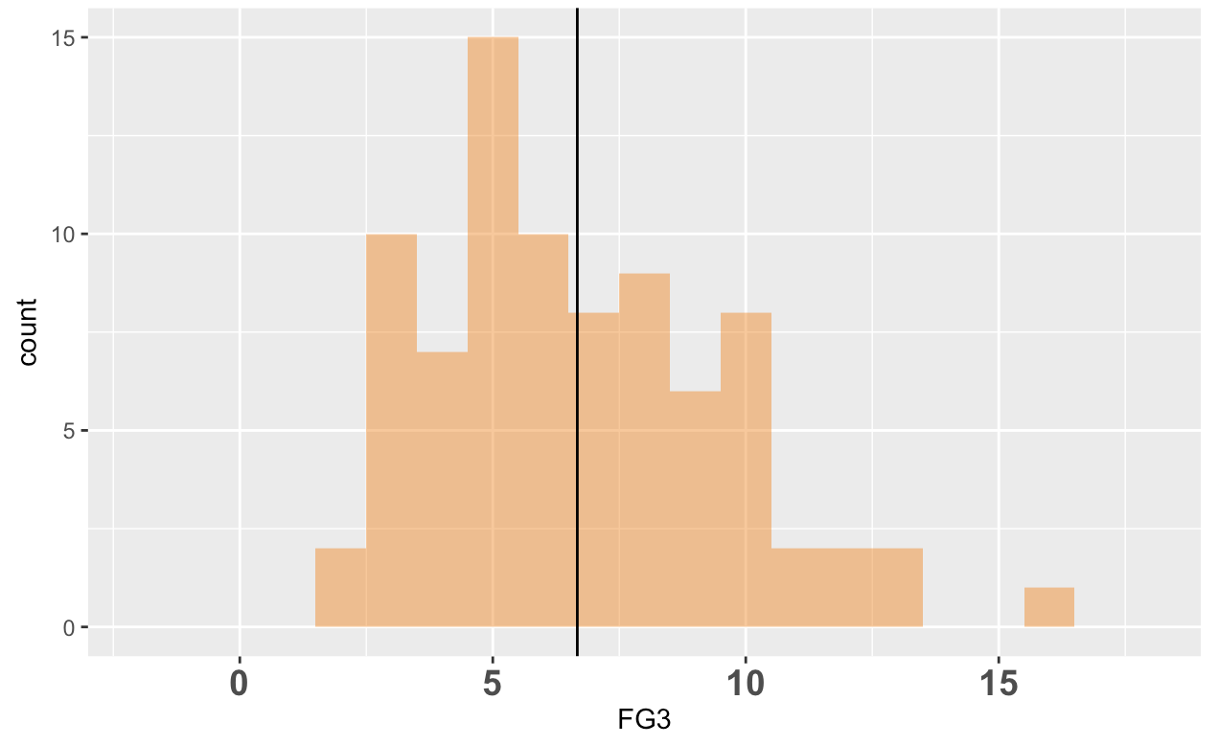
M = 6.7
SD = 2.9
n = 82
Why model error?
Notes:
We know mean is best estimate of next observation. But what if we want to estimate probability of a future observation falling into a certain range?

Slide 41
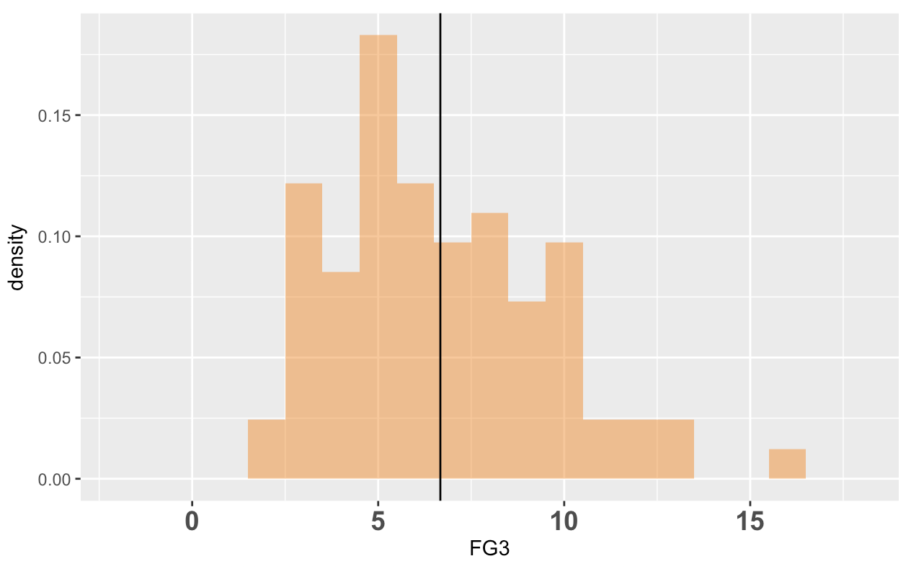
DGP
Population
Sampling
Distribution
Statistical Model
Data / Sample
What are the chances that the Miami Heat will make more than 15
3-pointers in the next game?
To answer this question, need to use data distribution as probability distribution.

Slide 42
M = 6.7
SD = 2.9
n = 82
How can I use this as a probability distribution? What is the probability of a game with more than 15 3-pointers?
Notes:
1 divided by 82.

Slide 43
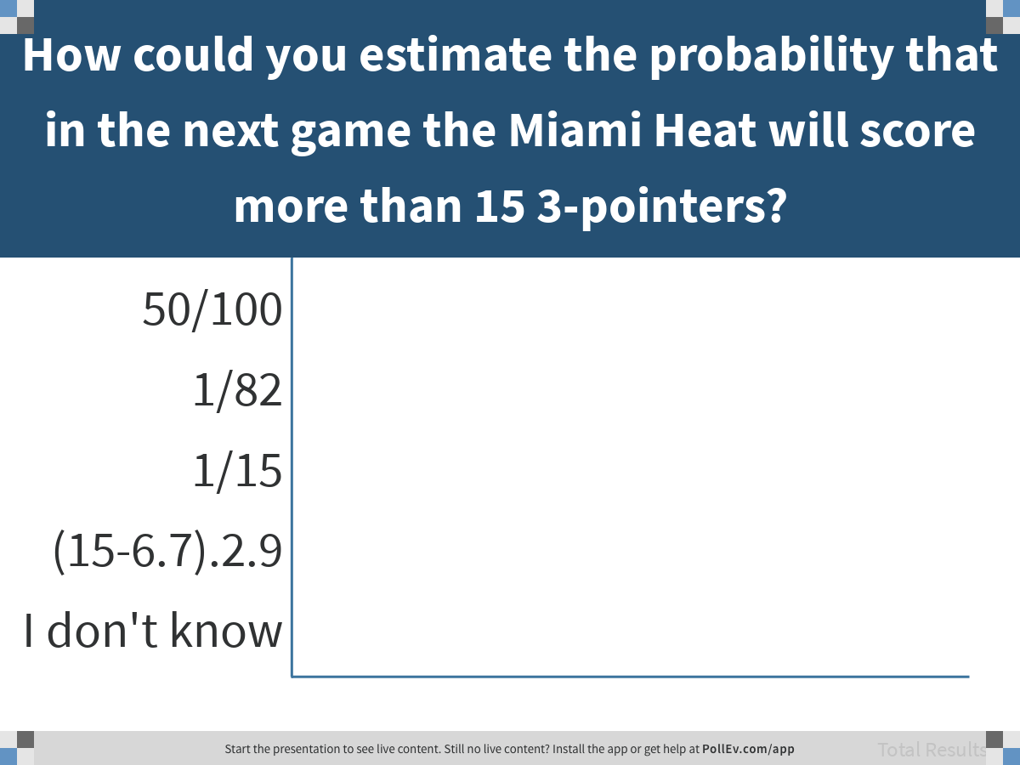
Notes:
How could you estimate the probability that in the next game the Miami Heat will score more than 15 3-pointers?
https://www.polleverywhere.com/multiple_choice_polls/luyc38eRkrMLkiGtffQhk

Slide 44
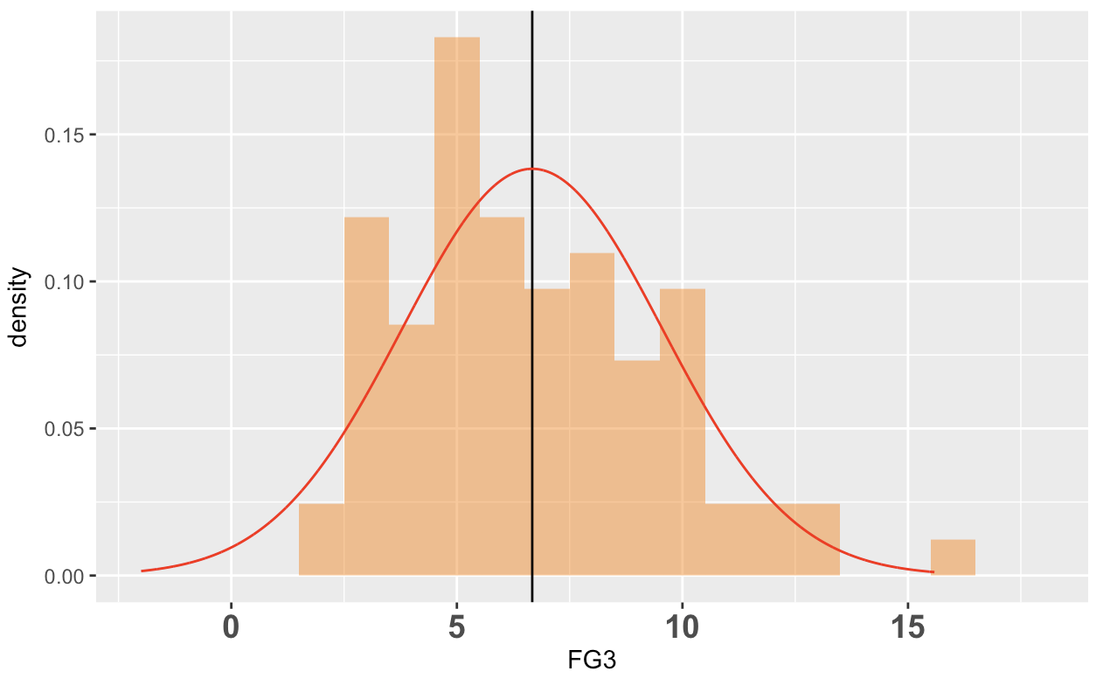
DGP
Population
Sampling
Distribution
Statistical Model
Data / Sample
Normal distribution
In both models, total area adds up to 100%.

Slide 45
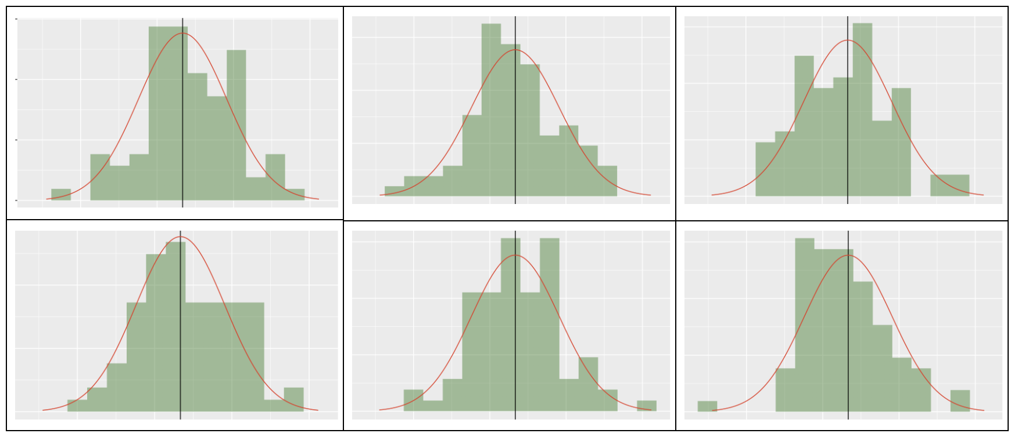
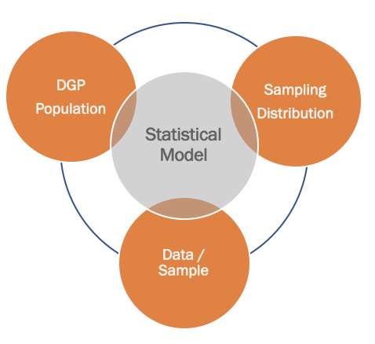
Normal doesn’t usually look normal.

Slide 46
Where do we see the probability on the normal curve?

Slide 47
The space under the whole curve?
The space under the curve here?
The length of this line segment?
The length of this line segment?

Slide 48
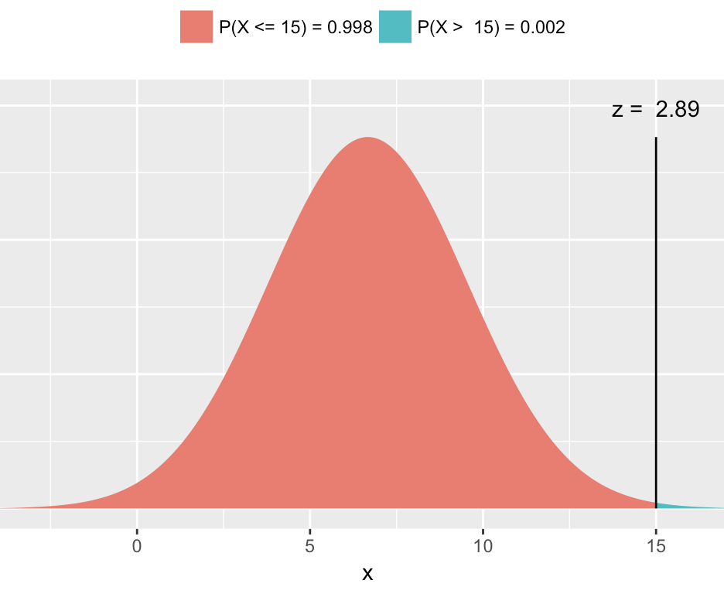
xpnorm(15, mean(MiamiHeat$FG3), sd(MiamiHeat$FG3))

Slide 49
Discuss with your group: Which probability model (data distribution vs. normal distribution) do you think would give result in a more accurate prediction in this case,
and why?
Post a group consensus

