Slide 1
Real Time Systems Applications
Petri Net Analysis
Course Coordinator: Dr. Salama A Mostafa
Address: FSKTM, 4th floor, Room No. 10
Email: salama@uthm.edu.my
Course Code: BIE 33303

Slide 2
Outline
Introduction/History
Transition enabling & firing
Modeling examples
Behavioral properties
Analysis methods
Liveness, safeness & reachability
Analysis & synthesis of Marked Graphs
Structural properties
Modified Petri Nets

Slide 3
Introduction
Petri Nets
A visualization method for RTS runs using a graph.
It can show concurrent, asynchronous, distributed, parallel, nondeterministic and/or stochastic systems
graphical tool
visual communication aid
mathematical tool
state equations, algebraic equations, etc.
communication between theoreticians and practitioners

Slide 4
History
1962: C.A. Petri’s dissertation (U. Darmstadt, W. Germany)
1970: Project MAC Conf. on Concurrent Systems and Parallel Computation (MIT, USA)
1975: Conf. on Petri Nets and related Methods (MIT, USA)
1979: Course on General Net Theory of Processes and Systems (Hamburg, W. Germany)
1980: First European Workshop on Applications and Theory of Petri Nets (Strasbourg, France)
1985: First International Workshop on Timed Petri Nets (Torino, Italy)

Slide 5
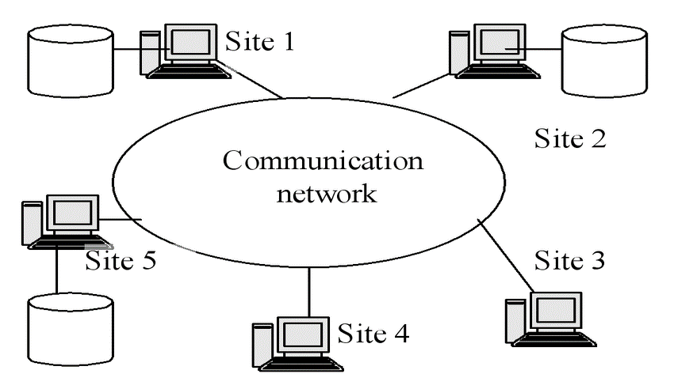
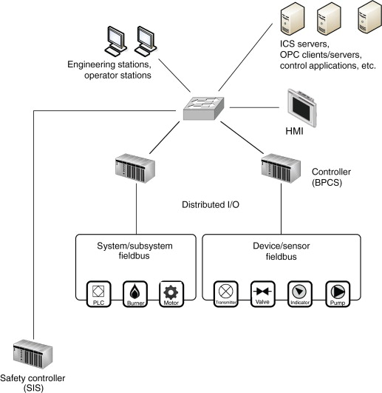
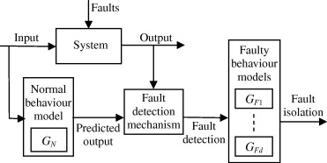
Applications
Performance evaluation
Communication protocols
Distributed-software systems
Distributed-database systems
Concurrent and parallel programs
Industrial control systems
Discrete-events systems
Multiprocessor memory systems
Dataflow-computing systems
Fault-tolerant systems
Distributed-database systems
Discrete-events systems
Industrial control systems

Slide 6
Definition
Directed, weighted, bipartite graph
places
transitions
arcs (places to transitions or transitions to places)
weights associated with each arc
Initial marking
assigns a non-negative integer to each place

Slide 7
Transition (firing) rule
A transition t is enabled if each input place p has at least w(p,t) tokens
An enabled transition may or may not fire
A firing on an enabled transition t removes w(p,t) from each input place p, and adds w(t,p’) to each output place p’

Slide 8
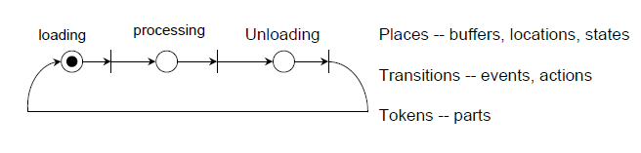
Petri Nets -- Graphic Tool
A bipartite directed graph containing
Places (circles),
transitions (bars), and
directed arcs (places <--> transitions).

Slide 9
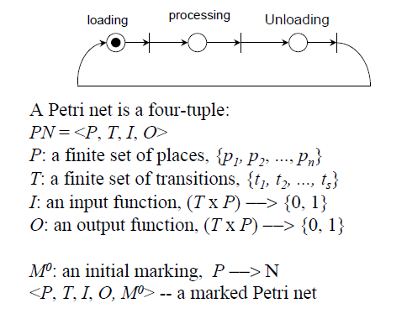
Petri Nets -- Mathematical Models

Slide 10
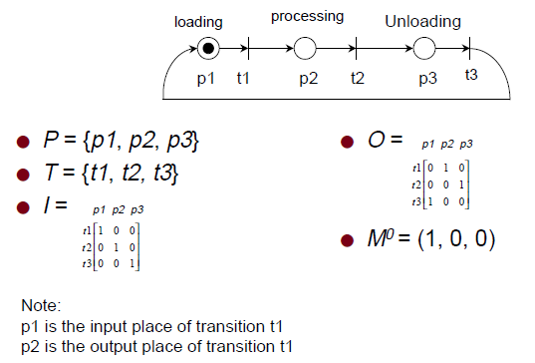
Petri Nets -- An Example

Slide 11
Petri Nets -- Firing example
2H₂ + O₂ → 2H₂O
token
2
t
H₂
2
H₂O
O₂

Slide 12
Petri Nets -- Firing example cont.
2H₂ + O₂ → 2H₂O
marking token transition
2
t
H₂
2
H₂O
O₂

Slide 13
Some definitions
source transition: no inputs
sink transition: no outputs
self-loop: a pair (p,t) s.t. (such that) p is both an input and an output of t
pure PN: no self-loops
ordinary PN: all arc weights are 1’s
infinite capacity net: places can accommodate an unlimited number of tokens
finite capacity net: each place p has a maximum capacity K(p)
strict transition rule: after firing, each output place can’t have more than K(p) tokens
Theorem: every pure finite-capacity net can be transformed into an equivalent infinite-capacity net

Slide 14
Modeling Finite State Machines (FSMs)
vend 15¢ candy
An FSM is a machine that can be in a specific state from a finite set of possible states at any point in time.
10
15
5
5
5
5
0
5
10
10
20
10
vend 20¢ candy

Slide 15
Modeling FSMs cont.
vend 15¢ candy
Each transition of the FSM has exactly one input and one output
10
5
5
5
5
10
10
vend 20¢ candy

Slide 16
Modeling FSMs cont.
vend
10
5
conflict,
decision
or choice
5
5
5
10
10
vend

Slide 17
Modeling concurrency
t2
marked graph:
each place has
exactly one
incoming arc
and one
outgoing
arc.
t1
t4
t3

Slide 18
Modeling concurrency cont.
concurrency
t2
t1
t4
t3

Slide 19
Modeling dataflow computation
x = (a+b)/(a-b)
a
copy
+
a+b
/
x
a
b
!=0
copy
-
a-b
NaN
b
=0

Slide 20
Modeling communication protocols
ready
to send
ready
to receive
buffer
full
send
msg.
receive
msg.
proc.1
wait
for ack.
proc.2
msg.
received
receive
ack.
send
ack.
buffer
full
ack.
received
ack.
sent

Slide 21
Modeling synchronization control
k
k
writing
k
reading
k

Slide 22
Behavioral properties (1)
Properties that depend on the initial marking
Reachability
Mn is reachable from M0 if exists a sequence of firings that transform M0 into Mn
reachability is decidable but exponential
Boundedness (the quality of being finite)
a PN is bounded if the number of tokens in each place doesn’t exceed a finite number k for any marking reachable from M0
a PN is safe if it is 1-bounded

Slide 23
Behavioral properties (2)
Liveness
a PN is live if, no matter what marking has been reached, it is possible to fire any transition with an appropriate firing sequence
equivalent to deadlock-free
strong property, different levels of liveness are defined (L0=dead, L1, L2, L3 and L4=live)
Reversibility
a PN is reversible if, for each marking M reachable from M0, M0 is reachable from M
relaxed condition: a marking M’ is a home state if, for each marking M reachable from M0, M’ is reachable from M

Slide 24
Behavioral properties (3)
Coverability
a marking is coverable if exists M’ reachable from M0 s.t. M’(p)>=M(p) for all places p
Meaning: After generating all possible firing states, remove the coverable places that lead to an existing place to avoid redundancy in the places.
Persistence
a PN is persistent if, for any two enabled transitions, the firing of one of them will not disable the other
then, once a transition is enabled, it remains enabled until it’s fired
all marked graphs are persistent
a safe persistent PN can be transformed into a marked graph

Slide 25
Behavioral properties (4)
Synchronic distance
The maximum difference of times two transitions are fired for any firing sequence.
The well-defined metric for condition/event nets and marked graphs
Fairness
bounded-fairness: the number of times one transition can fire while the other is not firing is bounded
unconditional(global)-fairness: every transition appears infinitely often in a firing sequence

Slide 26
Analysis methods (1)
Coverability tree
tree representation of all possible markings
root = M0
nodes = markings reachable from M0
arcs = transition firings
if the net is unbounded, then the tree is kept finite by introducing the symbol ω
Properties
a PN is bounded if ω (unbounded) doesn’t appear in any node
a PN is safe if only 0’s and 1’s appear in nodes
a transition is dead if it doesn’t appear in any arc
if M is reachable from M0, then exists a node M’ that covers M

Slide 27
Coverability tree example
M0=(100)
p1
t3
p2
t1
t0
t2
p3

Slide 28
Coverability tree example
M0=(100)
t1
p1
t3
M1=(001)
“dead end”
p2
t1
t0
t2
p3

Slide 29
Coverability tree example
M0=(100)
t1
t3
p1
t3
M1=(001)
“dead end”
M3=(1ω0)
p2
t1
t0
t2
p3

Slide 30
Coverability tree example
M0=(100)
t1
t3
p1
t3
M1=(001)
“dead end”
M3=(1ω0)
t1
p2
t1
t0
M4=(0ω1)
t2
p3

Slide 31
Coverability tree example
M0=(100)
t1
t3
p1
t3
M1=(001)
“dead end”
M3=(1ω0)
t1
t3
p2
t1
t0
M4=(0ω1)
M3=(1ω0)
“old”
t2
p3

Slide 32
Coverability tree example
M0=(100)
t1
t3
p1
t3
M1=(001)
“dead end”
M3=(1ω0)
t1
t3
p2
t1
t0
M4=(0ω1)
M6=(1ω0)
“old”
t2
t2
p3
M5=(0ω1)
“old”

Slide 33
Coverability tree example
Is the net unbounded (ω)?
100
M0=(100)
t1
t3
t1
t3
M1=(001)
“dead end”
M3=(1ω0)
001
1ω0
t1
t3
t1
t3
0ω1
M4=(0ω1)
M6=(1ω0)
“old”
t2
t2
M5=(0ω1)
“old”
coverability graph
coverability tree

Slide 34
Analysis methods (2) (for your own reading)
Incidence matrix
n transitions, m places, A is n x m
a_{ij} = a_{ij}⁺ - a_{ij}⁻
a_{ij} is the number of tokens changed in place j when transition i fires once
State equation
M_{k} = M_{k-1} + A^{T}u_{k}
u_{k}=e_{i} unit vector indicating transition i fires

Slide 35
Necessary reachability condition
M_{d} reachable from M₀, then
M_{d} = M₀ + A^{T} (u₁+u₂+...+u_{d})
A^{T} x = ΔM
then
ΔM ∈ range(A^{T})
ΔM ⊥ null(A)
B_{f} ΔM = 0
where the rows of B_{f} span null(A)

Slide 36
Analysis methods (3)
Reduction rules that preserve liveness, safeness and boundedness
Fusion of Series Places
Fusion of Series Transitions
Fusion of Parallel Places
Fusion of Parallel Transitions
Elimination of Self-loop Places
Elimination of Self-loop Transitions
Help to cope with the complexity problem

Slide 37
Subclasses of Petri Nets (1)
Ordinary PNs
all arc weights are 1’s
same modeling power as general PN, more convenient for analysis but less efficient
State Machine (SM)
each transition has exactly one input place and exactly one output place
Marked Graph (MG)
each place has exactly one input transition and exactly one output transition

Slide 38
Subclasses of Petri Nets (2)
Free Choice (FC)
every outgoing arc from a place is either unique or is a unique incoming arc to a transition
Extended Free Choice (EFC)
if two places have some common output transition, then they have all their output transitions in common
Asymmetric Choice (AC)
if two places have some common output transition, then one of them has all the output transitions of the other (and possibly more)

Slide 39
Subclasses of Petri Nets (3)
PN
PN
AC
EFC
FC
SM
MG

Slide 40
Summary of Petri Nets Criteria and Properties
Criteria
Liveness and Safeness
Reachability
Synthesis
Structural Properties
liveness
Controllability
Boundedness (partial)
Repetitiveness (partial)
Consistency (partial)

Slide 41
Extensions of Petri Nets
Timed Petri nets (TPN)
Stochastic Petri nets (SPN)
High-level Petri nets (HL PN)

Slide 42
Timed Petri nets (TPN)
deterministic time delays introduced for transitions and/or places
cycle time
assuming the net is consistent, τ is the time to complete a firing sequence leading back to the starting marking
delays in transitions
τ_{min}=max{y_{k}^{T}(A⁻) ^{T}Dx/y_{k}^{T}M₀}
delays in places
τ_{min}=max{y_{k}^{T}D (A⁺) ^{T}x/y_{k}^{T}M₀}
timed MG
τ_{min} = max{total delay in C_{k}/M₀ (C_{k})}

Slide 43
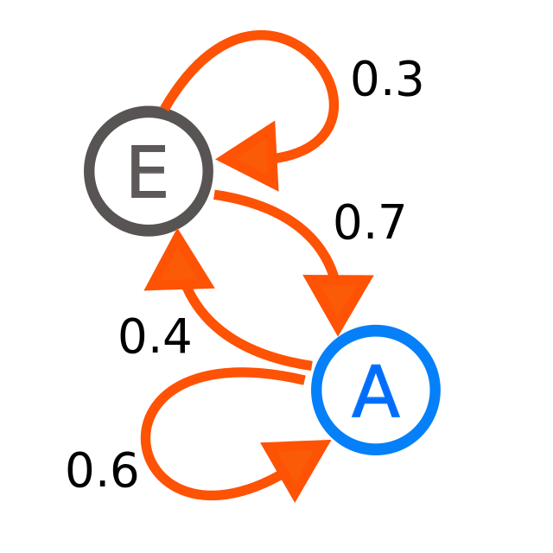
Stochastic Petri nets (SPN)
exponentially distributed r.v. models the time delays in transitions
the reachability graph of a bounded SPN is isomorphic to a finite Markov chain
a reversible SPN generates an ergodic Markov chain
steady-state probability distribution gives performance estimates
probability of a particular condition
expected value of the number of tokens
mean number of firings in unit time
generalized SPN adds immediate transitions to reduce state space

Slide 44
High-level Petri nets (HL PN)
To simplify SPN complexity
A HL net can be unfolded into a regular PN
each place unfolds into a set of places, one for each color of tokens it can hold
each transition unfolds into a set of transitions, one for each way it may fire
They include
predicate/transition nets
colored PN
nets with individual tokens

Slide 45
HL PN
a,a
d,d
a
2
<a,c>
2x
<x,z>
d
<d,b>
2
<a,b>
<b,c>
<d,a>
<x,y>
+<y,z>
e
<a,b>
e
<b,c>
<d,a>

Slide 46
HL PN
logic program
set of Horn clauses
B ← A₁, A₂, ..., A_{n}
where A_{i}‘s and B are atomic formulae
Predicate(arguments)
goal statement = sink transition
assertion of facts = source transition
can be represented by a high-level net
each clause is a transition
each distinct predicate symbol is a place
weights are arguments
sufficient conditions for firing the goal transition

Slide 47
Conclusions
PNs have a rich body of knowledge
PNs are applied successfully to a broad range of problems
analysis and synthesis results are available for subclasses of PNs
there are several extensions of PNs
much work remains to be done

Slide 48
Overall Technical Aims
To understand the basic requirements of real-time systems and how these requirements have influenced the design of real-time programming languages and real-time operating systems
To understand the implementation and analysis techniques which enable these requirements to be realized

Slide 49
Thank You
Real Time Systems Applications

