Slide 1
Real Time Systems Applications
RELIABILITY AND FAULT TOLERANCE
Course Coordinator: Dr. Salama A Mostafa
Address: FSKTM, 4th floor, Room No. 10
Email: salama@uthm.edu.my
Course Code: BIE 33303

Slide 2
Reliability

Slide 3
Reliability
Reliability is the probability of failure-free operation of a computer program for a specified period in a specified environment.
Reliability is a customer-oriented view of software quality. It relates to operation rather than design of the program, and hence it is dynamic rather than static.
The complexity of a system is inversely associated with software reliability, it is directly related to other vital factors in software quality, especially functionality, capability, etc.

Slide 4
Reliability
Reliability is hard to achieve because the complexity of RTS turn to be high. While any system with a high degree of complexity, containing software, will be hard to reach a certain level of reliability, system developers tend to push complexity into the software layer, with the speedy growth of system size and ease of doing so by upgrading the software.
Large next-generation aircraft will have over 1 million source lines of software on-board; next-generation air traffic control systems will contain between one and two million lines; the upcoming International Space Station will have over two million lines on-board and over 10 million lines of ground support software; several significant life-critical defense systems will have over 5 million source lines of software.

Slide 5
Reliability
RTS Major Reliability Issues
Low failure rate
Leads to fault tolerance design
Gracefully degradable

Slide 6
Failures, errors, faults
Fault – defects that cause malfunction
Hardware fault e.g. broken wire, stuck logic
Software fault e.g. bug
Error – unintended state caused by fault. E.g. software bug leads to wrong calculation → wrong output
Failure – errors leads to system failure (operates differently from intended)

Slide 7
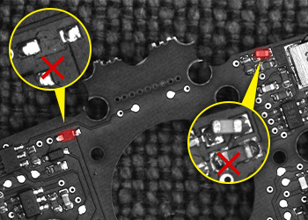
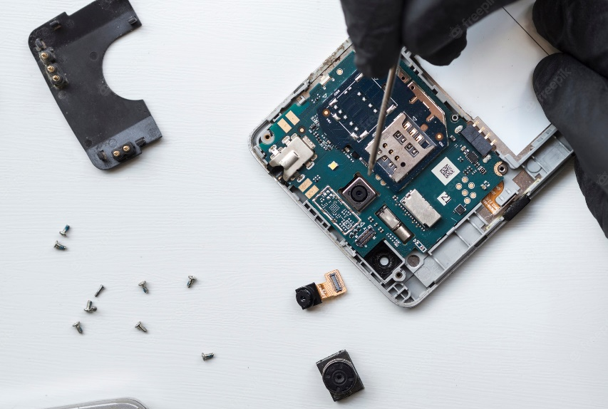
Fault
Component defects
Depends on device
Electronic components can have defects from manufacturing, and wear and tear.

Slide 8
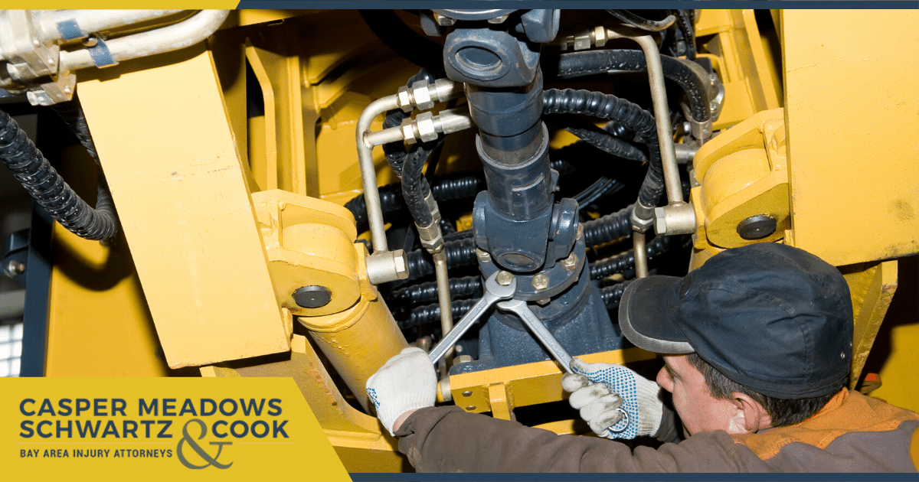
Faults
Operating environment
Stresses
Temperatures
Moisture
Vibration

Slide 9
Classifications of faults
Nature
By chance – broken wire
Intentional – virus
Perception
Physical
Design
Boundary
Internal – component breakdown
External – EMI causes faults

Slide 10
Classifications of faults
Origin
Development e.g. in program or device
Operation e.g. user entering wrong input
Persistence
Transient – glitches caused by lightning
Permanent faults that need repair

Slide 11
Errors
Errors in specification or design
Probably the hardest to detect
Embedded system development:
Specification
Design
Implementation
If specification is wrong, the following steps will be wrong. E.g. unit compatibility of rocket example.

Slide 12
Types of errors
Transient
Regularly occurs. E.g. electrical glitches causes temporary value error
Permanent
Transient fault can be kept in database, making it permanent.

Slide 13
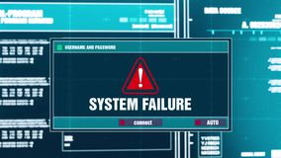
Failures
Failures can occur because of a hardware failure or a severe software issue, causing the system to freeze, reboot, or stop functioning altogether
Causes of Failures
Errors in specification or design
Component defects
Environmental effects

Slide 14
Classification of failures
Nature
Value – incorrect output
Timing – correct output but too late.
Perception – as seen by users
Persistent – all users see same results. E.g. sensor reading stuck at ‘0’
Inconsistent – users see differently. E.g. sensor reading floats (say between 1-3V, and could be seen as ‘1’ or ‘0’).
Called malicious or Byzantine failures

Slide 15
Classification of failures
Effects
Benign – not serious e.g. broken tv
Malign – serious e.g. plane crash
Oftenness
Permanent – broken equipment
Transient – lose wire, processors under stress (EMI, power supply, radiation)
Transient occurs a lot more often!

Slide 16
Example of transient failure
From report on fire control radar of F-16 fighters [3]
Pilot noticed malfunctions every 6 hrs
Pilot requested maintenance every 31 hrs
1/3 of requests can be reproduced in workshop
Overall less than 10% of transient failures can be reproduced!

Slide 17
Definitions
Reliability R(t)
Probability that a system will perform its intended function in the specified environment up to time t.
Maintainability M(t)
Probability that a system can be restored within t units after a failure.
Availability A(t)
Probability that a system is available to perform the specified service at tdt. (% of system working)

Slide 18
Reliability
R(0) = 1, R(∞) = 0.
Failure density f(t) = -dR(t)/dt
Failure rate λ(t) = f(t)/R(t)
λ(t) dt is the conditional probability that a system will fail in the interval dt, provided it has been operational at the beginning of this interval
When λ(t) = constant then R(t) = e^{-λt}
1/ λ = MTTF (Mean Time to Failure)

Slide 19
Failure rate
λ(t)
Late
faillures
Early
faillures
Period of constant Failure Rate
Burn-in
Wear-out
Real-time

Slide 20
Failure rate vs Costs [4]
λ(t)
US Air Force:
Failure rate of electronic systems
within a given technology
increases with increasing system cost.
Cost of System

Slide 21
Maintainability
Measured by Repair-rate μ
When μ(t) = constant then M(t) = e^{-μt}
1/ μ = MTTR (Mean Time to Repair)
Preventive maintenance:
If λ increases in time, then it makes sense to replace the aging unit.
If λ of different units evolves differently, preventive maintenance consists in replacing the “Smallest Replaceable Units” with growing λ.

Slide 22
Reliability vs. Maintainability
Reliability and maintainability are, to a certain extent, conflicting goals.
Example: Connectors
Inside a SRU, reliability must be optimized
Between SRU’s, maintainability is important
Plug
Solder
Reliability
bad
good
Maintainability
good
bad

Slide 23
Availability
A = MTTF / ( MTTF + MTTR )
Good availability can be achieved either
by a high MTTF
by a small MTTR
A high system MTTF can be achieved by means of fault tolerance: the system continues to operate properly even when some components have failed.
Fault tolerance reduces also the MTTR requirements.

Slide 24
Fault Tolerance
Fault tolerance is a process that enables an operating system to respond to a failure in hardware or software
Fault tolerance is obtained through redundancy (more resources assigned to a task than strictly required)
Redundancy can be used for
Fault detection
Fault correction
Redundancy can be implemented at various levels
at component level
at processor level
at system level

Slide 25
Redundancy in components
Error detection
to correct transient errors by retry
to avoid using corrupted data
Error correction
to correct transient errors on the fly
to remain operational after catastrophic component failure
Scheduled maintenance instead of urgent repair.

Slide 26
Fault detection at Processor Level
C
P
U
1
C
P
U
2
=
Error

Slide 27
Fault correction at Processor Level
Voting Logic
C
P
U
1
C
P
U
2
C
P
U
3

Slide 28
Replica Determinism
A set of replicated RT objects is “replica determinate” if all objects of this set visit the same state at about the same time.
“At about the same time” makes a concession to the finite precision of the clock synchronization
Replica determinism is needed for
consistent distributed actions
fault tolerance by active redundancy
Lack of replica determinism makes voting meaningless.
Example: Airplane on takeoff
System 1:
System 2:
System 3:
Majority:
Take off
Abort
Take off
Take off
Accelerate Engine
Stop Engine
Stop Engine (fault)
Stop Engine

Slide 29
Fault Correction at System Level
Hot Stand-By
systems continue to work, uninterrupted,
when one or more of its hardware
components fail.
S
Y
S
T
E
M
1
S
Y
S
T
E
M
2
Error Detection

Slide 30
Fault Correction at System Level
Cold Stand-By
a redundancy of having one
system as a backup for another
identical primary system
S
Y
S
T
E
M
1
S
Y
S
T
E
M
2
Error Detection
Common Memory

Slide 31
Fault Correction at System Level
Distributed Common Memory
Each processor has access to the memory of the other
Each processor keeps a copy of all critical processes
S
Y
S
T
E
M
1
S
Y
S
T
E
M
2
Error Detection
Distributed Common Memory

Slide 32
Fault Correction at System Level
Load Sharing
S
Y
S
T
E
M
1
S
Y
S
T
E
M
1
S
Y
S
T
E
M
1
S
Y
S
T
E
M
1
Common Memory

Slide 33
Safety Critical systems
Fail once, still operational
Fail twice, still safe
Voting Logic
S
Y
S
1
S
Y
S
2
S
Y
S
3
S
Y
S
4

Slide 34
Safety Critical Systems
Space Shuttle Computer system
in case of a Software Bug
Voting Logic
S
Y
S
1
S
Y
S
2
S
Y
S
3
S
Y
S
4
S
Y
S
5

Slide 35
Failure and Damage

Slide 36
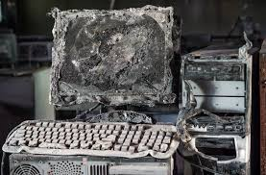
Damage
Physical damage means destruction of devices and other hardware
Damage could be a result from equipment failure, software corruption, sabotage, or occasionally be from human error and could leave the system unable to function.
Failure characterizes lack of functioning sometimes due to damage materials or parts.

Slide 37
Damage Confinement and Assessment
Fault treatment and continued service — an error is a symptom of a fault; although the damage is repaired, the fault may still exist
Damage assessment is closely related to damage confinement techniques used
Damage confinement is concerned with structuring the system so as to minimize the damage caused by a faulty component (also known as firewalling)
Modular decomposition provides static damage confinement; allows data to flow through well-define pathways (assuming strongly type language)
Atomic actions provides dynamic damage confinement. They are used to move the system from one consistent state to another

Slide 38
Thank You
Real Time Systems Applications

