Slide 1

WEEK 5
Neural Networks
for Loan Approval
A quick theory primer before the code deep dive
6 financial inputs → 1 approval probability
Notes:
Timing: 0:00–0:40
Open with the end goal: we are not proving every equation today. We are building enough intuition to understand every major line in the notebook.
Ask: what would you want to know before trusting a model that predicts loan approval?

Slide 2
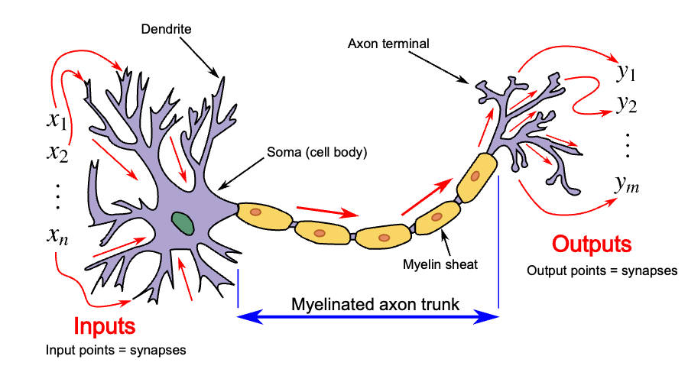
WEEK 5
A biological neuron passes a signal
Dendrites
Receive signals from other neurons
Soma
Combines incoming activity inside the cell body
Axon
Carries the outgoing signal toward other cells
Artificial neurons borrow the idea that many inputs influence one outgoing signal. They do not reproduce a real brain cell.
Diagram: Egm4313.s12, CC BY-SA 4.0, via Wikimedia Commons
02
Notes:
Timing: 0:40–1:55
Trace the direction of information from dendrites through the soma and down the axon.
Keep the analogy modest. Artificial neural networks borrowed vocabulary and a broad input-combine-output idea, but their units are mathematical functions rather than biological cells.
Biology source: https://openstax.org/books/psychology/pages/3-2-cells-of-the-nervous-system
Image source and license: https://commons.wikimedia.org/wiki/File:Neuron3.svg, CC BY-SA 4.0

Slide 3
WEEK 5
The general structure of a neural network
Values move through layers of connected artificial neurons.
Hidden layer
Input layer
Hidden layer
Output layer
raw values
learned combinations
new combinations
scores or predictions
A deeper network adds more hidden layers.
03
Notes:
Timing: 1:55–3:15
Name each layer from left to right. Inputs hold values, hidden neurons learn combinations, and outputs hold scores or predictions.
The lines represent learned connections. Each connection has a weight that changes during training.
Preview the notebook: our model stays small and uses one hidden layer with eight neurons.
Theory source: https://scikit-learn.org/stable/modules/neural_networks_supervised.html

Slide 4
WEEK 5
Start with the prediction task
Annual income
Loan amount
financial capacity
requested principal
Neural network
Approval
Loan term
CIBIL score
Learns patterns across the six inputs
probability
0 to 1
repayment window
credit history signal
Residential assets
Bank assets
declared asset value
declared liquid value
04
Notes:
Timing: 3:15–4:15
Name the six inputs slowly. They are concrete financial fields, which makes the example easier to reason about than raw pixels.
Emphasize that the target is the dataset's historical approval label. Prediction is not the same as a fair or legitimate lending decision.
Source: https://www.kaggle.com/datasets/architsharma01/loan-approval-prediction-dataset

Slide 5
WEEK 5
A neuron asks one weighted question
Every input gets a learned weight
1. Add the evidence
credit score
× positive weight
weighted inputs + bias
loan amount
× negative weight
annual income
× positive weight
2. Pass along a signal
stronger signal = stronger learned evidence
05
Notes:
Timing: 4:15–5:15
Avoid equations unless the room asks. A neuron is a weighted evidence collector: multiply, add, then pass a signal forward.
The signs shown are intuition, not a claim about the fitted model's exact learned weights.

Slide 6
WEEK 5
One hidden layer learns combinations
6 inputs
income
8 hidden neurons
amount
1 output
term
approval
probability
credit
Different neurons can learn different combinations of the same six inputs.
home assets
bank assets
Fully connected means every hidden neuron can use every input.
06
Notes:
Timing: 5:15–6:20
Point from left to right. Six numbers enter, eight small pattern detectors sit in the hidden layer, and one approval probability comes out.
Use the practical example: the same loan amount can mean something different at different income and credit-score levels.

Slide 7
WEEK 5
ReLU gives the network a bend
ReLU keeps positive signals and clips negative ones to zero.
Why it matters
Signal: −1.2
Signal: +2.4
Without an activation, stacked layers collapse into one linear rule.
ReLU lets simple pieces combine into more flexible patterns.
ReLU output: 0
ReLU output: 2.4
negative evidence stops here
positive evidence passes on
07
Notes:
Timing: 6:20–7:20
Demonstrate ReLU with the two numbers. This is the only activation math learners need before the notebook.
Connect back to the task: the network can learn interactions instead of relying on one straight boundary.
Source: https://scikit-learn.org/stable/modules/generated/sklearn.neural_network.MLPClassifier.html

Slide 8
WEEK 5
Training is a repeatable loop
1
2
3
4
Predict
Measure loss
Backpropagate
Update weights
make a first guess
score how wrong it was
trace responsibility backward
take a small improving step
Repeat across many examples until validation performance stops improving.
08
Notes:
Timing: 7:20–8:20
Walk clockwise through the loop. Backpropagation answers which connections contributed to the error. The optimizer then nudges those weights.
Lower the intimidation level: scikit-learn handles derivatives and updates when we call fit().
Source: https://scikit-learn.org/stable/modules/neural_networks_supervised.html

Slide 9
WEEK 5
Scaling keeps inputs on speaking terms
Raw features live on very different numeric scales
Annual income
StandardScaler
income +0.6
8,000,000
centers each feature
and scales its spread
term −0.2
Loan term
10
credit +1.1
CIBIL score
780
Fit the scaler on training data only. Reuse it for validation, test, and new applicants.
09
Notes:
Timing: 8:20–9:15
The numeric examples on the right are illustrative, not values from a specific row. The point is comparable scale, not the exact standardized result.
Stress the train-only rule because fitting the scaler on all data leaks information from the test set.
Source: https://scikit-learn.org/stable/modules/generated/sklearn.preprocessing.StandardScaler.html

Slide 10
WEEK 5
A probability becomes a decision
The network outputs a score between 0 and 1
decision threshold
0
0.50
1
18%
Rejected
54%
Approved
96%
Approved
A 0.50 threshold is a choice. Changing it changes the kinds of mistakes the model makes.
10
Notes:
Timing: 9:15–10:15
Make the distinction explicit: predict_proba returns a score first. The threshold turns that score into a class label.
The three percentages are illustrative. Ask which case deserves more human review: 54 percent is intentionally close to the threshold.

Slide 11
WEEK 5
Strong score, careful interpretation
Held-out test accuracy
96.9%
99.5%
balanced accuracy
ROC-AUC
97.4%
98.1%
approval precision
approval recall
Accuracy scale: 0%–100%
11
Notes:
Timing: 10:15–11:40
Compare the baseline and network first. Then point to balanced accuracy so learners see that class balance was considered.
Do not oversell the result. The source dataset does not clearly document collection process or currency units, and a held-out score does not establish fairness.
Metrics reproduced from notebooks/week-05-neural-networks.ipynb with random_state=42.
Dataset source: https://www.kaggle.com/datasets/architsharma01/loan-approval-prediction-dataset

Slide 12
WEEK 5
Code deep dive: make every step visible
Download
Select six inputs
Split + scale
Train
Evaluate
Edit an applicant
Keep four questions in view
Notebook goal
What enters the model?
What does each setting control?
What evidence supports the score?
What would make this unsafe in real lending?
Run the finished model, then rebuild it one step at a time.
notebooks/week-05-neural-networks.ipynb
12
Notes:
Timing: 11:40–12:30
Transition immediately into the notebook. The first code cell shows the finished result, then the class rebuilds the pipeline step by step.
Invite learners to keep the four questions visible while reading code. They turn implementation details into a model-inspection habit.

