Slide 1

WEEK 1
Foundations, Python, and NumPy
From AI concepts to a first prediction
Notes:
Open by naming the Week 1 deliverable and how students will use the website after class.
Sources: /Users/me/Documents/repos/ai-ml/src/capstone.md; /Users/me/Documents/repos/ai-ml/src/intro/whatisai.md; /Users/me/Documents/repos/ai-ml/src/intro/numpy.md; /Users/me/Documents/repos/ai-ml/notebooks/week-01-array-explorer.ipynb

Slide 2
WEEK 1
Where this semester is going
Build the confidence to turn an idea into a small, understandable machine-learning project.
Our goals
Capstone destination
Read and change Python without fear
Use data to train and test simple models
Explain what a model predicts and why the result matters
Weeks 8–10
Prepare the data, build a model, inspect the results, and share a project that another person can run and understand.
02
Notes:
Frame the capstone as a destination, not a test. Students will reuse the same prepare, build, inspect, and explain habits throughout the semester.
Sources: /Users/me/Documents/repos/ai-ml/src/capstone.md; /Users/me/Documents/repos/ai-ml/index.md

Slide 3


WEEK 1
Stay connected
Course contact
Discord and course hub
John Girgis
Email: jlg62@njit.edu]
Office hours: FMH104 (IEEE Lounge), M/W 4:00-5:30
Clem Eze
Email: cce24@njit.edu
Discord
Website: astarryknight.github.io/ai-ml
03
Notes:
Replace every bracketed field with the current course contact details and Discord invitation before presenting.
Sources: /Users/me/Documents/repos/ai-ml/index.md

Slide 4
WEEK 1
Today’s finish line
By the end of the session, every student should have:
A plain-language distinction between AI and machine learning
A NumPy array, summary statistics, and one Boolean mask
A labeled graph plus two observations
A first song-mood prediction from a scikit-learn model
04
Notes:
Use this slide to set expectations and point students to the same finish line on the website.
Sources: /Users/me/Documents/repos/ai-ml/index.md; /Users/me/Documents/repos/ai-ml/notebooks/week-01-array-explorer.ipynb

Slide 5
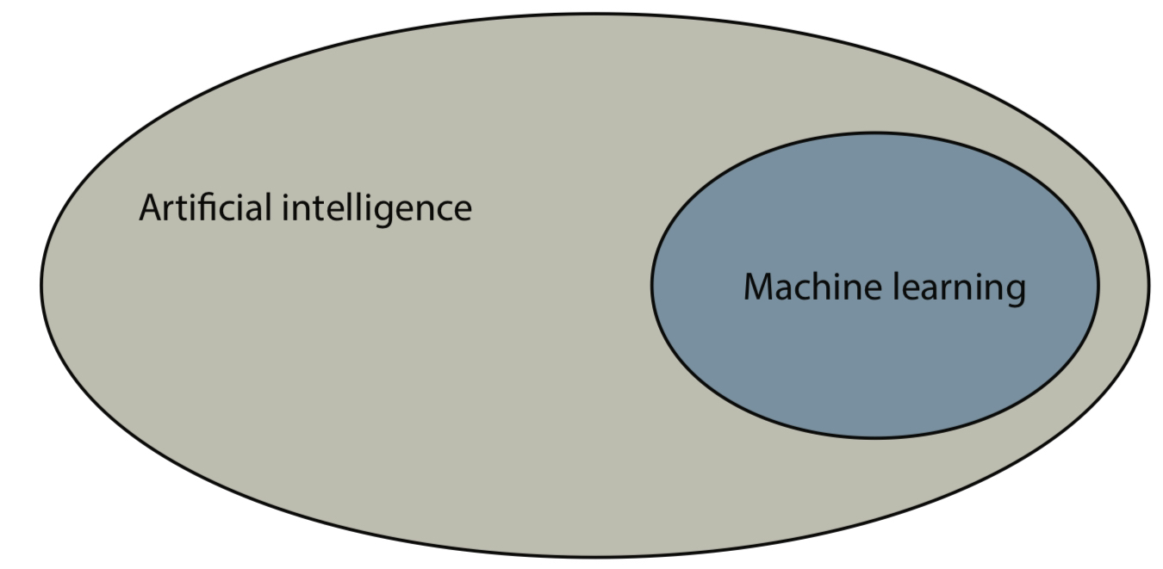
WEEK 1
AI and machine learning
Artificial intelligence
Systems that perform tasks associated with intelligent behavior.
Machine learning
Methods that learn patterns from examples instead of relying only on hand-written rules.
05
Notes:
Ask for one familiar AI system, then ask what data it might learn from.
Sources: /Users/me/Documents/repos/ai-ml/src/intro/whatisai.md; /Users/me/Documents/repos/ai-ml/src/res/ai_ml_diag.png

Slide 6
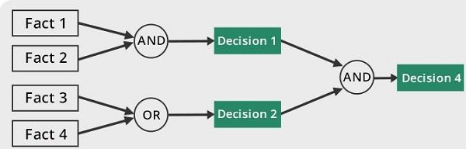
WEEK 1
Rule-based and data-driven systems
Data-driven
Examples replace many hand-written conditions
Training finds a pattern that supports prediction
Representative data and evaluation determine reliability
Rule-based
People write explicit conditions. The logic stays clear when rules are stable.
Where would an explicit rule be safer or easier to explain?
06
Notes:
Use a parking rule as the explicit-rule example and spam filtering as the learned-pattern example.
Sources: /Users/me/Documents/repos/ai-ml/src/intro/whatisai.md; /Users/me/Documents/repos/ai-ml/src/res/symbolic_ai.png

Slide 7
WEEK 1
Three common machine-learning problems
Regression
Classification
Clustering
Predict a number
Example: delivery time
Predict a category
Example: spam or not spam
Group similar examples
Example: songs with similar audio features
Which problem type fits predicting tomorrow’s temperature?
07
Notes:
Let students classify two additional examples before revealing the answer.
Sources: /Users/me/Documents/repos/ai-ml/src/intro/whatisai.md

Slide 8
WEEK 1
K-nearest neighbors
A new song gets the label used by most of its closest examples.
The gold point is the new song. With three neighbors, the model predicts energetic.
Class question: What could change if we move the gold point?
08
Notes:
Describe the method as a local vote. The slide shows every song in the tiny training set, so students can predict the result before running the code.
Sources: /Users/me/Documents/repos/ai-ml/notebooks/week-01-array-explorer.ipynb

Slide 9
WEEK 1
Python starts with names and values
song_name = "Ocean Eyes"
energy = 3
print(song_name)
print(energy)
A variable is a name for a value.
Quotes mark text
Numbers can be used in calculations
print lets us see a result
Quick check: What will Python print?
09
Notes:
Read the code from top to bottom. Ask students to predict both printed lines before revealing the output.
Sources: /Users/me/Documents/repos/ai-ml/notebooks/week-01-array-explorer.ipynb

Slide 10
WEEK 1
Lists and dictionaries organize data
song = {
"name": "Ocean Eyes",
"scores": [2, 3],
"mood": "chill"
}
print(song["mood"])
Dictionary
Connects a label such as mood to its value.
List
Keeps values in order. Here, [2, 3] means danceability 2 and energy 3.
10
Notes:
Point out the visual pairing between names and values. This is the same idea used by the notebook's song dictionary.
Sources: /Users/me/Documents/repos/ai-ml/notebooks/week-01-array-explorer.ipynb

Slide 11
WEEK 1
A loop repeats one small step
for
for name, details in songs.items():
print(name, details["energy"])
Run the indented line once for every song.
Indentation
The spaces show which code belongs inside the loop.
Next, NumPy collects those repeated numbers into one array.
11
Notes:
Focus on the repeated action rather than syntax details. The following NumPy slide shows why collecting the numbers is useful.
Sources: /Users/me/Documents/repos/ai-ml/notebooks/week-01-array-explorer.ipynb

Slide 12
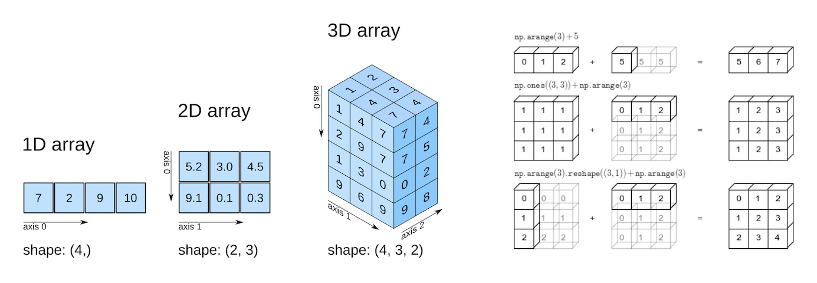
WEEK 1
NumPy arrays organize numeric data
An array has a shape, a data type, and one or more axes.
Shape describes the size along each axis
A data type controls how values are stored
Vectorized operations apply work across many values
12
Notes:
Have students predict the shape before running the notebook cell.
Sources: /Users/me/Documents/repos/ai-ml/src/intro/numpy.md; /Users/me/Documents/repos/ai-ml/src/res/numpy_arr_axis.png

Slide 13
WEEK 1
Boolean masks filter matching values
scores = np.array([52, 57, 63, 68, 74, 79])
mask = scores >= 70
print(mask)
print(scores[mask])
Output
[False False False False True True]
[74 79]
Pair task: change the condition to select scores below 65.
13
Notes:
Pause after the mask prints. Ask why the mask must have the same length as the source array.
Sources: /Users/me/Documents/repos/ai-ml/src/intro/numpy.md; /Users/me/Documents/repos/ai-ml/notebooks/week-01-array-explorer.ipynb

Slide 14
WEEK 1
Three model lines make a prediction
model = KNeighborsClassifier(n_neighbors=3)
model.fit(songs, moods)
model.predict([[6, 7]])
Prediction
energetic
The library handles the distance calculations. You provide examples and ask a question.
14
Notes:
Live-code the three model lines after showing the song and mood arrays. Emphasize that students already understand the data. The library handles the model machinery.
Sources: /Users/me/Documents/repos/ai-ml/notebooks/week-01-array-explorer.ipynb

Slide 15
WEEK 1
Exit ticket and take-home
Before leaving
Take-home
Define AI and machine learning in one sentence each
Explain what the shape (2, 3) means
Describe why nearby examples can guide a song-mood prediction
Finish the Array Explorer notebook. Submit the graph and reflection. Include the song prediction as a bonus result.
Notebook: notebooks/week-01-array-explorer.ipynb
15
Notes:
Collect the checkpoint before students leave. Remind absent students that the notebook includes the same validation cell.
Sources: /Users/me/Documents/repos/ai-ml/src/assessments/checkpoints.md; /Users/me/Documents/repos/ai-ml/notebooks/week-01-array-explorer.ipynb

Slide 16
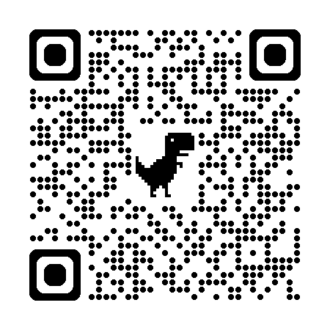
WEEK 1
Attendance!
15
Notes:
Collect the checkpoint before students leave. Remind absent students that the notebook includes the same validation cell.
Sources: /Users/me/Documents/repos/ai-ml/src/assessments/checkpoints.md; /Users/me/Documents/repos/ai-ml/notebooks/week-01-array-explorer.ipynb

