Slide 1
WEEK 2
Linear Regression and Optimization
A baseline, a fitted line, and an honest comparison
Notes:
Open by naming the Week 2 deliverable and how students will use the website after class.
Sources: /Users/me/Documents/repos/ai-ml/src/pathway.md; /Users/me/Documents/repos/ai-ml/src/theory/intro_ml.md; /Users/me/Documents/repos/ai-ml/src/theory/grad_desc.md

Slide 2
WEEK 2
Today’s finish line
Students leave with a complete comparison, not only a fitted model.
Identify the feature and numeric target
Split data before fitting
Measure a mean baseline with MAE and RMSE
Fit linear regression and explain the improvement
Suggested pacing: 25 minutes concepts, 60 minutes notebook, 15 minutes checkpoint
02
Notes:
Frame the session around model comparison so students do not treat training as the finish line.
Sources: /Users/me/Documents/repos/ai-ml/src/pathway.md; /Users/me/Documents/repos/ai-ml/notebooks/week-02-regression-baseline.ipynb

Slide 3
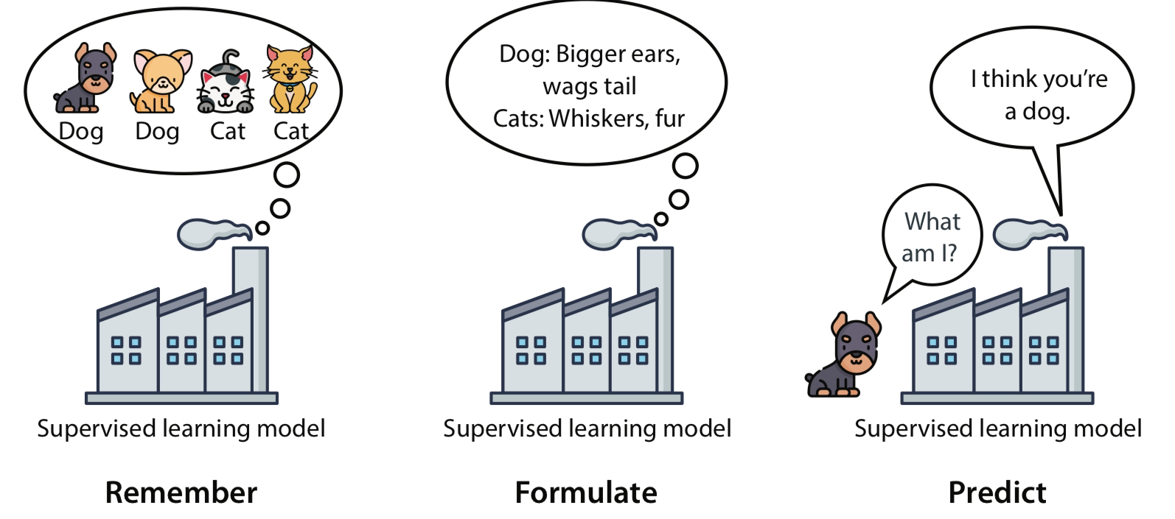
WEEK 2
The practical machine-learning workflow
Inspect the data and define the target
Split training and test examples
Fit a baseline, then a model
Evaluate on examples the model did not train on
03
Notes:
Connect the site’s three-step illustration to the more rigorous split, train, evaluate loop used in the notebook.
Sources: /Users/me/Documents/repos/ai-ml/src/theory/intro_ml.md; /Users/me/Documents/repos/ai-ml/src/res/3_step.png

Slide 4
WEEK 2
Features and numeric targets
Feature
Target
Input used to make a prediction
Example: practice hours per week
The value the model tries to predict
Example: assessment score
Pair check: Which column would be the target when predicting apartment rent?
04
Notes:
Ask students to name one feature that might help predict apartment rent and one feature that could leak the answer.
Sources: /Users/me/Documents/repos/ai-ml/src/theory/intro_ml.md; /Users/me/Documents/repos/ai-ml/notebooks/week-02-regression-baseline.ipynb

Slide 5
WEEK 2
A baseline sets the minimum comparison
Mean baseline
Baseline prediction
Predict the training-set mean for every new example.
65.5
A more complex model earns its place only when it improves on a simple reference.
The same value for every row
05
Notes:
Use the class data mean as the baseline prediction, then ask why the prediction ignores practice hours.
Sources: /Users/me/Documents/repos/ai-ml/notebooks/week-02-regression-baseline.ipynb

Slide 6
WEEK 2
MAE makes the model comparison concrete
MAE is the average absolute prediction error.
On this notebook’s fixed split, linear regression reduces MAE by 8.40 score points.
06
Notes:
The values come from the deterministic Week 2 notebook. Lower MAE indicates smaller average errors.
Sources: /Users/me/Documents/repos/ai-ml/notebooks/week-02-regression-baseline.ipynb

Slide 7
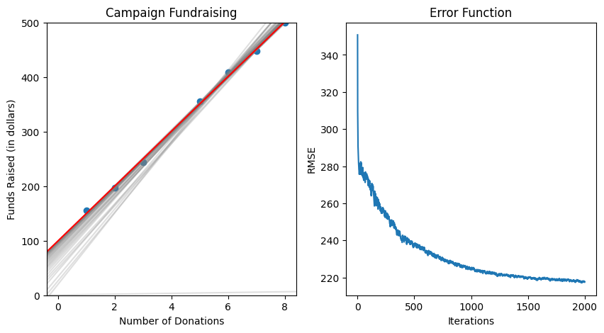
WEEK 2
Linear regression fits a line to the pattern
Prediction
ŷ = b + wx
b sets the intercept
w sets the slope
x is the feature value
07
Notes:
Keep the math brief. Ask students to interpret the slope in the context of their practice-hours dataset.
Sources: /Users/me/Documents/repos/ai-ml/src/theory/grad_desc.md; /Users/me/Documents/repos/ai-ml/src/res/campaign_lin_reg.png

Slide 8
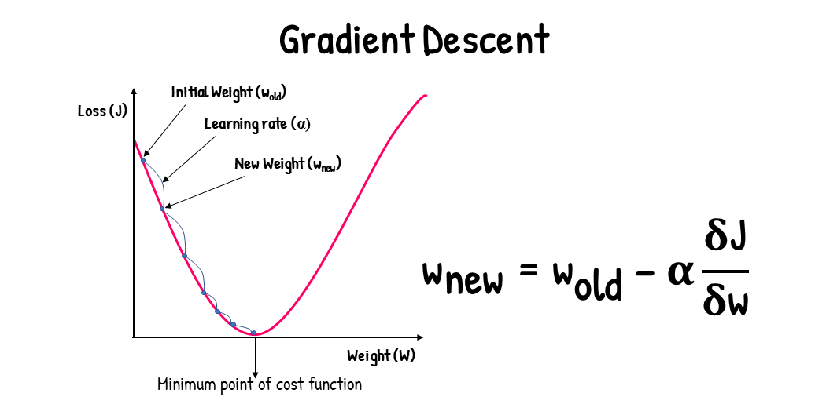
WEEK 2
Gradient descent searches for lower loss
One update at a time
Calculate how the current parameters affect loss
Move parameters in the direction that lowers loss
Repeat until improvement becomes small or training stops
08
Notes:
Treat gradient descent as optimization intuition. Students do not need to derive the gradient in this session.
Sources: /Users/me/Documents/repos/ai-ml/src/theory/grad_desc.md; /Users/me/Documents/repos/ai-ml/src/res/grad_desc_vis.png

Slide 9
WEEK 2
Notebook activity
Create data
Split
Mean baseline
Linear model
Compare MAE
Extension: double the noise and explain how the metrics and fitted line change.
Notebook: notebooks/week-02-regression-baseline.ipynb
09
Notes:
Circulate during the baseline step. Students often skip directly to the model without recording the reference metric.
Sources: /Users/me/Documents/repos/ai-ml/notebooks/week-02-regression-baseline.ipynb

Slide 10
WEEK 2
Exit ticket and take-home
Checkpoint
Take-home
What is the difference between a feature and a target?
What does a loss value measure?
What does the learning rate control?
Submit the baseline and model metrics, both plots, and a short explanation of which model you would use.
10
Notes:
Require the baseline and model results in the submission so the comparison remains visible.
Sources: /Users/me/Documents/repos/ai-ml/src/assessments/checkpoints.md; /Users/me/Documents/repos/ai-ml/notebooks/week-02-regression-baseline.ipynb

