Slide 2
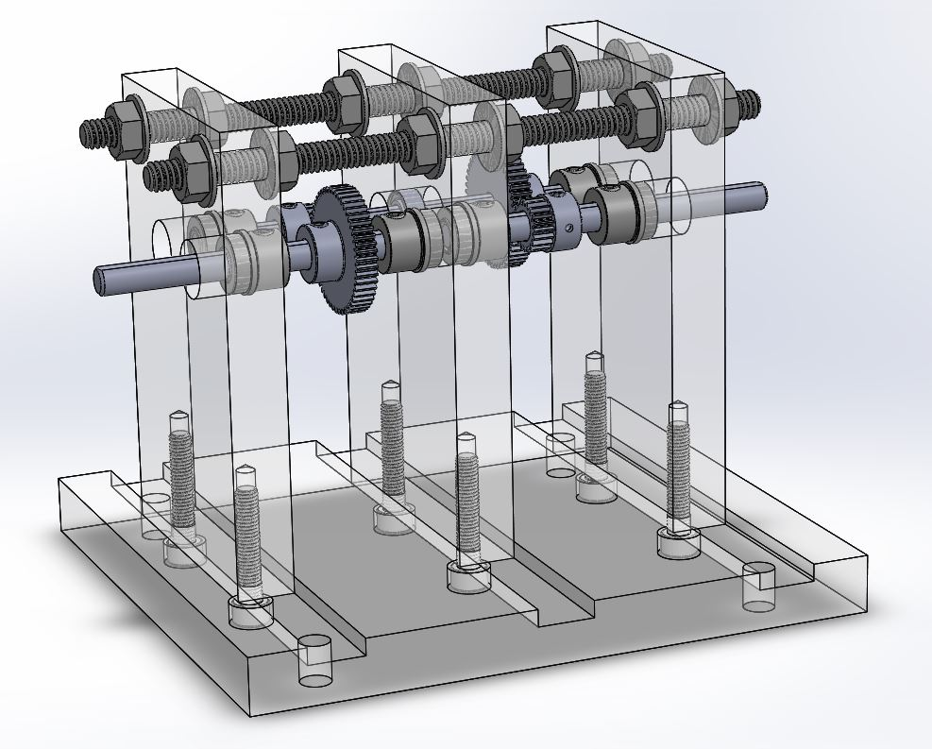
Overall design
Two stage inline drive
Three axles using spur gears – most simple, cheap design, allows higher quality parts
2.5 reduction at each gear interface = 6.25 overall gear ratio
Minimise size

Slide 3
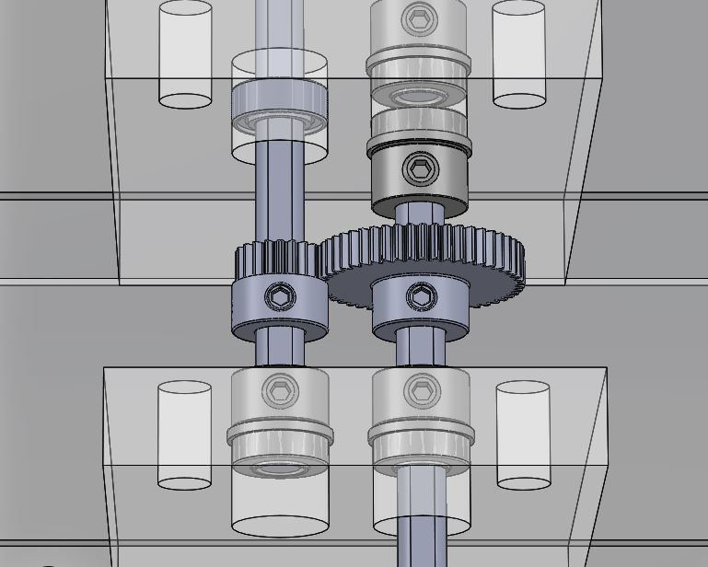
Gears
Gears: 20 teeth to 50 teeth for 2.5 ratio
Small gears instead of big – less inertia
48 diametral pitch instead of lower values – more teeth for better meshing
Aluminium instead of plastic/steel – stronger than plastic, able to machine if needed
Set screw hub cap for D shaft – easily adjustable, strong
20 degree pressure angle – only size available. Would have preferred 14.5 for better meshing.
Wide face width (0.1875) – more contact area

Slide 4
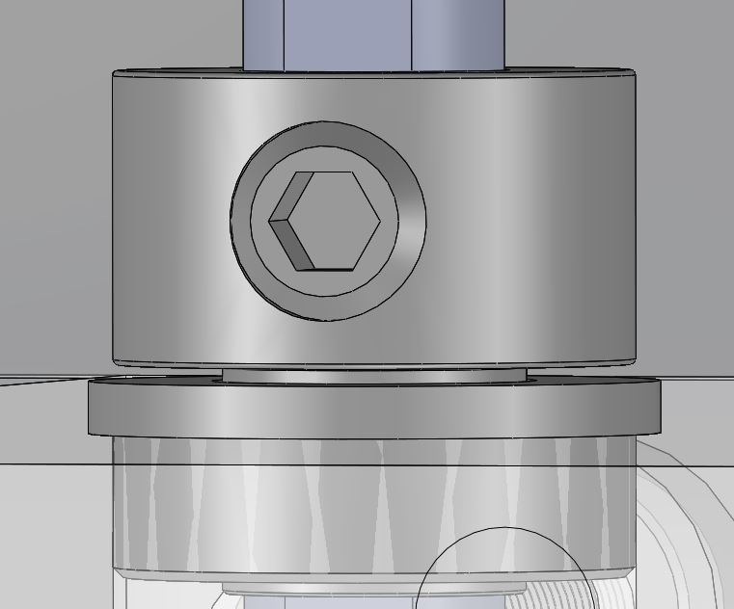
Bearings / Collars
Steel Ball Bearings for better efficiency / lower friction than bushings
Flanged instead of unflanged - so shaft/bearings are constrained
Set screw collars instead of – easy adjustment on D shaft, cheap
Smallest OD of ½ inch – fits press fit reamer in shop
Extended inner race – collars only contact inner rotating part of bearing. Minimizes friction.
Initially wanted bearings with set screw collars – too expensive

Slide 5
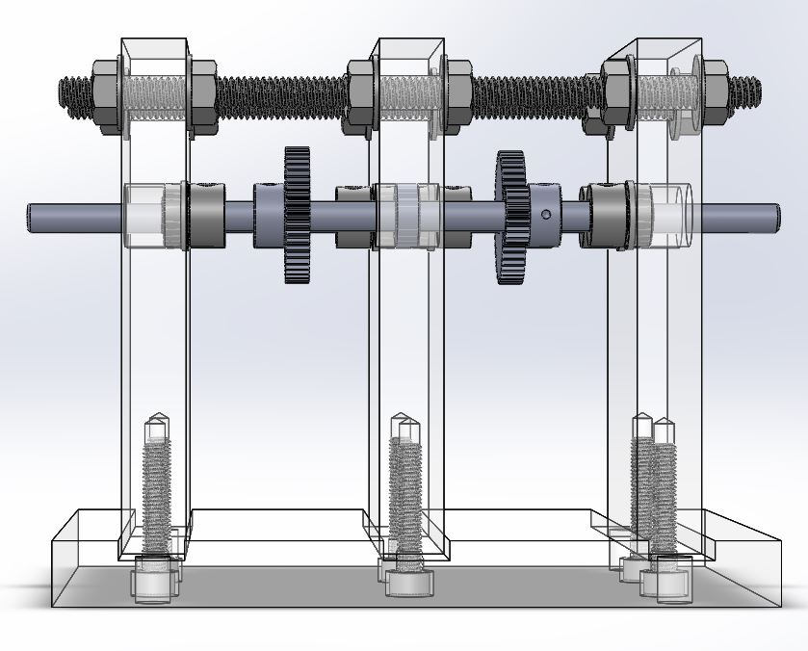
Supports
Machined slots at bottom for close, flat fit
10-32 set screws
Using threaded rod and nuts for top support – allows for tighter shaft constraining
Flange nut to spread out pressure more
Shaft steel – more rigid than other materials. ¼ inch as most popular bore size for gears.

