Slide 2
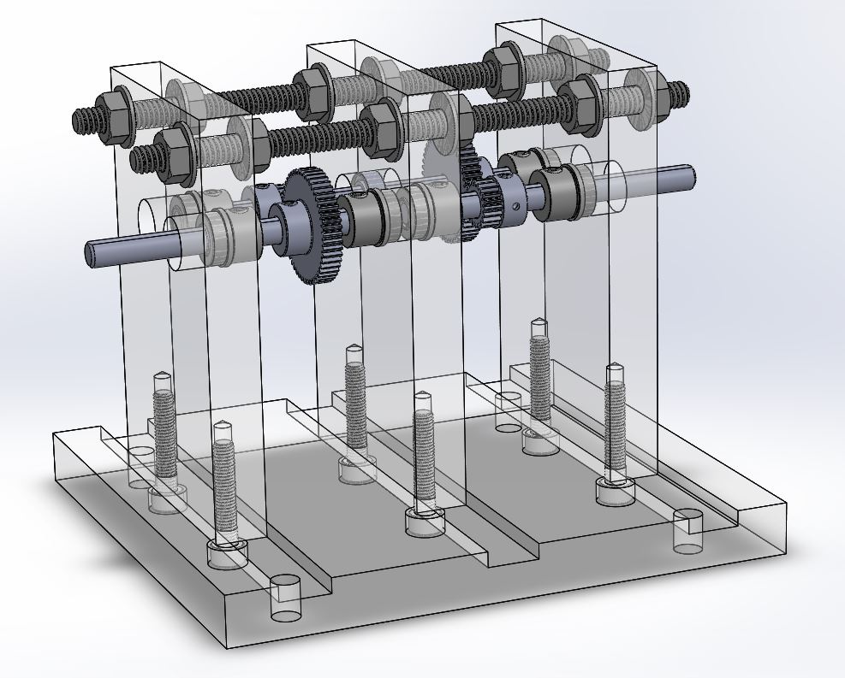
Overall design
Two stage inline drive
Three axles using spur gears – most simple, cheap design
2.5 reduction at each gear interface = 6.25 overall gear ratio
Minimise size

Slide 3
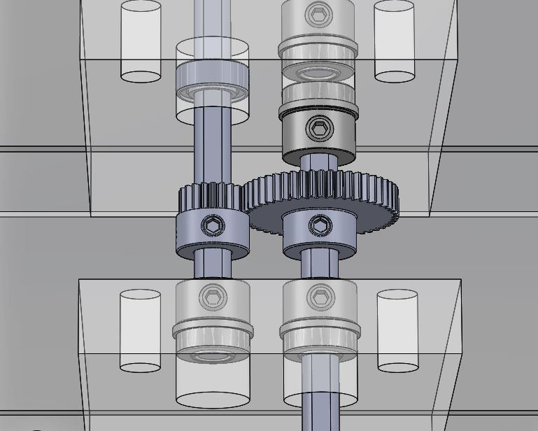
Gears
Gears: 20 teeth to 50 teeth for 2.5 ratio
48 diametral pitch – more teeth for better meshing
Aluminium – stronger than plastic, able to machine
Set screw hub cap for D shaft – easily adjustable, strong
Small gears – less inertia
20 degree pressure angle – moderate, most common
Wide face width (0.1875) – more contact area

Slide 4
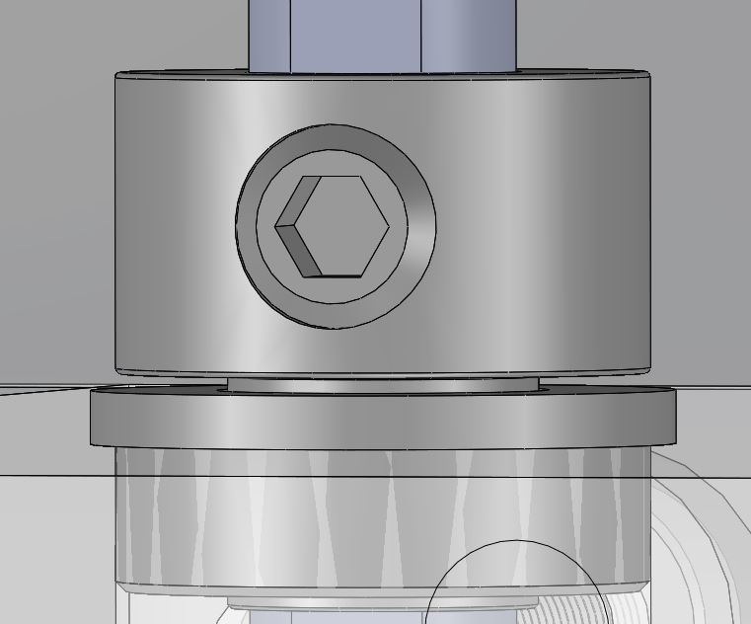
Bearings / Collars
Steel Ball Bearings for better efficiency / lower friction
Flanged so shaft/bearings are constrained
Set screw collars – easy adjustment on D shaft
Smallest OD of ½ inch – fits press fit reamer in shop
Extended inner race – collars only contact inner rotating part of bearing. Minimizes friction.

Slide 5
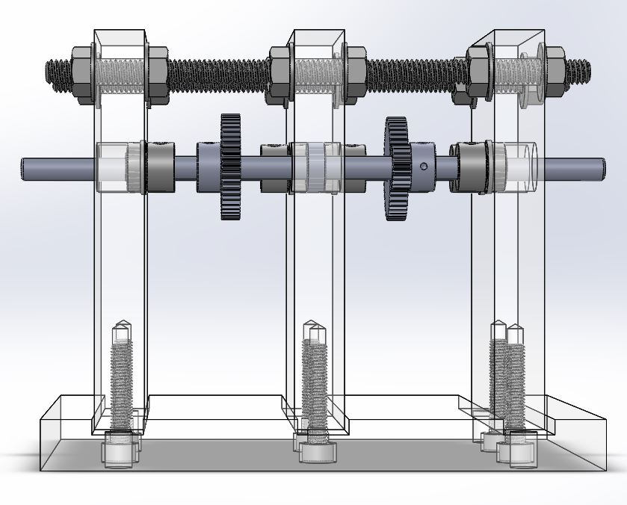
Supports
Machined slots at bottom for close, flat fit
Using threaded rod and nuts for top support – allows for tighter shaft constraining
Flange nut to spread out pressure more

