Slide 1
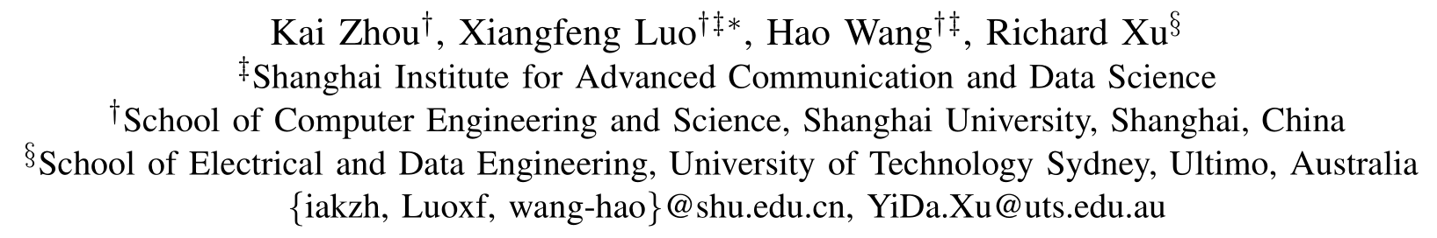
Multi-Task Learning for Relation Extraction

Slide 2
Relation Extraction
Definition: RE aims to extract relations between pairs of marked entities in raw texts.
Example: Shanghai University was established in Shanghai in 1922.
Extracted relation triples:
(Shanghai University, Founding-year, 1922)
(Shanghai University, Founding-location, Shanghai)
Applications: Question answering, Web search, Knowledge Base Population...

Slide 3

Distantly-Supervised Relation Extraction
Definition
Train a relation classifier using:
knowledge bases (e.g., Freebase, or the structured information in Wikipedia info-boxes) with a lot of relation triples
unstructured text containing entities
Feature
DSRE is an alternative paradigm combining advantages of both the supervised and unsupervised approaches:
using a probabilistic classifier
large amount of training data
“Any sentence that contains a pair of entities that participate in a known Freebase relationship is likely to express that relation in some way.”
Figure 1 : Wikipedia info-box about Shanghai University
Notes:
Train a relation classifier by automatically aligning relation instances in a knowledge base (e.g., Freebase, or the structured information in Wikipedia info-boxes) with unstructured text.
DSRE is an alternative paradigm combining advantages of both the supervised (using a probabilistic classifier) and unsupervised approaches (large amount of training data).

Slide 4
Wrong labeling problem
The distant supervision assumption might lead to wrong labels in the following situations:
Does
Entities have multiple valid relations in KG
Trump is the President of United States.
Trump was born in United States.
Empty relation between entities in KG.
About 80 percent of sentences in the common used dataset Riedel2010.
Fit
In
Distant Supervision ?
Notes:
Problem 1: since there can be multiple valid relations for the same entity pair, the relation between the entities expressed in the sentence may differ from the relation label from the knowledge base;
Problem 2: due to the incompleteness of knowledge bases, the relations between many entities are vacant. Thus, a majority of sentences are labeled with NA (about 80 percent of
instances in Riedel2010 dataset), which is a specific class for no relation between the entities.

Slide 5
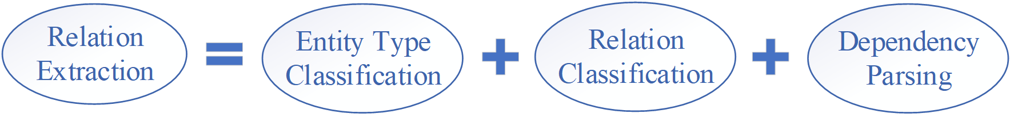
Motivations
Semantic and syntactic information like dependency paths and entity types have been found helpful for RE [Mintz et al. 2009] [Zhang et al., 2018] [Vashishth et al., 2018].
Employing an related task like entity type classification [Liu et al., 2018] in pre-training may improve model’s robustness against noisy relation labels in the training procedure.
So, we propose a novel hierarchical model in a multi-task learning fashion for relation extraction. We choose dependency parsing and entity type classification as auxiliary tasks.
Notes:
Dependency parsing can handle crucial structural information between the entities and other words in the context, implying the important relational words that interact with entities.
Entity type classification can capture contextualized entity representation, which puts a soft constraint on the type of relationship it involves in. For instance, the relation “/business/founders” can only exist between a “/person” and a “/organization”.

Slide 6
Our methodology
(1)Multi-task Learning Framework
Target Task:
Relation Extraction
Auxiliary Task:
① Entity Type Classification
② Dependency Parsing

Slide 7
Our methodology
(2)Neural Network Model
Pre-training (simultaneously):
Dependency Parsing
Entity Type Classification
Training (simultaneously):
Dependency Parsing
Entity Type Classification
Relation Extraction
Testing:
Relation Extraction
(a) Dependency parsing ;(b)Entity type classification

Slide 8
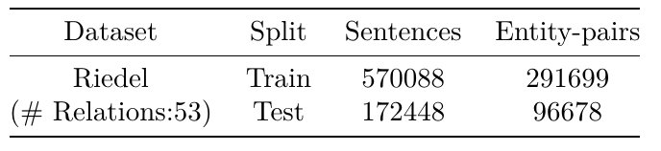
Experiments and Results
Dataset : Riedel NYT [Riedel et al., 2010]
Contain text from the New York Times Annotated Corpus with named entities extracted from the text using the Stanford NER system and automatically linked to entities in the Freebase knowledge base. Pairs of named entities are labelled with relationship types by aligning them against facts in the Freebase knowledge base (distant supervision) .
We employ Natural Language Toolkit (NLTK) [Steven Bird et al., 2009] to label sentences’ dependency arcs.
We label the entity types using the Fine-Grained Entity Recognizer (FIGER) [Xiao Ling and Daniel S. Weld, 2012] .
Table 1: Details of dataset used.

Slide 9
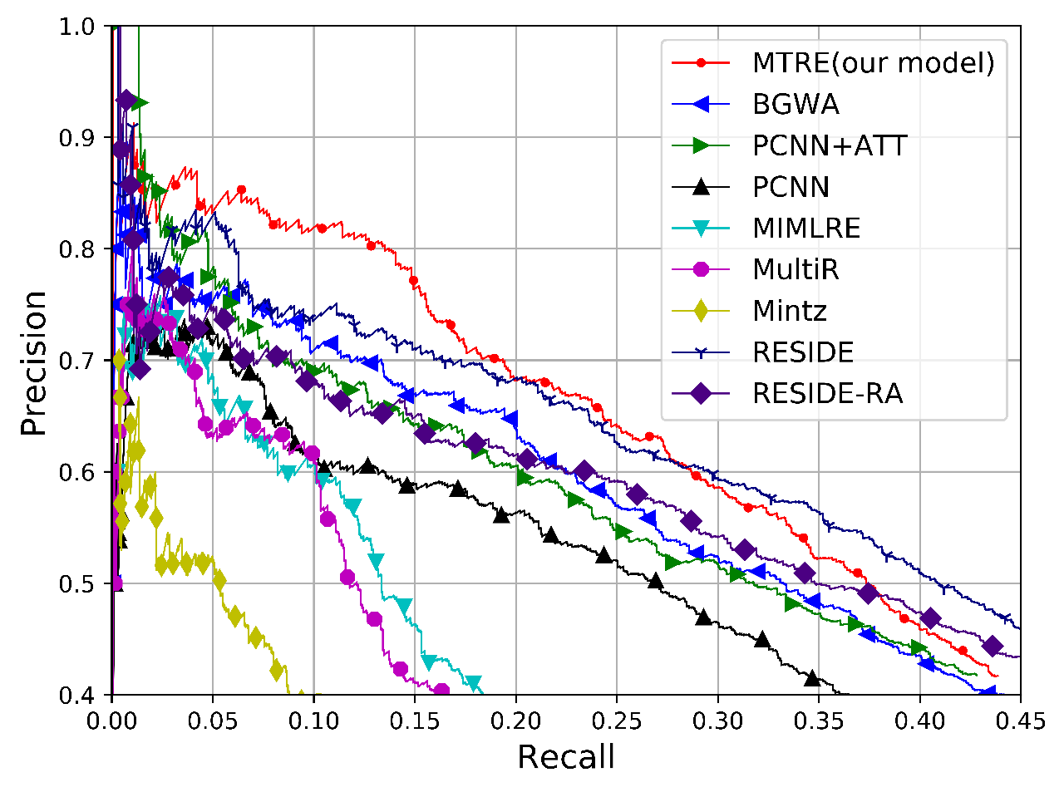
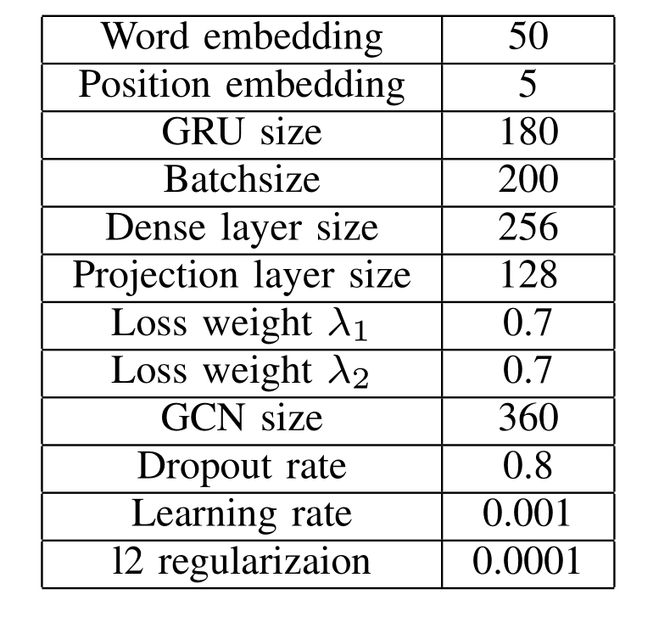
Experiments and Results
Figure 2: Comparison of Precision-recall curve.
Table 2: Details of hyperparameters used.

Slide 10
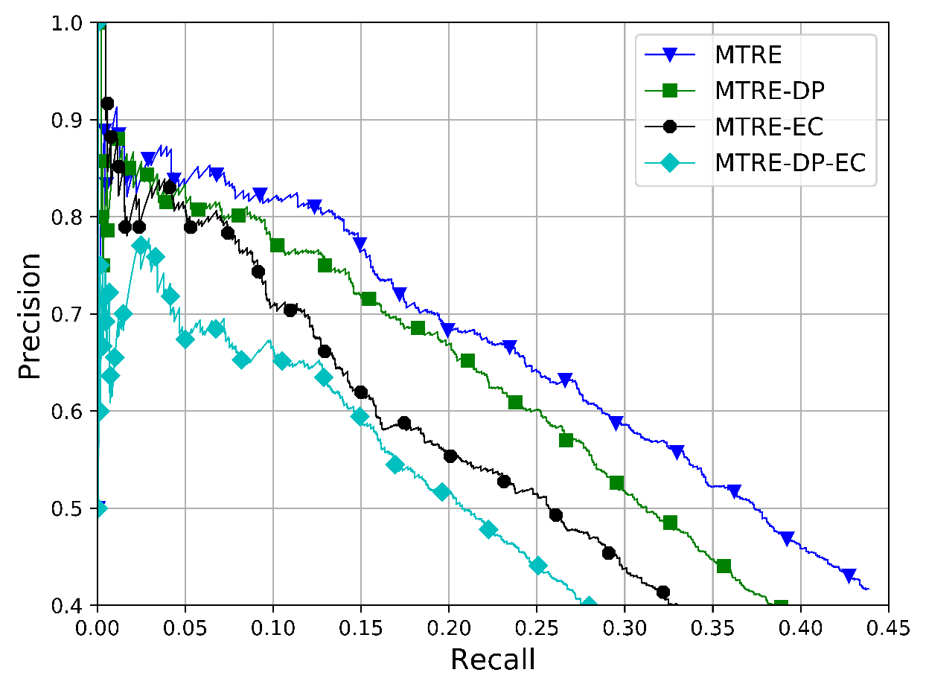
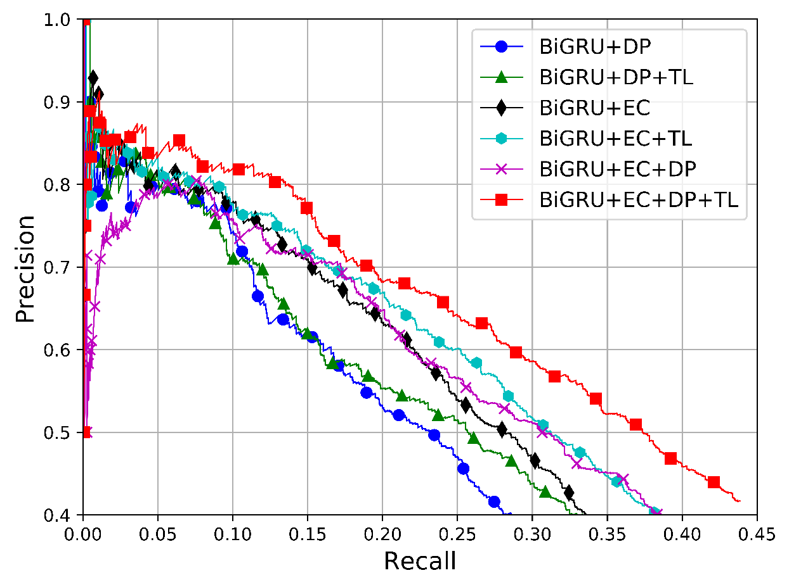
Ablation Study
Figure 3: Comparison of different sub-models w/o auxiliary tasks.
Figure 4: Comparison of different sub-models w/o pretraining.

Slide 11
Conclusion
Under the multi-task learning framework, we effectively take advantage of related tasks to improve the precision in relation extraction. Leverage supervised signals from related tasks as prior knowledge makes our model more robust against noisy relation labels generated from distant supervision.
In the future, we would explore more kinds of practical auxiliary tasks and optimization techniques between them because different tasks might conflict with each other and undermine the overall performance.

Slide 12
Thank you for your listening!
Author Email: iakzh@shu.edu.cn

Slide 13
Reference
M. Mintz, S. Bills, R. Snow, and D. Jurafsky, “Distant supervision for relation extraction without labeled data,” in Proceedings of the Joint Conference of the 47th Annual Meeting of the ACL and the 4th International Joint Conference on Natural Language Processing of the AFNLP: Volume 2-Volume 2. Association for Computational Linguistics, 2009, pp. 1003–1011.
Y. Zhang, P. Qi, and C. D. Manning, “Graph convolution over pruned dependency trees improves relation extraction,” in Proceedings of the 2018 Conference on Empirical Methods in Natural Language Processing, 2018, pp. 2205–2215.
S. Vashishth, R. Joshi, S. S. Prayaga, C. Bhattacharyya, and P. Talukdar, “Reside: Improving distantly-supervised neural relation extraction using side information,” arXiv preprint arXiv:1812.04361, 2018.
T. Liu, X. Zhang, W. Zhou, and W. Jia, “Neural relation extraction via inner-sentence noise reduction and transfer learning,” in EMNLP, 2018.
S. Riedel, L. Yao, and A. McCallum, “Modeling relations and their mentions without labeled text,” in Joint European Conference on Machine Learning and Knowledge Discovery in Databases. Springer, 2010, pp.148–163.
Xiao Ling and Daniel S. Weld."Fine-Grained Entity Recognition",in Proceedings of the twenty-sixth aaai conference on artificial intelligence (AAAI), 2012.
Steven Bird, Ewan Klein, and Edward Loper (2009). Natural Language Processing with Python. O’Reilly Media Inc

