Slide 1


JOIN
JOIN
JOIN
1
2
3
release
mb_album
artist_credit
release_country
medium
release_unkcountry

Slide 2
JOIN
JOIN
1
2
track
mb_song
recording
isrc

Slide 3
JOIN
FILTER
1
2
mb_album
mb_song
mb_song

Slide 4
mb_song
mb_album
1
JOIN
2
FILTER
mb_db

Slide 5
TRACK URI >
ARTIST URI
ARTIST URI > ARTIST INFO
spotify_artist
ISRC >
TRACK URI
TRACK URI > AUDIO FEATS
spotify_track

Slide 6
MBID > ALBUM INFO
ALBUM INFO >
SONG PLAYS
lastfm_song

Slide 7
MEGA JOIN
mb_db
working_data
spotify_artist
spotify_track
lastfm_song

Slide 8
Model Evaluation - Predictive Power
Data Collection & Merging
EDA & Data Preparation
Model Selection
Model Evaluation – Feature Importance
Predictive

Slide 9
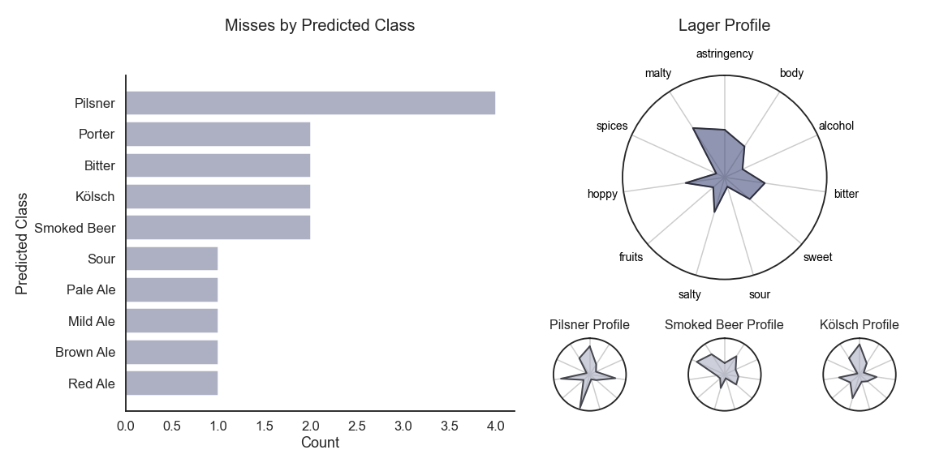

Slide 10
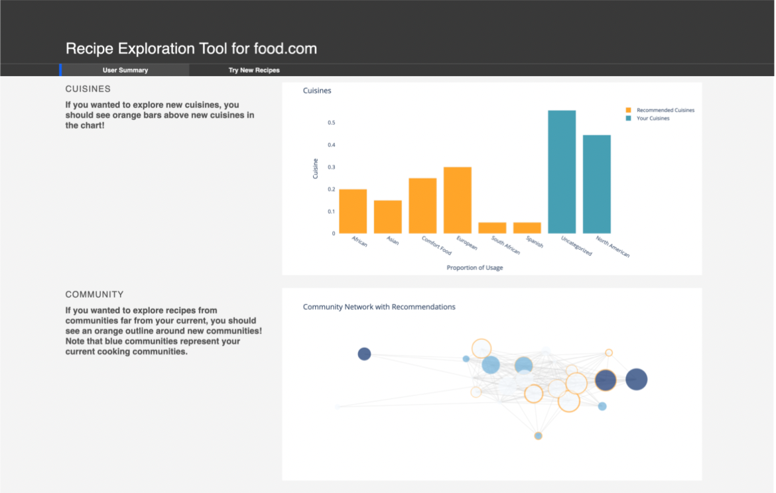
screenshot_p1s4.png

Slide 11
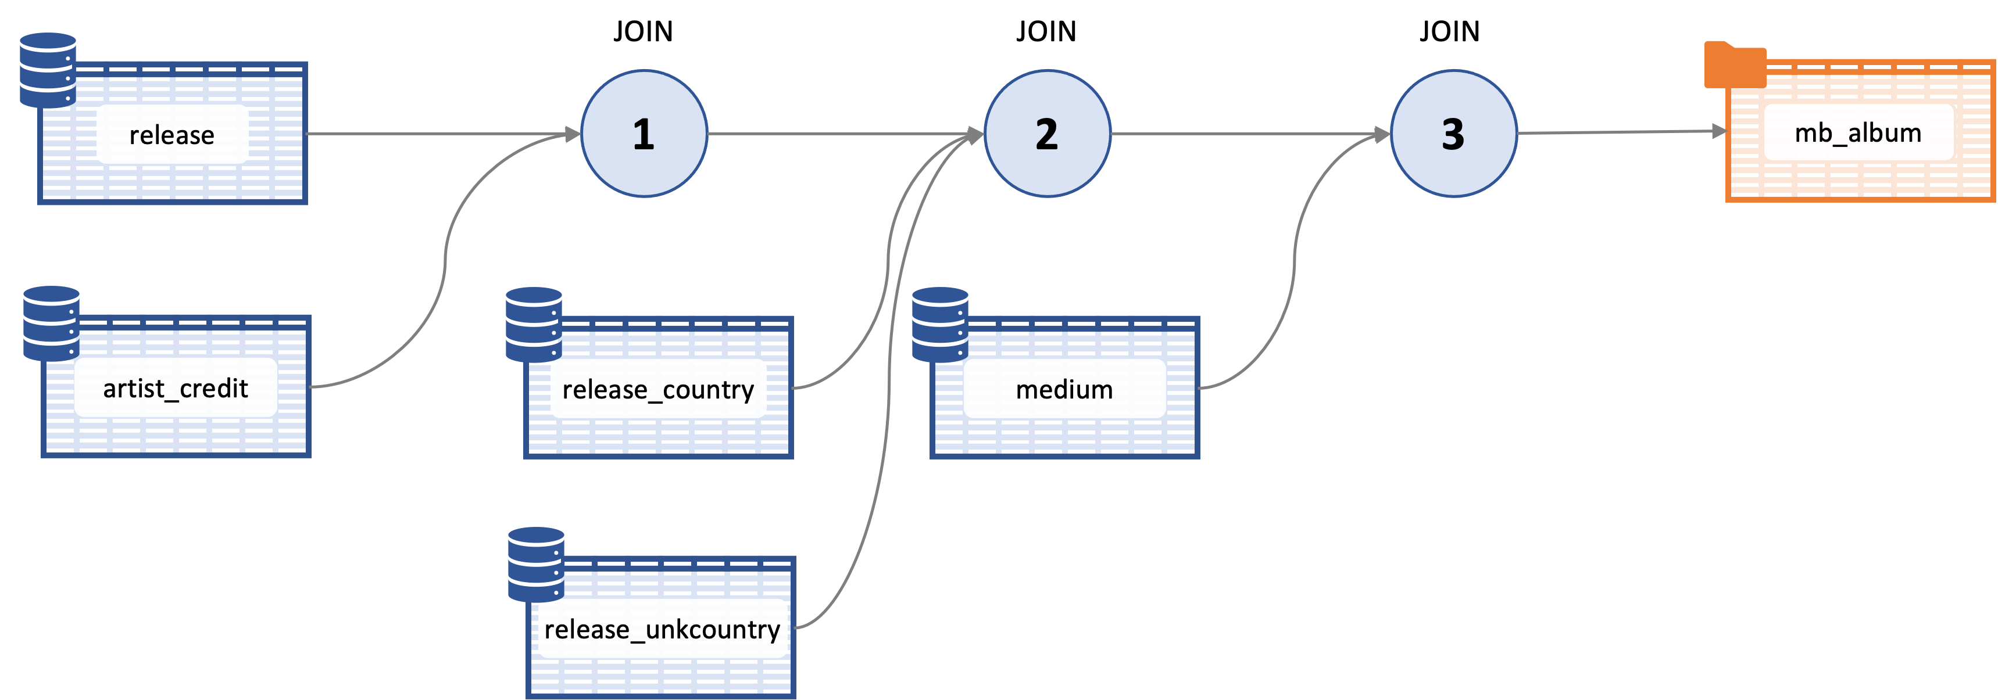
screenshot_p1s4.png

Slide 13
Data Collection
Data Transformation & Merge
Feature Downselection & Clustering
Experimentation
Output Analysis - Performance
Output Analysis – Value as a Feature

Slide 14
recording

Slide 15
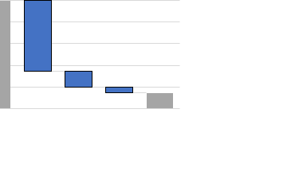


Slide 16
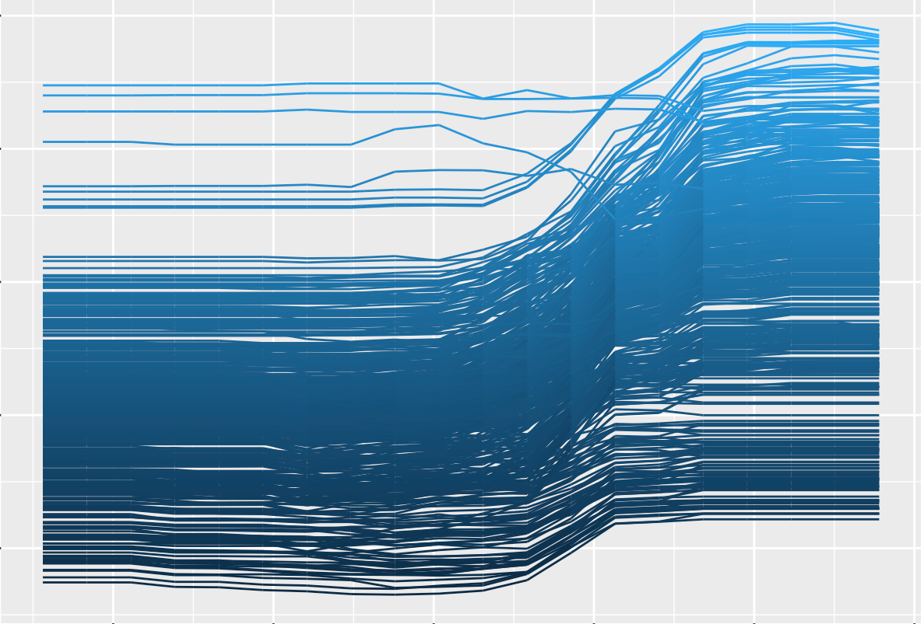

Slide 17


Slide 18
