Slide 2
A
B
C
Node
Node
Node
Node
Node
Memory
Memory
Memory
Memory
Memory
Core
Core
Core
Core
Core
Core
Core
Core
Core
Core
Core
Core
Core
Core
Core
Core
Core
Core
Core
Core
Single Core
(Scikit-Learn Default)
Multicore
(Parallelized Scikit-Learn)
Multinode
(Distributed Scikit-Learn)

Slide 3
A
B
C
Node
Node
Node
Node
Node
Memory
Memory
Memory
Memory
Memory
Core
Core
Core
Core
Core
Core
Core
Core
Core
Core
Core
Core
Core
Core
Core
Core
Core
Core
Core
Core
Single Core
Multicore
Multinode

Slide 4
Node
Memory
Node
Memory
Core
Core
Core
Core
Core
Core
Core
Core
Core
Core
Core
Core
Core
Core
Core
Core
Local Machine
Core
Core
Core
Core
Cloud Computing

Slide 5
Node
Memory
Node
Memory
Core
Core
Core
Core
Core
Core
Core
Core
Core
Core
Core
Core
Core
Core
Core
Core
Local Machine
Core
Core
Core
Core
Cloud Computing

Slide 6
A
B
C
Node
Node
Node
Node
Node
Memory
Memory
Memory
Memory
Memory
Core
Core
Core
Core
Core
Core
Core
Core
Core
Core
Core
Core
Core
Core
Core
Core
Core
Core
Core
Core
Single Core
(Scikit-Learn Default)
Multicore
(Parallelized Scikit-Learn)
Multinode
(Distributed Scikit-Learn)
Original image, but you should modify to 738 x 419

Slide 7
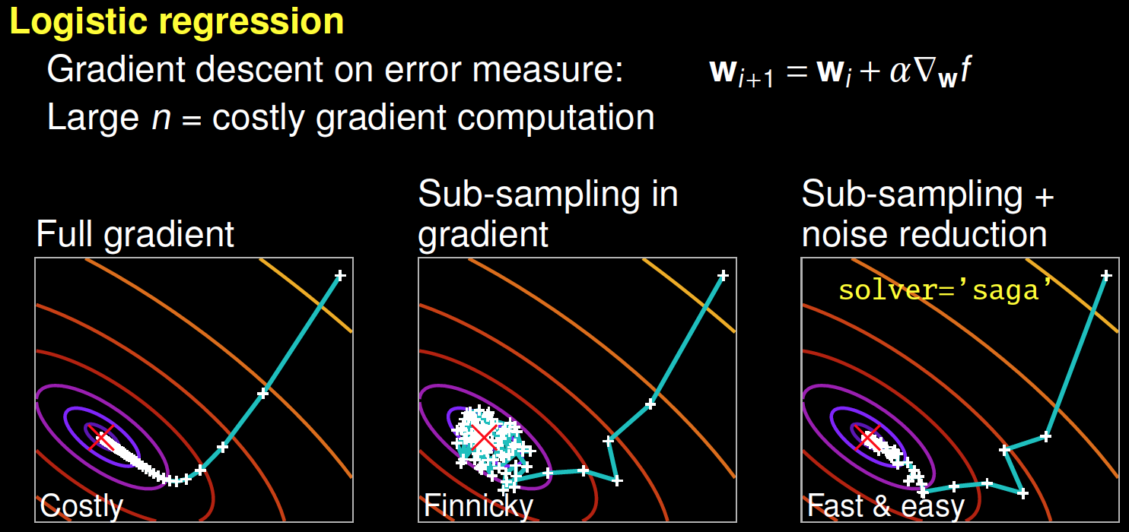

Slide 8

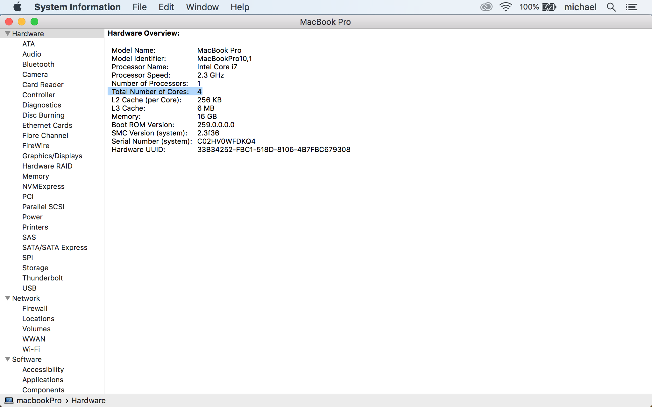

Slide 9
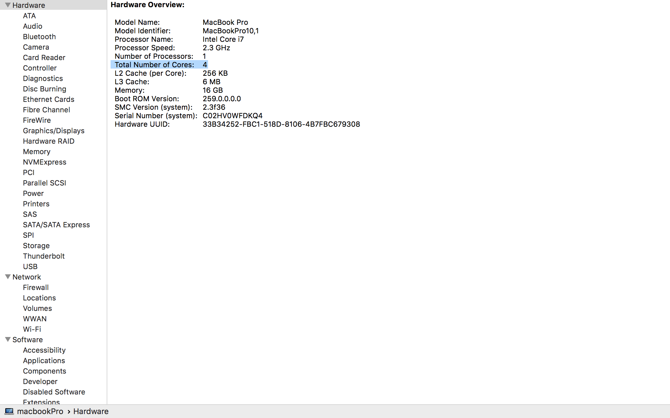

Slide 10
Memory
Original Data
Bootstrapped
Data
Bootstrapped Data
Bootstrapped Data
Bootstrapped Data
Bootstrapped Data
…
Decision Tree 1
Decision Tree 2
Decision Tree 3
Decision Tree 4
Decision Tree N
…
Combined Prediction

Slide 11
Original Data
Bootstrapped
Data
Bootstrapped
Data
Bootstrapped
Data
Bootstrapped
Data
Bootstrapped
Data
…
Decision Tree 1
Decision Tree 2
Decision Tree 3
Decision Tree 4
Decision Tree N
…
Combined Prediction

