Slide 1
Informatics in society: health informatics and security
INFO20002: Foundations of Informatics
12th May 2015

Slide 2
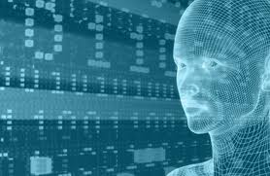
Clinical Informatics
Gathering information:
  Electronic patient records
  Biobanks
  Clinical registries
Analysing information:
  Clinical trials
  Medical guideline development

Slide 3



Electronic Medical Record
“Systematic collection of electronic health information about an individual patient or a population”
  This is not the same as the Personal Health Record, which is an attempt to make this information patient-controlled
You may have seen the Aus government leaflets last time you were waiting in a public hospital (PCEHR)?
Corporate attempts at farming patient data have been tried:
  Google Health, Microsoft HealthVault

Slide 4


Biobanks
“Organized collection of human biological material and associated information stored for one or more research purposes”
  Tissue (normal/cancerous), organs, blood, urine, etc
Captures genetic and DNA material of a person
UKBiobank
  0.5 million voluntary contributions
OMIM
  Online Mendelian Inheritance in Man
EBI
  European Bioinformatics Institute

Slide 5

Clinical Registries
Clinical data and information
  Blood pressure, hormone levels, surgery, therapies, follow-up measurements, etc
ENSAT
  European Network for the Study of Adrenal Tumors
Combine these with the biobanks…
  … and you can pretty much map the entire biological profile of a population

Slide 6

You = Mapped!

Slide 7
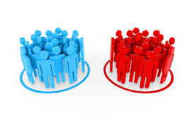
Clinical trials
“Evidence-based medicine”
Statistics and methodological sciences
To test a treatment:
  Divide participants into two groups
    Give one the treatment
    Give one the control (placebo)
  Blinded: patient doesn’t know they’re getting treatment
  Double-blinded: doctor doesn’t know who’s getting the treatment
  Try to control all other factors (inclusion/exclusion criteria)
  Then see what happens
    Follow up at regular intervals

Slide 8

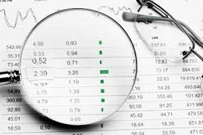
Clinical trials
Book of Daniel, chapter 1, verses 12 through 15:
  The physician observed those soldiers that “took The King’s food” over a period of 10 days
In modern day, trials/studies need lots of (useful) data so that the statistical “power” is high and interesting medical information can be extracted

Slide 9

Example: CRASH trial (brain trauma)
Corticosteroid Randomisation After Significant Head-Injury (CRASH)
  Final results 2005, The Lancet
Found out the application of steroids to treat head injuries were actually increasing the patient mortality
A large trial with good data showed a significant (negative) outcome

Slide 10
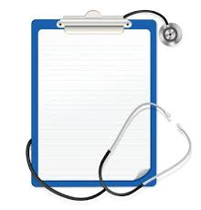
Guideline Development
Also “evidence-based medicine”
  Formed from the results of conclusive studies
Follows the scientific principle. Guidelines are:
  Repeatable
  Standardised
  Best practice for best outcomes
Allow a standardised repository of research data to be built up and fed back into development

Slide 11

Big Data
All the information the methods of information collection fall under the “Big Data” umbrella
And analytics challenges in developing therapies also exhibit “Big Data” characteristics: e.g. the data that contributed to the CRASH trial finding…

Slide 12
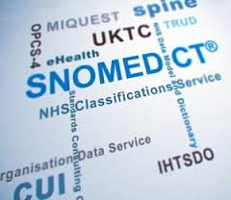
The Clinical Big Data Characteristics…
Clinical registries, bio-banks and study repositories need databases to underpin them…
  Populating can be considered a “Big Data” challenge
Many clinical centres have many data formats:
  One solution is to use a standardised format
  Some encoding formats already exist:
    Health Level 7 (HL7)
    SNOMED-CT
Glue-ing these together can be considered a “Big Data” challenge

Slide 13
Example of Clinical Big Data Solution
Many local databases, wired directly to ICU machines, filled with data once-per-minute
Every hour, the data difference was pushed to a central mirrored database at study HQ
Perform study analysis on central machine

Slide 14
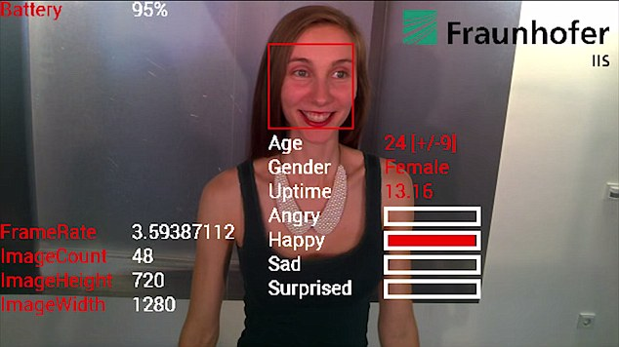
Which brings us to security…
But the biggest issue of all when dealing with health informatics on a grand scale is security…
“Internet of Things”
  How about Internet-enabled pacemakers?
    (Application Security)
Or what about Google Glass that tells you medical weaknesses about people?
    (Data security)

Slide 15
Layers to consider (with examples)
Data
How much can be identified?
Application
Sanitised user inputs
(e.g. checking ASCII text-fields)
Infrastructure
Patched Operating Systems
Physical
Servers behind locked doors

Slide 16
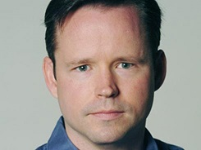
When people start dying because of the Internet…
“I will be concerned when people start dying because of the insecurity of the Internet”
  Brian Krebs,
    Tech security journalist, formerly Washington Post
    www.krebsonsecurity.com
CBS 60 Minutes
  Car hacking (brake-control removed by remote exploit)
  http://www.cbsnews.com/news/car-hacked-on-60-minutes/

Slide 17
Philosophy of Security #1
Prevention (gates, locks, etc)
  Technological applications
Detection (alarms)
  Audit trails
Reaction (prosecution, payback, etc)
  Organisational
  Auditing and Attribution
Least effective
Most effective

Slide 18
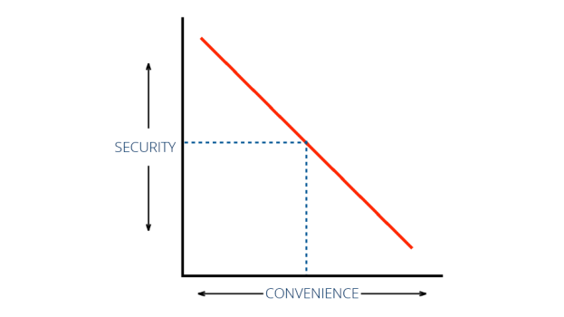
Philosophy of Security #2
Security is a process not a product
  Nothing is ever 100% secure
  It is always a trade-off between convenience, resources and risk
So in practice:
  Understand what you’re trying to secure (the threat model)
  Make sure it is a part of your project budget
    Whether that’s an allocation of time/money/whatever

Slide 19
Data Security Challenges: Statistical Inference
In isolation, individual bits of data are harmless, for example:
  A database of medical conditions tied to random IDs
  A database of postcode addresses
If these databases (somehow) get linked, then we now know the address of someone with a specific condition
If that condition is rare enough then you could immediately identify the individual…

Slide 20
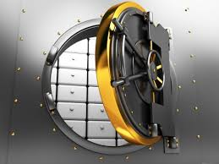
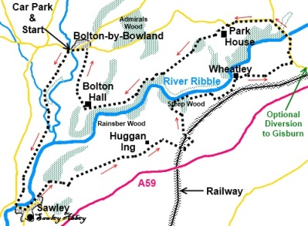
Data security: trying to protect it…
De-identify the data:
  No names, addresses
  Have a study ID
    Have the clinicians and researchers maintain a list of names against IDs behind their firewall
      On paper preferably, in a locked vault
        At the centre of the Earth
Watermark the data with false records
  These will always be unique and help with attribution and auditing in the event that the worst happens…
Ordnance Survey (maps)

Slide 21
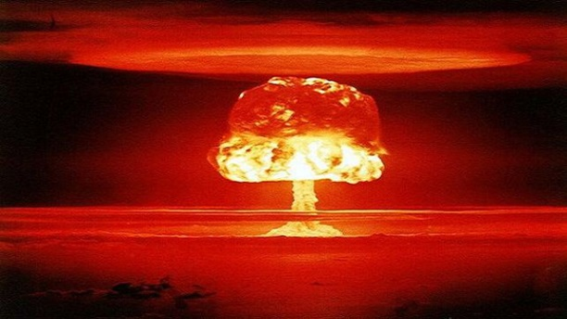

We’re all doomed…
The fact of the matter is that data is vastly available with names, Medicare numbers and everything else:
  Think of data like radioactivity:
    A little bit leaked here and there isn’t harmful…
    … but en-masse, with linkage, it’s like Chernobyl
Sony Pictures Entertainment
  Massive data leakage, Nov 2014
    Supposedly by North Korea
  Worst aspect of this was the mundane trivialities that were exposed:
    Bitchy emails, affairs, financial indiscretions, etc

Slide 22
How do you stop data capture?
Before the digital age, the difficult of reproduction often acted as a deterrent…
  Re-writing many copies of a piece of paper was hard
But now it’s really, really hard to stop a determined user to transfer information to another device:
  Ever tried properly locking a PDF?
    Ctrl-Alt-Prnt Scrn
  You will never win…
Medical attempts to lock this include safe havens:
  Completely isolated rooms for data download

Slide 23
Application security – solutions
To secure any online application, you need:
  A way to establish a perimeter (a “gated” community with only one gate)
  A way of sharing secrets

Slide 24
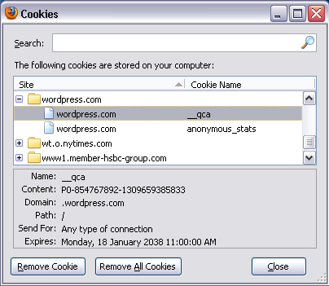
Cookies

Slide 25
Man in the middle attack
Server
Hi server!
Hi, I’m the server
Hi, I’m the client
Client
Hi client!

Slide 26

Encryption: sharing secrets
Prove it: do you have the secret I sent you earlier?
Do you have the secret I sent you earlier?
Yes, I do: here it is
Server
Well then, go away…
Um… no?
Hi, I’m the server
Client
Secret key

Slide 27
Authentication and Authorization
Now you have control of this little bit of the Internet you can control everything that happens there:
  Authentication allows users to assert their identity:
    “Who are you?” asks the computer
    “I am Anthony, and here are my credentials” you respond
  Authorization provides the rules of access to user:
    “Hi Anthony, here are a list of thing that you can do in this system:…”
  Auditing allows you to check on user behaviour
    “Anthony deleted a whole bunch of records that he shouldn’t have”
This is the “AAA” of security

Slide 28
Prevention, Detection, Reaction
Prevention
  Authentication and Authorization
Detection
  Auditing
Reaction
  Decisions based on information gathered from all of the above

Slide 29
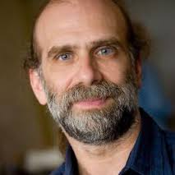

Reaction and Resources
Cyber-insurance
  If a car broke spectacularly and caused you massive damage, you could sue them…
    Not so with software
  Read the Microsoft EULA
    Especially the bit about updates and lack of responsibility
Bruce Schneier
  www.schneier.com/blog
Security Now (Steve Gibson)
  www.grc.com/securitynow

Slide 30
Summary
Informatics is applied to the clinical domain in two broad categories:
  gathering information (medical record, repositories, biobanks
  Analysis (studies, trials, guideline development)
Security has several layers:
  Physical, infrastructure, application, data
Security design philosophy includes:
  Prevention, detection, reaction
  “AAA” = Authentication, Authorization, Auditing
Data security has the major challenge of statistical inference
To control application security you need a perimeter and a way of sharing secrets

Slide 31
Example Exam Question
The harvesting of personal information for Big Data projects has ramifications for the privacy of an individual. Describe an example in real life where information is gathered on an individual through social media. What is the potential impact if this social information was linked to their electronic medical record? What steps could the curators of the social information and the medical records take to minimise this impact?

