Slide 1
Making sense of data: data analysis
INFO20002: Foundations of Informatics
20th April 2015

Slide 2

Context
Communication
  HTTP, CGI
Formatting
  XML, JSON, HTML, CSS
Dealing with the raw data
  Spreadsheets
Generating patterns with that data
  Visualisation

Slide 3
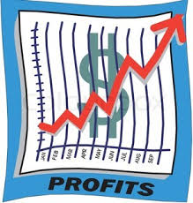
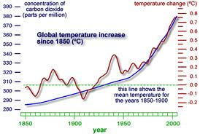
Context
The actual answers that the data gives us:
  This is the bit that the rest of the world want access to
    Scientists, policy-makers, journalists, general public…
How do we get to that?
Analysis

Slide 4
Analytics
Analytics
  Discovery and communication of meaningful patterns in data
This lecture gives the broad concepts of analysing data and some examples of grouping and prediction
  Tomorrow we’ll look at the specific, but very common, case of bivariate analysis (two variables)
  Next week we’ll look more deeply into the use of these analysis “tools” and touch on more advanced techniques (statistical analyses, machine learning)

Slide 5
Data in the rest of the (non-tech) world
Usually we’re presented with tables and tables of data…
  Comma-Separated Values (.csv)
  Spreadsheets
  Databases
The general Internet community seems to be happiest dealing with spreadsheets...
  So this is where the valuable data lies
  But spreadsheets and tables are terrible tools for communication…

Slide 6
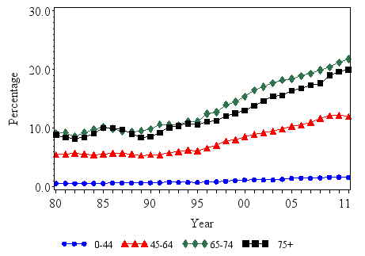
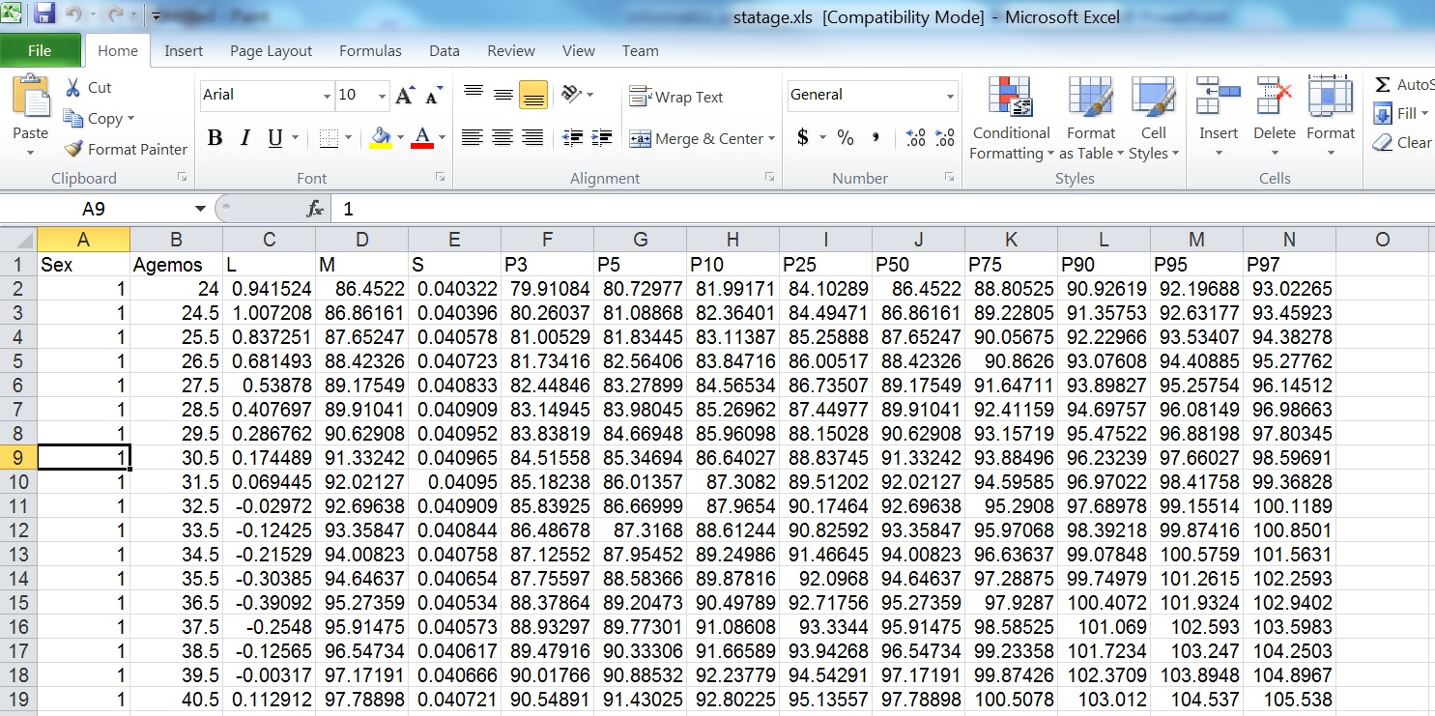
Example - health: CDC charts for diabetes
http://www.cdc.gov/diabetes/statistics/prev/national/figbyage.htm

Slide 7


Example - tech: what would Google do?
They have a massive data store under their control, facilitated by their product (online search):
  The original business driver was to match pages to users
  To improve this, Google need to know pages/documents are most relevent to their users’ search patterns
Google Analytics
  They can harvest all the information that we’ve been dealing with in the mechanics of the Internet:
    Browser setup, cookies, geo-location, timestamps, etc
And build up a targeted behavioural pattern and then advertise at you…

Slide 8


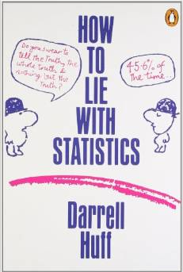
And if you’re in the business of “spin”…
How to lie with data visualisation:
  http://data.heapanalytics.com/how-to-lie-with-data-visualization/
How to lie with statistics, Darrell Huff

Slide 9
Data analysis – the steps
1. Sourcing
  Find your data…
2. Understanding
  What do the columns and values represent?
  Figure out what story is buried in that data…
3. Cleaning
  Are there errors and is the data valid?
  What was the original data collection purpose?
4. Transformation
  Turn the data into something presentable
5. Feature selection
  Pull out the relevant bits to address your hypothesis

Slide 10

Finding a hypothesis
A “chicken and egg” problem…
You need to look at the data to figure out a question…
Then you need to answer that question using the data…

Slide 11
Step 1: sourcing data
Data-set types:
  Surveys or polls, Experiments, Observational and other studies
Repository types:
  Operational databases, Data warehouses, Historical databases, Purchased data
Data types:
  Any kind of persistent file storage (SQL, CSV, XML, JSON, …)

Slide 12

Example - CDC diabetes
CDC files giving information about diabetes in the US population…
“I wonder if there are any trends in that data… maybe diabetes is growing or shrinking?”
Beware: looking at resultant patterns, drawing circles round them, then reaching a conclusion:
  Very tempting but completely wrong
  Always have your question first before analysis
  We’ll briefly come back to this in week 10 (clinical trials)

Slide 13
Step 2: understanding the data
Tables
  Data about “things”
  Column is a variable, row is an observation
Continuous and discrete variables
  Continuous = numbers or anything that can have a range
  Discrete = anything else
  Note: numbers can be discrete too

Slide 14
Step 2: understanding the data
Frequency distribution
  Define categories and plot them along the x-axis
If the variable is already categorical:
  … just use those
If it is numerical:
  … count the instances and put them into the categories (called a histogram)

Slide 15
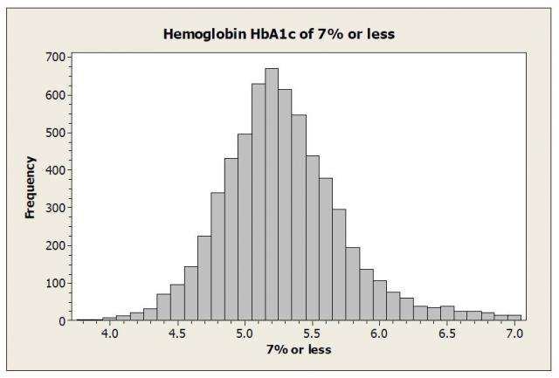
Example – CDC diabetes

Slide 16
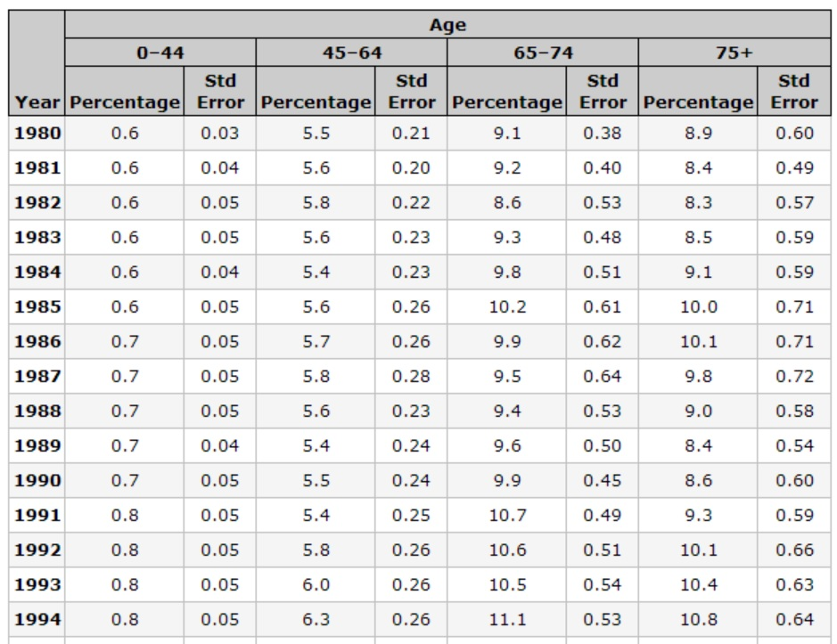
Example – CDC diabetes tables
Continuous variables
Discrete variables

Slide 17
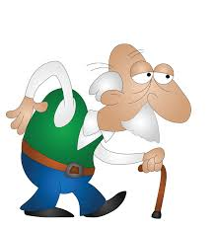
Step 3: cleaning the data
Validation and tidying of the data
Semantic similarities:
  “General Electric Company”
  “General Elec Co.”
  “GE”
  “Gen. Electric Company”
Range problems (or maybe wrong units…)
  Age = 150 years
  Blood pressure = 250 mmHg

Slide 18
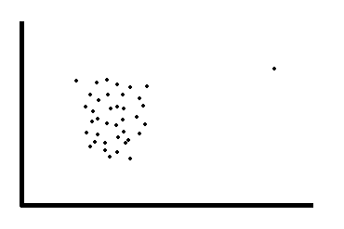
Removing variables
When we say remove variables we mean:
  “Removing an entire category because it contributes nothing of interest or relevance to the analysis”
We do NOT mean:
  “Removing a single data point because it makes the graph look bad”
In this case, these data points are called outliers and entire statistics courses look at how to deal with them…

Slide 19
Step 4: Transformation
Normalization
  Scale numerical columns so that they can be compared fairly
  e.g. converting absolute numbers to percentages, then scaling
Value mapping
  Convert text data (nominal) to numbers
  e.g. low = 0, medium = 1, high = 2
Discretization
  Convert numerical variables into categorical ones
Aggregation
  Derive a variable that isn’t present from two (or more) that are…

Slide 20

Step 5: Feature Extraction
If your data is way too big… then there will probably be some redundancy
  e.g. measurements in metres and feet
Feature extraction is an algorithm to pull only the information of relevance => Data Mining
This is yet another branch of mathematics in itself…
  Principal component analysis, Non-linear dimensionality reduction, etc.

Slide 21
Data mining - descriptive
Descriptive = grouping things together to get a view of the “data landscape”
Association rule
  Generate rules based on observations of the data-set
Clustering
  Groups data into sets of observations or clusters

Slide 22
Descriptive example – Association Rules
IF a patient is over 70
  AND they have history of liver problems
  AND they have low socio-economic status
    THEN they are 70% likely to be diabetic
Rule is easy to apply to other data points
Rule can be generated by analysing the data-set
Advantages:
  Easy to understand, actionable, good for large data
Disadvantages:
  Categorical only, time-consuming to generate, many rules means priority to be worked out

Slide 23
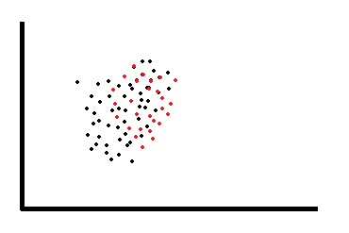
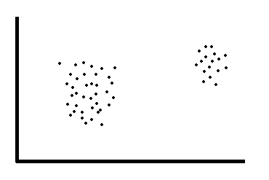
Descriptive example - Clustering
Advantages:
  Flexible, hierarchical approach possible
Disadvantages:
  Subjective interpretations, slow, size limits

Slide 24
Data mining - prescriptive
Prescriptive = using historical patterns to predict what will happen next…
Classification
  Allows observations to be assigned to different categories
Regression
  Mathematical model to predict a continuous response variable

Slide 25
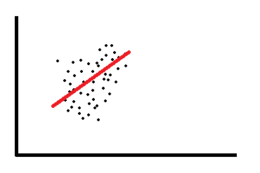
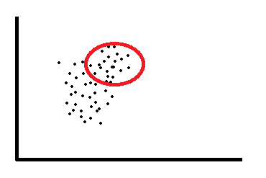
Prescriptive example - Classification
Build the model to predict which category the next data-point is going to fall into…
Assess the quality of a model using a contingency table:
TP = true positive
FN = false negative
FP = false positive
TN = true negative
Actual / Predicted | Positive (1) | Negative (0)
True (1) | TP | FN
False (0) | FP | TN

Slide 26
Sensitivity and Specificity
Sensitivity = how well the model is able to predict ‘true’ values:
  Sensitivity =
Specificity = how well the model is able to predict ‘false’ values:
  Specificity =
In real life, there is usually a trade-off between these two:
  e.g. airport scanners set to trigger on low-risk items like keys or belts (low specificity) so that they never miss the big things like bomb components…
TP
TP + FN
TN
FP + TN

Slide 27
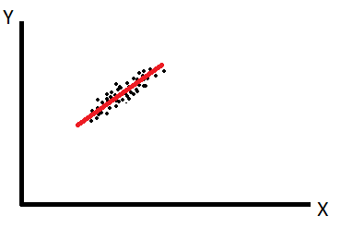

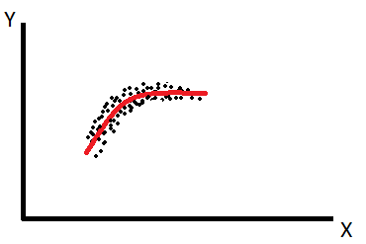
Prescriptive example - Regression
The idea is that there is a defined meaning of “normal” of this data-set, and in a good model the data points are never very far from “normal”
  i.e. they “regress to the mean”…

Slide 28
Summary
Analysis is the critical skill that interfaces your knowledge of obscure data to the real world
There are five broad steps to successful analysis:
  Sourcing, understanding, cleaning, transformation, feature selection
  Know what each of these steps entails
Know your hypothesis/research question before analysis
Feature extraction / data mining
  Broadly two types (with examples):
    Descriptive = association rules, clustering
    Prescriptive = classification, regression to the mean

Slide 29


© Copyright The University of Melbourne 2009

