Slide 1
Overview
People are always going to be buying homes.
How can we predict the prices of those future homes given our data ?
Notes:
Intro

Slide 2
Background
E-Z- Houses is a real estate company, located in Ames,Iowa.
In business for over 20 years, interested in leveraging technology to identify homes that would sell for the most profit.
Most important features(variables) as they relate to the sale price.
Notes:
Context / why this matters

Slide 3
Goal
Create and implement a machine learning model that can take previous data and tell us the future price of a home,given the various features in the data set.
Perform an in depth EDA to evaluate the relationship between the sale price and the other 79 features.
Notes:
Method

Slide 4
Dataset
The data comes from Ames Housing Study
79 exploratory features
1460 Rows x 81 Columns
Notes:
Data Cleaning - Data was already prepared to be used as this data set came from ames study.

Slide 5
Data wrangling
The data came separated in test and train files so there was no data wrangling needed.
We did have to impute missing data for features as well as correct skewness in our data.
Notes:
EDA

Slide 6
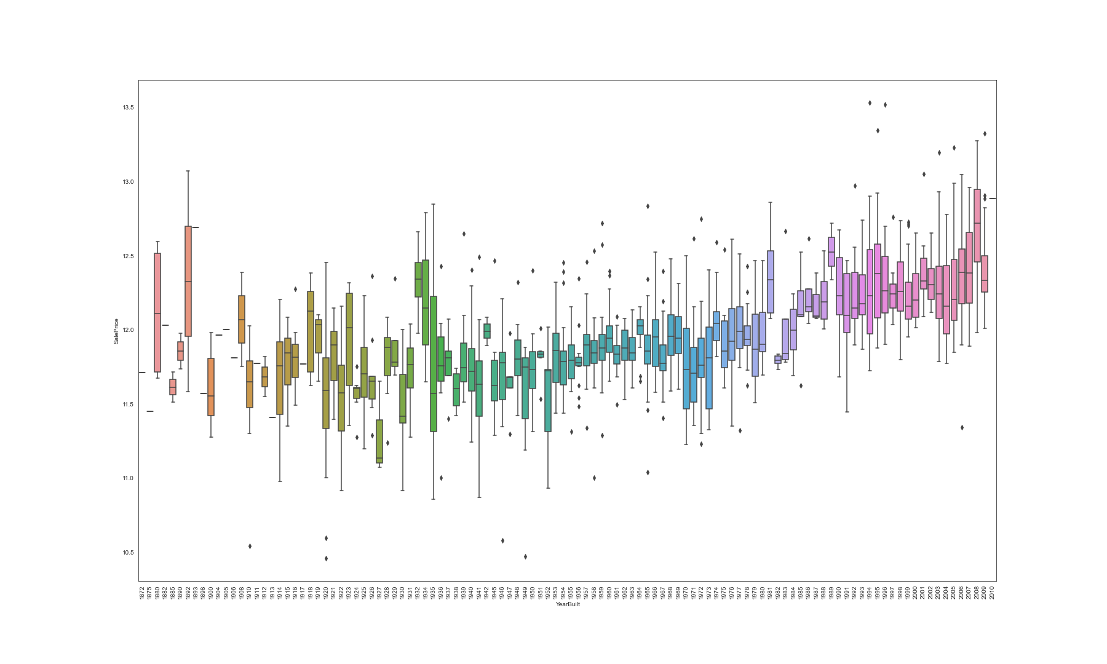
Yearbuilt vs Saleprice
Notes:
The first relationship that we explored was SalePrice vs YearBuilt. What was interesting was that there were more outliers than expected in the data. Also, as the years increased, the median price for homes increased as well. In addition, we would be remiss to add that inflation most likely had something to do with increased housing prices but does not answer the entire question.

Slide 7
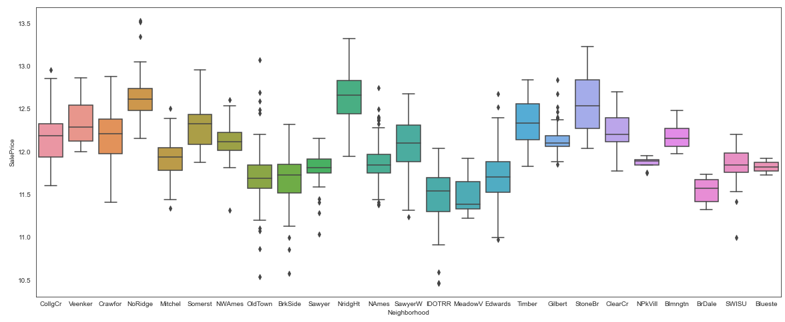
Saleprice vs Neighborhood
Notes:
We can see from the graph above that there are some outliers, especially in old town. In addition, NAmes,CollgCr,OldTown,Edwards have the highest number of houses.That being said, we can see how some communities are more expensive, whereas other communities have a much wider range of prices. Also,StoneBr,NoRidge and NridgHT are the most expensive neighborhoods.

Slide 8
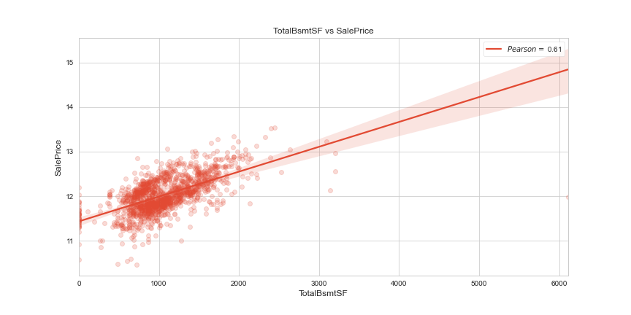
SalePrice vs Total Basement Sqft.
Notes:
Showing a linear relationship without outliers

Slide 9
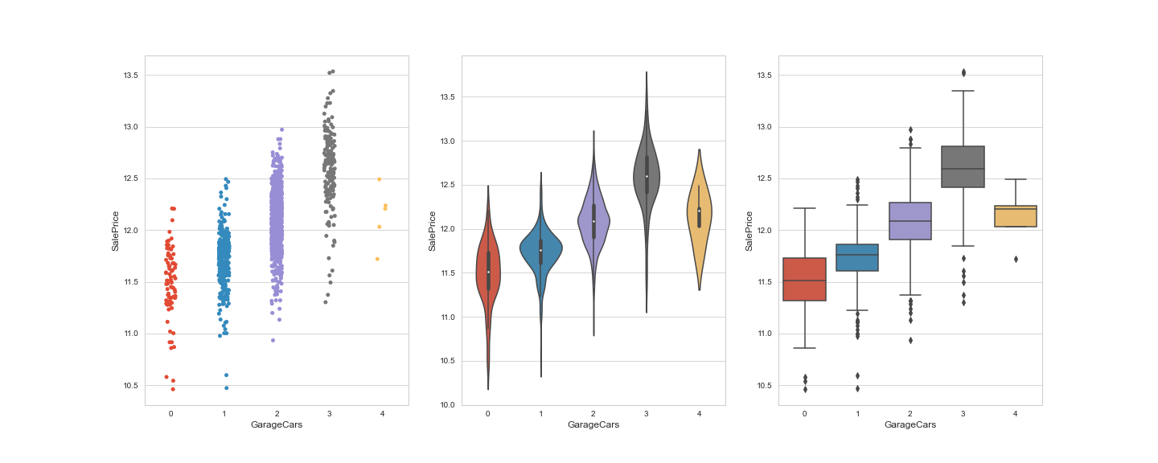
Saleprice vs GarageCars
Notes:
There is also a positive correlation here as well, with the exception of a few outliers. It does make sense that the price increases with the increased square footage to house cars. An interesting find is that homes with 4 car garages are all priced at or greater than the mean sale price. On the other side, homes with 1 or less GarageCars are less than the mean sale price.

Slide 10
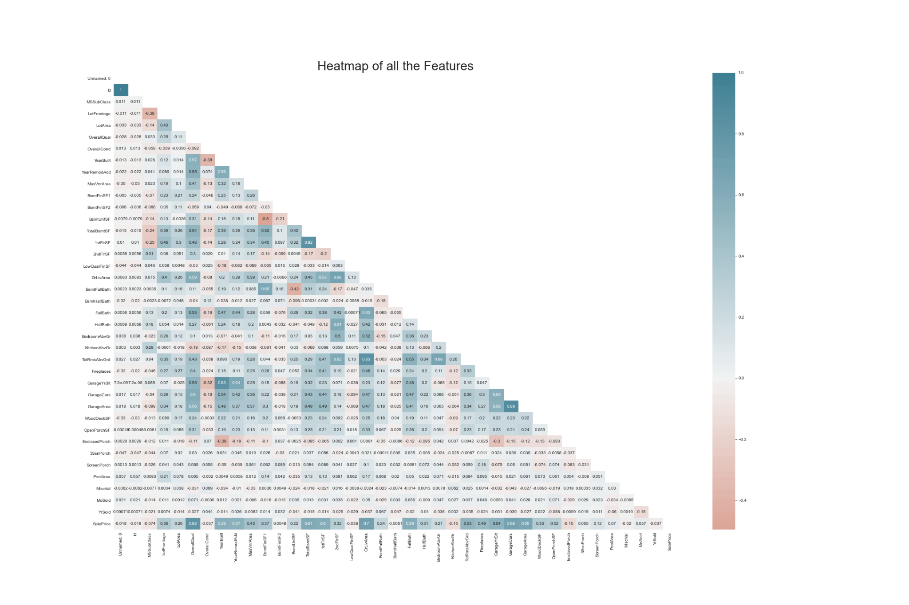
Heatmap
Notes:
This heatmap shows us the correlation between all the features in the data set. The highest correlations found were : 82% between the 1stflr and TotalBsmtSf,83% between YearBuilt and GarageYrBlt,88% between GarageCars and GarageArea
That being said, we have removed GarageArea,TotRmsABVGr,1stFlrSF in order to reduce collinearity that we detected when we first ran linear models.

Slide 11
Feature Engineering
To reduce the risk of collinearity, we have removed 3 features(GarageArea,TotRmsABVGr,1stFlrSF)
Notes:
Recommedations

Slide 12

Machine Learning
Test train split
Standardizing data
Notes:
Recommedations

Slide 13



Performance

Slide 14


Performance continued

Slide 15
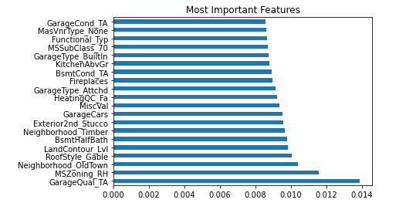
Conclusion
Gradient boosting is the model with the best performance overall that we have chosen to move forward with. The most important features can be seen below
Notes:
As we can see, the most important features are at the bottom, starting with Garage_quality. From the chart we can see that : GarageQual_TA,MSZoning_RH,Neighborhood,Roofstyle,Landcontour are the most important features with regards to the model.

Slide 16
Conclusion
Client has now is the ability to plug in and predict the price of that home in the future with an RMSE <.11.
Most important features besides Square feet: Garage(garage quality,size),Zoning(high density residential),Neighborhood,Roofstyle(Gable-which is best for cold weather, which is where Iowa is located),LandCountour(built on level ground).
Gradient boosting model is the winner
Notes:
The biggest takeaway our client has now is the ability to plug in a home and our predictive model will be able to predict the price of that home in the future with an RMSE <.11.
The best fit was using Gradient Boosting, which is great because of how fast and efficient it is. In addition to Square footage, the most important features that affect a houses sale price, with regards to the model, are Garage(garage quality,size),Zoning(high density residential),Neighborhood,Roofstyle(Gable-which is best for cold weather, which is where Iowa is located),LandCountour(built on level ground).

Slide 17
Conclusion (Continued)
Sales and marketing department can now use the neighborhood by sale price graphic as a key starting point with their clients.

Slide 18
Future Work
Finding which neighborhoods have more successful homeowners vs others, but that would require getting Income and demographics data.
Another feature that would have been nice to add would have been time. Such as the change in price of these homes over time, the only information about the homes we have is what they last sold for but not every sale.

