Slide 1
Bank Marketing Analysis
By: Andrew Stephens

Slide 2
Overview
The likelihood that someone will take a loan in their lifetime is almost a guarantee in today’s society.
What are the chances, that a customer will subscribe to a loan ?
Notes:
There has been a revenue decline for a Portuguese bank and they would like to know what actions to take. After investigation, they found out that the root cause is that their clients are not depositing as frequently as before. Knowing that term deposits allow banks to hold onto a deposit for a specific amount of time, banks can invest in higher gain financial products to make a profit. In addition, banks also hold better chances to persuade term deposit clients into buying other products such as funds or insurance to further increase their revenues. As a result, the Portuguese bank would like to identify existing clients that have higher chances to subscribe for a term deposit and focus marketing effort on such clients.To resolve the problem, we suggest a classification approach to predict which clients are more likely to subscribe for term deposits.

Slide 3
Background
Obrigado Bank is a Portuguese banking institution, with locations all over Portugal and Europe.
Term deposits allow banks to hold onto a deposit for a specific amount of time, banks can invest in higher gain financial products to make a profit.
Banks hold better chances to persuade term deposit clients into buying other products to increase their revenues.
Notes:
Founded 1876 in Lisbon, Obrigado Bank is the largest of the banks in Portugal in terms of total assets, and the country’s largest public-sector banking corporation. It also ranks 109th on the list of major banks in the world and is the 69th largest European bank. The bank operates through branches, representative offices, and direct equity interest in local financial institutions in 23 countries located on four continents

Slide 4
Goals
Create and implement a machine learning model that will classify customers that are more likely to subscribe to a loan.
The model will have an AUC score higher than 90% and an FP score less than 10%.
Find features any feature that may be significant with regards to the outcome of the model and the campaign.
Notes:
Our goal is to create and implement a machine learning model that will help target customers that are more likely to subscribe to a loan. The model will have an AUC score higher than 90% and an FP score less than 10%. In addition, Find features any feature that may be significant with regards to the outcome of the model and the campaign.

Slide 5
Dataset
Data comes from UCI Machine Learning Repository
Instances : 45211
Attributes/Features: 17
Notes:
We received our data from the UCI Machine Learning Repository. It is a multivariate data set, with 45,211 instances and 17 attributes. The data originated from a portuguese banking institution, where they wanted to measure and improve their direct marketing campaigns.

Slide 6
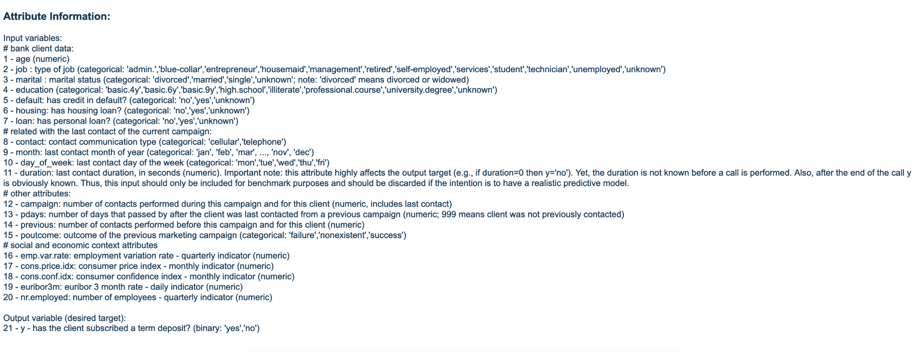
Dataset explored
Mostly categorical attributes/features with about 6 or 7 numerical features.

Slide 7
Data Wrangling
The data came clean so there was no data wrangling needed.
Notes:
There was not much to do as far as cleaning and manipulating the data was concerned. All the data came organized and did not need to be manipulated. The biggest things we had to do was balance our data set by undersampling which we will speak more to later.

Slide 8
Exploratory Data Analysis
Does being married play a factor in whether a person has a loan or not ?
Does having a specific profession or career factor in whether someone has a loan?
Does age play a big factor in who will take a loan ?
Notes:
We decided to ask some questions of the data to help guide our exploratory data analysis. For example, the questions we asked were

Slide 9
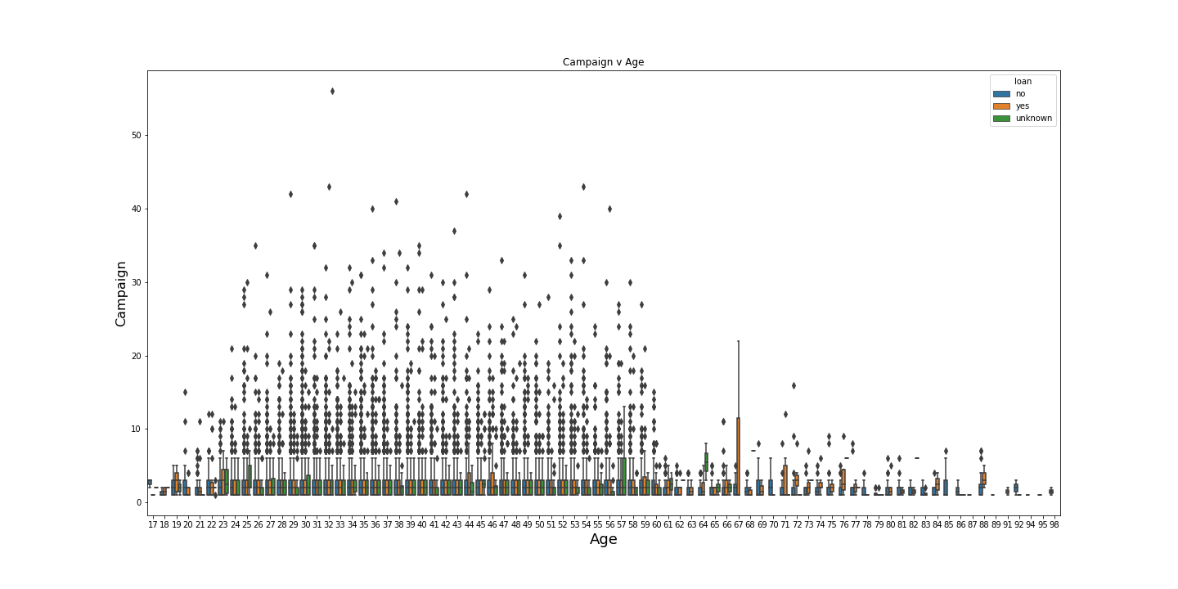
Age
Notes:
This graph shows the ages that said yes or no to a new loan. Not including outliers,the campaign was pretty successful within 10 days if they were able to get in contact with their prospects.
Age 19,23,44,46,59,67,71,76 are the ages where we see increased spikes in subscriptions. Based on the age ranges, you could create custom campaigns to target each age segment.

Slide 10
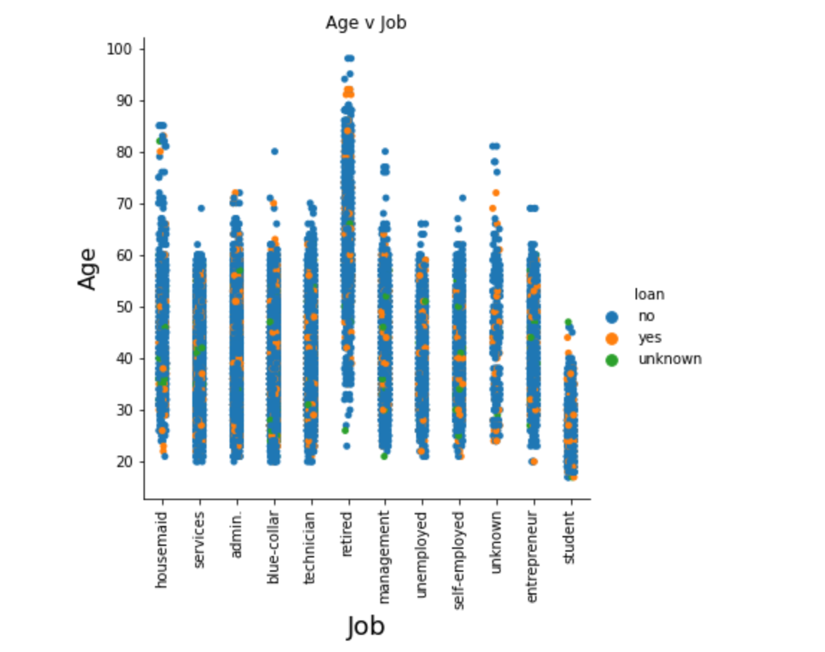
Continued
Notes:
Age is definitely a factor, we can see a lot of people that have loans in their 90’s .The loans are very specific to where their respective occupations interact with age. For example,we can see lots of retired people with loans at a higher age than you would see a housemaid getting a loan or a blue collar worker.

Slide 11
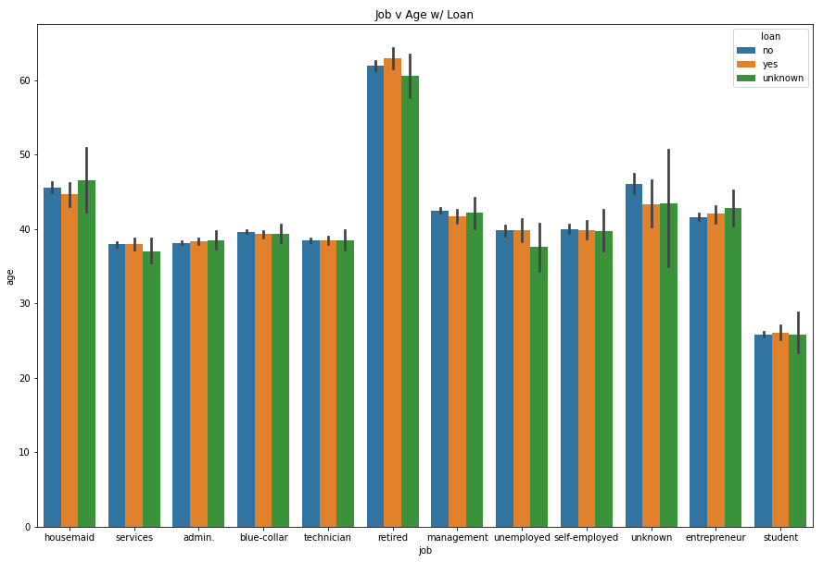
Occupation
Notes:
The graph above shows the comparison between occupation and likelihood to have a loan. As we can see, retired people are the highest group with current loans which makes sense. It takes 15-30 years to pay off a loan. No surprise that students are last but the standout in this graph is the amount of housemaids that have applied for and received a loan.

Slide 12
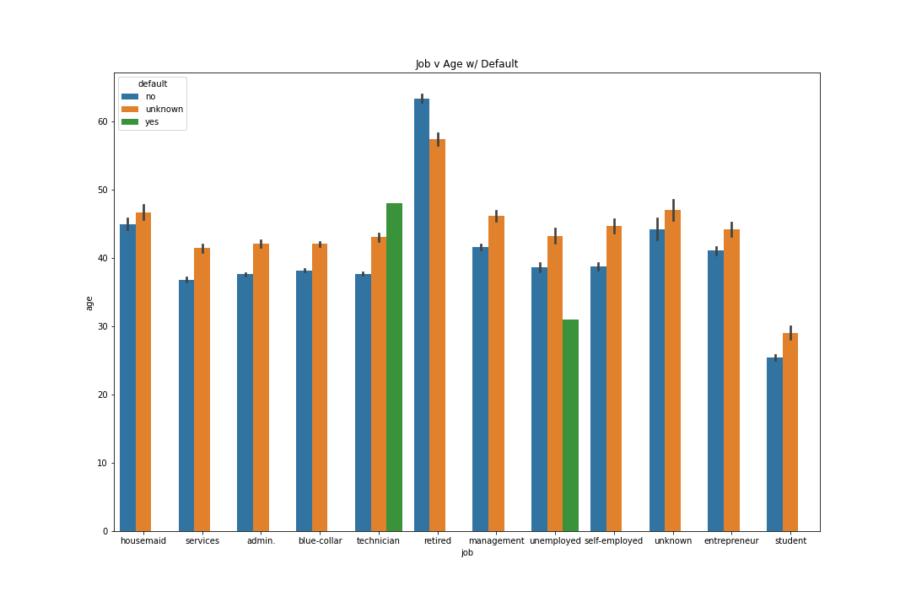
Continued
Notes:
Above we can see that technicians and unemployed people have defaulted on their loan in the past. According to investopedia.com, “Default is the failure to repay a debt, including interest or principal, on a loan or security”. What is interesting to see is that technicians have defaulted and no other profession has a record of defaulting. It is concerning to not see other defaults in other categories.

Slide 13
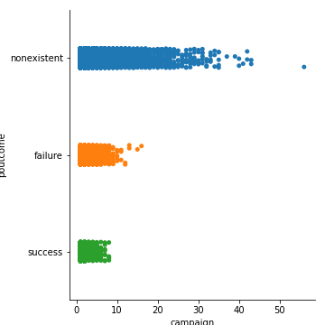
Campaign Performance
Notes:
The highest chance of success for the campaign depended on employees being able to perform and execute calls within 10 days of starting their marketing campaign. There is not an outlier to support making attempts after 10 days.

Slide 14
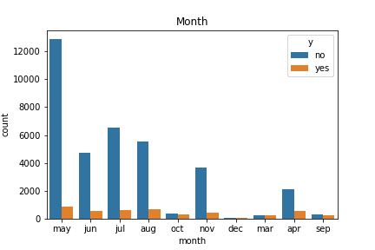
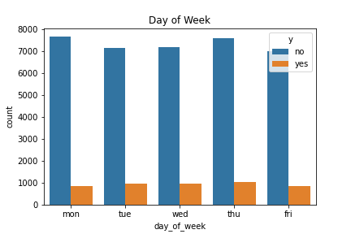
Continued
Notes:
The previous campaign resulted in 4640 people saying yes and 36,548 people saying no. That comes out to just over 11% of people saying yes to a loan. Depending on what constitutes a successful campaign, from an outside perspective it did not behave poorly however, it can be revamped to work more efficiently. In addition, as we can see from the day of week graph, the best times to call during the week are Tues,Wed, and Thursday. Also, the best time of the year for the campaign seems to be the Spring and Summer months, with the peak being in May.

Slide 15
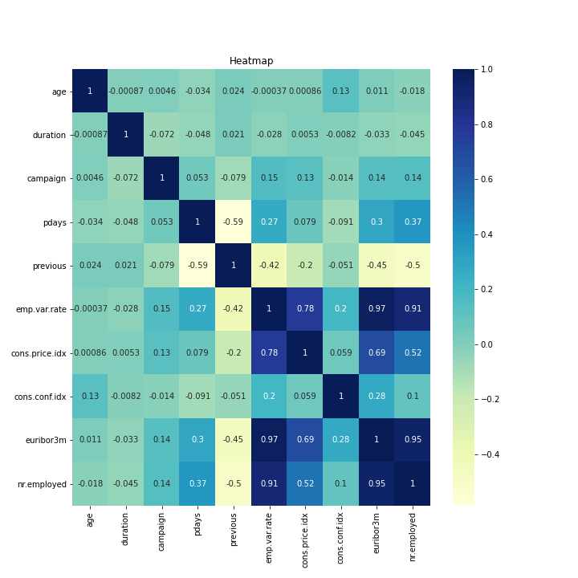
Heatmap
Notes:
From the heatmap, we can see that employees play their part whether it's the number employed or their variation rate. In addition, it seems like pdays and previous have a correlation as well to how likely someone will subscribe to a loan

Slide 16
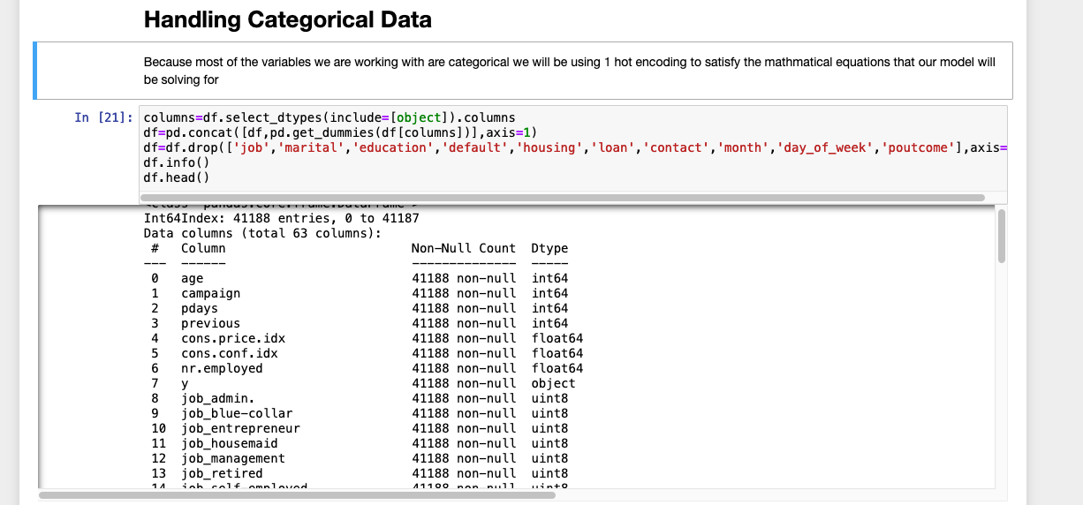
Feature Engineering
First, we removed any features with correlation > 80%
Next we transformed our categorical data using Onehotencoding
Notes:
The first preprocessing step that we took was to remove any feature with a correlation of > 80%. Because in the correlation matrix, we saw how highly the company's internal statistics were such as employee variation rate.
The next step we applied was using one hot encoding on our features. The reason why is because we have no particular order that our features need to be encoded in, which makes choosing one hot encoding the obvious choice

Slide 17
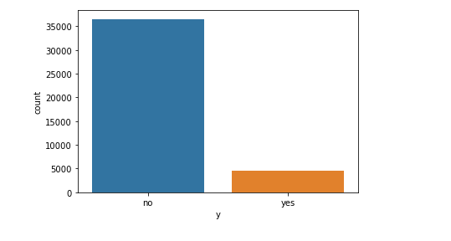
Continued
Taking care of imbalanced data
Before
After
Notes:
The last preprocessing step we did was take care of the data imbalance .The process that we originally used was oversampling, however, most models that were used did perform or even meet our expectations. Considering that we only have 8GB of ram to use and diminishing gains, we decided to try another approach. Instead, we did the opposite by oversampling, using the smote technique which creates synthetic data. At this point of the project, we do have to declare that we have introduced a new form of bias in the form of synthetic data. This may affect our ability to generalize with our model moving forward.

Slide 18
Machine Learning
Models we are using are :
KNN
SVM
Logistic Regression
Random Forest
XGBoost
Notes:
KNN- PROS : Fast,versatile CONS : Hard to work with lots of data, needs standardization and normalization,sensitive to outlier
SVR : used for classification&regression, thrives in high dimension,fast prediction CONS: costly computation time, overfitting risk,hard to work with large data , needs scaling
Logistic Regression : Fast,versatile,easy to train&implement, simple to generalize CONS: constructs linear boundaries, trouble with high dimensional datasets, non linear problems cant be solved, sensitive to outliers
RF: versatile(continuous,categorical),feature importances, works well large dataset,handles outliers well,missing data, CONS : prone to overfit,lower prediction accuracy compared to other algos,high variance,sluggish if not optimized,
XGboost: less feature engineering(scaling,imputing), feature importance, fast, large datasets well, CONS many hyperparameters to tune, more likely to overfit than bagging, difficult to interpret(blackbox)

Slide 19
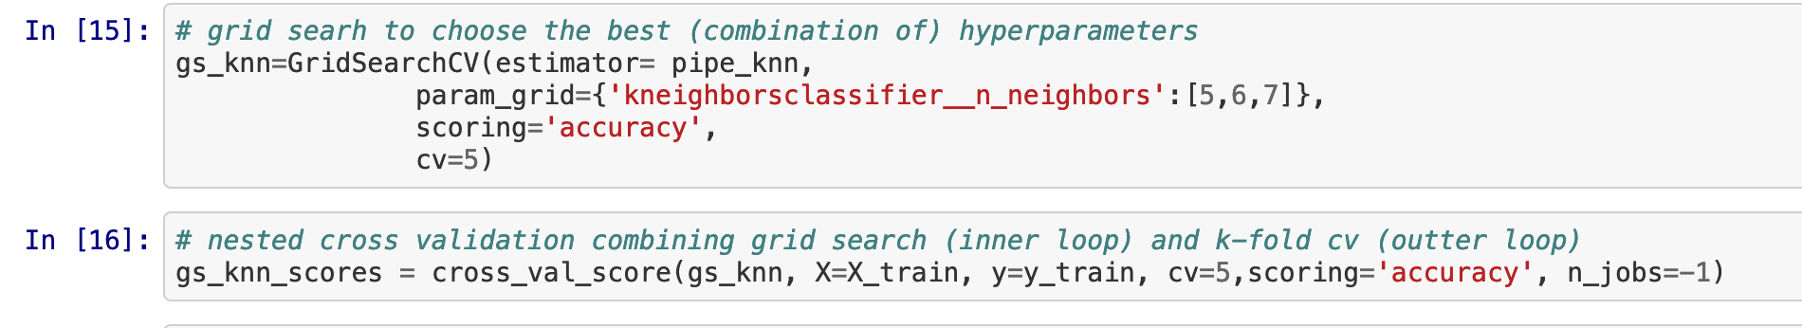
KNN
Code snippet
Notes:
Used gridseach to find and implement best parameters

Slide 20
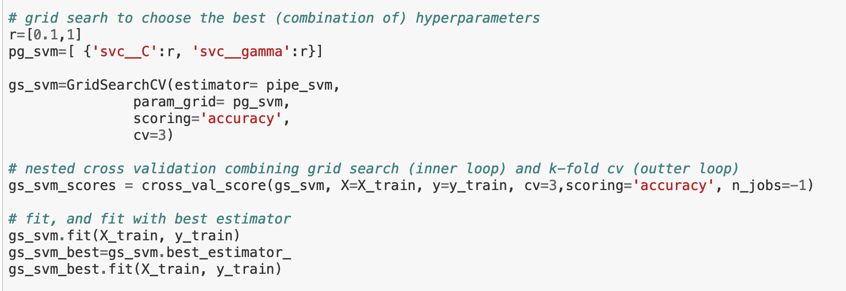
SVM
Code snippet

Slide 21
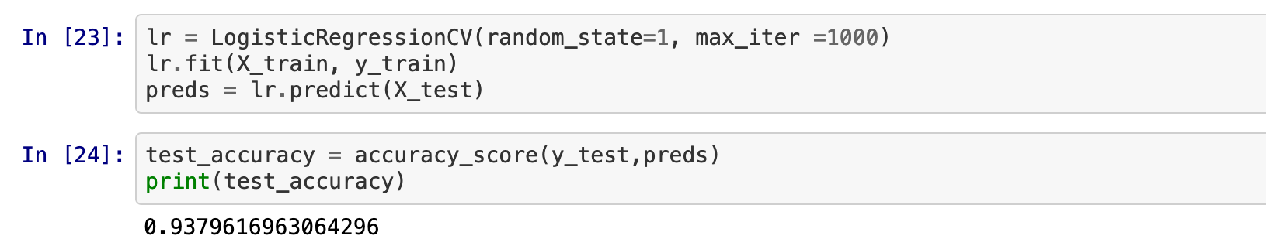
Logistic Regression
Code snippet

Slide 22
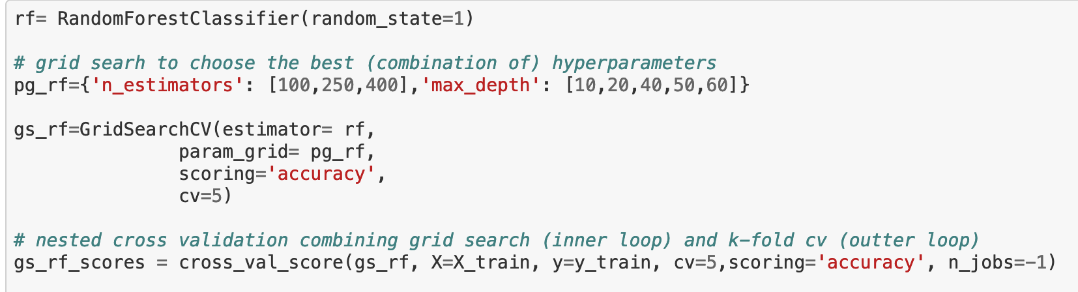
Random Forest
Code snippet

Slide 23
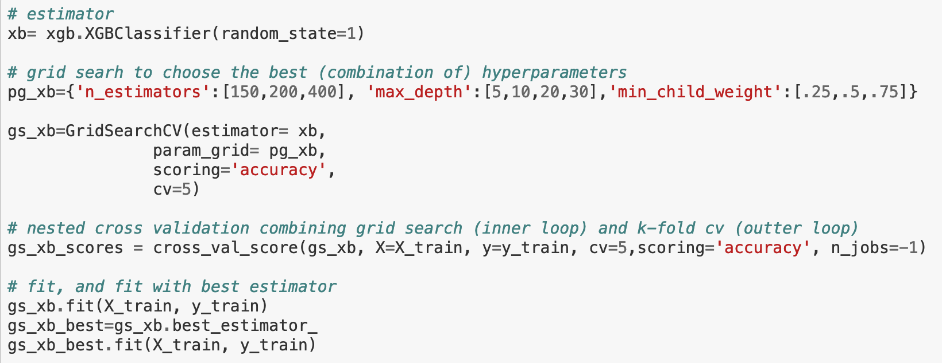
XGboost
Code snippet

Slide 24
Oversampling vs Undersampling Comparison
Oversampling
Undersampling
Model | FP% | FN% | AUC%
KNN | 7.9 | 7.3 | 96
LR | 11 | 1.9 | 97
SVM | 11 | 2.3 | 97
RF | 7.1 | 5.2 | 98
XGBoost | 9.2 | 2.9 | 97
Model | FP% | FN% | AUC%
KNN | 37 | 21 | 75
LR | 38 | 14 | 80
SVM | 29 | 32 | 74
RF | 37 | 13 | 80
XGBoost | 36 | 18 | 78
Notes:
These are the scores using oversampling
Overall, the model that we have chosen to implement is Random Forest. The reason why we chose it is because of the AUC accuracy, in addition to having one of the lowest type 1 error rates,which is more important for us than type 2 error in our study. The reason being, the campaign would be negatively affected more by false positives than false negatives because if we have too much type 1 error, we really don't know how well the campaign is performing due to bias. We can also use the feature importances chart to help guide future campaigns as well.

Slide 25
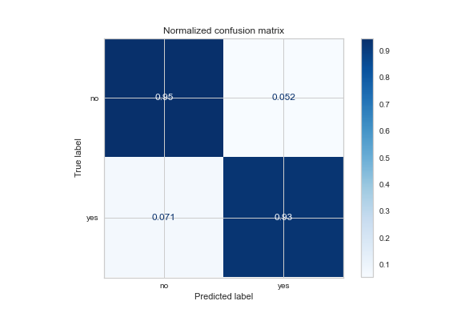
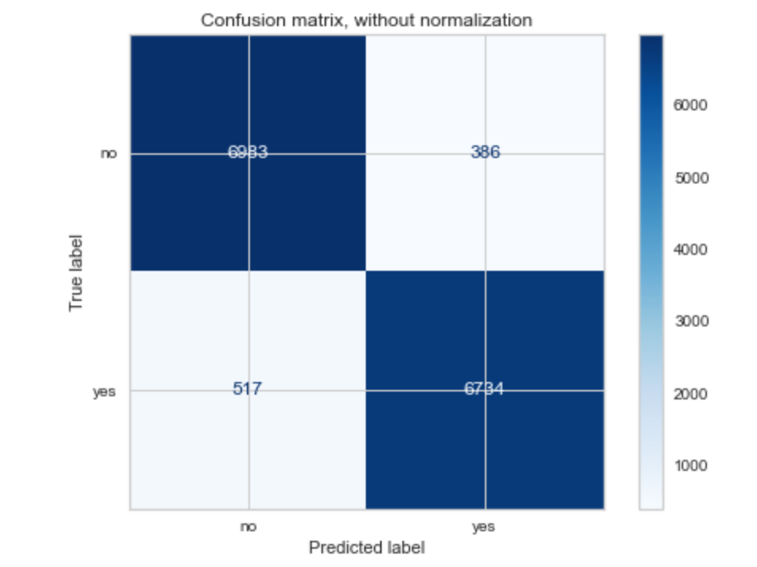
Random Forest Confusion Matrix
Notes:
Confusion Matrix
FP= 7.1% ,FN=5.2%, AUC=98% with oversampling
The best score, since we are most interested in reducing type 1 error. The lower the FP rate, the better our campaign will be.

Slide 26
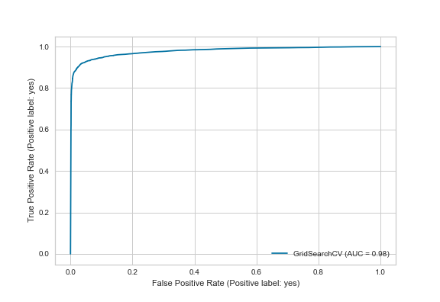
LR ROC

Slide 27
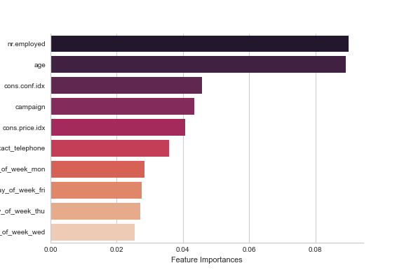
Feature Importance
Notes:
It looks like employees plays the biggest factor with how many employees are there to make the calls.Employee volume is another factor, because we can see how important the number of employees to carry through the campaign is.Any decrease in the workforce suggests that would have negative effect to the campaign. Age also seems to be a factor,but that is no surprise because the younger they can get a client, the longer they can do business with them over the course of their life.Consumer confidence plays a factor due to its relationship with consumers and how well they believe the economy is doing. The better the economy the more likely the customer will take a loan because good economy equals stable work for most.

Slide 28
Recommendations
Focus on calling customers Tues,Wed,Thur
Drop any customer that hasn't subscribed in at least 15 days or 8 call attempts.
Keep employees working and happy, any drop in workforce affects the campaign.
Segment customers by age and incorporate lifestyle segmentation
Focus on targeting entrepreneurs.Target the management occupation to help drive volume.
Notes:
The recommendations that we believe will positively affect the next campaign are:
Focus on calling customers Tues,Wed,Thur for highest success
Drop any customer that hasn't subscribed in at least 15 days or 8 call attempts.
Keep employees working and happy, any drop in workforce affects the campaign.
Segment customers by age and incorporate lifestyle segmentation as well with regards to occupations and how they vary by age. Ex: A 40 year old executive should be marketed differently than a 22 year old college graduate.
Focus on targeting entrepreneurs, through specified business loan offerings and deals. In addition, target the management occupation in order to help drive volume.

Slide 29
Takeaways
April-August produces the highest results for the campaign.
Age is a factor as we can see from the feature importances chart and heatmap
Any chance of success will happen within 10 days of direct marketing to a customer; after 10 days there were no successful attempts.
Employees carry high significance, with regards to the feature importances chart, with how many employees are there to make the calls
Notes:
From our EDA, we learned that calling during the middle of the week gave our client the highest chance for success. In addition, April-August produces the highest results for the campaign. That being said, Age is a factor as we can see from the feature importances chart and heatmap. After evaluating the poutcome with regard to the previous campaign, it would be safe to say that any chance of success will happen within 10 days of direct marketing to a customer; after 10 days there were no successful attempts. Another point to add is the age groups that subscribed to a loan can be segmented in such a way that can help target consumers of the same age for the next campaign. It looks like employees carry high significance, with regards to the feature importances chart, with how many employees are there to make the calls.
With regards to modeling,Logistic Regression gave us the lowest FN rate. Random Forest gave us one of the highest AUC scores as well as FP score less than 10%.

Slide 30
Future work
Include time
Include more personal data such as loan balance, account balance, debt to income ratio
Include geographic location

Slide 31
Thank You

