Slide 1
Kites
Open Source Shopping Cart

Slide 2
Kites Team
Ghazy Abdallah
Team lead
Core developer
Hashim Adam
UI, UX
Data visualization
Safa Mohamed
XP analyst
User feedback

Slide 3

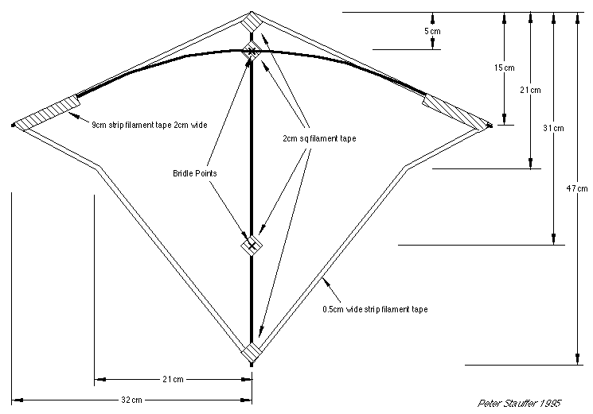

Why ?
Kites name.
M-commerce, Shopping cart.

Slide 4
Goals & Vision
Goals
E-Commerce directly on consumer hands.
Hassle free choices
Vision
Complete E-Commerce solution.
Semantic Web.
Internet of Things (IoT).

Slide 5




Features & Technologies
Open source (Already on GitHub).
Component based.
Agile developed (XP).
Secure & private.
SHA2 256.
AES 128-bit.
RSA 2048-bit.
Intuitive.

Slide 6

User Interface & User Experience

Slide 7

User Interface & User Experience

Slide 8
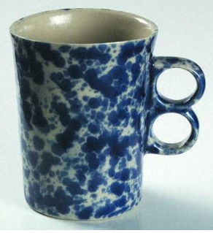
User Interface & User Experience

Slide 9
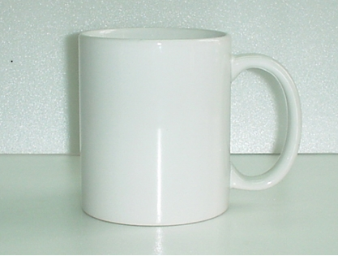
User Interface & User Experience

Slide 10
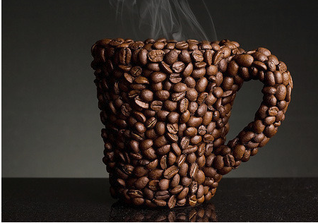
User Interface & User Experience

Slide 11
Overall Overview
Kites Administration Panel
Jory
(Desktop)
Persistence Layer
DB
Kites Cryptography
Roxy
(AES, RSA)
Kites Client Application
Yasmin
(Android)
Kites RESTful Web Service
Alice
(JSON/XML)

Slide 12
Problems
Time.
SSL/TLS certificates.
Application hosting.
Networking infrastructure.

Slide 13
Demo

