Slide 1
Data Methods for the Analysis of Currency Exchange Rates
Aster Li

Slide 2
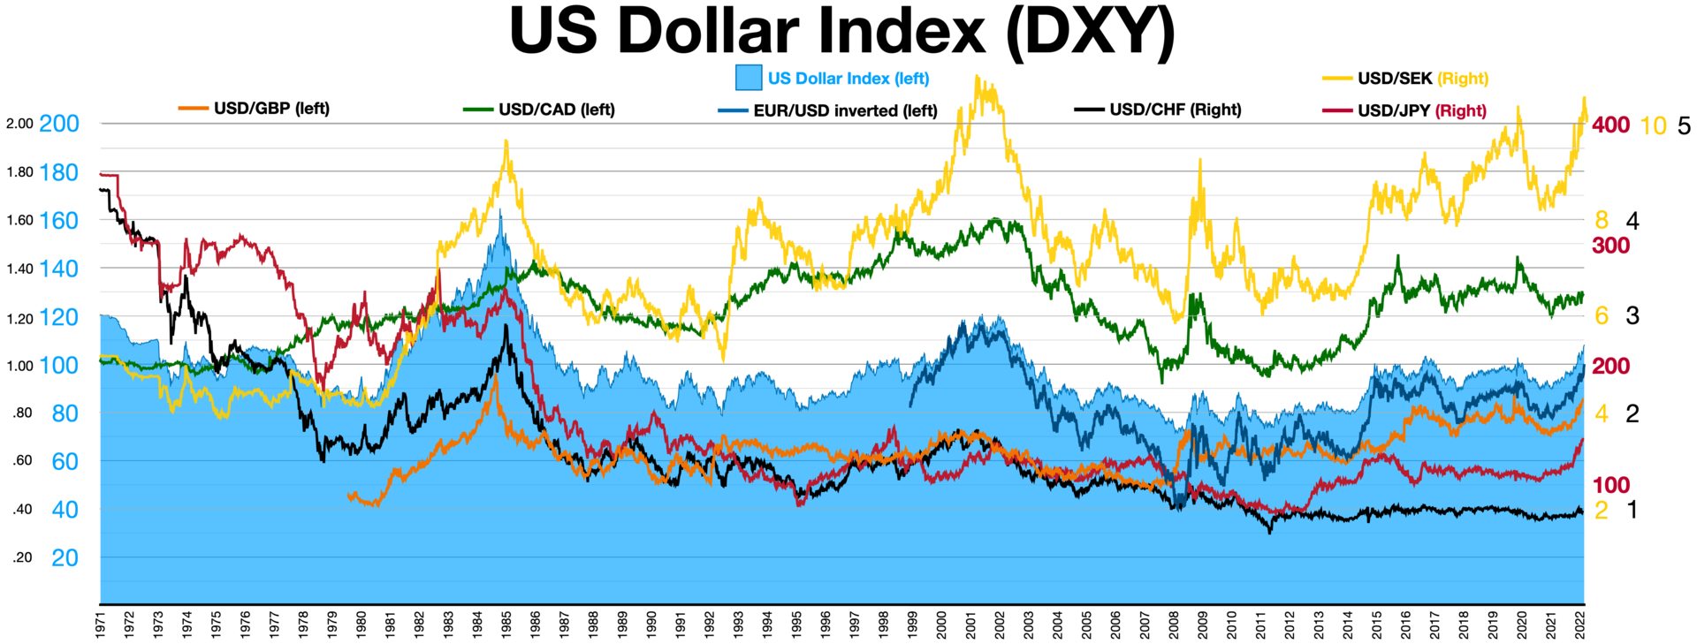
Introduction
The program allows the user to designate a currency pair (22 currencies available, all pairs valid) and request exchange rate data and calculated statistics for either a single date or for the period between two dates
Daily data from as far back as 1971 to 2018
Possible use by economists, business professionals, government, casual investors

Slide 3
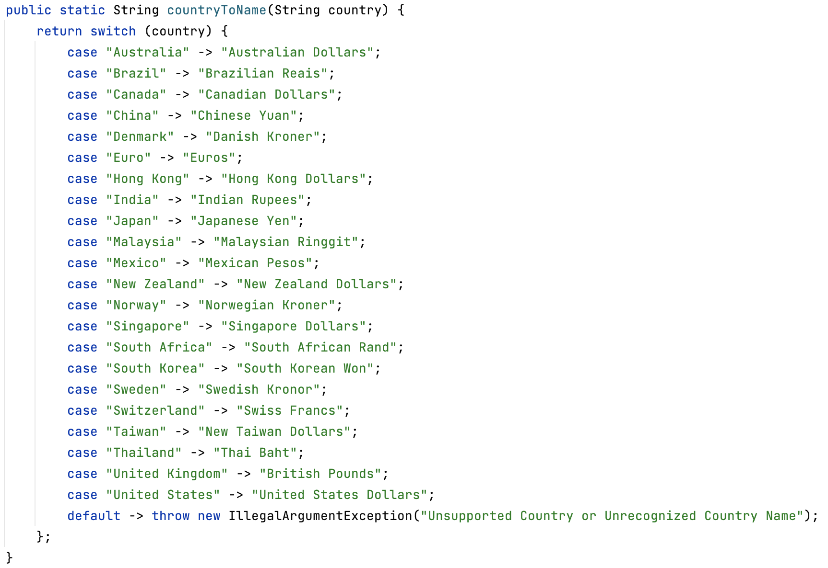

Slide 4
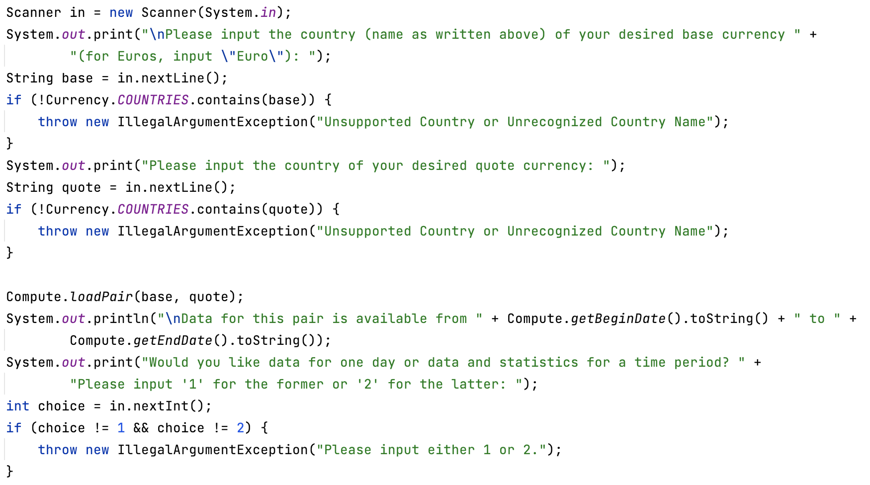

Slide 5
Data Processing and Structure
Data from a GitHub data set: https://github.com/datasets/exchange-rates
CSV file of dates, countries, and exchange rates
Raw data is loaded into LinkedHashMaps (dates being keys, exchange rates being values) for each country’s currency
Currency class represents each currency and contains a LinkedHashMap (as above)
Top level of data storage is another LinkedHashMap of country names and Currency objects

Slide 6
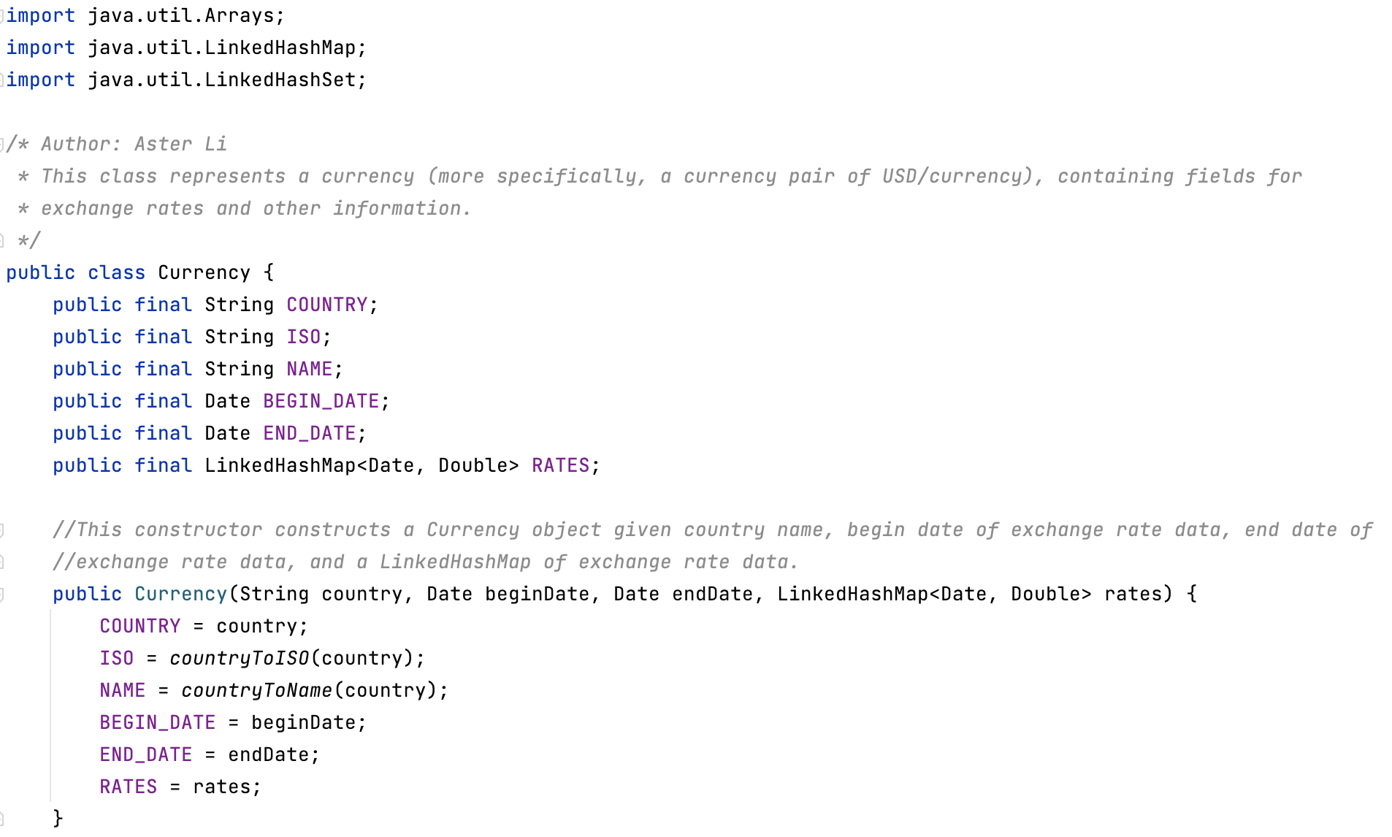

Slide 7
LinkedHashMap
Primary data structure of the program
Predictable, insertion-order iteration
Hash table and linked list
Almost as fast as HashMap; O(1) for add, contains, remove
Good choice for this program

Slide 8
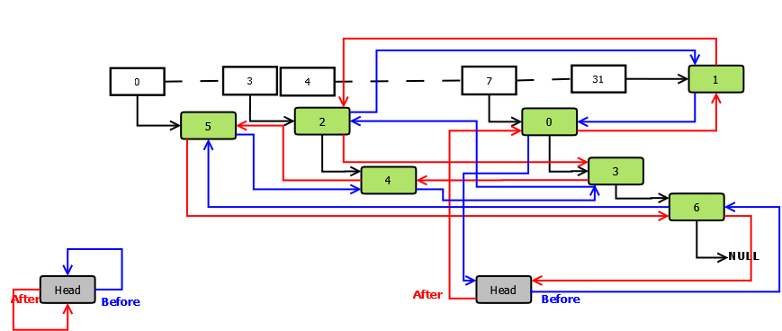

Slide 9
Computational Methods
No machine learning was used in this project, so no machine learning algorithms were implemented
Nevertheless, many methods and computations used to form a cohesive program, despite the absence of a “defining” algorithm
Example of an algorithm used: calculate and load exchange rate data for a designated currency pair

Slide 10
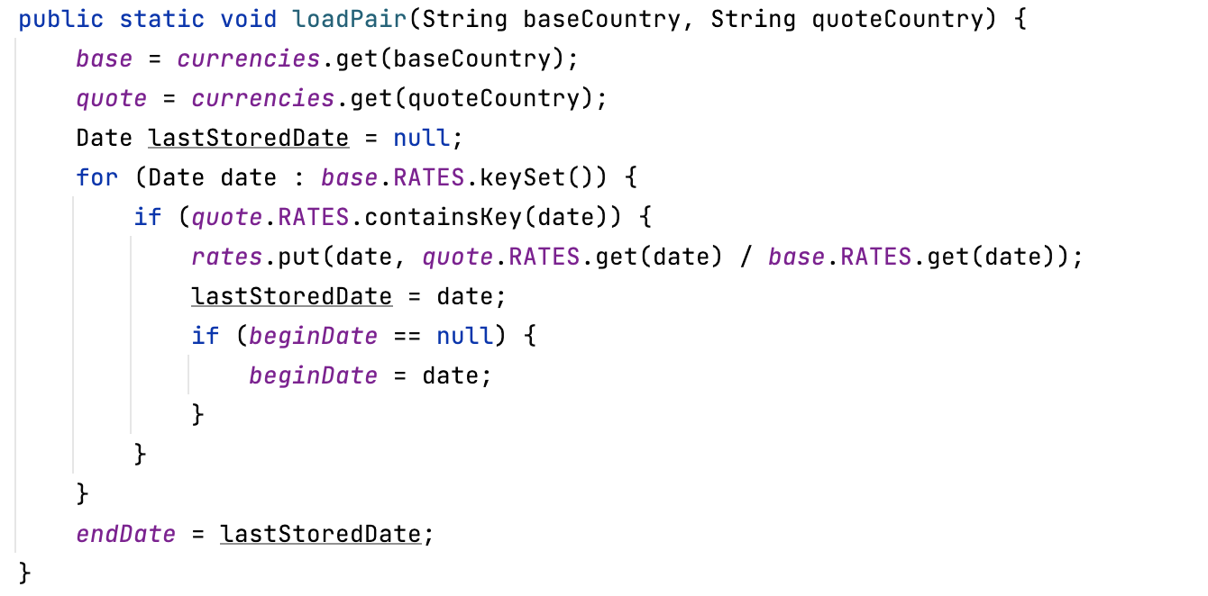

Slide 11
Pros and Cons
Pros
Cons
The program is a quick, efficient resource to access decades of exchange rates for nearly two dozen currencies; this has tremendous applications in finance, trade, public policy, and beyond
Using exchange rates without truly understanding their mechanism can lead to serious loss
Trading currencies for its own sake doesn’t necessarily produce economic output (apart from providing market liquidity) or contribute to society

Slide 12
Challenges
Due to the size of the project, planning in advance which classes and methods to write was difficult
Considerable amount of debugging and figuring out mistakes (e.g., for the custom “Date” class that I wrote to represent dates, I had to override the default “equals” method – something I only realized after much thought)
The description of the data set on GitHub did not seem to precisely match up with the actual data, so I had to sift through the raw data to confirm details (specifically, whether exchange rates were USD/currency or currency/USD)

Slide 13
Conclusion
I was surprised by the incredible complexity of what, in a professional setting, would probably be considered a tiny project
Optimally designing data structures and algorithms is a much greater challenge than I anticipated
I learned about the organizational thinking skills needed to tackle complex programming projects

Slide 14
Bibliography
https://commons.wikimedia.org/wiki/File:US_Dollar_Index_DXY.webp
https://github.com/datasets/exchange-rates
https://docs.oracle.com/en/java/javase/17/docs/api/java.base/java/util/LinkedHashMap.html
https://stackoverflow.com/questions/31698572/understanding-acessorder-linkedhashmap-implementation-in-java

Slide 15
Thank You for Your Attention
Data Methods for the Analysis of Currency Exchange Rates
Aster Li

