Slide 1
AI project : Single Particle Tracking with Simulated Annealing
Stella Stylianidou and Phil Snyder

Slide 2
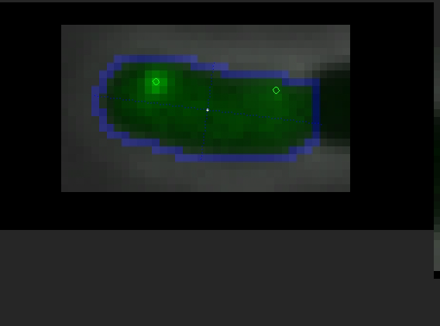
Notes:
One focus is more stationary where is the other one is a lot more dynamic and moving a lot more
start at poles end at poles

Slide 3
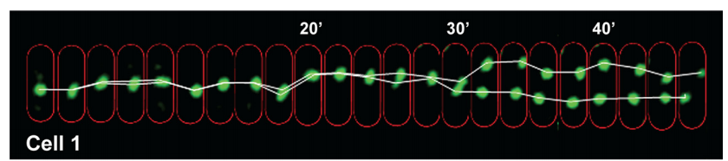
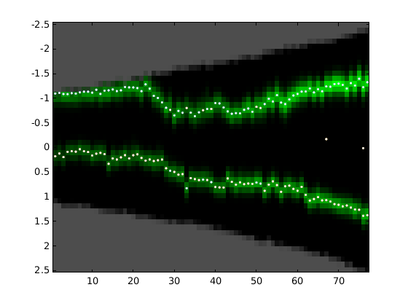
Finding the tracks

Slide 4
Simulated Annealing
Accepts states with probability
exp ((OldCost-NewCost)/T)
Our cost function :
distance of each protein to the next
how many gaps there are during
penalty for track being born and dying during lifecycle

Slide 5
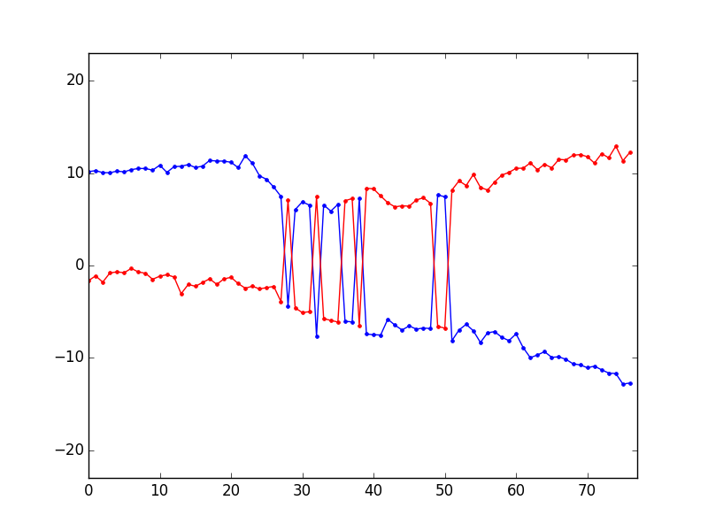
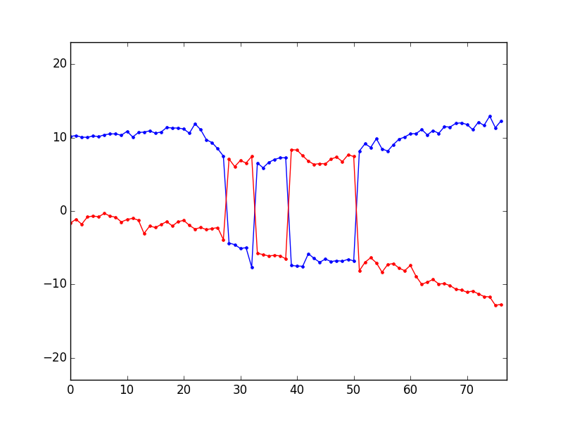
What does our program do?

Slide 6
What does our program do?

Slide 7
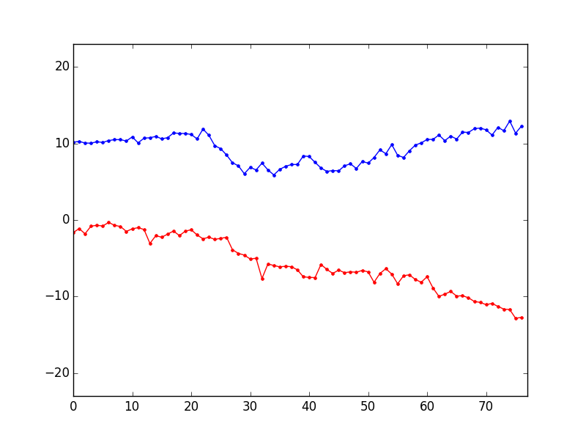
What does our program do?

