Slide 1
AI project : Single Particle Tracking with Simulated Annealing
Stella Stylianidou and Phil Snyder

Slide 2
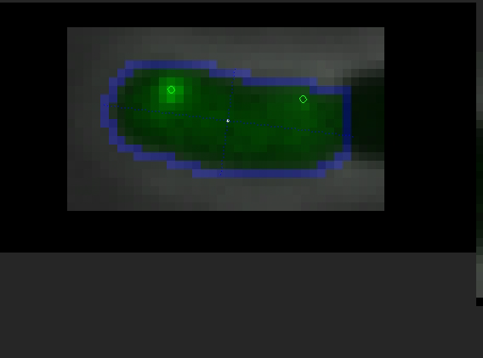
Notes:
One focus is more stationary where is the other one is a lot more dynamic and moving a lot more
start at poles end at poles

Slide 3
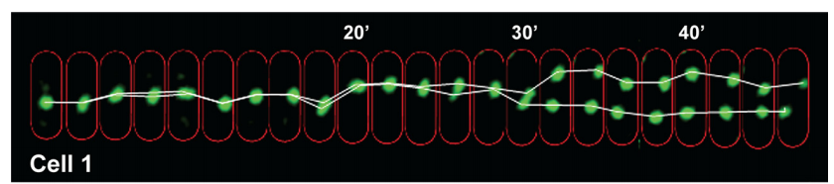
Finding the tracks

Slide 4
Simulated Annealing
Accepts states with probability exp ((OldCost-NewCost)/T)
Our cost function :
combination of distance
how many gaps there are
penalty for being born from nothing, and dying

