Slide 1
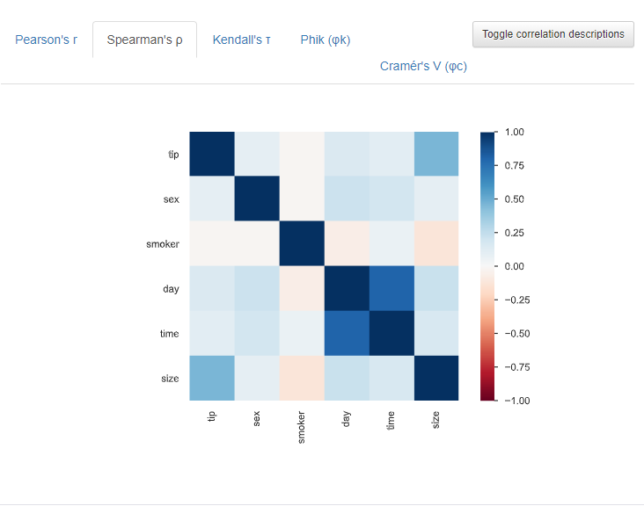
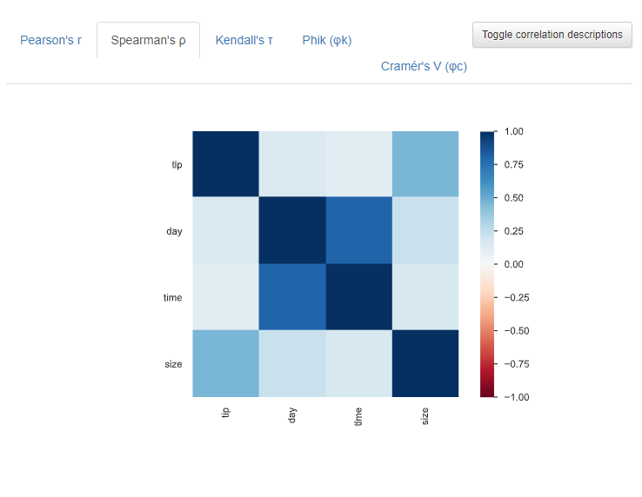
A_1.RFE / tip_rate 없음
before
after

Slide 2
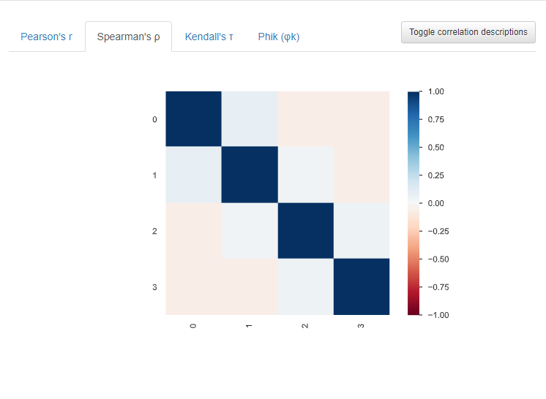
A_2.PCA / tip_rate 없음
before
after

Slide 3
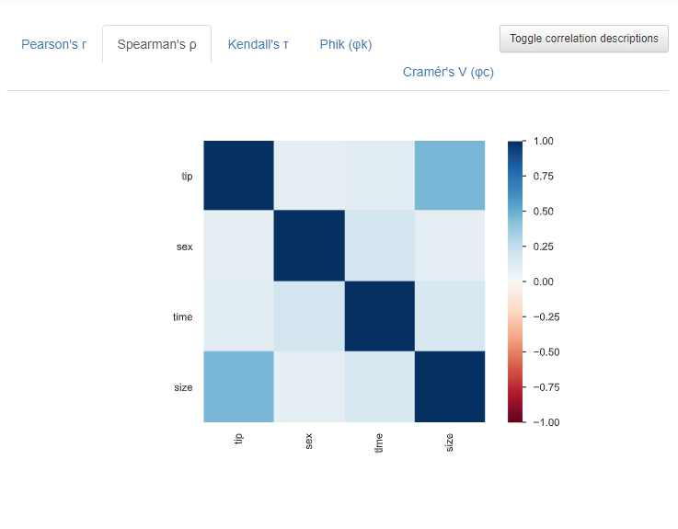
A_3.REG / tip_rate 없음
before
after

Slide 4
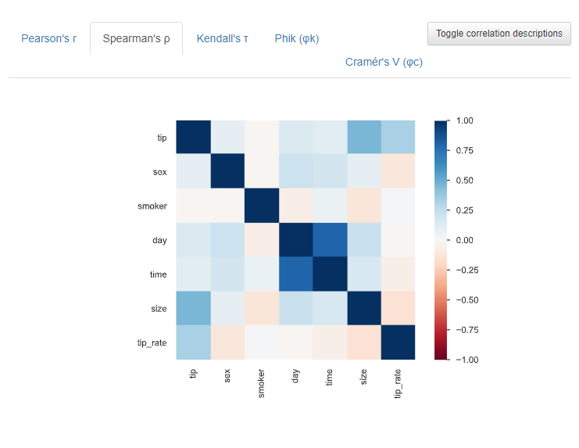
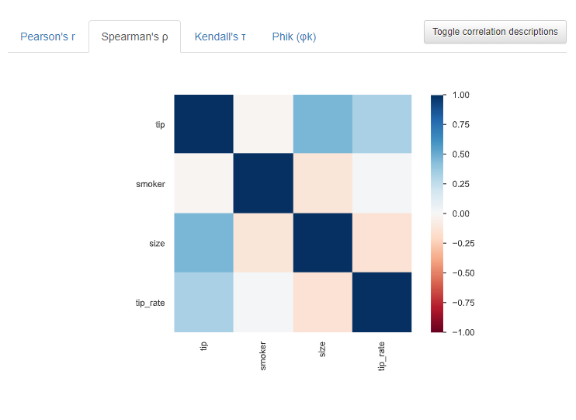
B_1.RFE / tip_rate 있음
before
after

Slide 5
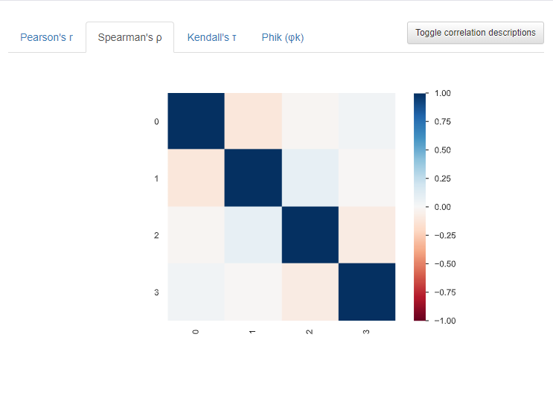
B_2.PCA / tip_rate 있음
before
after

Slide 6
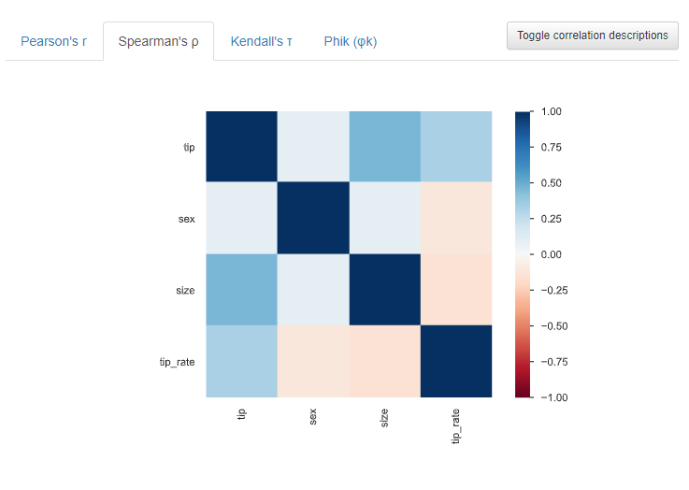
B_3.REG/ tip_rate 있음
before
after

Slide 7
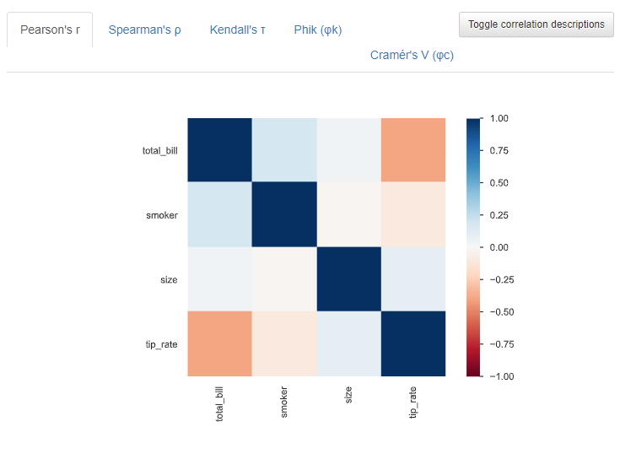
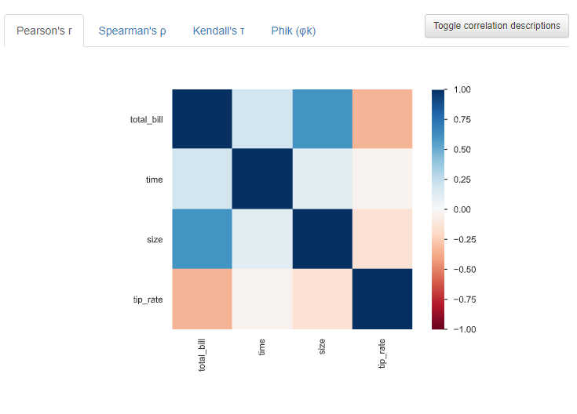
RFE vs stand → RFE
before
after

Slide 8
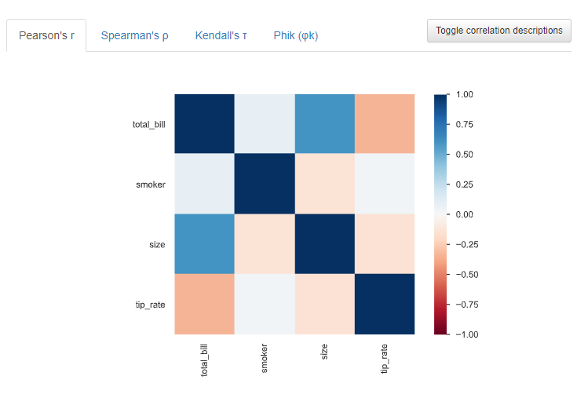
RFE vs norm → RFE
before
after

