Slide 1
Load Testing Asterisk based PBXs with sipp
Trunk and Extension Simulation

Slide 2
Why Load Test?
Make sure that our system can handle a required threshold
Ensure that the network throughput is sufficient
Optimize dial plan and applications
Reassure end users
Notes:
Threshold - unexpected usage, cpu and disk, is transcoding causing a penalty? Is recording affecting IO too much Network - LAN and WAN, unexpected bottlenecks? Routing working as expected?
Optimization - does a queue work as expected? Would a ring group give better performance? Are we over or under speccing?
Reassurance - The ultimate goal, to make sure the folks we are installing for feel confident in the solution.

Slide 3
What is sipp and why is it so useful?
sipp is an open source test tool created under the GNU general license used to simulate SIP user agents.
sipp contains basic UAS and UAC scenarios, but more importantly it allows us to script specific scenarios, written in XML format. Adding additional variables from csv files makes the scenarios files flexible, improving automation.
Support for out-of-scenario secondary scripts and automatic responses for INFO, NOTIFY, OPTIONS and UPDATE messages further increase flexibility and allow sipp instances to act more like real SIP User Agents.
See: http://sipp.sourceforge.net/
Notes:
Assume that most of the audience is familiar with this tool, but may not know how useful and adaptable it is.
UA - User Agent. C/S - Client/Server

Slide 4
What is sipp and why is it so useful?
RTP echo and PCAP playback features allow for realistic media simulation and with the use of secondary analysis tools like htop, tcpdump and wireshark we can get a good sense of how the system performs.
Summary screens and logs indicate failure rates giving a sense of how the test ran, but not necessarily the quality of particular calls. Capturing traces from the simulated UA’s helps quantify things like jitter and packet loss.
We can always have sipp simulate load while we simultaneously make some sample human calls. This is especially useful as the human experience is the most important metric.
Notes:
Compare input vs output in wireshark, look at jitter, packet loss etc.
We can even navigate IVRS!
Having some humans make test calls while the system is under test also helps us understand if the results we see have bearing on actual call value.

Slide 5
Trunks are easy, extensions are hard
Simulating a trunk is relatively simple. FreePBX and most other Asterisk based PBXs define a trunk based on an IP or hostname (and port.) Combined with IP auth and the -aa flag, our trunk simulators can be relatively simple uac/uas scenarios.
sipp binds to a specific IP and port so we may need to create multiple trunks to different scripts if we intend to simulate inbound and outbound traffic simultaneously. Alternatively, we can use the Match (permit) setting on pjsip trunks.
Rate, ramp up and max simultaneous calls are all based on command line arguments but also can be adjusted on-the-fly either via stdin or via udp port
Notes:
-aa : Enable automatic 200 OK answer for INFO, NOTIFY, OPTIONS and UPDATE.
Inbound and outbound simultaneously can be tricky as these need to be simulated with different ip:port bindings. Freepbx pjsip trunks have no problem with this, although we have to take care to make sure our pjsip endpoint identifiers are defined in the correct order.
Less flexible PBXs like switchvox will require multiple trunks, most likely at different IPs
SIPp can be "remote-controlled" through a UDP socket. This allows for example
To automate a series of actions, like increasing the call rate smoothly, wait for 10 seconds, increase more, wait for 1 minute and loop. Have a feedback loop so that an application under test can remote control SIPp to lower the load, pause the traffic, ...
Each SIPp instance is listening to a UDP socket. It starts to listen to port 8888 and each following SIPp instance (up to 60) will listen to base_port + 1 (8889, 8890, ...).
It is then possible to control SIPp like this:
echo p >/dev/udp/x.y.z.t/8888 -> put SIPp in pause state (p key)
echo q >/dev/udp/x.y.z.t/8888 -> quit SIPp (q key)

Slide 6
Trunks are easy, extensions are hard
The easiest way to simulate load would be to have a trunk in and a trunk out, with calls directly routed from the inbound trunk to the outbound trunk.
This can be useful if we want to determine the maximum input and output but this avoids the load associated with having the expected number of extensions registered or the overhead of things like ring groups or queues.
Still, this method can be helpful for a production PBX where we do not want to take the place of existing extensions and only want to add call traffic.
Notes:
It’s true that we could still have existing extensions registered on the PBX and this would be more accurate

Slide 7
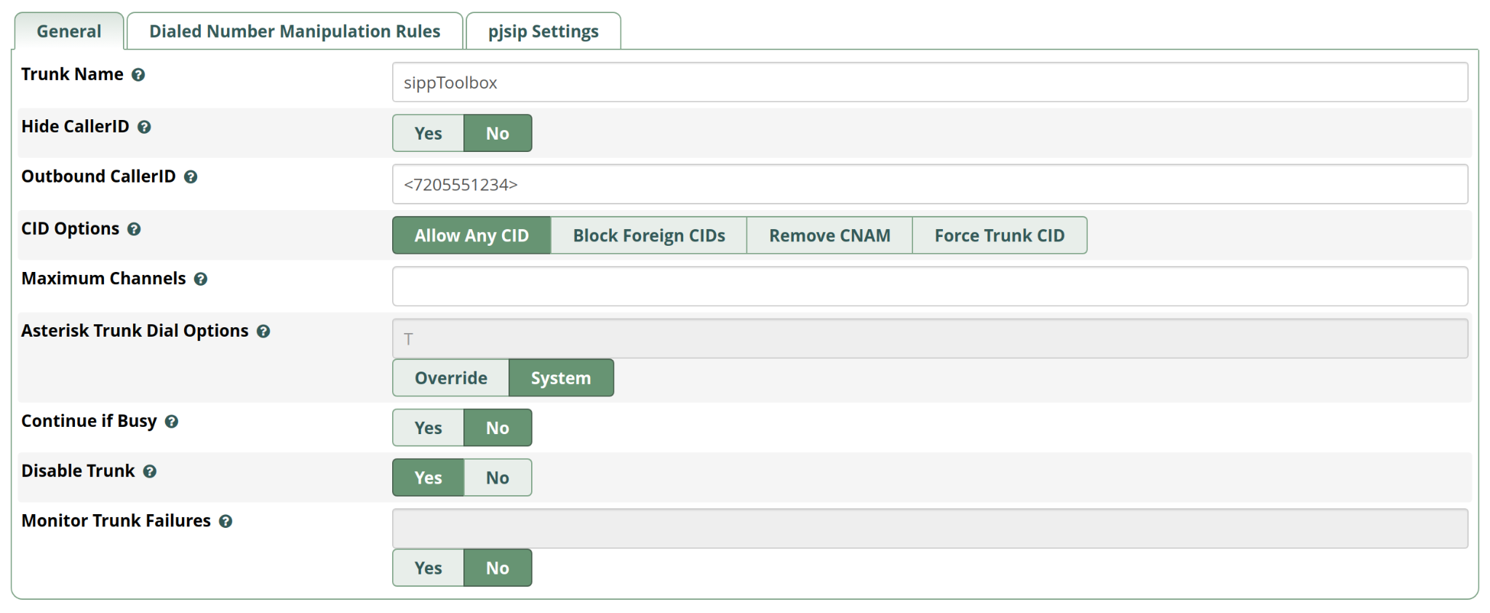
IP Auth trunk to sipp test host
General Settings

Slide 8
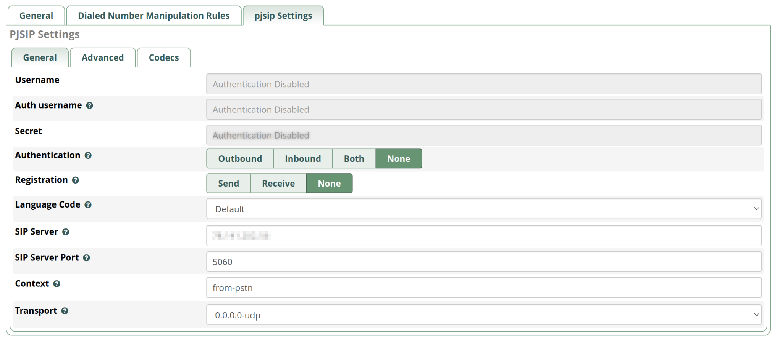
IP Auth trunk to sipp test host
PJSIP Settings

Slide 9
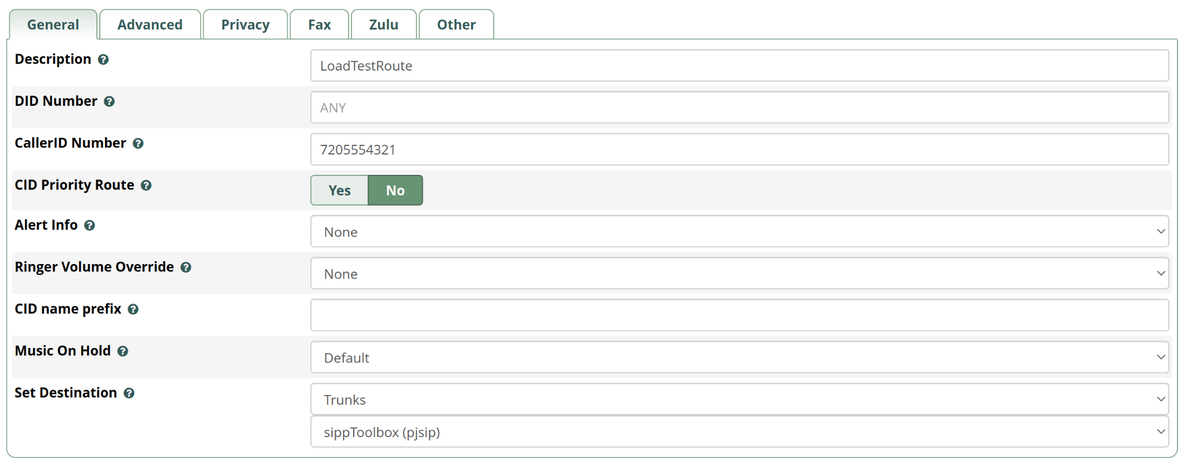
IP Auth trunk to sipp test host
Inbound route based on test Caller ID routes back to sipp trunk

Slide 10
Trunk simulation - reception
Start the uas scenario first so that it is waiting for calls.
sipp -sf /opt/sipp/sipp-3.6.0/XML/uas.ASTC.g711.pcap.xml -i <sipp_systemIP> -p 5060 -aa -mp 15000
This will run, waiting for calls to come in to <sipp_systemIP> at port 5060, which matches our trunk configuration.
All configuration files, xml scenarios and rtp samples are available at the following google drive folder: https://bit.ly/3l015c0

Slide 11
Trunk simulation - generation
We then can start the uac, making sure to specify the calling party to match the test route we created.
Sample command line, uac call generator that sends calls to the specified IP and port
sipp -sf /opt/sipp/sipp-3.6.0/XML/uac.ASTC.g711.pcap.xml <PBX_SUT_IP> -aa -mp 10000 -r 1 -rp 10 -m 1 -l 1 -i <sipp_systemIP> -p 5160
Note that we are running this on a different port than the uas script, which is tied to the trunk port.
All configuration files, xml scenarios and rtp samples are available at the following google drive folder: https://bit.ly/3l015c0

Slide 12
Trunk simulation - generation
Break down of the options we are specifying
sipp -sf /opt/sipp/sipp-3.6.0/XML/uac.ASTC.g711.pcap.xml <PBX_SUT_IP> -aa -mp 10000 -r 1 -rp 10 -m 1 -l 1 -i <sipp_systemIP> -p 5160
-sf : which scenario file to use -aa : Enable automatic 200 OK answer for INFO, NOTIFY, OPTIONS and UPDATE -mp : local rtp echo port -r : call rate in calls per second -m : number of test calls to run -l : maximum number of simultaneous calls -i, -p : local IP and Port to bind to

Slide 13
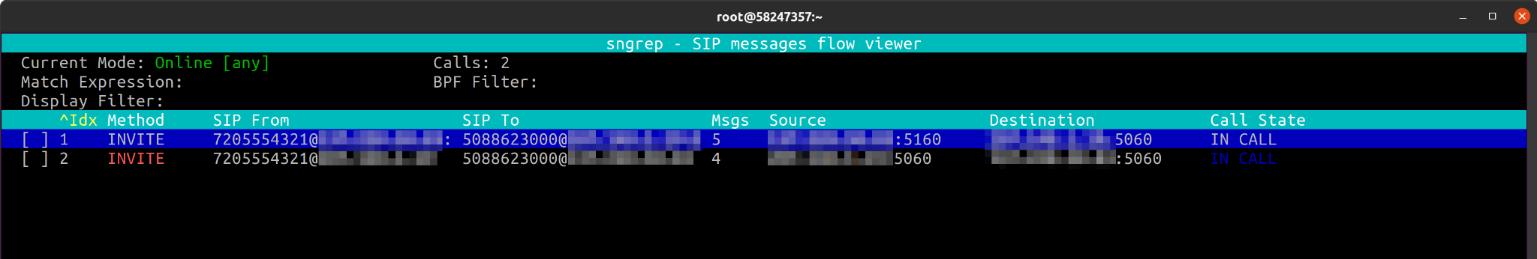
Monitoring active calls with sngrep
We can watch the calls get routed through the system live using sngrep:

Slide 14
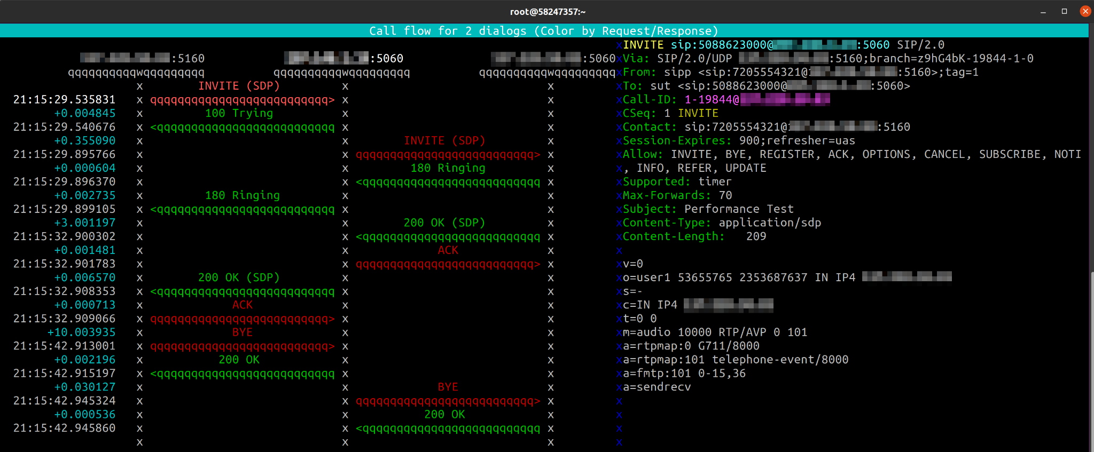
Monitoring active calls with sngrep
Call Detail:

Slide 15
Trunks are easy, extensions are hard
Extensions are more difficult to simulate as they act as both uas and uac, which requires separate scripts. Even if our only goal was to register then wait for a call, this can not be done within a single script because the post-registration INVITE from the PBX would be considered a new dialog and would ‘break’ the scenario.
The -aa flag can handle non-call messages but not calls.

Slide 16
Simulating Extensions
To simulate extensions we will take advantage of sipp’s ooscf (Out of Scenario File) feature that lets us receive messages that are outside of the scope of the scenario file and hand them to a separate scenario file.
This lets us act as a UAC for the purposes of registering with the PBX, while within the same sipp instance act as a UAS that can receive new INVITE messages and respond to them as an extension typically would.
This is impossible within one scenario file as sipp will treat the INVITE as a separate call even if the scenario file expects it and will error-out of the dialog.

Slide 17
Simulating Extensions - two scenarios
The first scenario file acts as a UAC, registering with the normal REGISTER - 401 - REGISTER - 200 OK then waits for a period less than the registration timeout. The -m N flag specifies how many times this loop will be run.
N * the wait period will determine how long the simulated extension will stay registered but does not limit the number of calls that can be run. The sipp instance simulating the extension will pass all dialogs to the ooscf scenario that are not already covered by the -aa option (INFO, NOTIFY, OPTIONS and UPDATE.)
This is not a perfect reproduction in that the outlined method does not cover subscriptions for any BLFs, etc but the ability to register and accept calls is very close.
Notes:
In theory more is possible in terms of SUBSCRIBE, etc. 3PCC could also simulate transfers, but that could be it’s own topic.

Slide 18
Simulating Extensions - auth info
We will read the auth info (extension, PBX IP, and secret) from a csv file to feed to our scenario.
Sample csv entry: SEQUENTIAL user-extension;PBX-IP;[authentication username=user-name password=user-secret];
Matching REGISTER message from scenario file: REGISTER sip:[remote_ip] SIP/2.0
Via: SIP/2.0/[transport] [local_ip]:[local_port];branch=[branch]
From: <sip:[field0]@[field1]>;tag=[call_number]
To: <sip:[field0]@[field1]>
Call-ID: [call_id]
CSeq: 2 REGISTER
Contact: sip:[field0]@[local_ip]:[local_port]
[field2]
Max-Forwards: 5
Expires: 1800
User-Agent: SIPp/Linux
Content-Length: 0

Slide 19
Simulating Extensions - auth info
Reading this info from the csv file has the advantage of letting our register script be completely generic.
We can then create multiple csv files and pass the csv file to the scenario from the command line: sipp -sf uac.ExtensionRegWait.xml [PBX-IP] -inf Client.csv -i [local_p] -p [local_port] -m [iterations to run] -l 1 -aa
This lets us simulate multiple extensions at the same time. We do however need to make sure that the local port is unique to each instance so we do not cause any collisions.

Slide 20
Simulating Extensions - two scenarios
The second scenario file acts as a UAS in that it waits for an INVITE, answers and then waits for a BYE. The scenario we use here sends a ringing then waits 2 seconds and answers the call. This can be modified to match the desired call flow. It is even possible to use the “distribution” option to make the answer time variable:
<pause distribution="uniform" min="2000" max="5000"/>
This can be useful if the extensions are in a ring group or ring-all queue and you do not want all extensions to try and answer at the same time.

Slide 21
Simulating Extensions
It is possible for the extension simulating script to originate the BYE instead of waiting for it, but having the trunk side originate and terminate the call prevents error scenarios from leaving trunk side instances hanging.
As our goal is to load the system rather than test a variety of specific scenarios, encapsulating the call duration, rate and concurrency to the trunk side simplifies the process and allows real-time modification to these variables in one place.
Please refer to the following link for details on how to change parameters on a running script: http://sipp.sourceforge.net/doc/reference.html#Controlling+SIPp

Slide 22
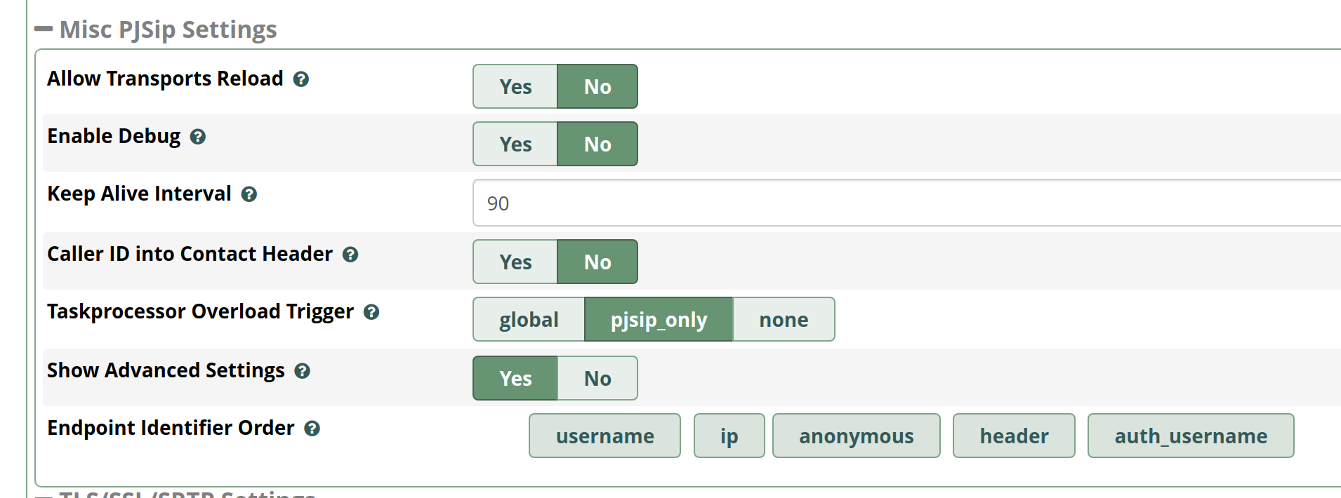
Simulating Extensions - single sipp host
A note: it is possible to use the same test box to simulate the trunk and the extensions, but if you do you need to make sure that the endpoint identifier has username before ip.
Notes:
A single server can be ok, provided it can handle simulating both trunks and extensions. If you are running a large number of extensions, it may be necessary to use more than one server.

Slide 23
Combining the two scenarios - SwitchVox Example
Now that we are able to simulate trunks and extensions, we can put the two together and simulate “real world” call scenarios by having the trunk simulating UAC dial into the PBX, then have the PBX route the calls to the registered simulated extensions.
Using Switchvox, this can be done with a Ranged DID Rule that routes incoming trunk calls to specific extensions (https://support.digium.com/s/article/How-do-you-create-a-ranged-incoming-call-rule). We can then pass the list of DIDs to the UAC trunk instance as a sequential list, which sipp will then iterate through. Example csv: SEQUENTIAL 17203782060; 17203782061; 17203782062;
Matching to line from scenario file: To: sut <sip:[field0]@[remote_ip]:[remote_port]>

Slide 24
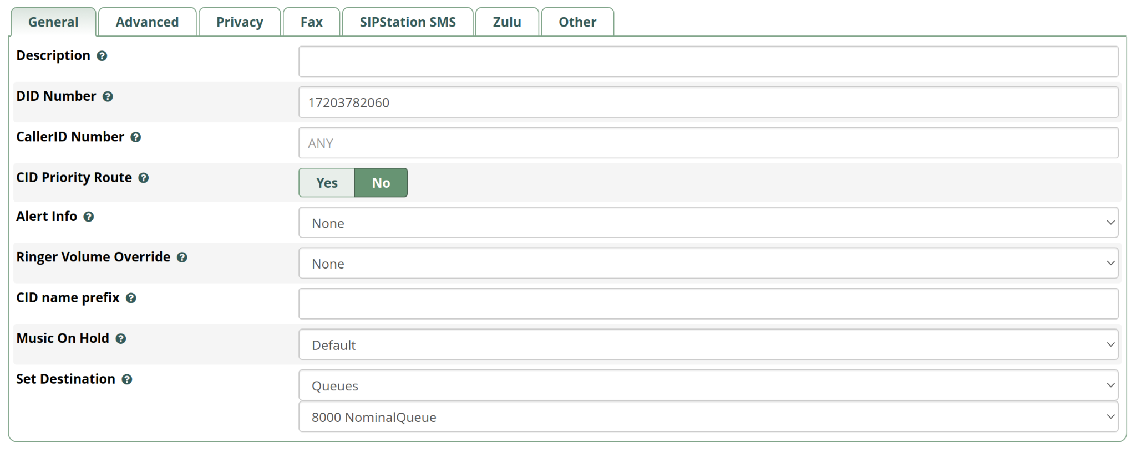
Combining the two scenarios - FreePBX Example
Queues are a popular feature on FreePBX but can cause higher than anticipated load due to the additional overhead associated with queue calls.
To test, we will then create an inbound route based on the DIDs we pass to the script in the csv and route it to a round-robin queue (note DID number is from the csv we saw earlier):

Slide 25
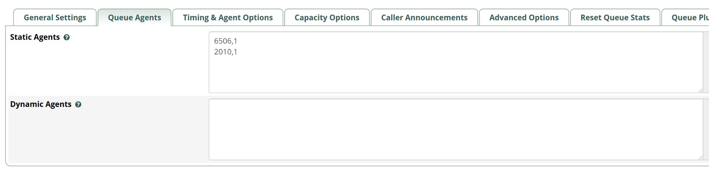
Combining the two scenarios - FreePBX Example
Here we assign two extensions to the queue:

Slide 26
Combining the two scenarios - FreePBX Example
We then create two csv files, one for each extension:
2010.csv: SEQUENTIAL 2010;<PBXIP>;[authentication username=2010 password=<extensionSIPSecret>];
6506.csv: SEQUENTIAL 6050;<PBXIP>;[authentication username=6050 password=<extensionSIPSecret>];
Then start a sipp instance for each Extension: sipp -sf uac.ExtensionRegWait.xml <PBXIP> -inf 2010.csv -oocsf uas.ExtensionWaitForINVITE.xml -i <localIP> -p 5160 -mp 10000 -m 100 -l 1 -aa & sipp -sf uac.ExtensionRegWait.xml <PBXIP> -inf 6506.csv -oocsf uas.ExtensionWaitForINVITE.xml -i <localIP> -p 5161 -mp 10010 -m 100 -l 1 -aa &
(note that we change the port for each running instance)

Slide 27
Combining the two scenarios - the value of passing variables from csv files
For the most part, it is a good idea to abstract the scenario file from things like DIDs, auth info, etc by separating the information that can change from the actual call flow scenario.
This abstraction helps us in multiple ways:
The scenario files can be re-used between systems simply by using a different csv file at run-time.
Automate the generation of the csv files (bulk export, GraphQL).
Re-use the csv files in multiple scenarios: ie; keep the same DID list but change codecs or play a different audio stream.

Slide 28
Adding Audio streams
Up until this point we have focused on simulating the SIP traffic. This in and of itself is useful and will help us make sure our trunks and extensions are configured correctly, but to really simulate traffic we need to add rtp.
sipp contains an ‘rtp echo’ option, similar to an echo test. This is controlled with the following command line options:
-rtp_echo: Enable RTP echo. RTP/UDP packets received on port defined by -mp are echoed to their sender. RTP/UDP packets coming on this port + 2 are also echoed to their sender (used for sound and video echo).
-mb: Set the RTP echo buffer size (default: 2048).
-mp: Set the local RTP echo port number. Default is 6000.
This is useful if one side is a “real” endpoint, but having two sides echo back at each other doesn’t accomplish much.

Slide 29
Adding Audio streams - pcap playback
The pcap playback feature of sipp allows us to take a pre-recorded rtp stream and have the sipp script “play back” this stream as the rtp portion of the call.
We can use this to send a variety of audio data:
White noise (good for looking for packet loss)
DTMF tones (for navigating IVRs)
Pre-recorded voice (best all-around simulation)
Problematic streams (extracted audio from ‘bad’ calls that we may have previously pulled from the PBX)
It is a good idea to have a few baseline streams for re-use. We have extracted a few based on public domain presidential speeches, available at the google drive link provided at the end of this presentation.

Slide 30
pcap playback - capturing a call
The first step is to capture a call containing an rtp stream in the appropriate codec. This can be done with wireshark, tcpdump, tshark, etc. If you are making one from scratch, make sure that the SIP UA you are using is configured to use the codec format that you want to test with. In this example we are generating a ulaw rtp stream.

Slide 31
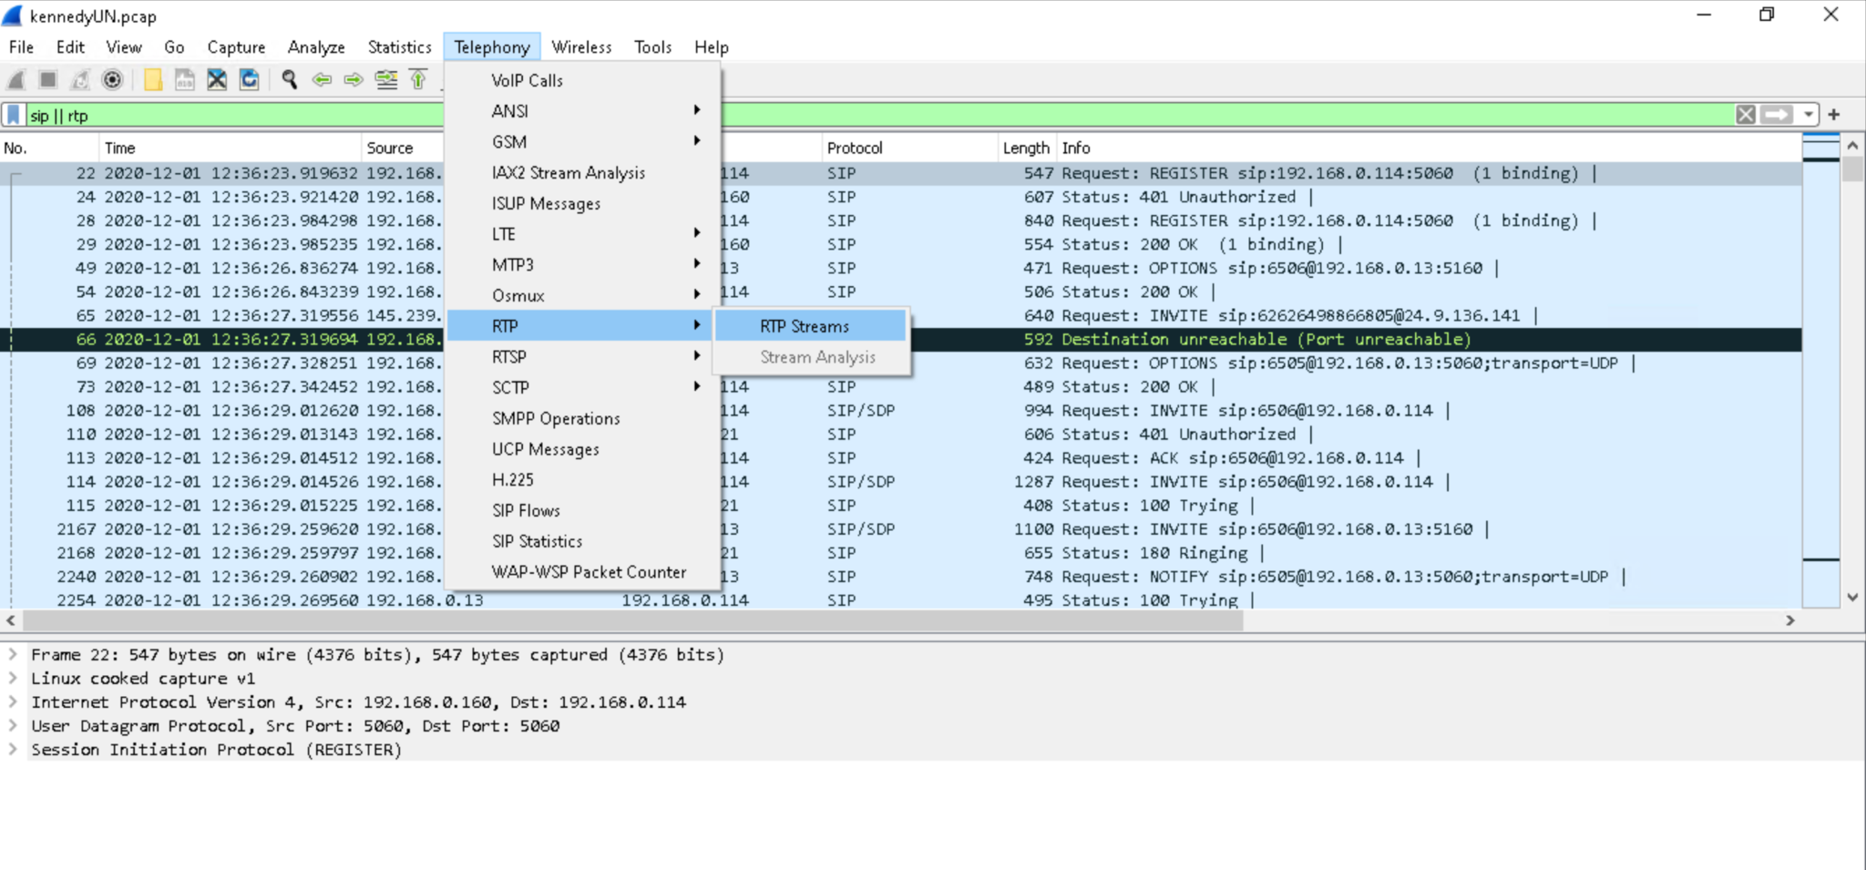
pcap playback - RTP Streams
Start by opening the captured call in wireshark, then selecting Telephony > RTP > RTP Streams:

Slide 32
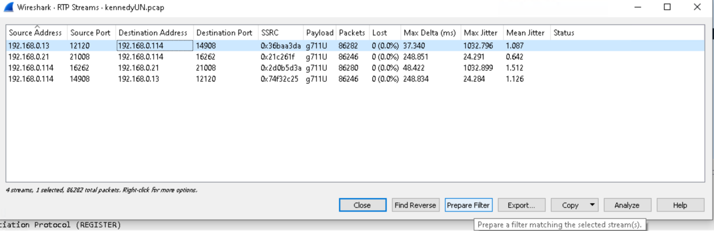
pcap playback - RTP Streams
This will list the RTP streams that Wireshark found in the trace. From here we look for the stream associated with our call (usually identified by source and destination IP and Port from the SDP of the call.) Once we have found it select Prepare Filter:

Slide 33
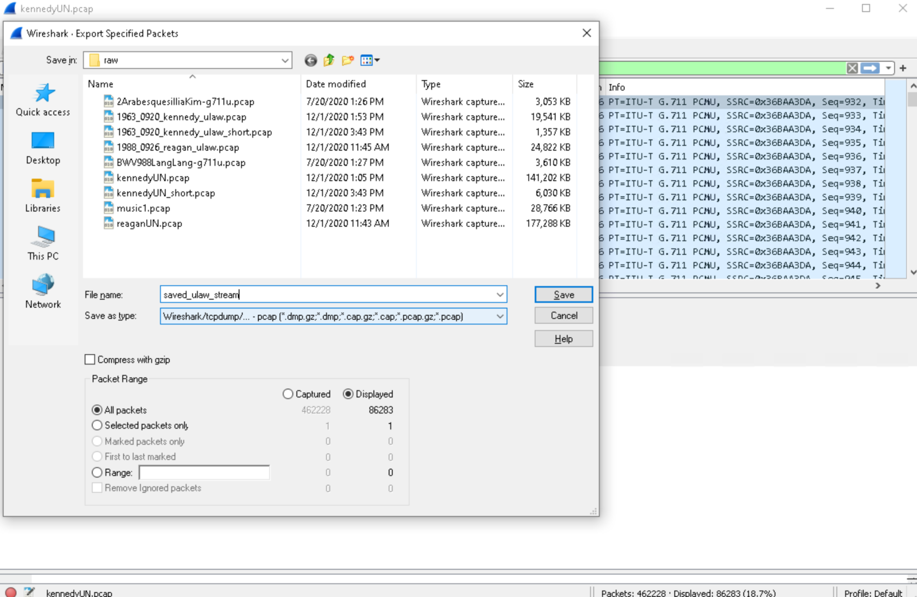
pcap playback - Exporting an RTP Stream
From Here we select File > Export Specified Packets and make sure to select “Displayed”

Slide 34
pcap playback - Using the recorded stream
Now that we have a pre-recorded RTP stream we can start playback of this stream using the play_pcap_audio action. <nop> <action> <exec play_pcap_audio="/opt/sipp/sipp-3.6.0/XML/pcap/saved_ulaw_stream.pcap"/> </action> </nop>
A few things to keep in mind:
The SDP offer in the sipp script should match the codec type
The timing of the action within the script is important, don’t start sending rtp before the SDP negotiation is complete

Slide 35
Monitoring and analyzing the results
In general we want to keep the System Under Test “SUT” as close to production/real world as possible so try to run any network traces on the sipp test server or network switch (both is even better.) Taking the resulting captures from the sipp server also gives a better representation of how the output will look at the end-device which is what is most important.
Local monitoring tools like top or Zabbix running on the PBX can help give a view of how the system is handling the load.
The asterisk full log is also helpful to look at after the fact. Did asterisk report any taskprocessor issues? Did any peers become unreachable during the test?

Slide 36
Re-examining our goals
While any one part of what has been outlined here is useful, when putting them all together we can really get a good idea of how the system will operate under load.
When building our test, we want to remember why we are doing this and make sure that the designed test meets those requirements.
Make sure that our system can handle a required threshold
Ensure that the network throughput is sufficient
Optimize dial plan and applications
Reassure end users

Slide 37
Resources
All referenced scripts and pcap files: https://bit.ly/3l015c0
https://wiki.freepbx.org
https://support.digium.com
http://sipp.sourceforge.net/doc/reference.html
https://www.wireshark.org/

