Slide 1

Coding talks can be boring

Slide 2
Intro to Asterisk Dev:
Coding in Asterisk
David M. Lee, II
Senior Software Developer

Slide 3

I'll endeavor to do better
http://xkcd.com/303/

Slide 4
Overview
Modules
Applications in Dialplan
Channel Development
Internal vs. External Applications

Slide 5
Modules!

Slide 6
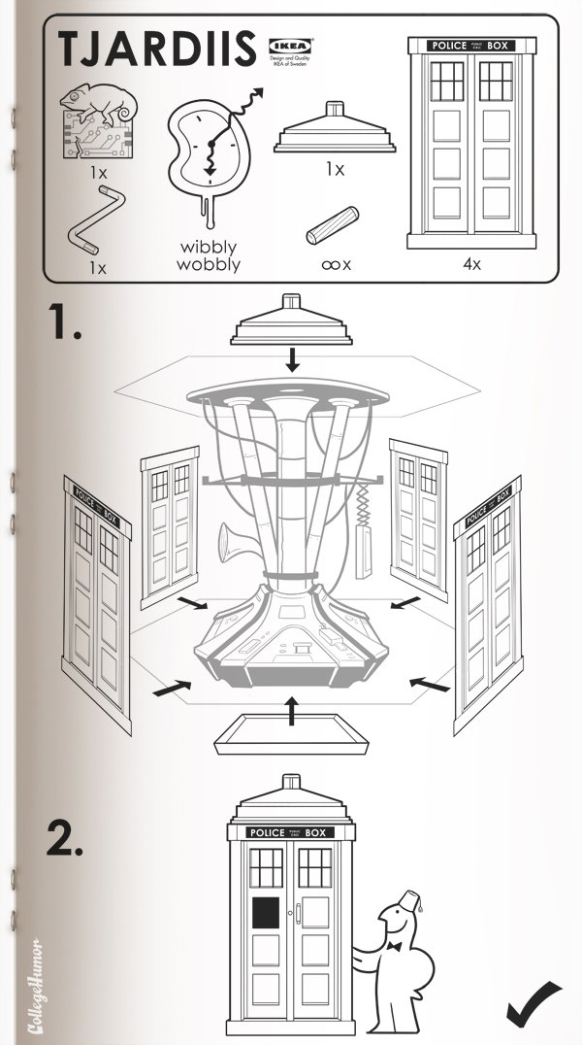
Modules
Asterisk has modules!
  channels/chan_*.c – Channel driver
  funcs/func_*.c – Dialplan function
  apps/app_*.c – Dialplan application
  res/res_*.c – Shared resource module
  Several others, but not as interesting

Slide 7
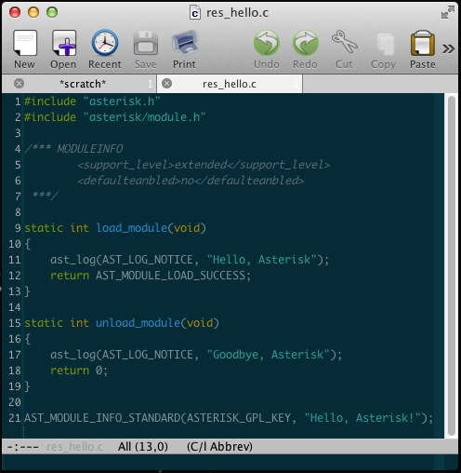
Bare Bones Module

Slide 8

MODULEINFO
Comment at top of file /*** MODULEINFO
Defines metadata used by configure and build system
  Build dependencies
  Module dependencies
  Support level
  Enabled by default

Slide 9

load_module
Entry point for the module
Read configuration; allocate resources
Registers self
  ast_custom_function_register
  ast_register_application_xml
  ast_channel_register
  Etc.

Slide 10

unload_module
Exit point
Free up resources; deregister
Returns -1 if in use or cannot unload

Slide 11
AST_MODULE_INFO
MOAR METADATA!
  License key string
  Module description
  AST_MODULE_INFO gives you more options, but not needed for simple modules.
Macro injects the code necessary for the module to be loadable by Asterisk's conventions.

Slide 12
Adding a module to Asterisk
Just drop the file into the appropriate directory
The Asterisk build system will automagically scan the source, add compile dependencies from the MODULEINFO block, and build your module
  No editing Makefiles

Slide 13
Didn't catch all that?
Here's the gist of it: https://gist.github.com/3919683

Slide 14

Okay, how do I right a good module?
Keep your modules small and targeted.
It's better to write many small modules than one big one.
We've not always followed that advice. We certainly wish that we had.

Slide 15
Applications!

Slide 16
Applications in Dialplan
apps/app_*.c
In load_module, call ast_register_application_xml
  _xml means synopsis and description are pulled from the XML docs
In unload_module, call ast_unregister_application
In your app_exec function, write your app

Slide 17
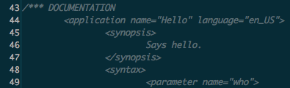
Documentation!
/*** DOCUMENTATION block near the top of the file
Becomes a part of the docs, and autogenerated on wiki.asterisk.org

Slide 18
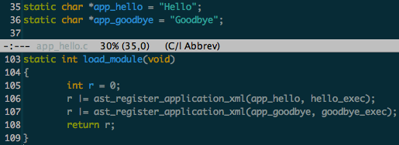
Registering your application
Define your app name in static char *app_whatever
Name your application function whatever_exec
If you register multiple apps, |= results together for final return code

Slide 19
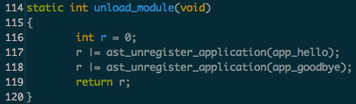
Unregister you application
No surprises here, call ast_unregister_application, |= results together

Slide 20

Application _exec function
Your app_exec callback function takes two params
  chan – The channel being applied to
  data – Application params

Slide 21
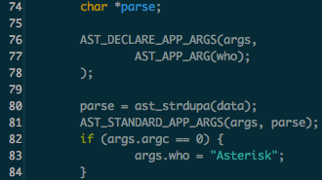
Now for writing your app
Parse your arguments
  Handful of macros to help you out

Slide 22

Do the work
struct ast_channel passed to the app for working with the channel
  app_echo.c is a good example of doing simple stuff
If you going to be a while in the app, be sure you continue to read media from the channel
  Don't let media pile up

Slide 23
Didn't catch all that?
Gist of the sample app
  https://gist.github.com/3931190
apps/app_skel.c is a more complete example you can use as a starting point

Slide 24
Channels!

Slide 25
Channel Development
I have discovered a truly marvelous example of this, which this slide is too narrow to contain
channels/chan_console.c → bare bones example of writing a channel driver

Slide 26
Channel Development High Points
Provide a module_reload function to AST_MODULE_INFO
  Module can be reloaded without bouncing the world
Define an ast_channel_tech with name, description and callbacks for your channel
Register a set of command line and manager commands to administer and debug your channel
Once again: don't write everything in one giant blob of code

Slide 27
Internal vs. External Applications

Slide 28
Internal vs. External Applications
There are two approaches to building applications
  Internal – Write your application as an app_*.so Asterisk module.
  External – Write your application using some combination of AMI and AGI
So, which is better?
  Answer: It depends
  Programmers know the benefits of everything and the tradeoffs of nothing. - Rich Hickey

Slide 29
Internal Applications
Written in C
  You decide if this is good or bad.
Written directly against Asterisk's internal API's
  More churn as Asterisk's internals change
  More powerful
    Can get at more of Asterisk's internal state
  Constrained by the Asterisk way of doing things
    Modularity (functions, apps, resources)
    Threading model
  With great power, comes great responsibility. – Uncle Ben

Slide 30
External Applications
Interacts with Asterisk using AMI+AGI(+ExternalIVR)
Pick your language!
  Helper libraries are available for many languages
    Python – StarPy
    Java – asterisk-java
    Ruby – Adhearsion
Protocols evolved organically over time
  Inconsistent
  Expedient implementations vs. something that make sense
    Some AMI commands respond with Success, and send the actual results/failure in a later event.

Slide 31
In General, though
When writing an application, I recommend starting with AMI+AGI
  If this is sufficient for you, Excellent!
  Or, you may need to write a few new Manager commands
  Either way, you'll find that it's probably less effort than writing your entire application as an Asterisk module

Slide 32
Questions?

