Slide 1
Twitter Image Sentiment Analysis

Slide 2
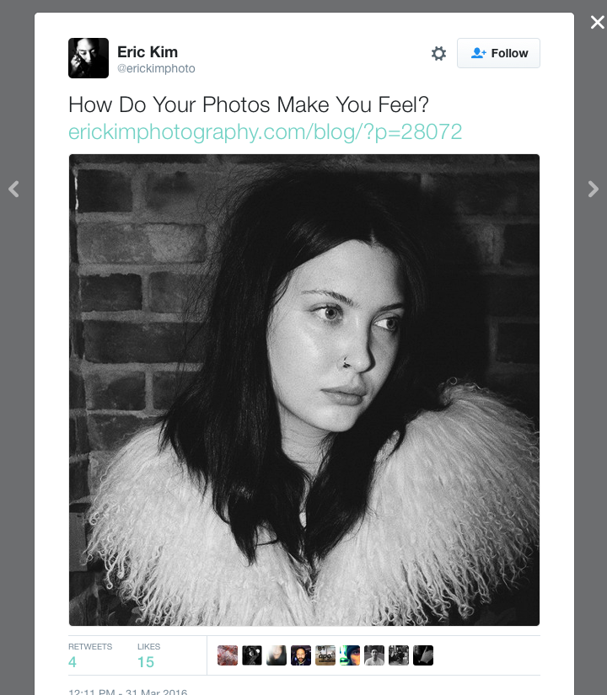
Using Images to Understand Tweets
Issue: Social media has become image-centric; can’t only rely on text
Issue: Hard to score image sentiment automatically
Problem: can we build an image sentiment classifier relying on images in Twitter data?
Notes:
Social media is increasingly important for brands, politicians, etc
Much work is on text, but social media is increasingly image-centric
Not lots of work done in terms of determining image sentiment – more in object identification
Hard to build datasets – sentiment is more subjective than object identification
Try to see if can build an unsupervised classifier using Twitter data

Slide 3
Literature Review – Main Lessons
DETERMINING image sentiment
Determining Twitter Text Sentiment
Associated text can be used to determine image sentiment
Neural Networks seem to perform better than other approaches
- Yilin Wang, Suhang Wang, Jiliang Tang, Huan Liu and Baoxin Li, Unsupervised Sentiment Analysis for Social Media Images, International Joint Conference on Artificial Intelligence, 2015
Attributing sentiment to tweets is tricky
Short messages
Use of unconventional grammar & slang
Approaches tend to be lexicon-based
-C.J. Hutto and Eric Gilbert, VADER: A Parsimonious Rule-based Model for Sentiment Analysis of Social Media Text, Association for the Advancement of Artificial Intelligence, 2014
Notes:
Number of different papers reviewed: 2 main categories
Determining image sentiment
Determining twitter text sentiment
Image sentiment
Some researchers have had good success determining image sentiment based on text or metadata with image
Neural Networks seem to have better results than “bag of features”, or overall pixel comparisons
Twitter text sentiment
Harder than larger lexicons
Short messages
Slang, odd grammar, abbreviations, emoji, hashtags
Tend to be lexicon based with various degrees of processing & complexity

Slide 4
Dataset
Primary data: Downloaded tweets & images
tweet text (and id)
image as 400px x 400px RGB jpeg
Validation set: Human-scored images from www.crowdflower.com
image sentiment score
image as 400px x 400px RGB jpeg
Notes:
Twitter data doesn’t provide reliable ground truth
Crowdflower has human-scored images
Majority vote
Only positive/negative sentiment (no neutral)

Slide 5
Approach (block diagram)
Pull Raw Twitter Data
Subset to Original Tweets with Images
Ascribe Sentiment to Tweets Based on Text
Use Tweet Sentiment to build a predictor for Image Sentiment
Test Classifier against Twitter and Crowdflower Images
Notes:
Pull Twitter Data: Pretty straightforward from Twitter API
Downloaded appx 10,000,000 tweets
Subset to tweets
English
Has an image
Not a retweet
Cut down to appx 125,000
Ascribe sentiment
Used lexicons and VADER tool (see paper)
Split hashtags based on combined sentiment dictionary
Ascribed as positive/neutral/negative
Use sentiment to build predictor
For fun, tried a few approaches
Random Forest
Support Vector Machines
Multi-Layer Perceptron
Neural Network
Test model
In most cases, just tested against a test panel
For Neural Network, also tested against Crowdflower data

Slide 6
Approach (cont’d)
Key decisions
Only rely on original tweet text – not responses
Multi-lexicon approach to text sentiment (requiring unanimous agreement)
Treatment of repeated images
Leveraging LeNet engine (-2 layer)
Notes:
Couple of key choices along the way
Wanted to include responses; rate limits on Twitter API prevented this
Because of tricky nature of sentiment ascription – used 3 approches
Only rated sentiment where all 3 agreed.
Cut down to 70,000 images (only 5,000 negative)
Some images repeated – in some cases a lot
De-duped
If less than 80% agreement, discarded from usable image
Actually building Neural Net
Misery of Theano

Slide 7
Results
= Failure!
Notes:
Basically, no different from chance
Neural Net was better @39 % but, really, at 39%, who cares?

Slide 8
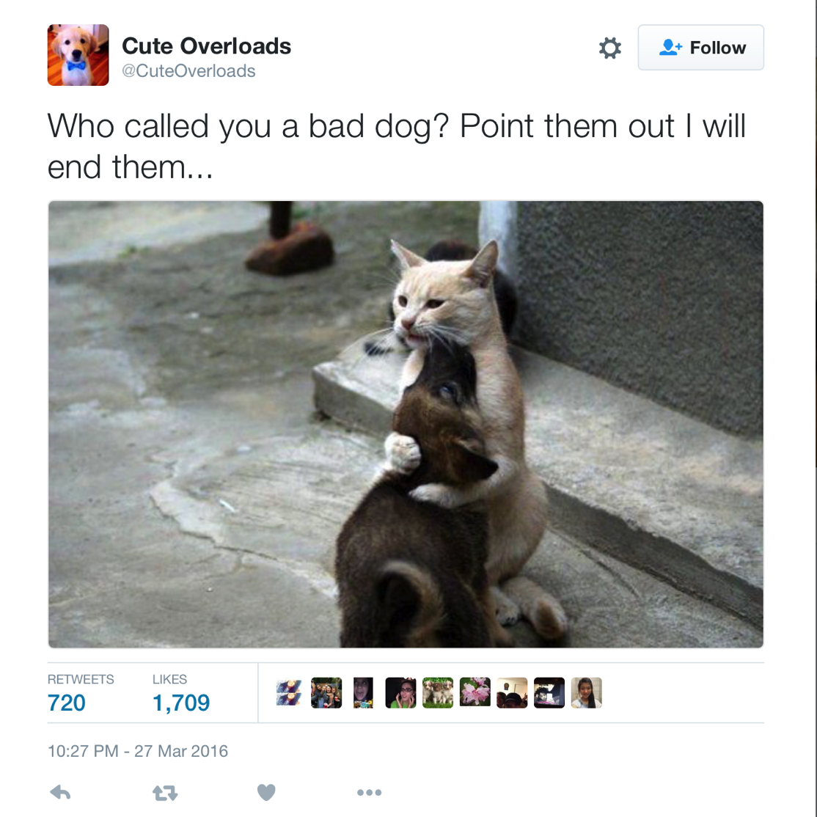
Conclusion/Discussion
For Twitter, text & sentiment probably don’t align
CNN had 74% accuracy on Crowdflower (chance was 50%)
How to improve?
Better pre-processing?
Other data set?
Custom CNN?
Notes:
Interesting question is why
Literature showed good results from similar approaches to mine, using Flicker or Instagram data
Jury-rigged CNN still worked well on Crowdflower data
Problem is likely with how nature of twitter messages:
- Text is not an image label
- Text interacts with image to create an effect
- Lots of advertising
Solutions?
- Better pre-processing?
- Find a way to remove ads?
- Custom-trained CNN?

