Slide 1
Image Sentiment Analysis

Slide 2
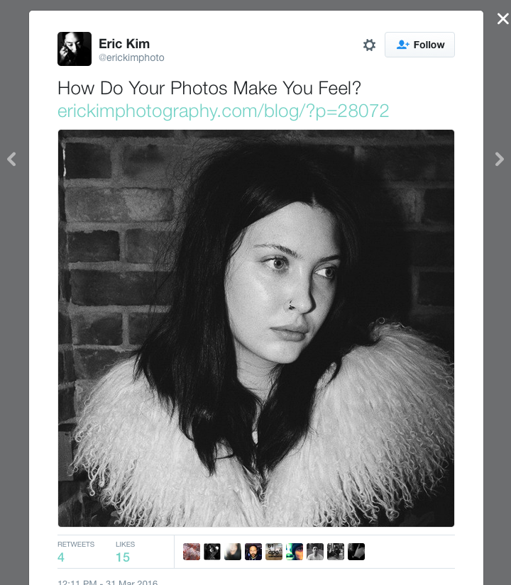
Text Sentiment ≠ Tweet Sentiment
Goal: To better understand tweet sentiment
Issue: Tweets are not just text
Problem: can we build an image sentiment classifier based on tweet data?

Slide 3
Literature Review
Twitter Text Sentiment
Social Media image sentiment
Attributing sentiment is tricky
Short messages
Use of unconventional grammar & slang
Approaches tend to be lexicon-based
-C.J. Hutto and Eric Gilbert, VADER: A Parsimonious Rule-based Model for Sentiment Analysis of Social Media Text, Association for the Advancement of Artificial Intelligence, 2014
Associated text can be used to determine image sentiment
Neural Networks seem to perform better than other approaches
- Yilin Wang, Suhang Wang, Jiliang Tang, Huan Liu and Baoxin Li, Unsupervised Sentiment Analysis for Social Media Images, International Joint Conference on Artificial Intelligence, 2015

Slide 4
Dataset
Primary data: Downloaded tweet & images
tweet text (and id)
image as 400px x 400px RGB jpeg
Validation set: Human-scored images from www.crowdflower.com
image sentiment score
image as 400px x 400px RGB jpeg

Slide 5
Approach (block diagram)
Pull Raw Twitter Data
Subset to Original Tweets with Images
Ascribe Sentiment to Tweets Based on Text
Use Tweet Sentiment to build a predictor for Image Sentiment
Test Classifier against Twitter and Crowdflower Images

Slide 6
Approach (cont’d)

Slide 7
Results

Slide 8
Conclusion/Discussion

