Slide 1
Design set up
Scan 1
Training
Scan 2
To be learned
Unlearned
Learned
Unlearned
A capella
Instrumental
Spoken
whole
A capella
Instrumental
Spoken
whole
A capella
Instrumental
Spoken
whole
A capella
Instrumental
Spoken
whole
8 different songs
(4 types)
Same as in scan 1
8 different songs
(4 types)
19 participants

Slide 2
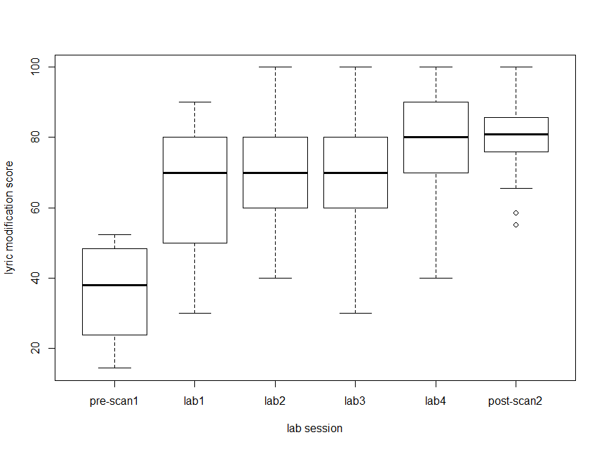
Lyric modification score – participants are learning the lyrics to songs

Slide 3
Stim presented two ways
Short clips of 10secs each (BOLD)
10 per song
8 songs
Full Songs (ISC)
8 songs

Slide 4
BOLD vs ISC results
No systematic differences based on familiarity
In BOLD or ISC
Stim type differences
BOLD and ISC show
Spoken > A capella > Whole > Instrumental
(across whole brain)
Pattern analysis to differentiate stim
Does MVPA show different areas beyond GLM/ISC?
still working on this

Slide 5
Intersubject synchrony in ROIs
Frontal, Auditory, Cingulate, Basal Ganglia, Cerebellum
Method:
Extract mean synchrony value from each ROI, for each participant
‘how synchronized was the activity in this participant’s ROI to everyone else’s activity’
Ran stats on the mean values

Slide 6
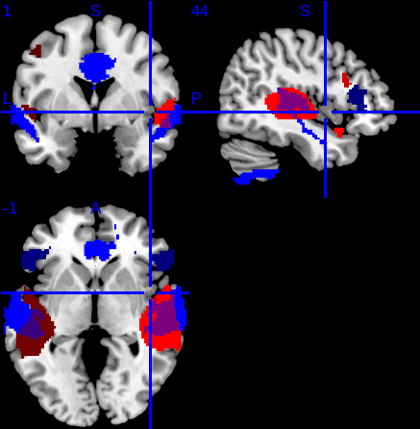
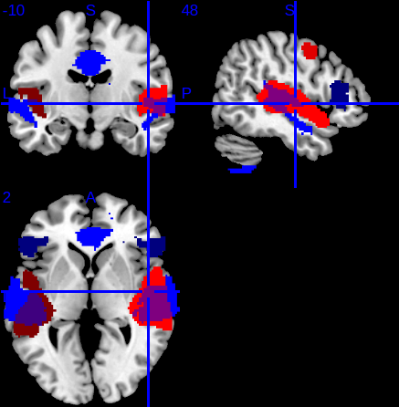
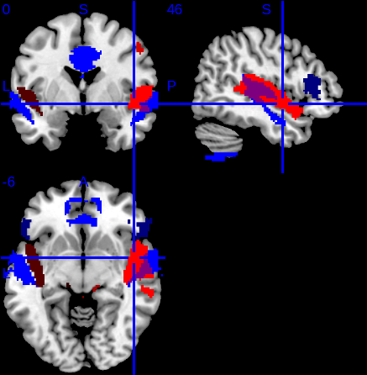
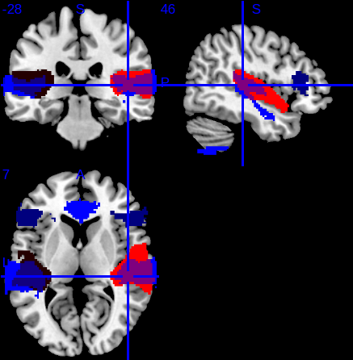
Ignoring Session
ROIs where ISC differentiate 4 stimuli overlay with GLM results (ANOVA results)
BLUE: ISC ROIs
RED: BOLD activation
(same across all 4 figs)
(different for 4 stim)
Spoken
A capella
Whole
Instrumental

Slide 7
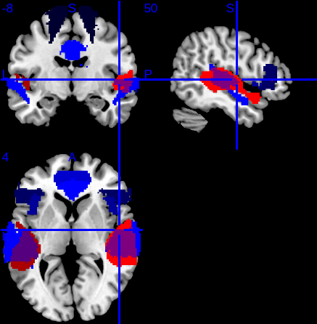
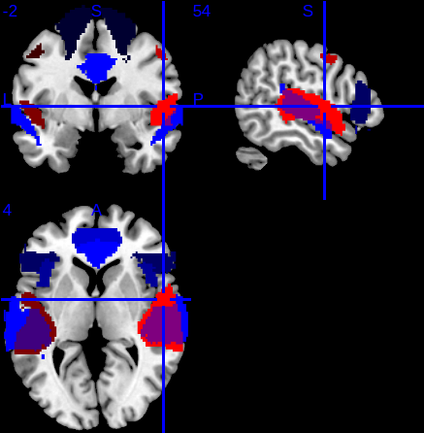
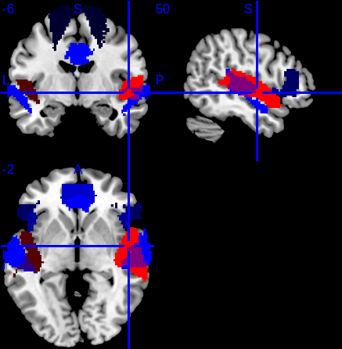
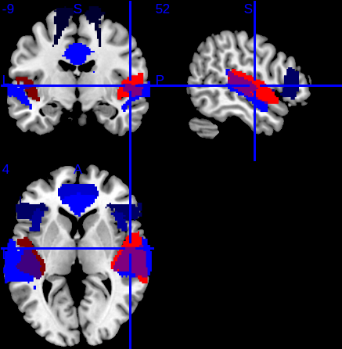
Session 1
ROIs where ISC differentiate 4 stimuli overlay with GLM results (ANOVA results)
BLUE: ISC ROIs
RED: BOLD activation
(same across all 4 figs)
(different for 4 stim)
Spoken
A capella
Whole
Instrumental

Slide 8
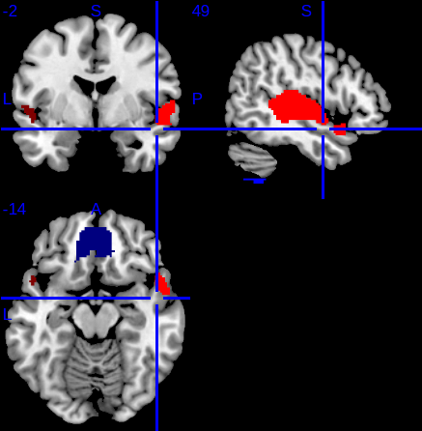
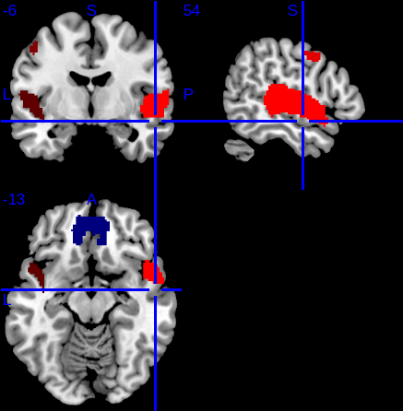
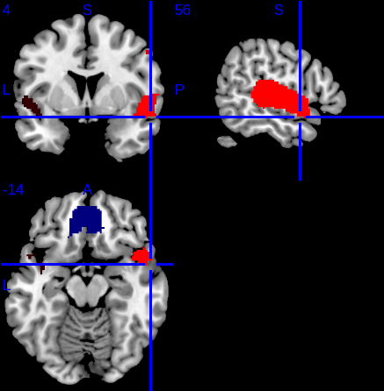
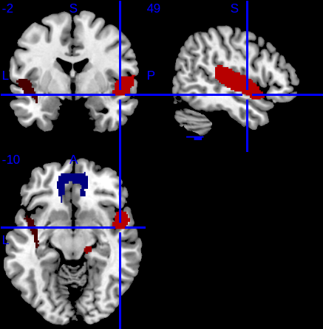
Session 2
ROIs where ISC differentiate 4 stimuli overlay with GLM results (ANOVA)
BLUE: ISC ROIs
RED: BOLD activation
(same across all 4 figs)
(different for 4 stim)
Spoken
A capella
Whole
Instrumental

Slide 9
Summary
Some overlap between BOLD results and ISC – mostly in auditory areas
What happens when we include familiarity ?

Slide 10
Familiarity
2x4 ANOVA (ses x stim type)
No interactions between type and session
T-tests: no difference between synchrony (or BOLD) in familiar and unfamiliar stim in Session 2
T-tests: some differences in some ROIs between ISC in familiar stim across session with ses 1 > ses 2

Slide 11
Explore the synchrony stim effect
Spoken > a capella > whole > instrumental
Example ROIS:
Auditory
Heschel’s gyrus
Anterior STG
Posterior STG
Cingulate
Anterior
Frontal
IFG – pars triangularis
ANOVAs say synchrony to 4 stim is significantly different in these ROIS both when session is ignored and in session 1
not in session 2

Slide 12
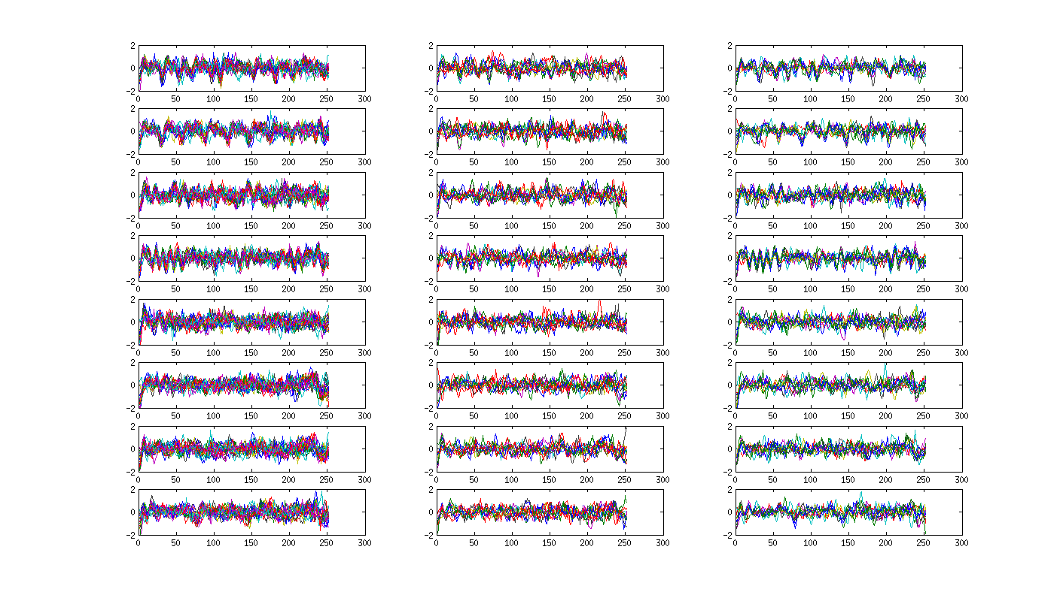
Heschel’s Gyrus
Session 2
Group A
Session 2
Group B
Session 1
S
FAM
S
FAM
A
FAM
A
FAM
I
FAM
I
FAM
W
FAM
W
FAM

Slide 13
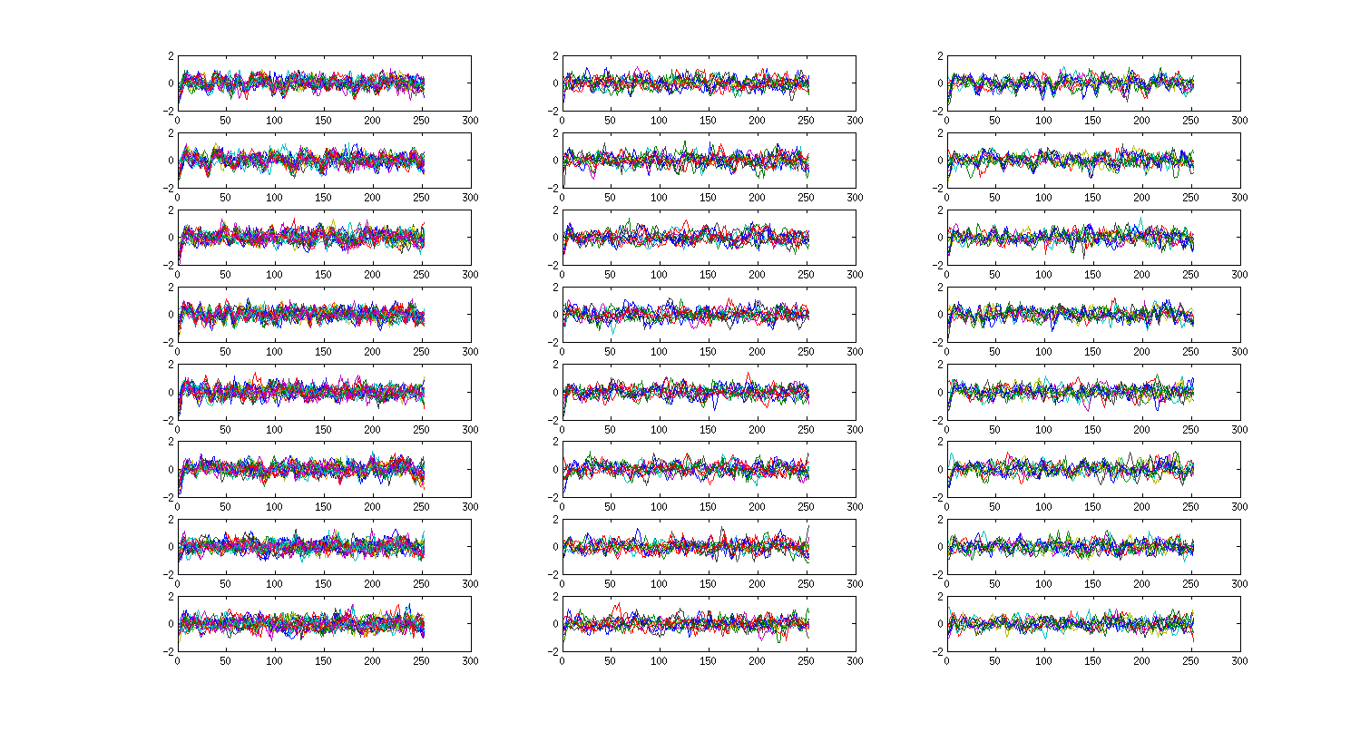
Anterior STG
Session 2
Group A
Session 2
Group B
Session 1
S
FAM
S
FAM
A
FAM
A
FAM
I
FAM
I
FAM
W
FAM
W
FAM

Slide 14
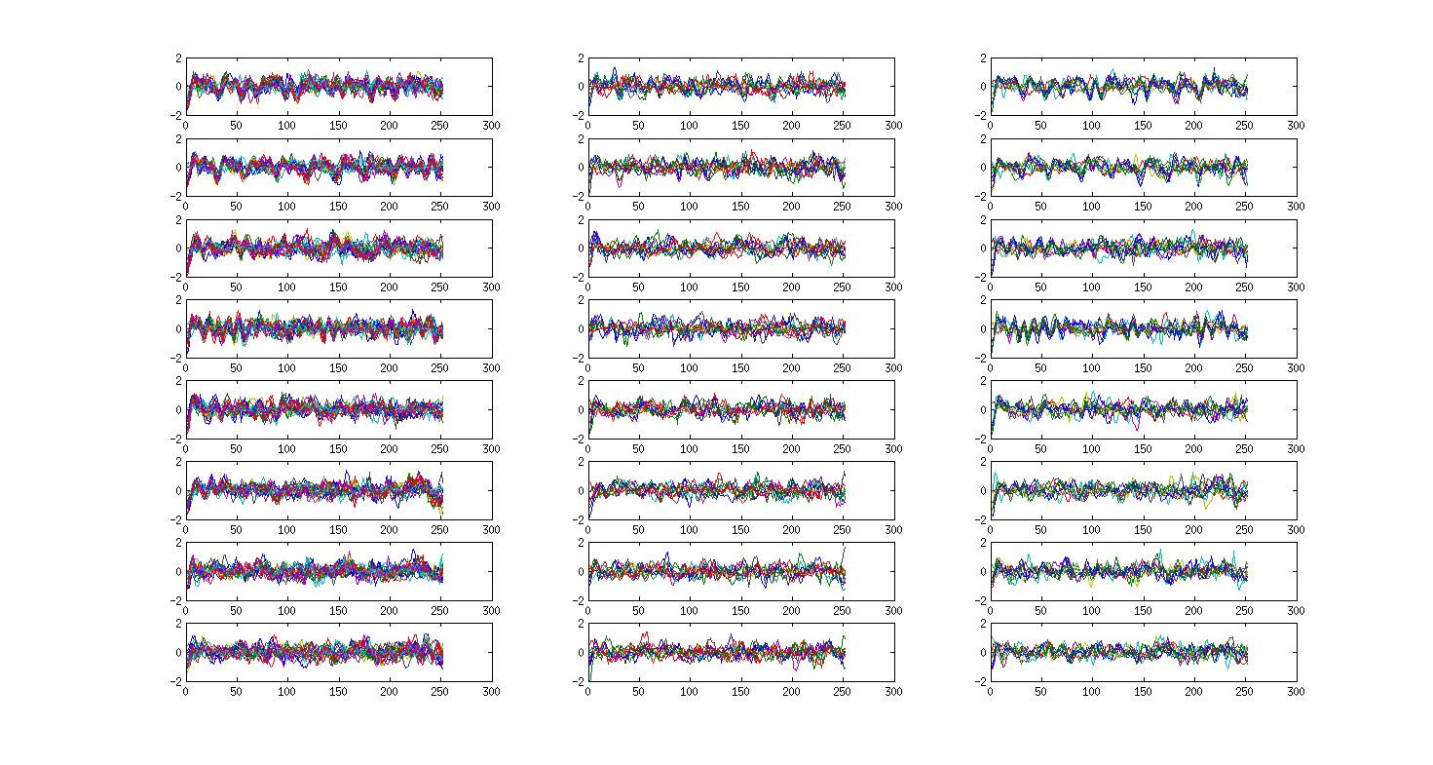
Posterior STG
Session 2
Group A
Session 2
Group B
Session 1
S
FAM
S
FAM
A
FAM
A
FAM
I
FAM
I
FAM
W
FAM
W
FAM

Slide 15
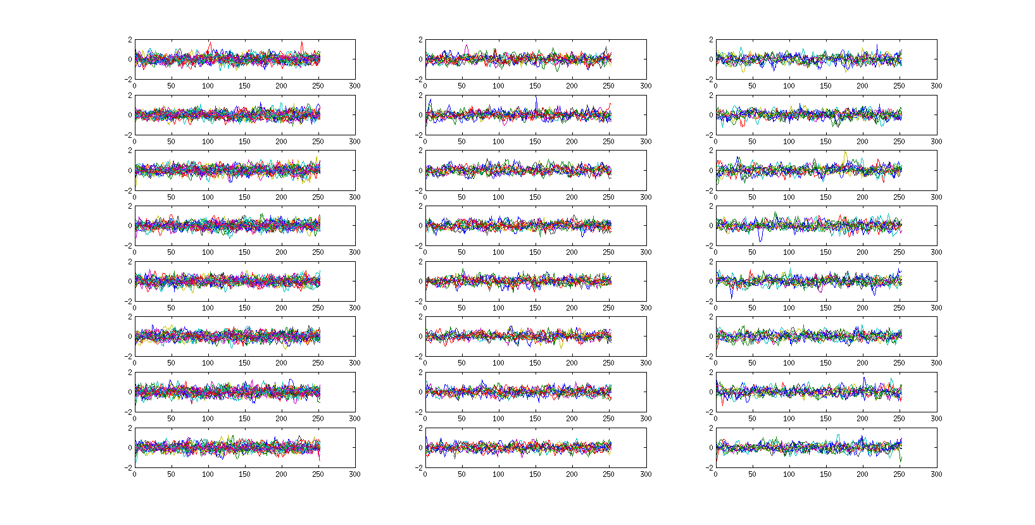
Anterior Cingulate
Session 1
Session 2
Group A
Session 2
Group B
S
FAM
S
FAM
A
FAM
A
FAM
I
FAM
I
FAM
W
FAM
W
FAM

Slide 16
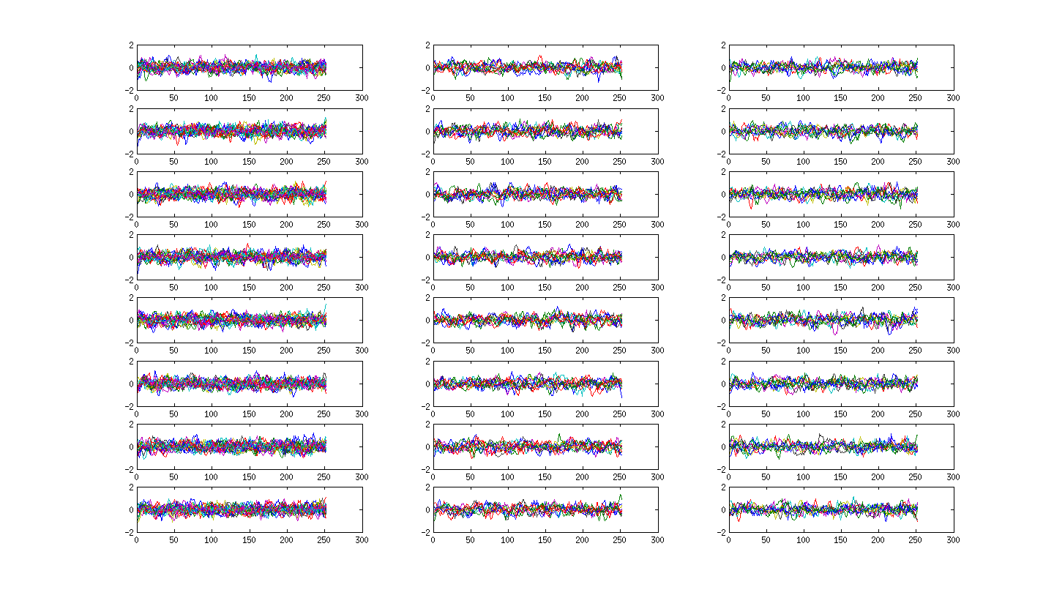
IFG - triangularis
Session 1
Session 2
Group A
Session 2
Group B
S
FAM
S
FAM
A
FAM
A
FAM
I
FAM
I
FAM
W
FAM
W
FAM

Slide 17
Summary
In session 1: Synchrony to 4 stim types differ, but not as expected
Expected synchrony to change as a result of familiarity
This doesn’t happen, and can’t be teased apart from a session effect of familiarity in the scanner
Overall more synchrony in session 1 than session 2

Slide 18
Also working on…
Pattern analyses in the data from the short clips
Relationship between cognition and synchrony
Started, but unclear how to interpret
Might wait until the older adult data is in to compare how older and young adults differ

