Slide 1
CBS v MoCA v MMSE

Slide 2
41 participants (34 female)
Mean age = 81 (62-92)
Completed:
MMSE
MoCA
12 CBS tasks

Slide 3
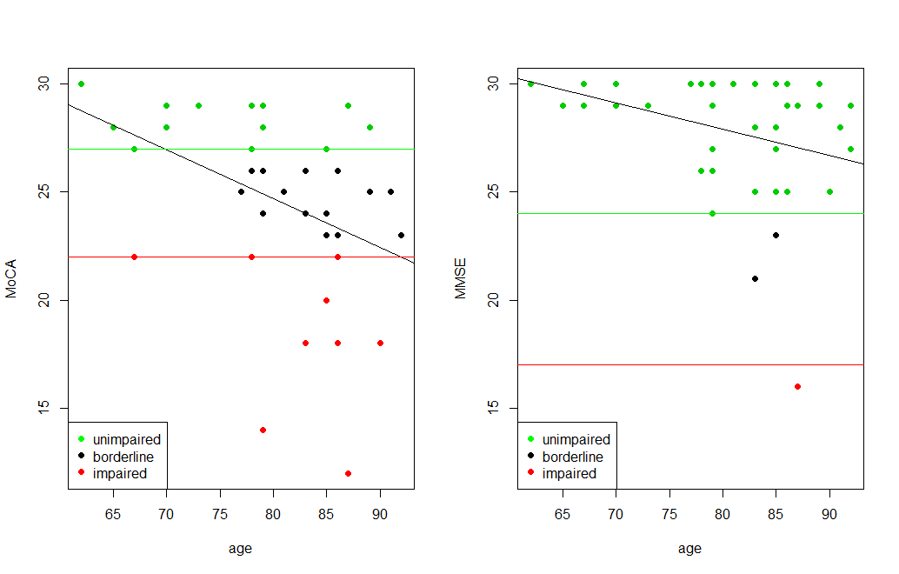

Slide 4
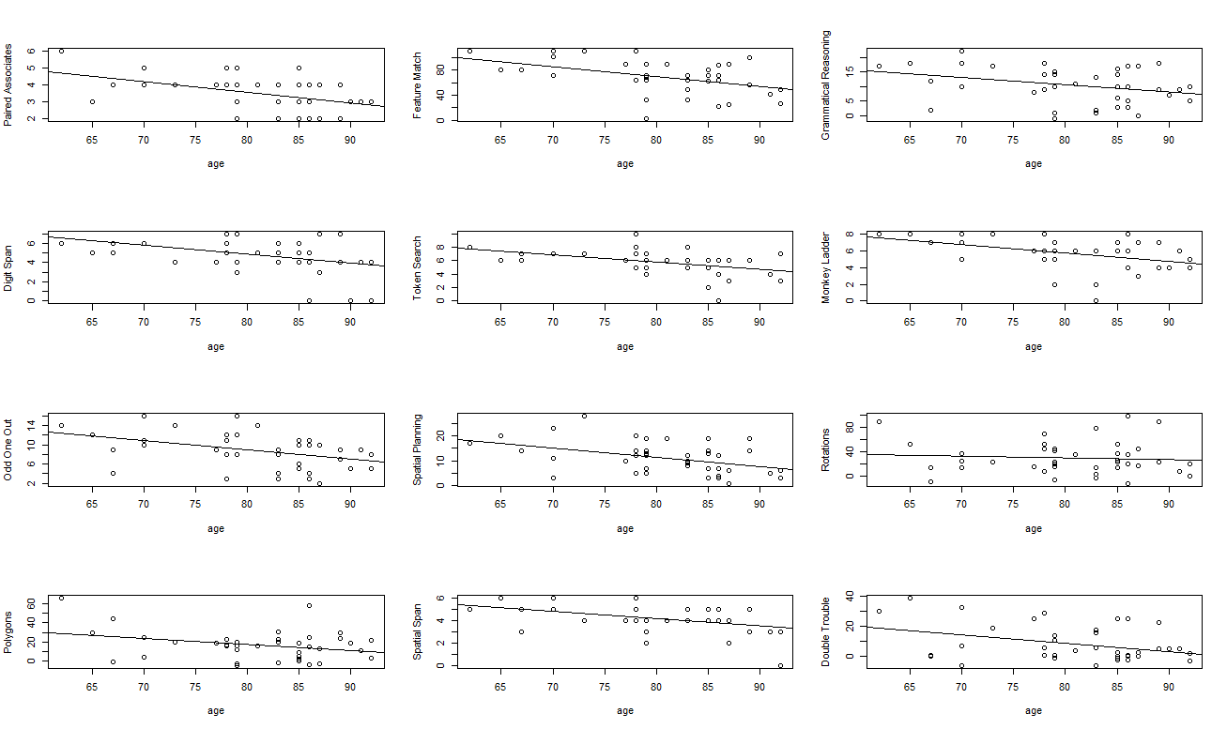

Slide 5
Unclear what to do with patients who end up in the borderline category
Can we use the scores on the CBS tasks to further categorize our borderline participants?

Slide 6
Within each task separately
 | OOO | FM | DS | TS | GR | ML | SS | R | SP | PA | DT | P
% left in Borderline | 78 | 78 | 72 | 67 | 61 | 61 | 44 | 39 | 39 | 33 | 28 | 22
% moved to Unimpaired | 17 | 0 | 11 | 11 | 11 | 17 | 28 | 17 | 17 | 0 | 22 | 33
% moved to Impaired | 6 | 22 | 17 | 22 | 28 | 22 | 28 | 44 | 44 | 67 | 50 | 44
If borderline score ≥ unimpaired score
(if they did as well or better)
If borderline score ≤ impaired score
(if they did as well or worse)

Slide 7
Question:
Is a single borderline participant always categorized in the same direction? (across all 12 tasks)
Answer:
No. Only four participants, when categorized, were always categorized in the same direction. In this case they were all categorized into the impaired group. The rest of the participants in the borderline group were sometimes categorized to impaired and sometimes to unimpaired depending on the task.

Slide 8
Brenkel et al, 2017
 | OOO | FM | DS | TS | GR | ML | SS | R | SP | PA | DT | P
% left in Borderline | 78 | 78 | 72 | 67 | 61 | 61 | 44 | 39 | 39 | 33 | 28 | 22
% moved to Unimpaired | 17 | 0 | 11 | 11 | 11 | 17 | 28 | 17 | 17 | 0 | 22 | 33
% moved to Impaired | 6 | 22 | 17 | 22 | 28 | 22 | 28 | 44 | 44 | 67 | 50 | 44
Brenkel et al, 2017 only used: Feature Match, Paired Associates, and Double Trouble
They found that FM and PA were the least useful
DT was the most useful
We replicate this except for the PA result (although we replicated it exactly at 33ppl)

Slide 9
regression
MoCA
MoCA scores are best predicted by: Feature Match, Odd One Out, and Token Search together
Adjusted R² = 0.6686 = 0.67
Age was included as a factor and predicts 13% of the variance in MoCA scores (adjusted R² = 0.1298) on its own
 | OOO | FM | DS | TS | GR | ML | SS | R | SP | PA | DT | P
% left in Borderline | 78 | 78 | 72 | 67 | 61 | 61 | 44 | 39 | 39 | 33 | 28 | 22
% moved to Unimpaired | 17 | 0 | 11 | 11 | 11 | 17 | 28 | 17 | 17 | 0 | 22 | 33
% moved to Impaired | 6 | 22 | 17 | 22 | 28 | 22 | 28 | 44 | 44 | 67 | 50 | 44

Slide 10
regression
MMSE
MMSE scores are best predicted by: Odd One Out and Grammatical Reasoning
Adjusted R² = 0.4148 = 0.41
Age was included as a factor and predicts 6% of the variance in MMSE scores (adjusted R² = 0.0634) on its own
 | OOO | FM | DS | TS | GR | ML | SS | R | SP | PA | DT | P
% left in Borderline | 78 | 78 | 72 | 67 | 61 | 61 | 44 | 39 | 39 | 33 | 28 | 22
% moved to Unimpaired | 17 | 0 | 11 | 11 | 11 | 17 | 28 | 17 | 17 | 0 | 22 | 33
% moved to Impaired | 6 | 22 | 17 | 22 | 28 | 22 | 28 | 44 | 44 | 67 | 50 | 44

Slide 11
MoCA + FM + OOO + TS
On its own the MoCA classified 41% of participants into impaired or unimpaired
The MoCA + the 3 CBS tasks classified 83% of participants into impaired or unimpaired

Slide 12
takeaways
Further insight into working memory and reasoning abilities provides better classification into impaired or unimpaired groups
Important for diagnostic and treatment purposes
Computerized testing can be used with older adults
Only 1 person did not complete all 12 tasks
Test administration is consistent between sessions – important for tracking abilities over time

