Slide 1
Owen Lab Meeting
June 7, 2019

Slide 2
Questions:
Using naturalistic stimuli to probe consciousness
music
How does processing of these stimuli change with…
age?
language?
familiarity?
What does that teach us about what it’s like to be a…
Young adult?
Older adult?
Changes in synchrony between individuals
Notes:
Starting with Young adults & music
Speech and movie has been done
Moving to healthy older adults
Same music paradigm as younger adults
Introduce well known music
Maybe Hitchcock movie?
Finally to dementia/AD
Use well known music only
Use well characterized stim – Hitchcock movie, Taken, etc

Slide 3
Data summary so far
 | Young Adults |  | Older Adults (*so far)
 | BOLD | Synchrony | BOLD | Synchrony
N | 19 |  | 14 | 13
age | 23 (18-36) | 24 (18-39) | 70 (64-74)
gender | 11 F / 8 M | 10 F / 9 M | 8 F / 6 M | 7 F / 6 M
# of listens | 13 |  | x | x
# of days between scans | 19 |  | x | x
 | 11 spoke more than one language |  | 5 spoke more than one language
Notes:
14 participants
Average age: 24
6 males
# of listens: 7-23
# of days between scans: 14-29

Slide 4
Young adult paradigm
Scan 1
Training
Scan 2
To be learned
Unlearned
Learned
Unlearned
A capella
Instrumental
Spoken
whole
A capella
Instrumental
Spoken
whole
A capella
Instrumental
Spoken
whole
A capella
Instrumental
Spoken
whole
8 different songs
(4 types)
Same as in scan 1
8 different songs
(4 types)
19 participants

Slide 5
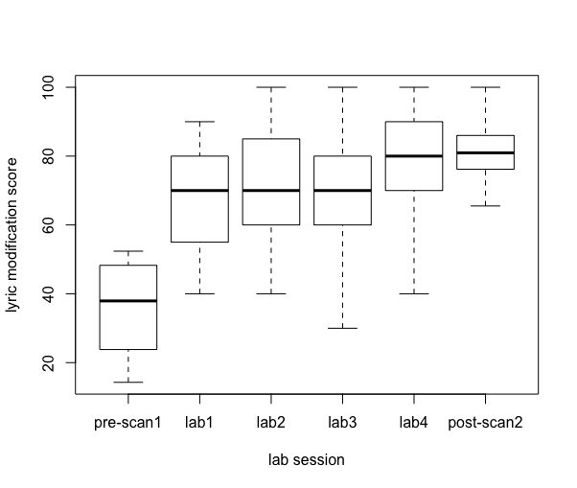
(some) Young Adult Behavioural Data
Lyric modification task
Participants learn songs over the course of training
p<0.001 from pre- to post-scan
(participants scoring <70% at post-scan2 were excluded)
Notes:
Participants who scored less than 70% on post-scan2 were excluded

Slide 6
Intersubject synchrony in ROIs
Frontal, Auditory, Cingulate, Basal Ganglia, Cerebellum
Method:
Extract mean synchrony value from each ROI, for each participant
‘how synchronized was the activity in this participant’s ROI compared to everyone else’s activity?’
Ran stats on the mean values

Slide 7
Young Adult Synchrony Data
ROIs in:
Frontal
Auditory
Cingulate
Cerebellum
Session x stimulus (2x4) ANOVA
Main effect of session in some ROIs
No interaction
No main effect of stimulus
Stimulus ANOVAs (1x4) within session 1 or 2
Show strong stimulus effects in some ROIs
Familiarity
No difference between synchrony in familiar and unfamiliar stimuli (in Session 2)

Slide 8
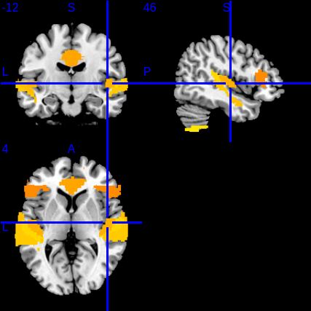
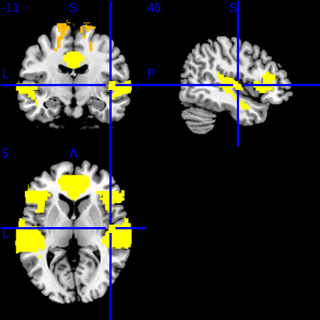
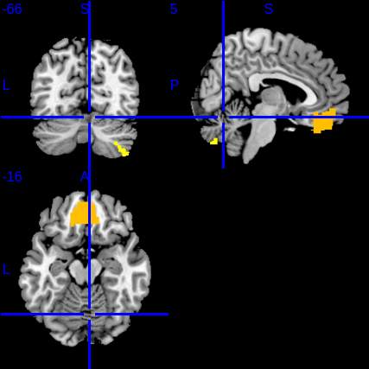
Areas where synchrony to stimuli significantly differs
Ignoring session
Session 2 only
Session 1 only

Slide 9
Explore the synchrony stim effect
Spoken > a capella > whole > instrumental
Example ROIS:
Auditory
Heschl’s gyrus
Frontal
IFG – pars triangularis
ANOVAs show synchrony to 4 stim is significantly different in these ROIS both when session is ignored and in session 1
not in session 2

Slide 10
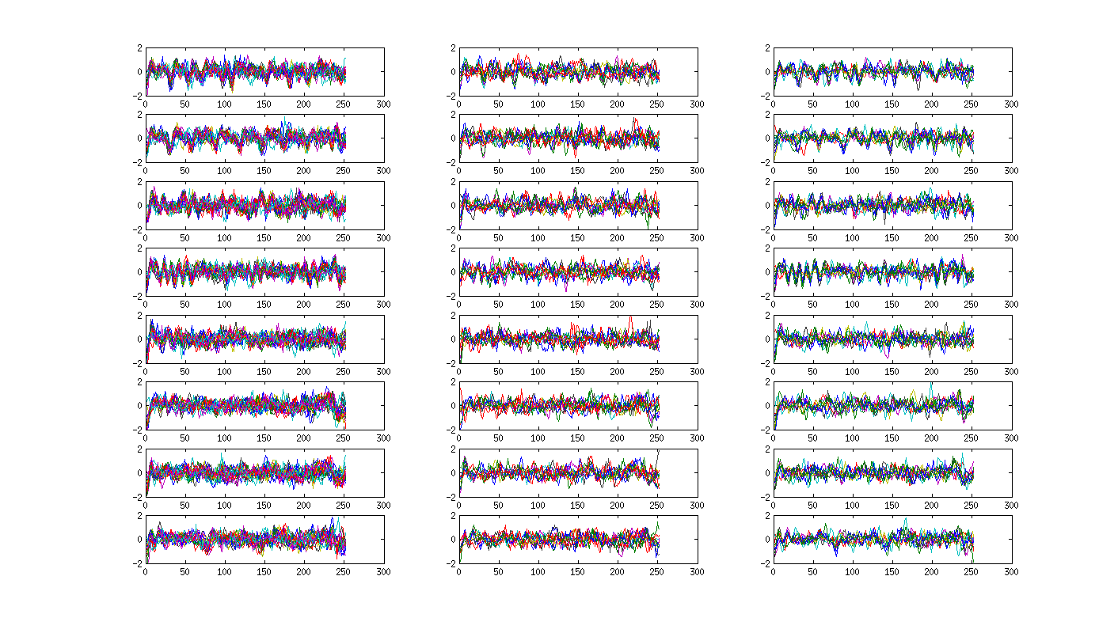
Heschl’s Gyrus
Session 2
Group A
Session 2
Group B
Session 1
S
FAM
S
FAM
A
FAM
A
FAM
W
FAM
W
FAM
I
FAM
I
FAM

Slide 11
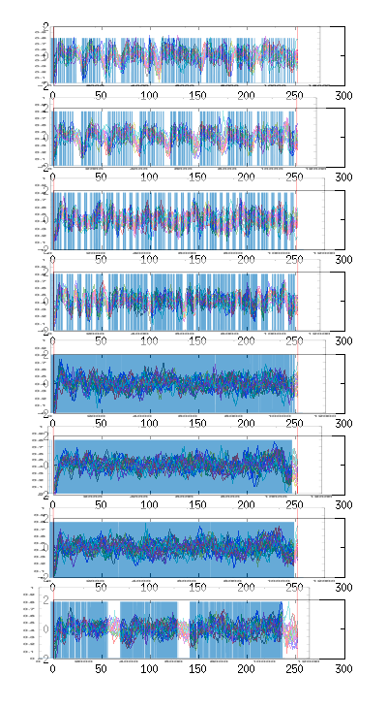
Heschl’s overlay with stim envelope
S
S
A
A
W
W
I
I

Slide 12
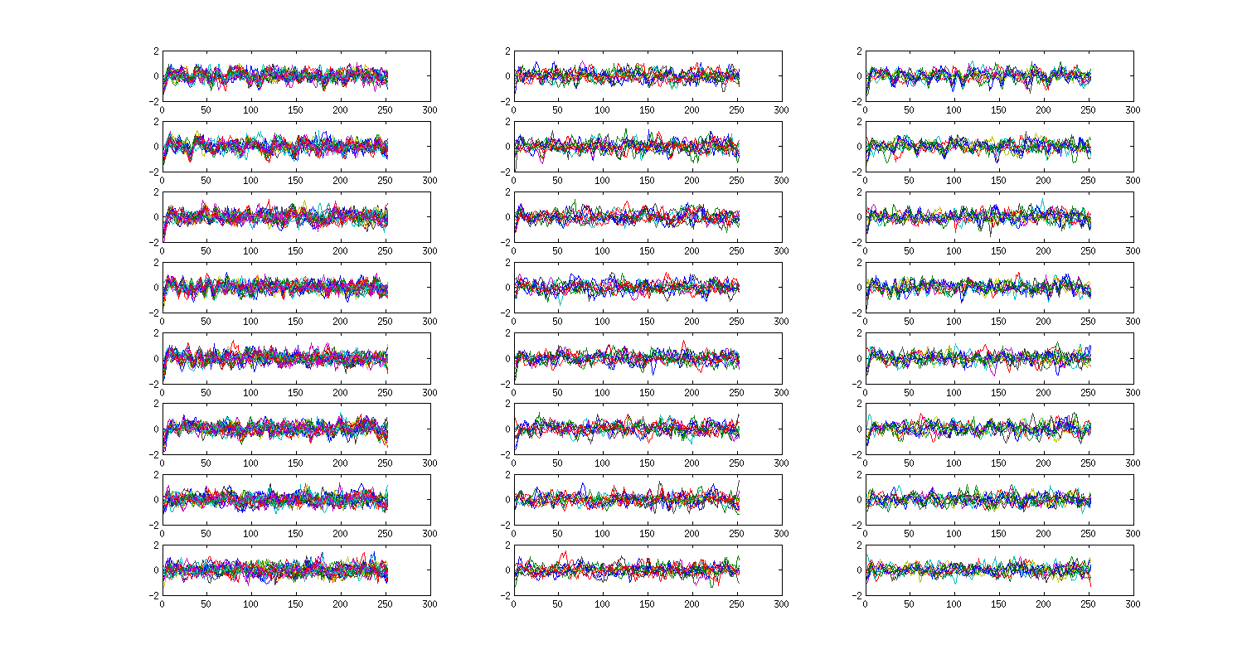
Anterior STG
Session 2
Group A
Session 2
Group B
Session 1
S
FAM
S
FAM
A
FAM
A
FAM
W
FAM
W
FAM
I
FAM
I
FAM

Slide 13
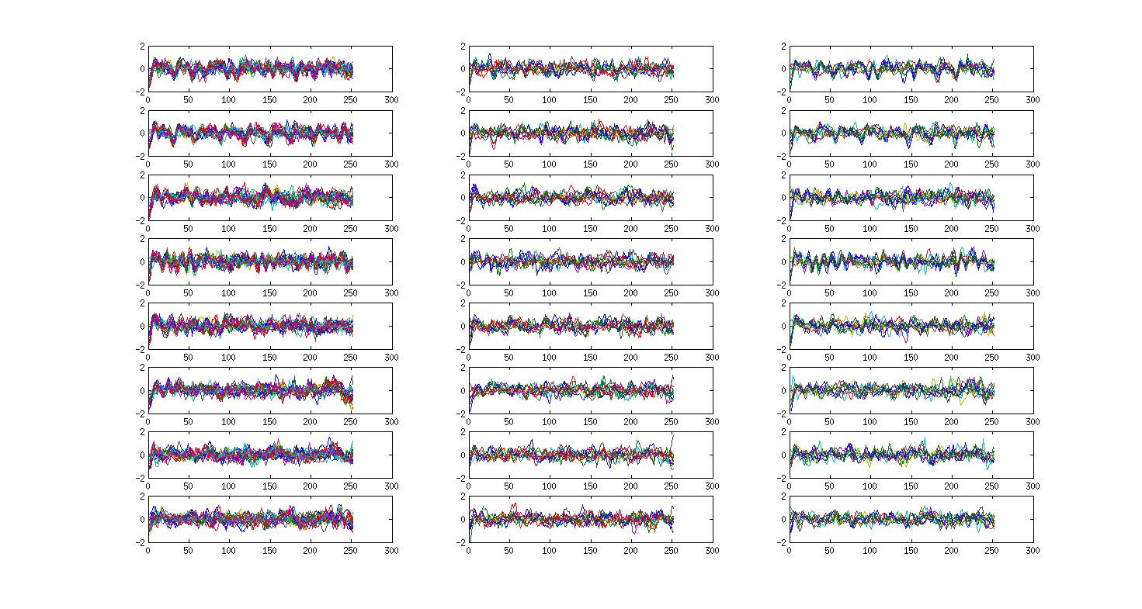
Posterior STG
Session 2
Group A
Session 2
Group B
Session 1
S
FAM
S
FAM
A
FAM
A
FAM
W
FAM
W
FAM
I
FAM
I
FAM

Slide 14
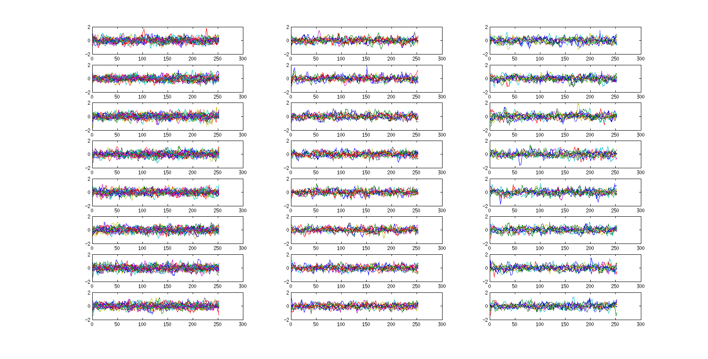
Anterior Cingulate
Session 1
Session 2
Group A
Session 2
Group B
S
FAM
S
FAM
A
FAM
A
FAM
W
FAM
W
FAM
I
FAM
I
FAM

Slide 15
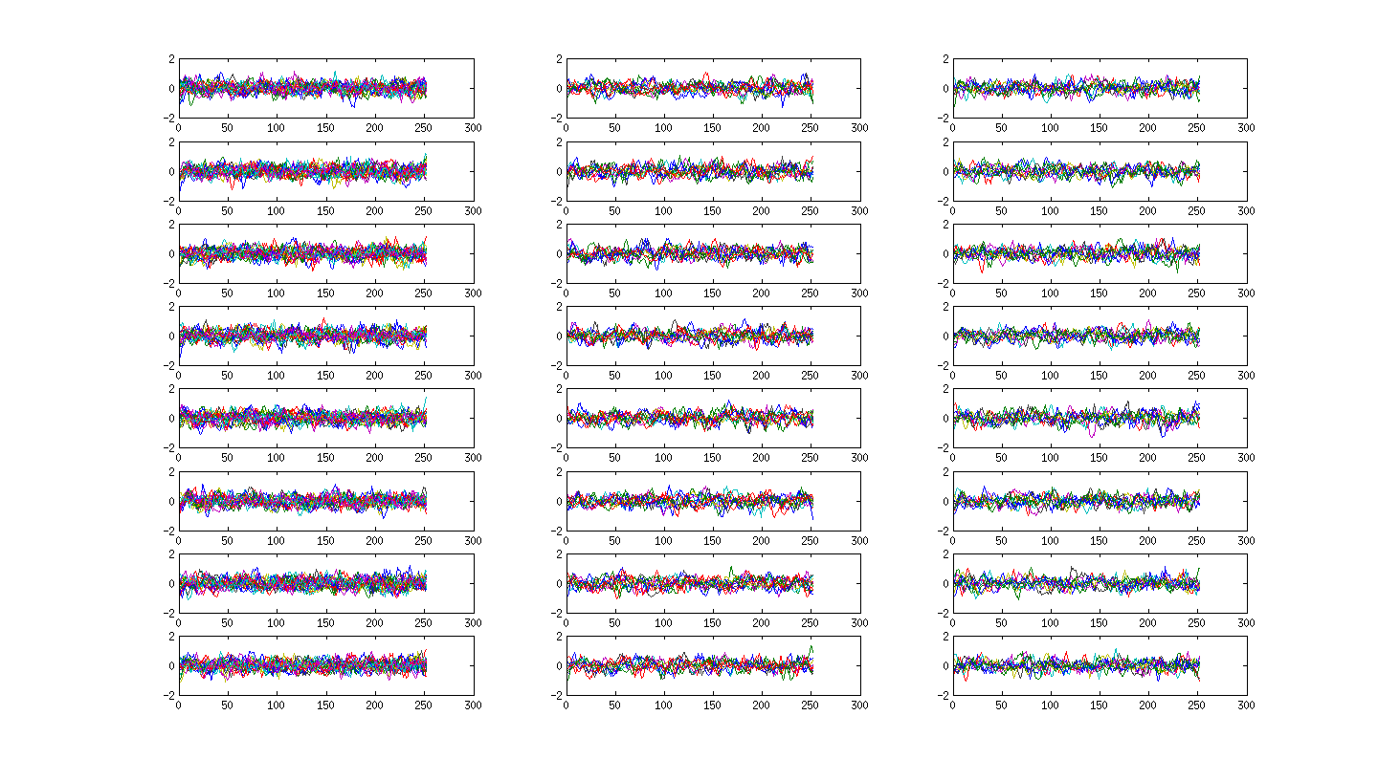
IFG - triangularis
Session 1
Session 2
Group A
Session 2
Group B
S
FAM
S
FAM
A
FAM
A
FAM
W
FAM
W
FAM
I
FAM
I
FAM

Slide 16
Young Adult Data Summary
No effect of familiarity in Synchrony data
Session effects are seen with Session 1 > Session 2
Effects are seen in stimulus type
Synchrony in Auditory cortices are sensitive to stimulus envelope, but differences in synchrony in other areas are driven by something else.
Notes:
L sided frontal
Bilateral auditory areas

Slide 17
Older Adult paradigm
Single scan session
Spoken, Instrumental, Whole (BOLD and synchrony)
2 long known (synchrony only)
WF: Hey Jude
SF: Twas the Night Before Christmas
Single Behavioural session
Demographics, music experience questionnaires, CBS
Notes:
Young Adult preliminary stats showed little to no difference between A and I
Especially in synchrony
In BOLD data too – until some people were excluded due to familiarity measures

Slide 18
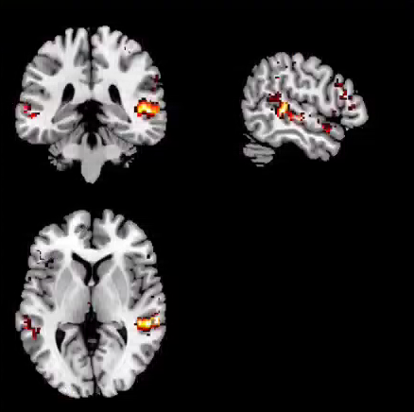
Older Adult BOLD data *
Preliminary look with 14 participants
Instrumental, Spoken, Whole
Activation in auditory cortices
Spoken – small cluster in frontal inferior (sig at cluster level)
Spoken > whole and instrumental stimuli
W>IS and I>SW show no significant areas of activation

Slide 19
Older Adult Synchrony Data *
ROIs in:
Frontal
Auditory
Cerebellum
Stimulus Effects
Stimulus effects in some ROIs
Both within unknown stimuli (I,S,W) and with all stimuli (I,S,W,SF,WF)
General pattern: S > W > I
Familiarity
Unfamiliar Spoken > Familiar Spoken
(doesn’t come out in whole stimuli)

Slide 20
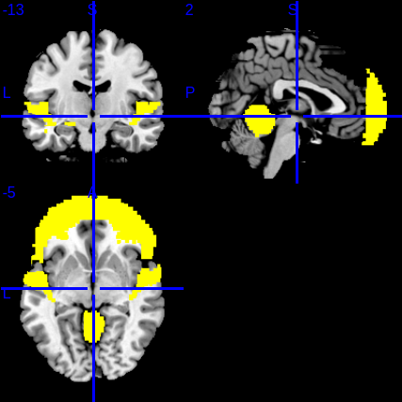
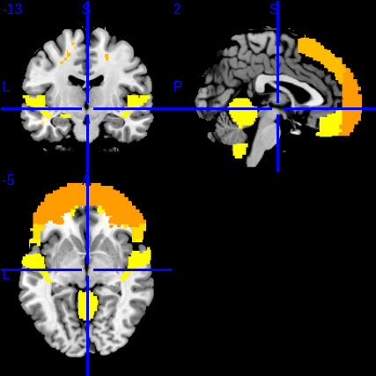
Areas where synchrony to stimuli significantly differs
Unknown stimuli only
Unknown and known stimuli

Slide 21
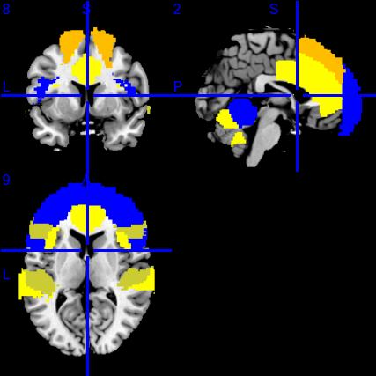
Young v Older adult comparisons
Synchrony
Young: Spoken > a capella > whole > instrumental
Older: Spoken > whole > instrumental
ROIs: Frontal, Auditory, Cerebellum (Young show cingulate too)
Warm: Young Adults – session 1
Blue: Older Adults – unknown stimuli

Slide 22
Does synchrony predict CBS scores?
Is there a difference in how synchrony predicts CBS scores for younger and older adults?
Currently looking in Yeo’s FPN
no obvious patterns emerging
Will next look in the ROIs that come out in my synchrony analysis

