Slide 1
Committee Meeting
June 4, 2019

Slide 2
Questions:
Using naturalistic stimuli to probe consciousness
music
How does processing of these stimuli change with…
age?
language?
familiarity?
What does that teach us about what it’s like to be a…
Young adult?
Older adult?
Change in both levels of activation and levels of synchrony between individuals
BOLD fMRI data
Inter-subject synchrony
Notes:
Starting with Young adults & music
Speech and movie has been done
Moving to healthy older adults
Same music paradigm as younger adults
Introduce well known music
Maybe Hitchcock movie?
Finally to dementia/AD
Use well known music only
Use well characterized stim – Hitchcock movie, Taken, etc

Slide 3
What is new?
Characterizing music familiarity without using long-known music
Young adult training paradigm controls for musical characteristics between known and unknown music
Inter-subject synchrony
The way synchrony to music changes as we age has not yet been characterized.
Exploring how other factors relate to synchrony (e.g. familiarity, cognition)
How synchrony relates to conscious processing of stimuli with and without language

Slide 4

= data collection completed & analysis ongoing
Young Adults
Marker of music familiarity
Tightly controlled familiarity
How lyrics/language interact with familiarity
Young Adults
Music synchrony
What does it look like when young adults synchronize to familiar/unfamiliar music?
Relationship between synchrony and cognition (CBS scores)
How does cognition change as we age?
CBS as an addition to better differentiate MoCA scores
Publication under review
Older Adults (healthy)
How does the marker of music familiarity change with age?
Unfamiliar and long known music
Older Adults (healthy)
How does music synchrony change with age?
How do older adults synchronize to familiar/unfamiliar music?
Relationship between synchrony and cognition (CBS scores)
*
*
Notes:
----- Meeting Notes (18-05-03 13:27) -----
Add CBS to young adults - email out to young adults
hampshire - cbs & synchrony

Slide 5
Data summary so far
 | Young Adults |  | Older Adults (*so far)
 | BOLD | Synchrony | BOLD | Synchrony
N | 19 |  | 14 | 13
age | 23 (18-36) | 24 (18-39) | 70 (64-74)
gender | 11 F / 8 M | 10 F / 9 M | 8 F / 6 M | 7 F / 6 M
# of listens | 13 |  | x | x
# of days between scans | 19 |  | x | x
 | 11 spoke more than one language |  | 5 spoke more than one language
Notes:
14 participants
Average age: 24
6 males
# of listens: 7-23
# of days between scans: 14-29

Slide 6
Young adult paradigm
Scan 1
Training
Scan 2
To be learned
Unlearned
Learned
Unlearned
A capella
Instrumental
Spoken
whole
A capella
Instrumental
Spoken
whole
A capella
Instrumental
Spoken
whole
A capella
Instrumental
Spoken
whole
8 different songs
(4 types)
Same as in scan 1
8 different songs
(4 types)
19 participants

Slide 7
Stim presented two ways
Short clips of 10secs each (BOLD)
10 per song
8 songs
Full Songs (ISC)
8 songs

Slide 8
Young Adult Training Paradigm
Scan 1
Training
Scan 2
Scan 1 – all 16 stimuli
Baseline familiarity test
fMRI scan
Training – 2-3 weeks – only 8 stimuli
Music player with questions
Lab sessions 2x per week
Scan 2 – all 16 stimuli
Final familiarity test
fMRI scan
Notes:
Over 2-3 weeks, participants listen to 8 stimuli using an online music player that records each time they listen to the songs.
They also come in to the lab twice a week to listen to the songs in lab (to make sure that they are at least listening to them that much) and to fill out a number of questionnaires.

Slide 9
Familiarity test 1
Lyric modification
Forced choice between original and modified lyric
1. But don’t rush me now, I can hear you coming
2. But don’t rush me now, I can hear you calling
Notes:
Describe what the two familiarity tests are

Slide 10
Familiarity test 2
Melody Familiarity
Forced choice between 2 sec clips
Familiar vs Unfamiliar
Scan 1
Training
Scan 2
Full set
(25 pairs)
Notes:
Describe what the two familiarity tests are

Slide 11
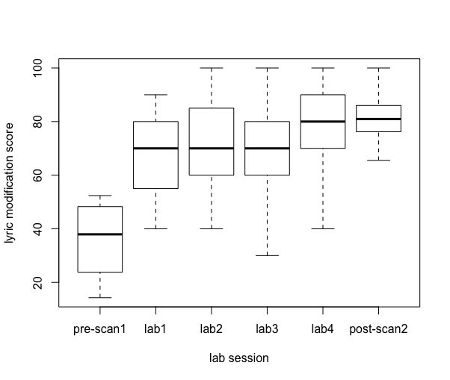
(some) Young Adult Behavioural Data
Lyric modification task
Participants learn songs over the course of training
p<0.001 from pre- to post-scan
(participants scoring <70% at post-scan2 were excluded)
Notes:
Participants who scored less than 70% on post-scan2 were excluded

Slide 12
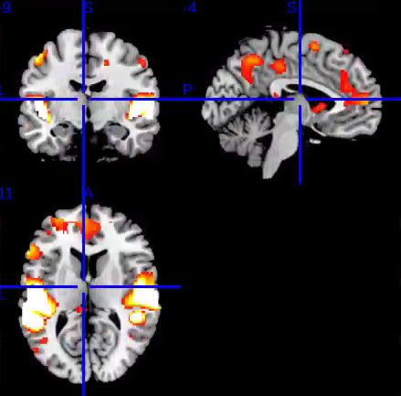
Young Adult BOLD Data
Session x stimulus type interaction
n.s.
Effect of session?
n.s.
Effect of Familiarity?
n.s.
Effect of stimulus type?
F test: significant clusters (corr p<0.05)
Auditory, premotor,
PFC, Inferior parietal

Slide 13
Young Adult BOLD Data
Session x stimulus type interaction
F test: No significant voxels/clusters
Effect of session?
F test: No significant voxels/clusters
T test S1>S2 and S2>S1: No significant voxels/clusters
Effect of Familiarity?
F test: No significant voxels/clusters
T test L > UL and UL > L: No significant voxels/clusters
Effect of stimulus type?
F test: significant clusters (corr p<0.05)
Auditory, premotor,
PFC, Inferior parietal

Slide 14
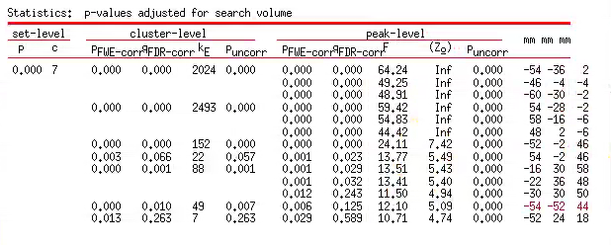
Main Effect of a/i/s/w
auditory
L premotor
L PFC
Inf parietal

Slide 15
Pairwise stimulus comparison show sig. clusters: (corr p<0.05)
Stimuli | Auditory | Premotor | frontal | other
A > I | L/R | L | -
A > S | L/R | R | -
A > W | L/R | L | -
I > A | - | - | -
I > S | L/R | - | L PFC | L angular gyrus
I > W | - | - | - | -
S > A | R
S > W | L/R
S > I | L/R | - | L inf frontal
W > A | - | - | - | -
W > I | L/R
W > S | L/R
A = a capella, I = instrumental, S = spoken, W = whole

Slide 16
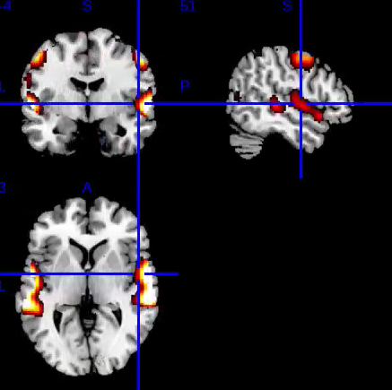
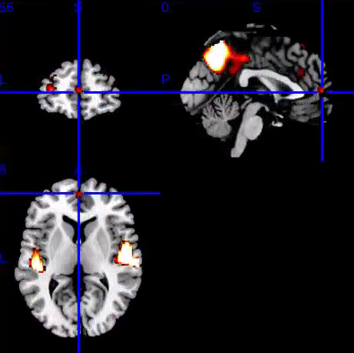
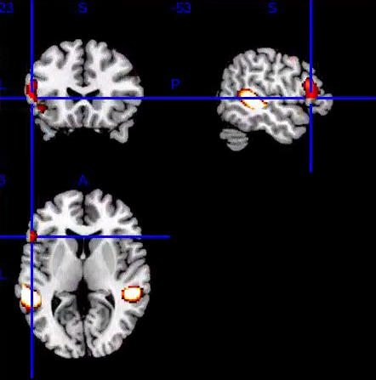
Young Adult BOLD Data
A > ISW
I > S
S > I
L/R aud
L/R Premotor
L/R aud
L PFC
L angular gyrus
L/R aud
L/R Inf frontal
A = a capella, I = instrumental, S = spoken, W = whole

Slide 17
Young Adult BOLD data
Summary so far:
Auditory cortices are, not surprisingly, involved in all stim types differently
A capella specifically involves premotor more than other stim types
Spoken stimuli involve inferior frontal cortex more than instrumental
Instrumental stimuli involve parietal cortices more than spoken stimuli
No effect of familiarity
How does this compare to synchrony data?

Slide 18
Intersubject synchrony in ROIs
Frontal, Auditory, Cingulate, Basal Ganglia, Cerebellum
Method:
Extract mean synchrony value from each ROI, for each participant
‘how synchronized was the activity in this participant’s ROI compared to everyone else’s activity?’
Ran stats on the mean values

Slide 19
Young Adult Synchrony Data
ROIs in:
Frontal
Auditory
Cingulate
Cerebellum
Session x stimulus (2x4) ANOVA
Main effect of session in some ROIs
No interaction
No main effect of stimulus
Stimulus ANOVAs (1x4) within session 1 or 2
Show strong stimulus effects in some ROIs
Familiarity
No difference between synchrony in familiar and unfamiliar stimuli (in Session 2)

Slide 20
Explore the synchrony stim effect
Spoken > a capella > whole > instrumental
Example ROIS:
Auditory
Heschl’s gyrus
Frontal
IFG – pars triangularis
ANOVAs show synchrony to 4 stim is significantly different in these ROIS both when session is ignored and in session 1
not in session 2

Slide 21
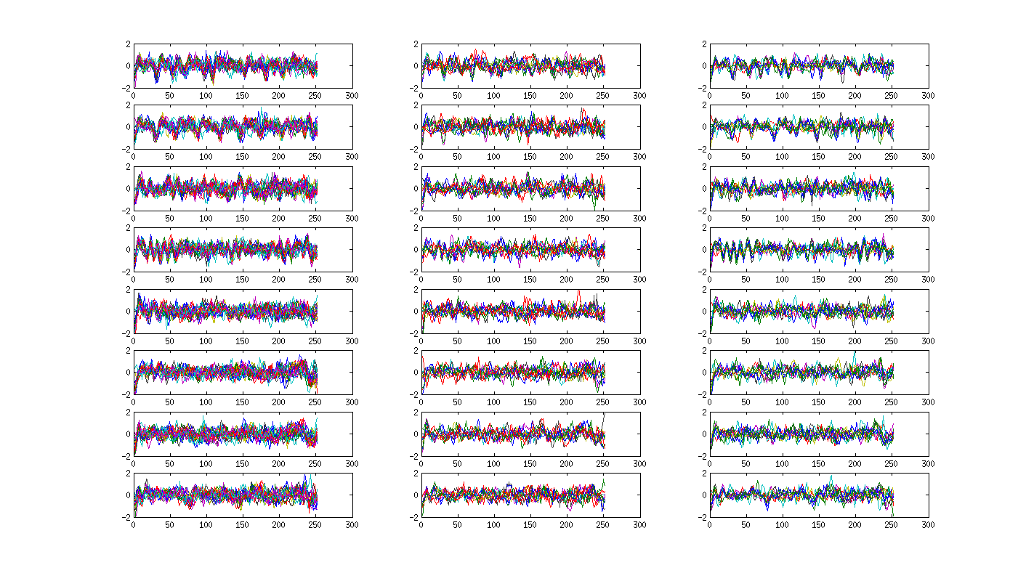
Heschl’s Gyrus
Session 2
Group A
Session 2
Group B
Session 1
S
FAM
S
FAM
A
FAM
A
FAM
W
FAM
W
FAM
I
FAM
I
FAM

Slide 22
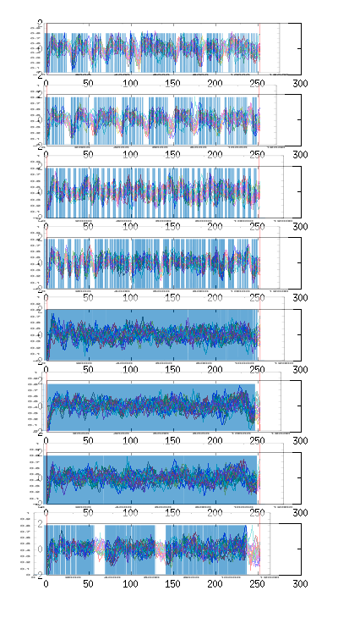
Heschl’s overlay with stim envelope
S
S
A
A
W
W
I
I

Slide 23
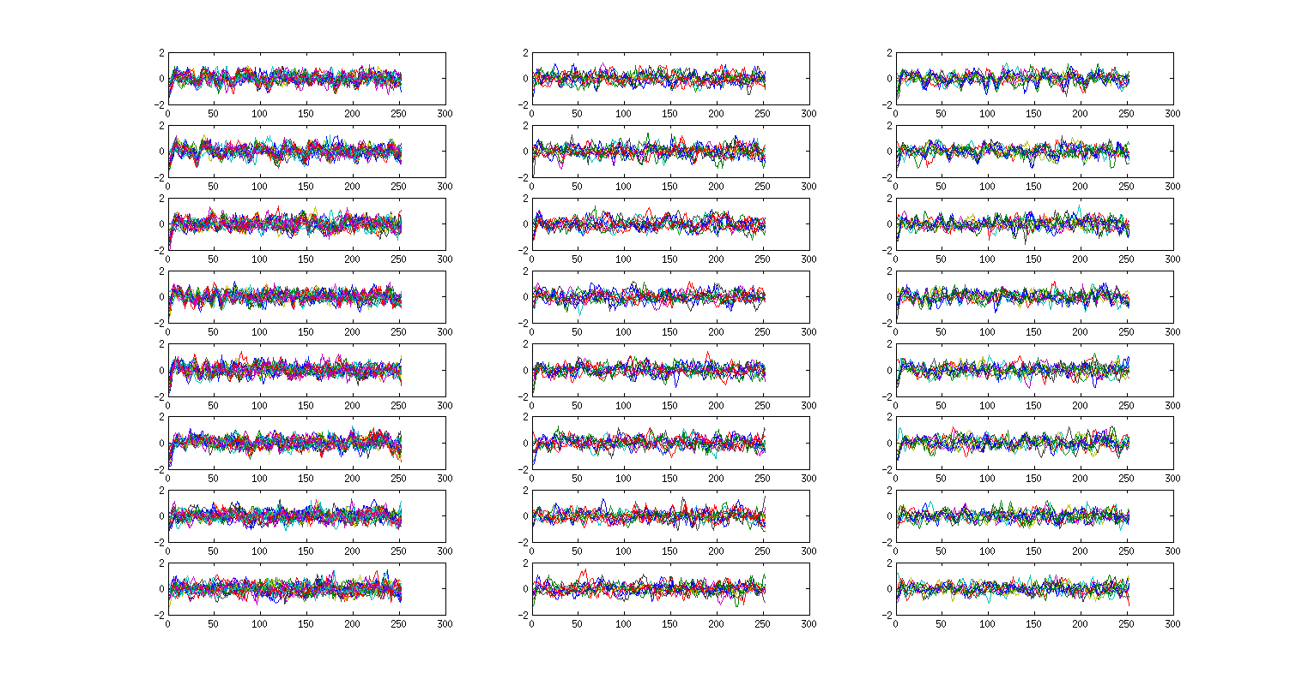
Anterior STG
Session 2
Group A
Session 2
Group B
Session 1
S
FAM
S
FAM
A
FAM
A
FAM
W
FAM
W
FAM
I
FAM
I
FAM

Slide 24
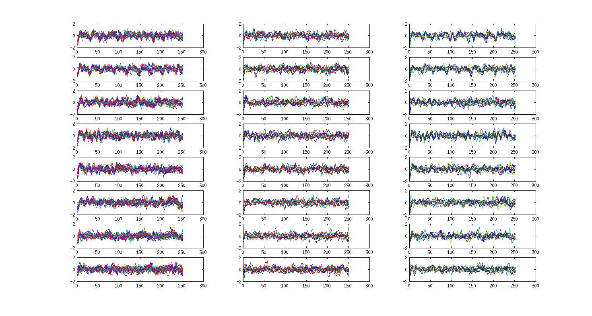
Posterior STG
Session 2
Group A
Session 2
Group B
Session 1
S
FAM
S
FAM
A
FAM
A
FAM
W
FAM
W
FAM
I
FAM
I
FAM

Slide 25
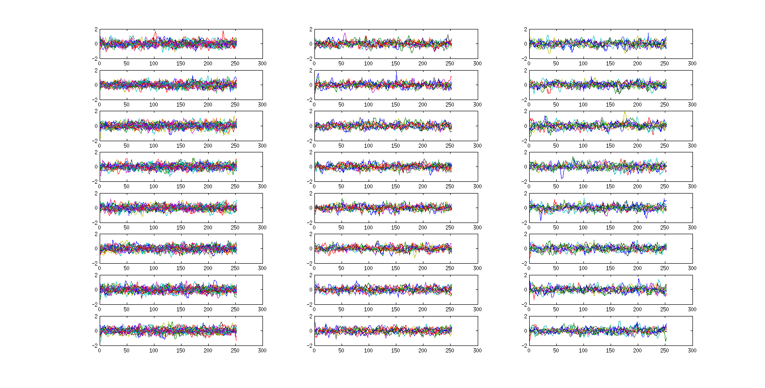
Anterior Cingulate
Session 1
Session 2
Group A
Session 2
Group B
S
FAM
S
FAM
A
FAM
A
FAM
W
FAM
W
FAM
I
FAM
I
FAM

Slide 26
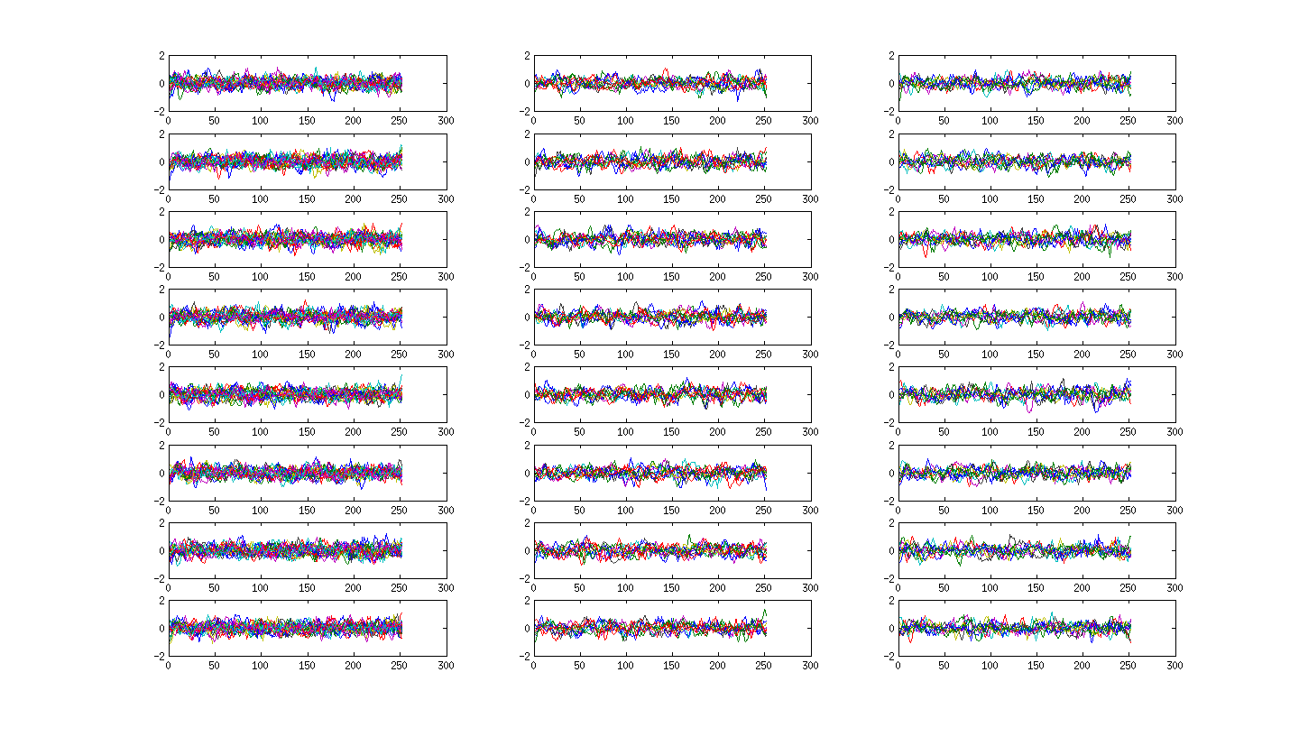
IFG - triangularis
Session 1
Session 2
Group A
Session 2
Group B
S
FAM
S
FAM
A
FAM
A
FAM
W
FAM
W
FAM
I
FAM
I
FAM

Slide 27
Young Adult Data Summary
No effect of familiarity in either BOLD or Synchrony data
Session effects are seen with Session 1 > Session 2
Effects are seen in stimulus type
Synchrony in Auditory cortices are sensitive to stimulus envelope, but differences in synchrony in other areas are driven by something else.
Notes:
L sided frontal
Bilateral auditory areas

Slide 28
Next analyses
Pattern analyses in the data from the short clips (used in BOLD analyses)
Relationship between cognition and synchrony
Started, but unclear how to interpret
Will wait until the older adult data is collected to compare how older and young adults differ

Slide 29
Older Adult paradigm
Single scan session
Spoken, Instrumental, Whole (BOLD and synchrony)
2 long known (synchrony only)
WF: Hey Jude
SF: Twas the Night Before Christmas
Single Behavioural session
Demographics, music experience questionnaires, CBS
Notes:
Young Adult preliminary stats showed little to no difference between A and I
Especially in synchrony
In BOLD data too – until some people were excluded due to familiarity measures

Slide 30
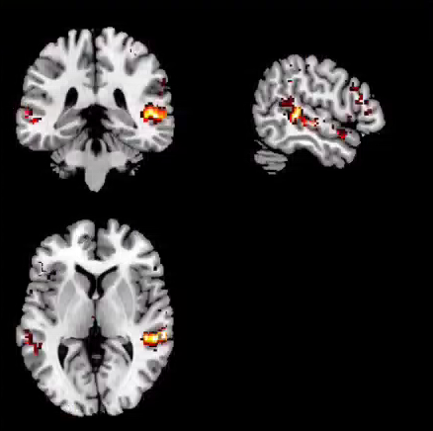
Older Adult BOLD data *
Preliminary look with 14 participants
Instrumental, Spoken, Whole
Activation in auditory cortices
Spoken – small cluster in frontal inferior (sig at cluster level)
Spoken > whole and instrumental stimuli
W>IS and I>SW show no significant areas of activation

Slide 31
Older Adult Synchrony Data *
ROIs in:
Frontal
Auditory
Cerebellum
Stimulus Effects
Stimulus effects in some ROIs
Both within unknown stimuli (I,S,W) and with all stimuli (I,S,W,SF,WF)
General pattern: S > W > I
Familiarity
Unfamiliar Spoken > Familiar Spoken
(doesn’t come out in whole stimuli)

Slide 32
Young v Older adult comparisons
BOLD
Both young and older adults show activation mainly in auditory cortices
Both show inferior frontal activation for spoken stimuli
Young adults show activation in other areas
Lack in older adults could be power related
Synchrony
Young: Spoken > a capella > whole > instrumental
Older: Spoken > whole > instrumental
ROIs: Frontal, Auditory, Cerebellum (Young show cingulate too)

Slide 33
Next Steps
Finish older adult data collection (first week of July)
Explore young and older adult CBS data in relation to synchrony data
Decide on how to ‘package’ all the results and write them up!

