Slide 1
Music & Memory
fMRI data overview

Slide 2
Training Paradigm
Scan 1
Training
Scan 2
Scan 1 – 8 stimuli (songs)
Baseline familiarity test
fMRI scan
Training – 2-3 weeks – only 4 stimuli
Music player with questions
Lab sessions 2x per week
Scan 2 – 8 stimuli
Final familiarity test
fMRI scan

Slide 3
Data
22 participants (12F/10M)
Average age 24
Average # of listens: 13 (4-20)
Average # of days between scans: 20 (14-29)

Slide 4
6 behavioural measures
Familiarity – objective # of listens from music player
Lyric modification test (created in lab)
Old vs New melody memory (created in lab)
Lyric Orientation Score (borrowed from different lab)
BAT – melody memory
BAT – beat perception

Slide 5
Familiarity test 1
Lyric modification
Forced choice between original and modified lyric
1. But don’t rush me now, I can hear you coming
2. But don’t rush me now, I can hear you calling
Notes:
Describe what the two familiarity tests are

Slide 6
Familiarity test 2
Old vs New
Forced choice between 2 sec clips
Familiar vs Unfamiliar
Scan 1
Training
Scan 2
Full set
(25 pairs)
Notes:
Describe what the two familiarity tests are

Slide 7
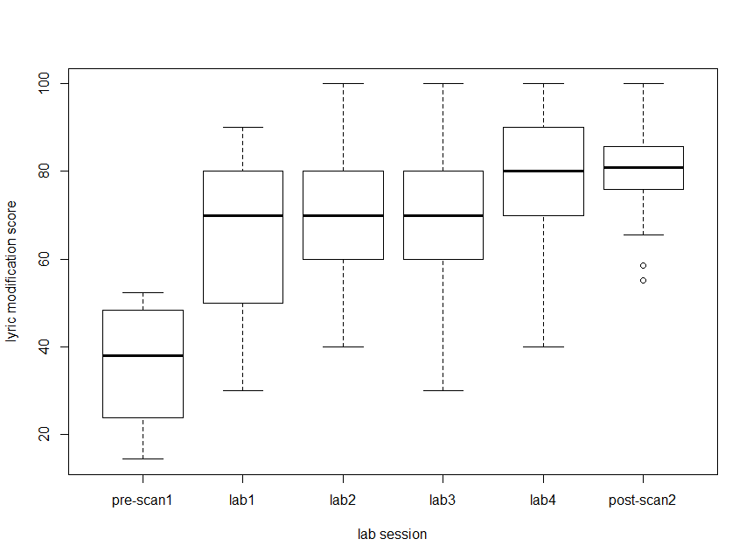
Lyric modification score – participants are learning the lyrics to songs

Slide 8
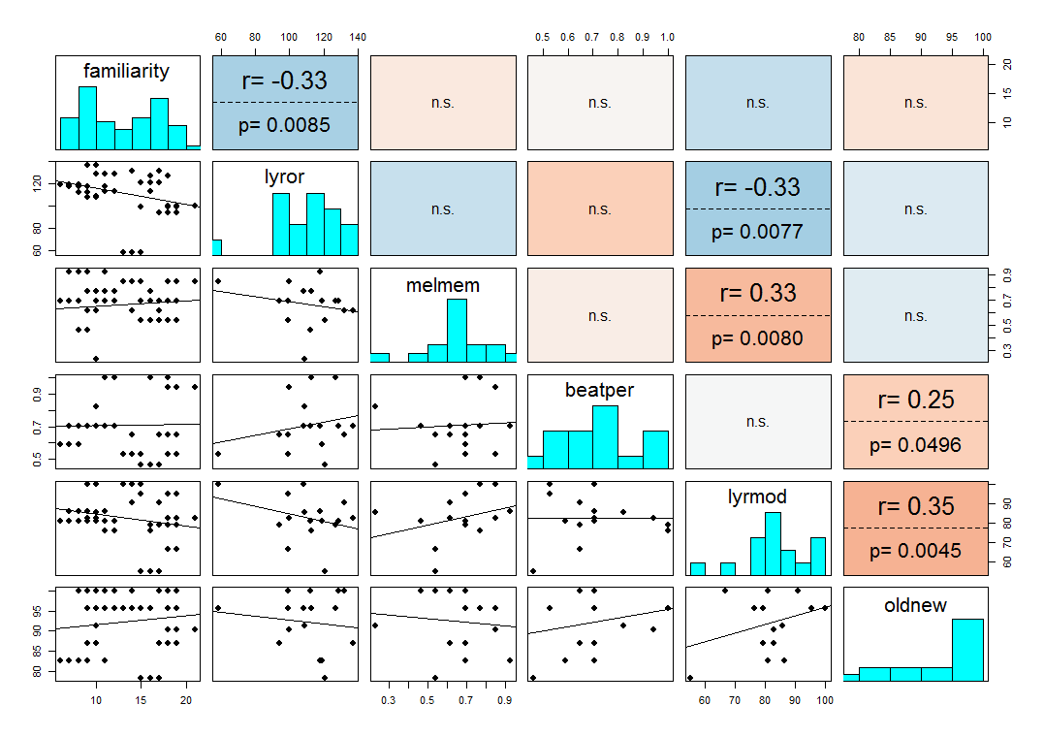
Correlations between 6 behavioural covariates
# of listens
BAT
BAT

Slide 9
Design set up
Scan 1
Training
Scan 2
To be learned
Unlearned
To be learned
Unlearned
A capella
Instrumental
Spoken
whole
A capella
Instrumental
Spoken
whole
A capella
Instrumental
Spoken
whole
A capella
Instrumental
Spoken
whole
8 different songs
(4 types)
Same as in scan 1
8 different songs
(4 types)
S1TBL
S1UL
S2TBL
S2UL

Slide 10
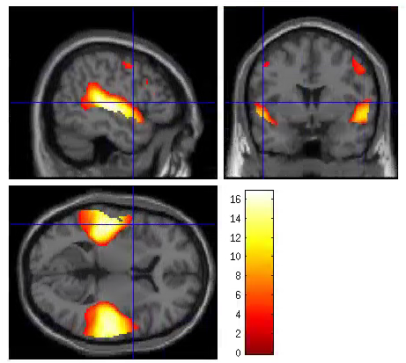
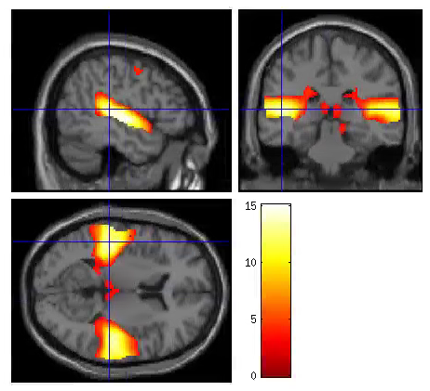
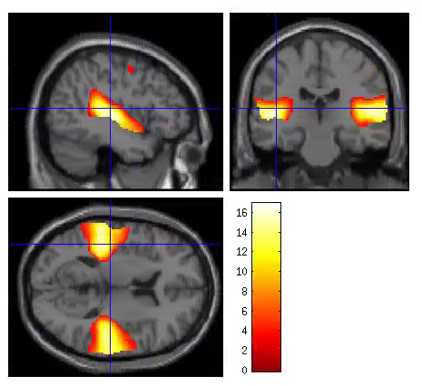
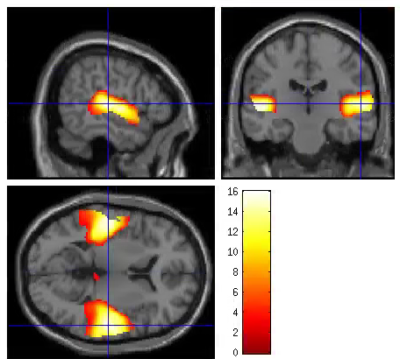
Activation during Learned and unlearned songs
S1TBL
S2TBL
S1UL
S2UL

Slide 11
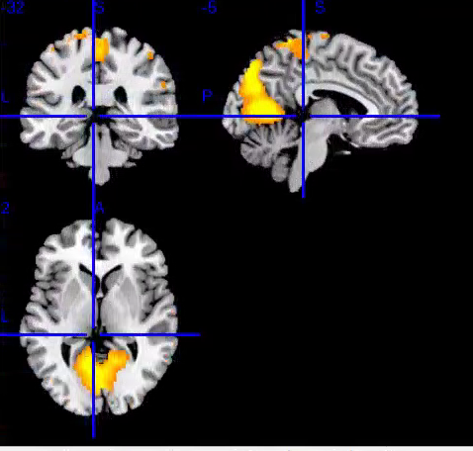
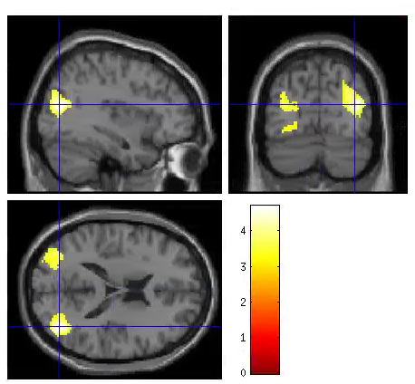
Are there differences between learned and unlearned songs?
(S2TBL-S2UL)-(S1TBL-S1UL) – no significant peaks or clusters
Across sessions
S1TBL-S2TBL or S2TBL-S1TBL – n.s.
S2UL-S1UL – n.s.
S1UL-S2UL – sig. clusters in paracentrul Lobule (L/R) and Lingual (L/R)
Within sessions
S2TBL-S2UL or S2UL-S2TBL – n.s.
S1TBL-S1UL – n.s.
S1UL-S1TBL – sig. clusters in L/R mid Occipital
Notes:
S1UL-S1TBL
31, -74, 18
-38, -78, 28
S1UL-S2UL

Slide 12
Next things to try…
MVPA
Are the differences between conditions more subtle?

Slide 13
Behavioural measures as covariates with S2TBL
Not significant
BAT Beat Perception
Old New memory task
Lyric Modification
Familiarity
BAT Melody memory
cov_i+ - sig. cluster in cerebellum
cov_i- - sig. cluster in superior frontal (L)
Lyric Orientation
Negative covariate is sig. in middle temporal (L)
Driven by a capella and whole songs
(sig. at peak-level, not at cluster-level)
Notes:
Lyric orientation – cov- is sig driven by a and w – see it in i and s but not significant.

Slide 14
Behavioural measures as covariates with S1TBL
Not significant
BAT Beat Perception
Old New memory task
Lyric Modification
Familiarity
Lyric Orientation
BAT Melody memory
Negative covariate - sig. cluster in superior temporal (L)
Driven by instrumental song
Notes:
Melody memory covariate – sig cluster with cov- : driven by cov_i- -> peak is seen, but not sig in other 3 stim types

Slide 15
Lyric – Non Lyric with Lyric Orientation Covariate
For each participant, create Lyric-NoLyric contrasts for each session
Put all of the S1 and S2 scans into a model with the lyric orientation covariate
Investigate
Discover pizza brains in S2, but not in S1…

