Slide 1
Neural Correlates of Music Familiarity
Avital Sternin PhD2
Dr. Jessica Grahn
Dr. Adrian Owen

Slide 2
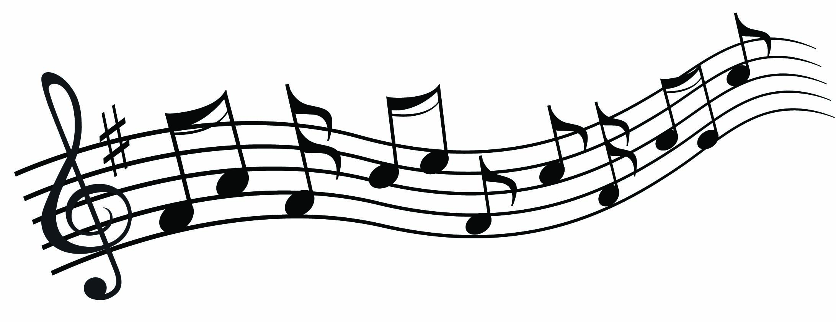
Musical Memory
Notes:
Have you ever had the experience of recognizing a song that you haven’t heard in a very long time?
PLAY CLIPS
Sesame street? Arthur?
How is it that you can remember these songs even though you haven’t heard them or thought about them in years?
Or in other words…

Slide 3
Why is musical memory special?

Slide 4
Evidence for specific musical memory
Patient CN: bilateral temporal lobe damage led to severe, music specific agnosia (Peretz, 1996)
Recognized lyrics, but did not recognize previously familiar music
Normal performance on musical perceptual tests
Patient PM: encephalitis led to severe ante- and retrograde amnesia (Finke et al, 2012)
Professional cellist
Severe memory impairments, but performed like healthy musicians on music recognition tests

Slide 5
From case studies…
Proposed musical lexicon that “contains all the representations of the specific musical phrases to which one has been exposed during one’s lifetime” (Peretz & Coltheart, 2003)
The musical lexicon is separate from the verbal lexicon
Posterior inferior temporal cortex (PITC) may be an interface between lyrics and melody to facilitate the recognition of familiar songs (Saito et al, 2012)

Slide 6
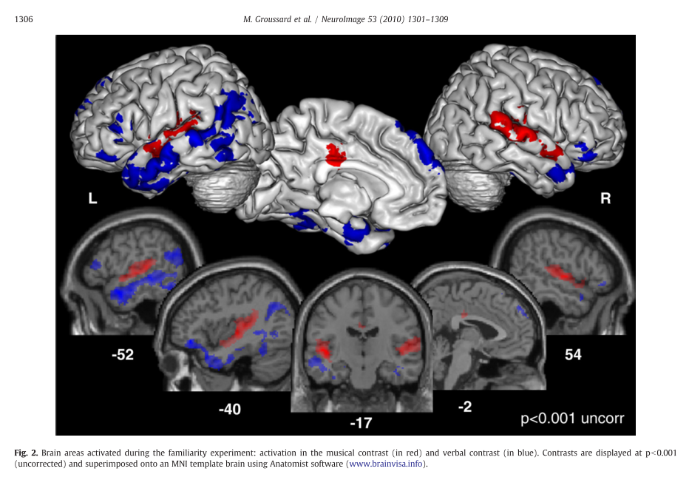
Evidence for separate networks
[Music-Verbal] [Verbal-Music]
Notes:
Music contrast – RED - Bilateral activation in superior temporal gyri, left middle cingulate, and right insula
Verbal contrast – BLUE – left-sided activation in the inferior and middle temporal gyri, medial superior and inferior pars triangularis frontal gyri, posterior MTG, on the right – inferior orbitofrontal cortex, middle temporal pole and the anterior part of the hippocampus and cerebellum

Slide 7
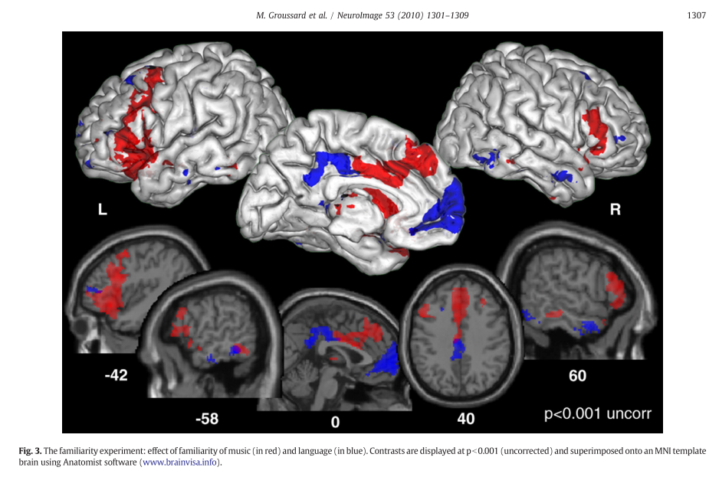
Areas where activity increased with familiarity Music Verbal
Notes:
“parametric regressor modeling familiarity was constructed,”
Greater activity for music in an extended network that included the bilateral inferior frontal gyrus (BA45) (extending to the middle frontal gyrus), the posterior part of the inferior and middle temporal gyri (BA20/37), the medial superior frontal gyrus (BA10) and the right superior temporal pole (BA38).
The verbal familiarity analysis revealed greater activity in the left medial superior frontal gyrus (BA10), the middle cingulate cortex bilaterally, the left putamen and thalamus, and the inferior and middle parts of the frontal (BA47/46) and temporal gyri (BA20/21) bilaterally. We also found activation of the posterior part of the right hippocampus and the left parahippocampal cortex.

Slide 8
Alzheimer’s disease (AD)
Memory for music seems to be selectively spared
Long-term familiarity for melody and music lyrics is present even in severe AD
Musical semantic memory seems to be preserved (Cuddy et al, 2012)
Theory: spared musical memory is because of intact functioning of necessary brain regions that are spared in AD (Baird & Samson, 2009)

Slide 9
Current Questions
Neurally, what differentiates familiar from unfamiliar music?
How does the presence of lyrics interact with music familiarity?
Is memory better with lyrics?

Slide 10
Project Outline
Scanning session 1
Training – 2-3 weeks
Scanning session 2

Slide 11
Stimuli
16 unfamiliar songs
4 spoken words
4 sung lyrics (acapella, no music)
4 instrumental music only
4 ‘whole’ songs (music + lyrics)
Notes:
PLAY STIM CLIPS

Slide 12
Project Outline
Scanning session 1 – all 16 stim
Baseline familiarity test
fMRI scan
Training – 2-3 weeks
Scanning session 2

Slide 13
Project Outline
Scanning session 1 – all 16 stim
Baseline familiarity test
fMRI scan
Training – 2-3 weeks – only 8 stim
Music player with questions
Lab sessions 2x per week
Scanning session 2

Slide 14
Project Outline
Scanning session 1 – all 16 stim
Baseline familiarity test
fMRI scan
Training – 2-3 weeks – only 8 stim
Music player with questions
Lab sessions 2x per week
Scanning session 2 – all 16 stim
Final familiarity test
fMRI scan

Slide 15
Familiarity tests
Lyric modification
Forced choice between original and modified lyric
Full set in session 1 and session 2 (~25)
Subset during lab training session (~10, monitor progress)
Melody familiarity
Short clips (2 sec) – Old vs New task
All during session 2 (~25 clip pairs)
Notes:
----- Meeting Notes (17-05-11 10:57) -----
music + lyrics association

Slide 16
Preliminary Data
7 participants
Average age: 25
3 males
All right handed
Average # of listens: 7-20
Average # of days between scans: 14-29

Slide 17
Lyric Modification Task

Slide 18
Final Behavioural Memory Tests

Slide 19
Thank you

