Slide 1
Design set up
Scan 1
Training
Scan 2
To be learned
Unlearned
Learned
Unlearned
A capella
Instrumental
Spoken
whole
A capella
Instrumental
Spoken
whole
A capella
Instrumental
Spoken
whole
A capella
Instrumental
Spoken
whole
8 different songs
(4 types)
Same as in scan 1
8 different songs
(4 types)
19 participants

Slide 2
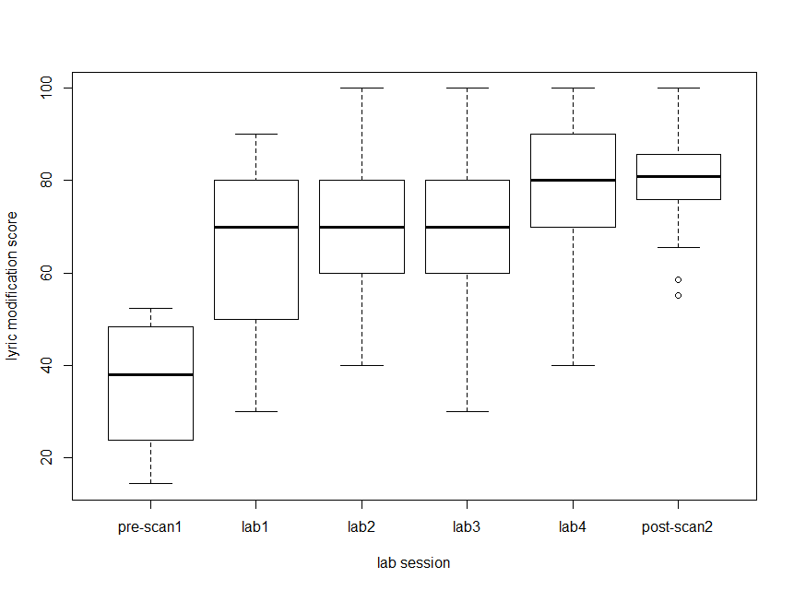
Lyric modification score – participants are learning the lyrics to songs

Slide 3
GLM vs ISC results
No systematic differences based on familiarity
In GLM or ISC
Stim type differences
GLM and ISC show
Spoken > A capella > Whole > Instrumental
(across whole brain)
Pattern analysis to differentiate stim
Does MVPA show different areas beyond GLM/ISC?
still working on this

Slide 4
Intersubject synchrony in ROIs
Frontal, Auditory, Cingulate, Basal Ganglia, Cerebellum
Method:
Extract mean synchrony value from each ROI, for each participant
‘how synchronized was the activity in this participant’s ROI to everyone else’s activity’
Ran stats on the mean values

Slide 5
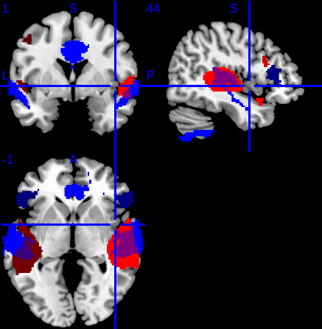
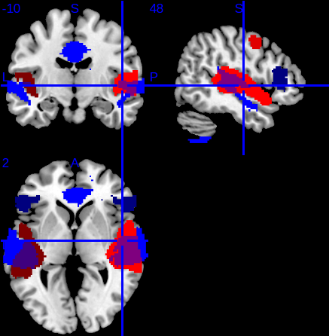
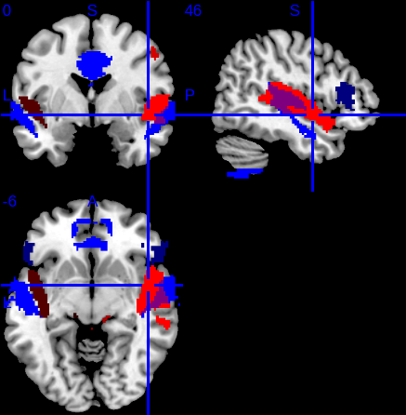
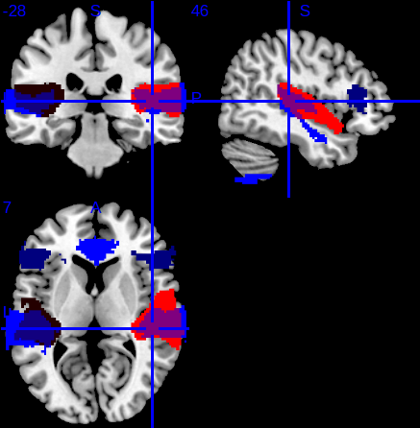
Ignoring Session
ROIs where ISC differentiate 4 stimuli overlay with GLM results
BLUE: ISC ROIs
RED: GLM activation
Spoken
A capella
Whole
Instrumental

Slide 6
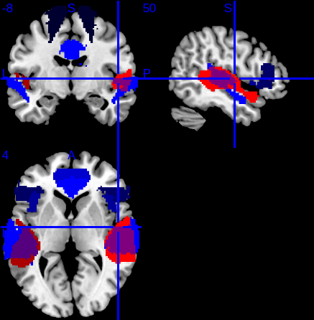
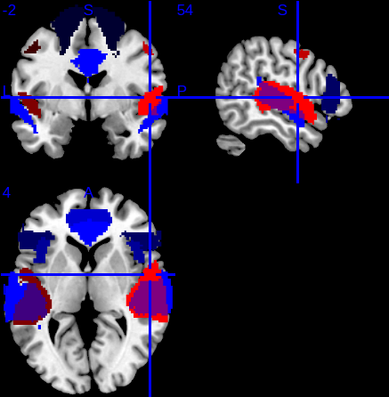
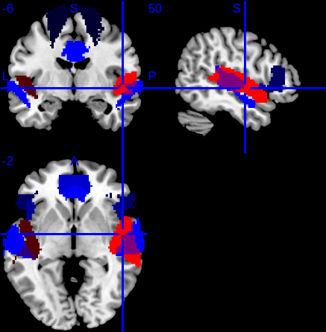
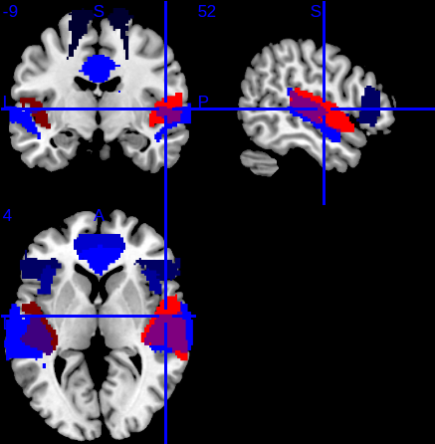
Session 1
ROIs where ISC differentiate 4 stimuli overlay with GLM results
BLUE: ISC ROIs
RED: GLM activation
Spoken
A capella
Whole
Instrumental

Slide 7
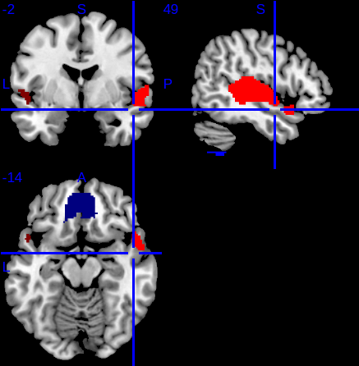
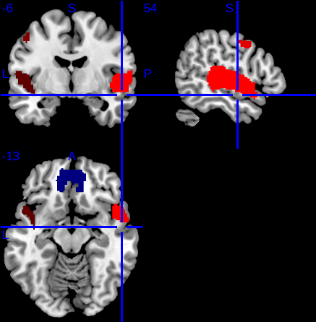
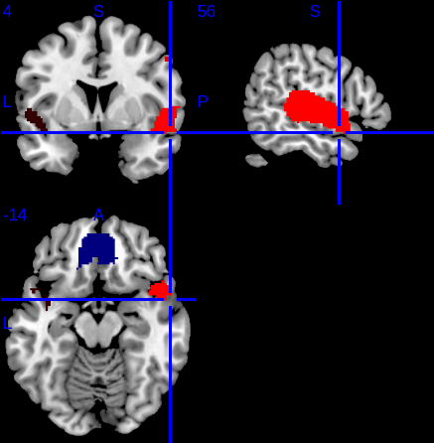
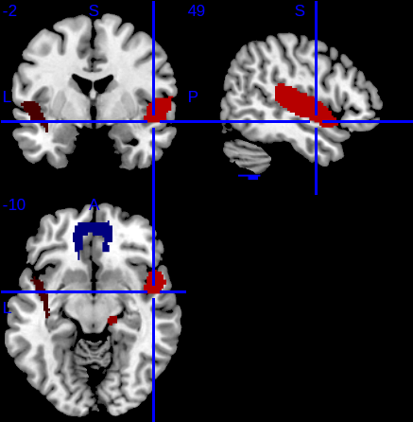
Session 2
ROIs where ISC differentiate 4 stimuli overlay with GLM results
BLUE: ISC ROIs
RED: GLM activation
Spoken
A capella
Whole
Instrumental

Slide 8
Familiarity
2x4 ANOVA (ses x stim type)
No interactions between type and session
T-tests: no difference between synchrony in familiar and unfamiliar stim in Session 2
T-tests: some differences in some ROIs between ISC in familiar stim across session with ses 1 > ses 2

Slide 9
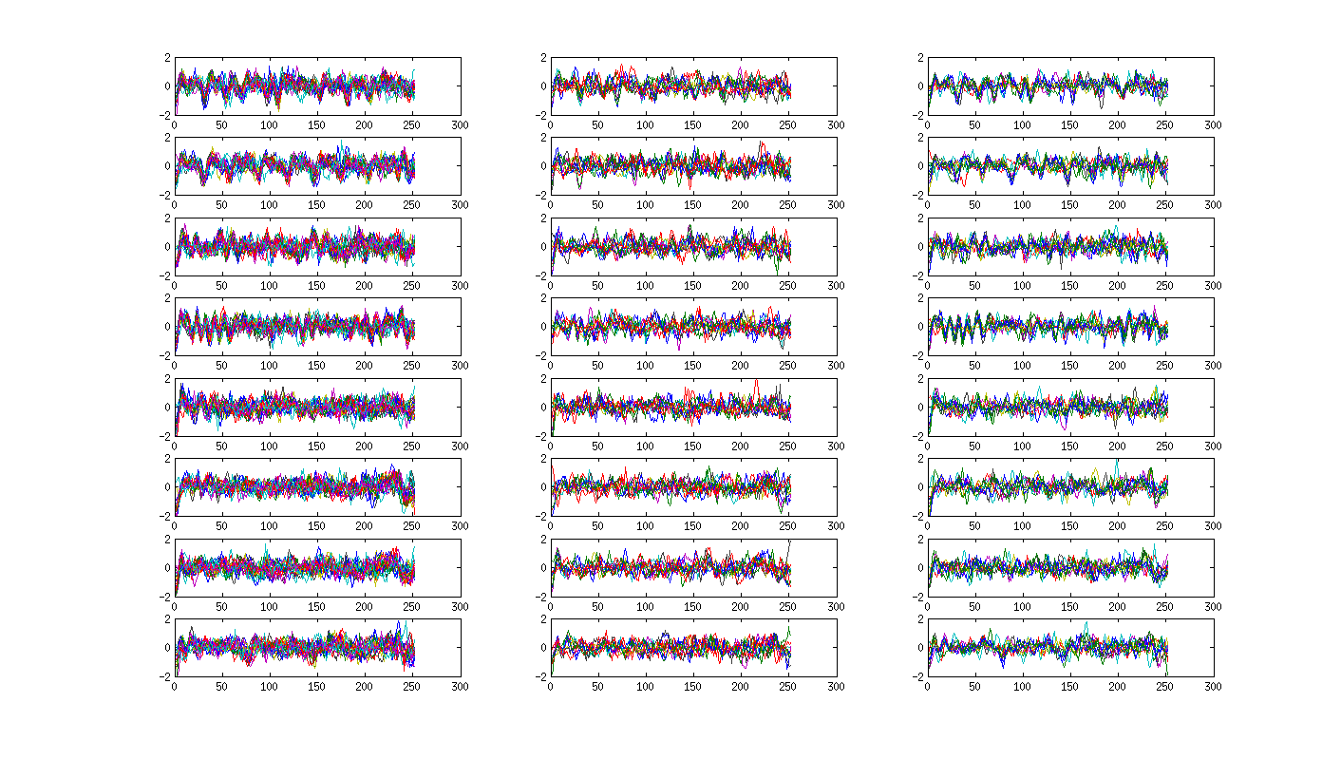
Heschel’s Gyrus
Session 2
Group A
Session 2
Group B
Session 1
S
FAM
S
FAM
A
FAM
A
FAM
I
FAM
I
FAM
W
FAM
W
FAM

Slide 10
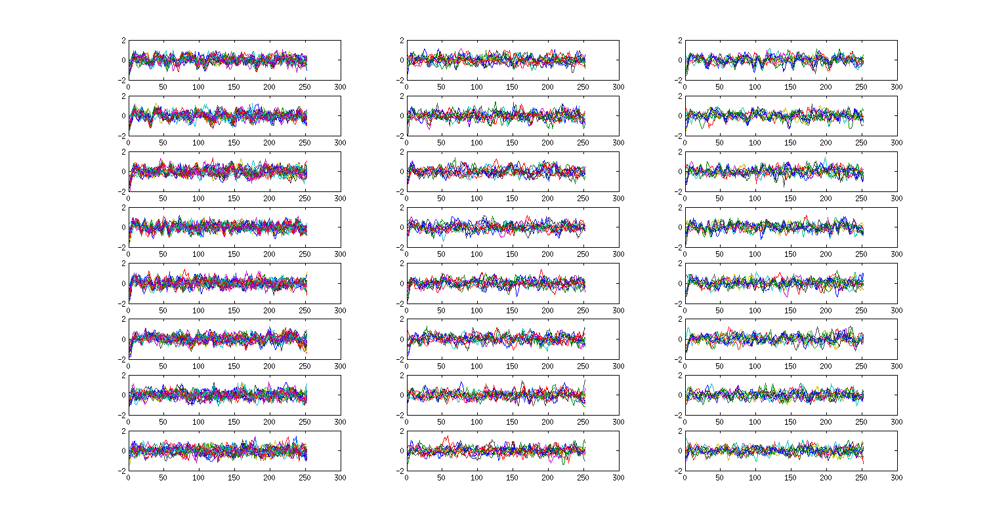
Anterior STG
Session 2
Group A
Session 2
Group B
Session 1
S
FAM
S
FAM
A
FAM
A
FAM
I
FAM
I
FAM
W
FAM
W
FAM

Slide 11
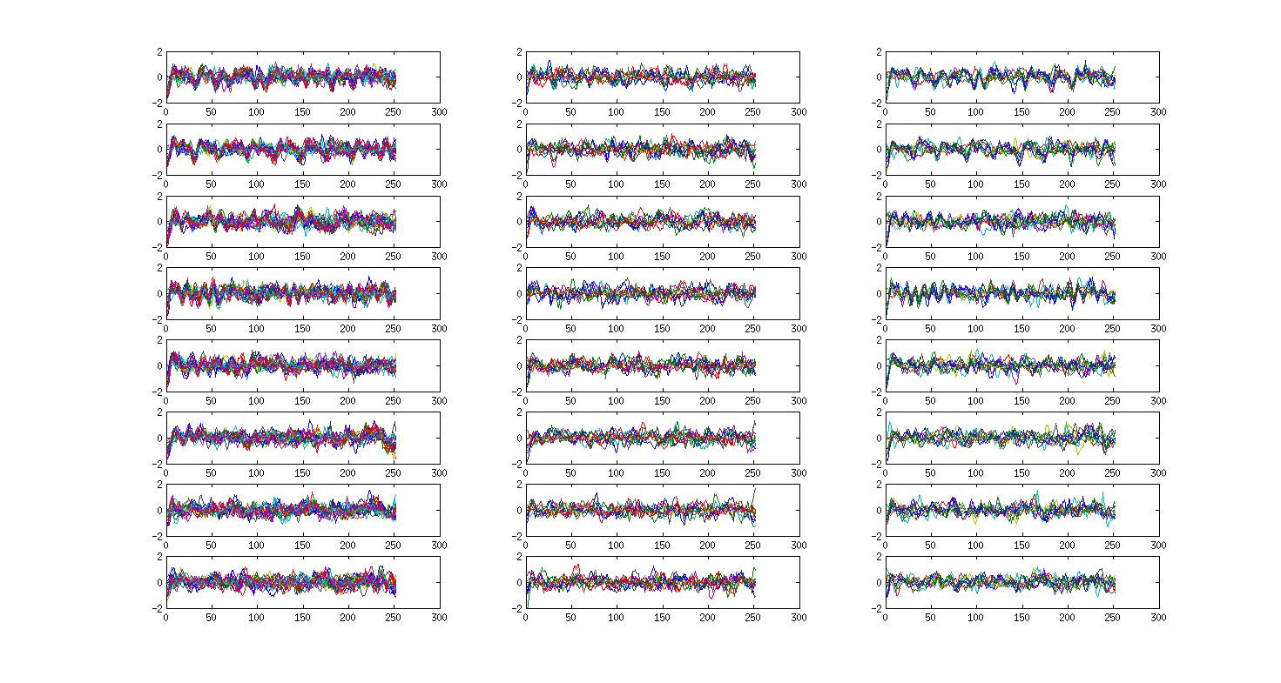
Posterior STG
Session 2
Group A
Session 2
Group B
Session 1
S
FAM
S
FAM
A
FAM
A
FAM
I
FAM
I
FAM
W
FAM
W
FAM

Slide 12
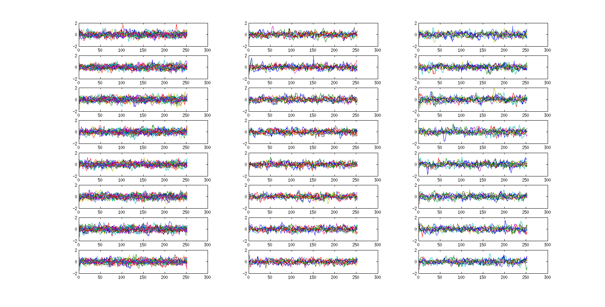
Anterior Cingulate
Session 1
Session 2
Group A
Session 2
Group B
S
FAM
S
FAM
A
FAM
A
FAM
I
FAM
I
FAM
W
FAM
W
FAM

Slide 13
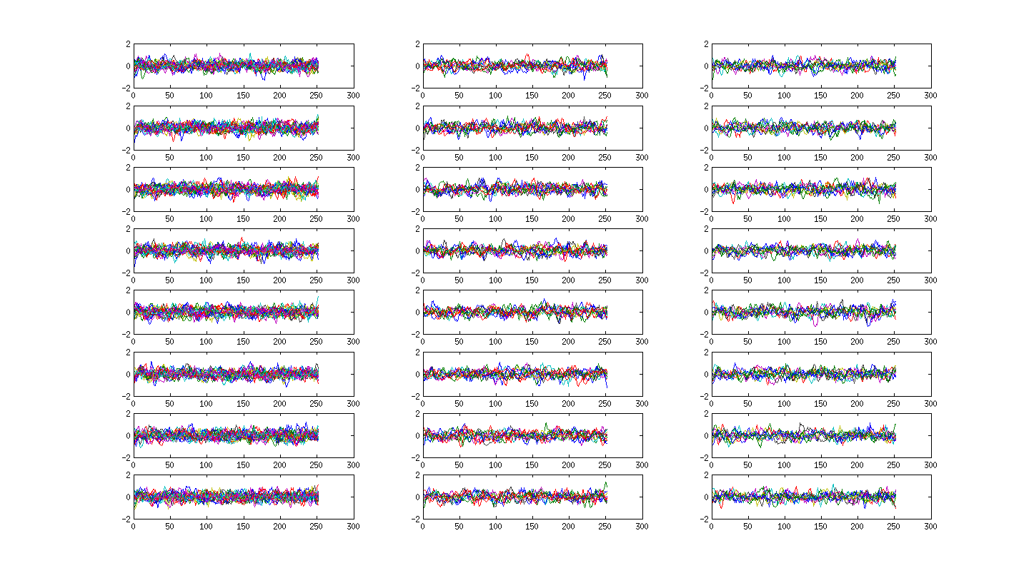
IFG - triangularis
Session 1
Session 2
Group A
Session 2
Group B
S
FAM
S
FAM
A
FAM
A
FAM
I
FAM
I
FAM
W
FAM
W
FAM

Slide 14
Summary

Slide 15
Cognition?

