Slide 1
Investigating shared neural representations of familiar and unfamiliar music
Avital Sternin
Supervisors: Jessica Grahn & Adrian Owen

Slide 2
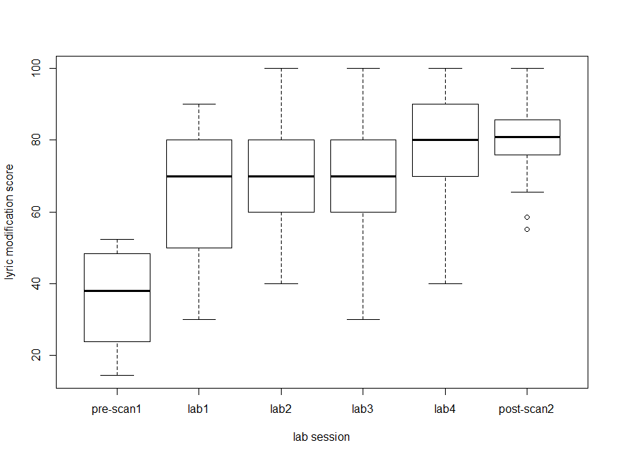
Lyric Modification Test
Forced choice between correct and modified lyric
- Which is familiar?
% correct

Slide 3
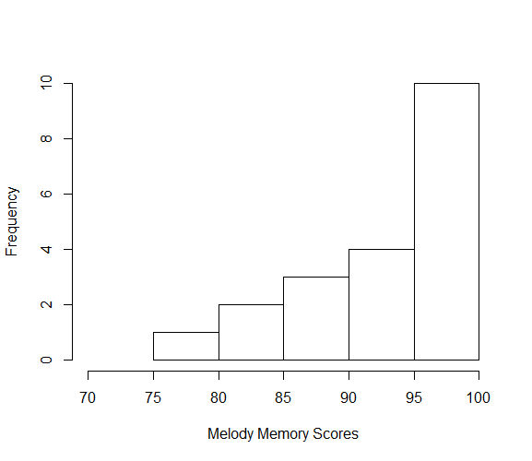
Old vs New melody memory
Forced choice between two clips
Which is familiar?
Results are at ceiling:
Mean 92% (SD = 6.4)
% correct
Participants are more familiar with the music after training
Successful familiarity manipulation

Slide 4
Data
22 participants (12F/10M)
Average age 24
Average # of listens: 13 (SD = 4.6)
Average # of days between scans: 20 (SD = 4.0)
Participants who did not receive an average of 70% across the two behavioural tests were excluded from the fMRI analyses
(average used so as not to bias the sample one way or another in terms of memory for lyrics vs melody)

Slide 5

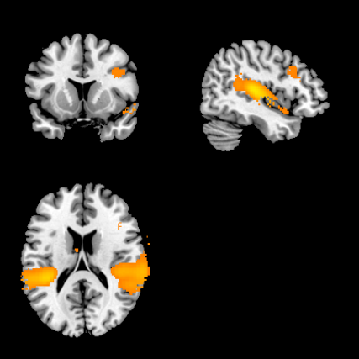
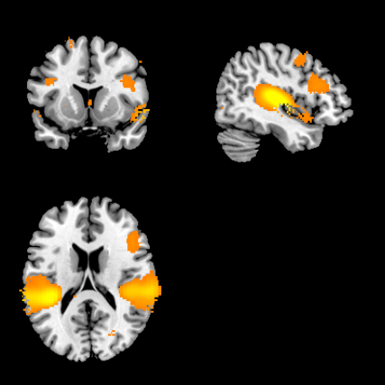
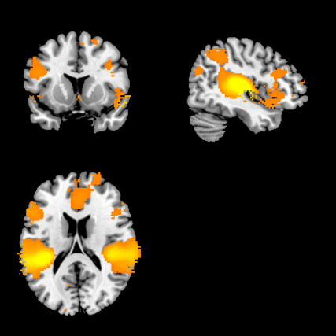
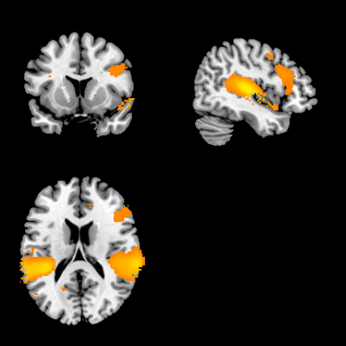
Is there inter-subject synchrony?
Data from Session 1
instrumental
a capella
spoken
whole
(x=45, y=12, z=18)
Notes:
Data from Session 1 was used – all of the songs are novel to all participants.
Each of the figures shows average synchrony for the two stimuli in that category (2 instrumental, 2 a capella, etc.)
We see strong synchrony in all 4 categories (Each stimulus on its own drives synchrony, but for presentation purposes I collapsed across category)

Slide 6
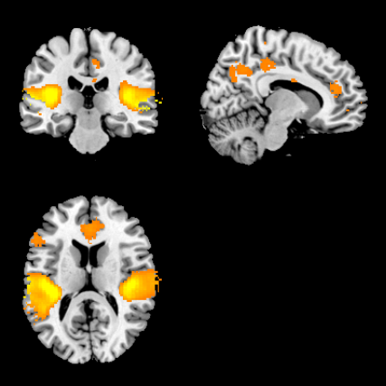
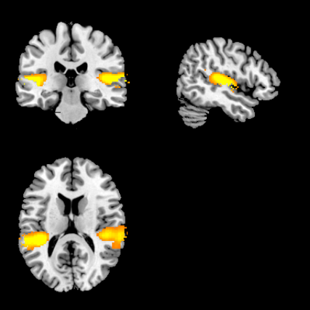
Main Effects
Effect of learning?
No synchrony difference between learned and unlearned songs
Effect of song type?
Yes, there are differences in synchrony based on song type
Effect of session?
Yes, there are differences in synchrony between sessions
Notes:
INTERACTIONS:
No Session x Learning interaction
Session x song is significant – figure on next slide

Slide 7
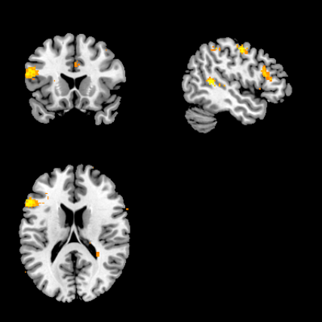
Significant session x song type interaction

Slide 8

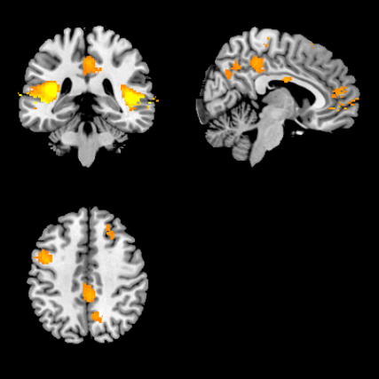
Digging deeper into song type
Hypothesis: We expect to see more synchrony to whole stimuli than to spoken stimuli.
spoken > whole
(x=6, y=-36, z=43)
Notes:
Started with whole vs spoken to look at the “most simple” vs. the “most complex” stimuli
The opposite contrast (whole > spoken) shows no significant voxels

Slide 9

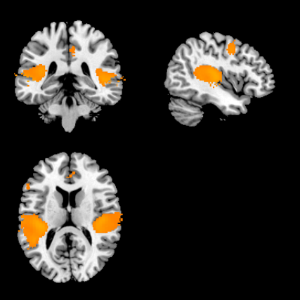
Digging deeper into song type
What happens as we start adding music and lyrics together?
Hypothesis: intuitively, we think there will be more synchrony as more information is added
Spoken > a capella, instrumental, whole
Next step -> look at all pairwise comparisons between the four types of stimuli.
(x=-43, y=-36, z=14)
Notes:
Whole > a capella was not sig.

Slide 10
Digging deeper into song type
Pairwise comparisons reveal this pattern regarding the amount of synchrony:
spoken > a capella > whole > instrumental
Three main areas involved:
Frontal
Auditory
Motor
Next step -> Does this pattern hold true in each region
Analysis was done on the whole brain but I found that there were really three areas involved
Currently working on running the synchrony analysis in ROIs to see if the pattern changes based on region
- will also look in basal ganglia

Slide 11
Digging deeper into session effect
More synchrony in Session 1 than in Session 2
The larger amount of synchrony in session 1 is driven by the spoken and the a capella stimuli
There is no session x learning interaction
Previous literature shows decreases in synchrony with repetition which is assumed to be the participant losing interest/boredom. It’s very possible that my participants are just bored and not engaged in the second session despite 50% of the songs still being ‘novel’

