Slide 2
Play stims
Do you think that everyone’s brain is doing the same thing while you listen?
Use rCA to answer that question

Slide 3
rCA Correlational component analysis
Produces linear components that are maximally correlated in time
So what do rCA components look like for perception and imagination of my stim?

Slide 4
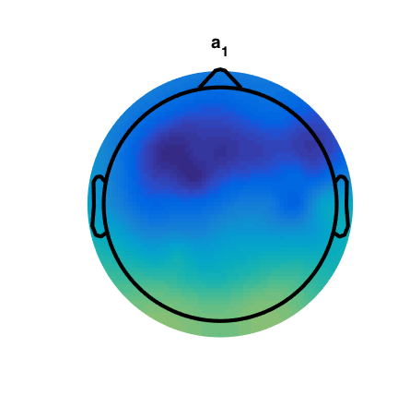
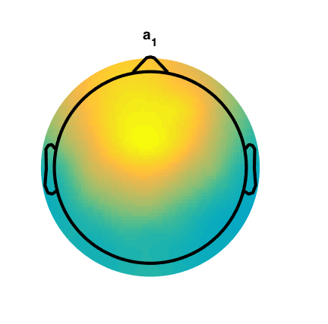
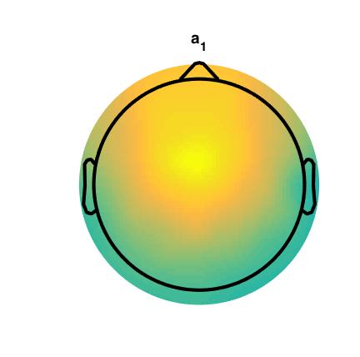
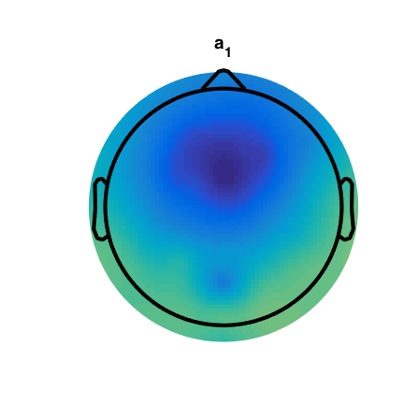
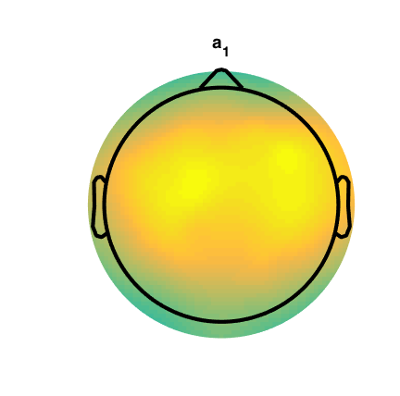
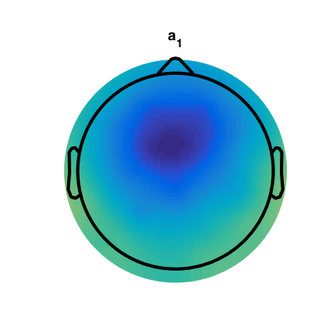
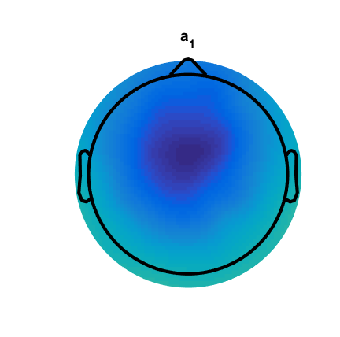
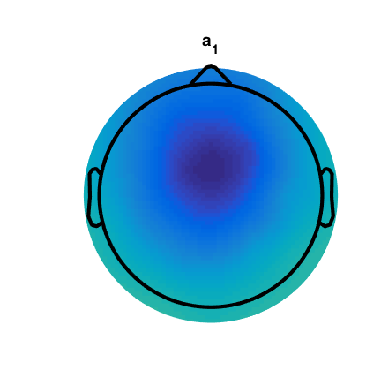
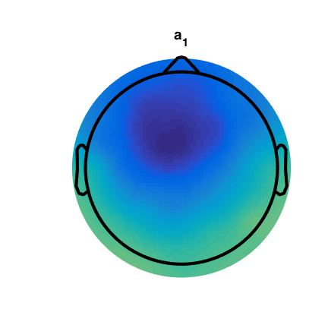
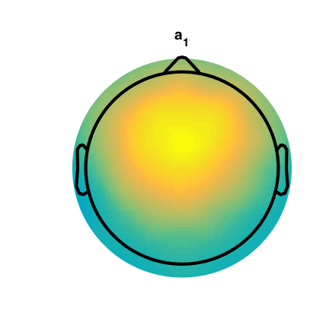
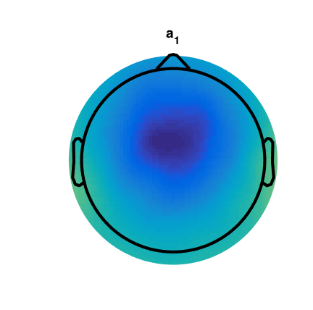
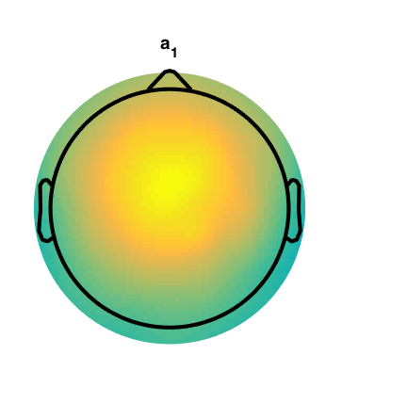
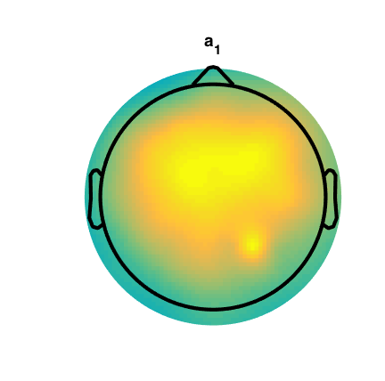
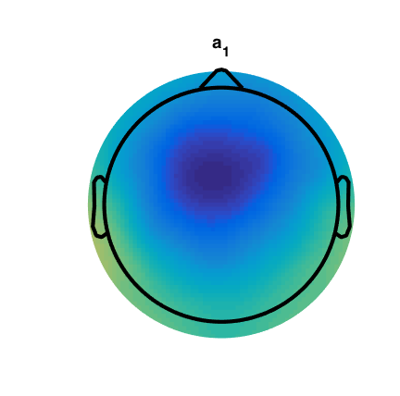

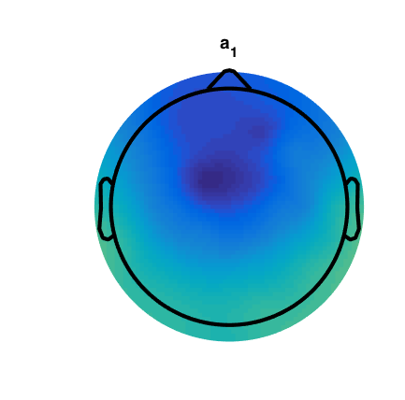
Perception
Imagination
speech
rhythm
speech
rhythm
hungry
hurts
No
Yes

Slide 5
Topographically everything looks the same
Perception and imagination
Rhythm and speech
Is there any way to differentiate the 4 stimuli conditions?
Use rCA timecourse

Slide 6
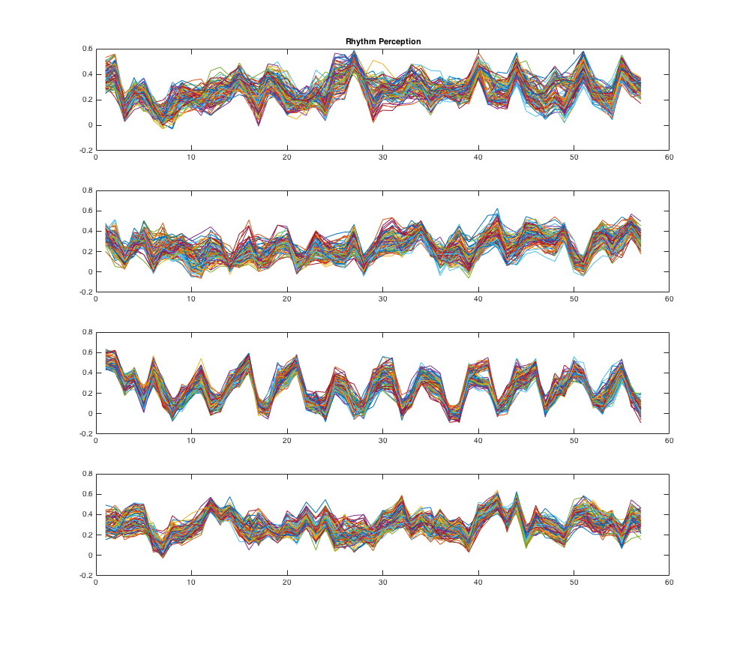
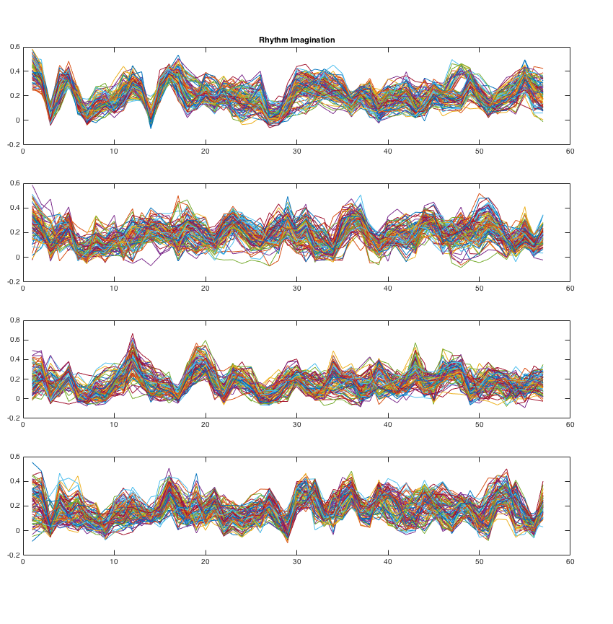
Rhythm Perception
Rhythm Imagination
0.064
0.069
0.069
0.075
0.058
0.081
0.062
0.077
Variance is larger in rhythm imagination
Notes:
Rhythm Perception Variance vs Rhythm Imagination Variance ttest
Cond 1: t= 336 p=0
Cond 2: t=189 p=0
Cond 3: t=1066 p=0
Cond 4: t=961 p=0

Slide 7
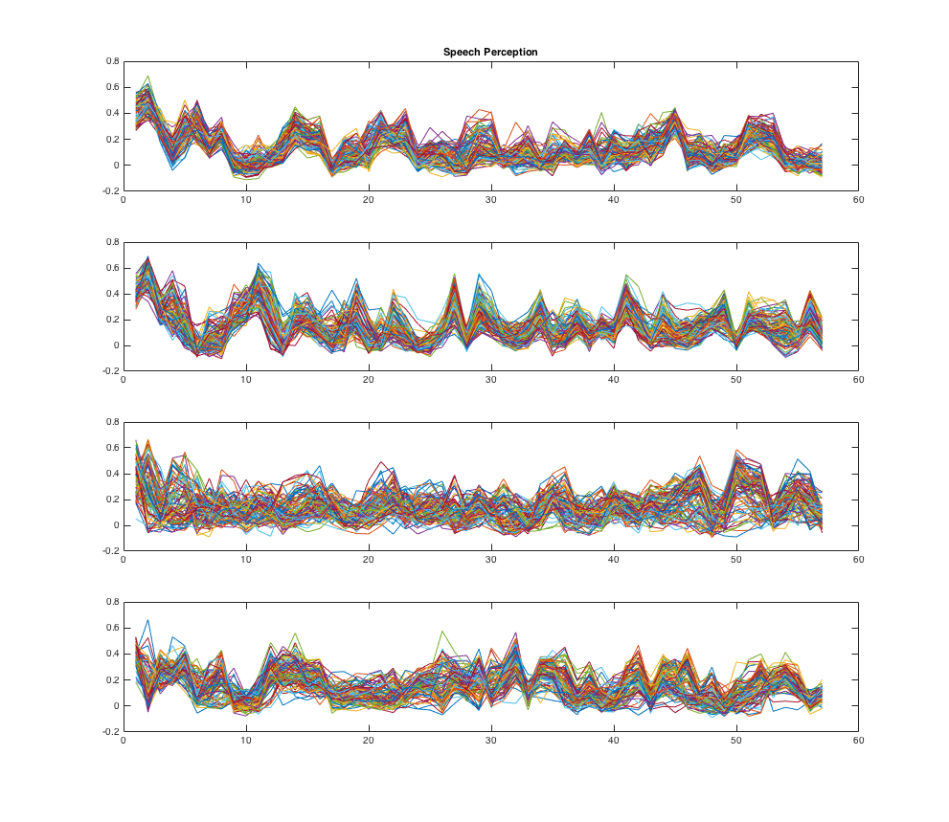
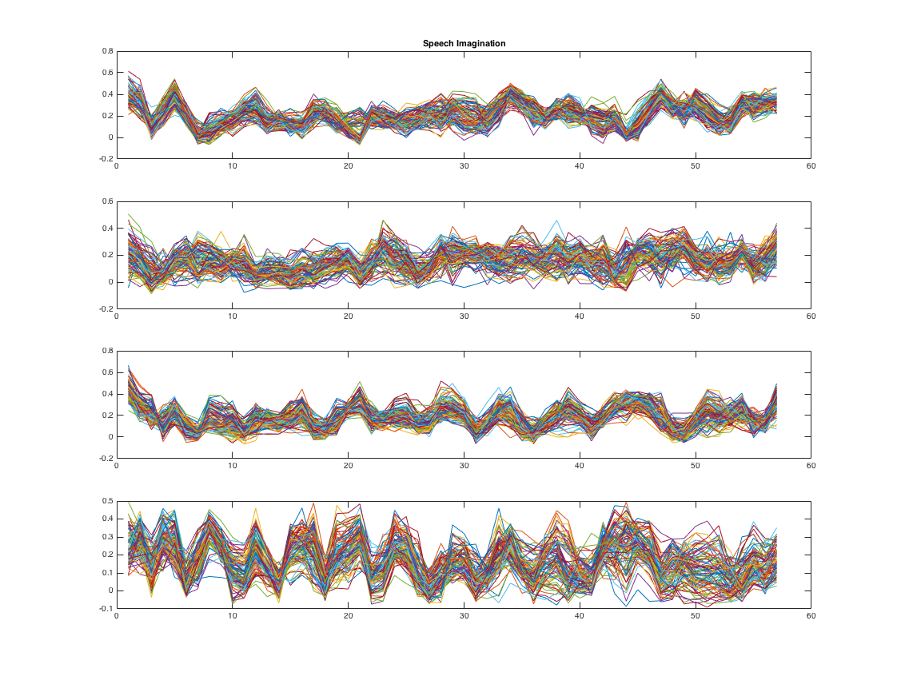
Speech Perception
Speech Imagination
0.065
0.064
0.075
0.071
0.095
0.065
0.079
0.076
More variance in speech perception
Notes:
speechPerception Variance vs speech Imagination Variance ttest
Cond 1: t=88 p=0
Cond 2: t=151 p=0
Cond 3: t=1438 p=0
Cond 4: t=128 p=0

Slide 8
Classification

Slide 9
Classification 4 Conditions
Within type and modality
Speech perception
Speech imagination
Rhythm perception
Rhythm imagination
100% classification accuracy
1-2, 1-3, 1-4, 2-3, 2-4, 3-4
Conditions are different from each other
Notes:
When the timecourse data is scrambled, classification falls to chance

Slide 10
Classification Perception vs Imagination
Is the way the classifier is differentiating between conditions the same in perception and imagination?
Train on perception, test on imagination
Classifier is at chance
The difference between imagination trials is different from the difference between perception trials (drawing different lines)

Slide 11
Classification
Perception
Imagination

Slide 12
Classification Perception vs Imagination
Train: Speech perc 1 & Speech imag 1
99 trials of each
Test: on perception1 imagination1
1 trial of each
100% classification accuracy
Timecourses of Imagination and Perception are different from each other within the same condition

Slide 13
Summary
Perception and Imagination are spatially similar (fMRI studies)
But their patterns of activations are different
The way the group is imagining sounds is different from the way it is perceiving sounds

Slide 14
Classification Rhythmicity
The similarity between the rhythm and speech stimuli is in the pattern of sounds
Train on Rhythm Perception, Test on Speech Perception
1-2, 1-3, 1-4, 2-3, 2-4, 3-4
Some pairs are classified above chance
In some pairs, the differences between conditions in rhythm and speech have a significant overlap

