Slide 1
CBS & MoCA & MMSE

Slide 2
51 participants (42 female)
Mean age = 81 (62-97)
Completed:
MMSE
MoCA
12 CBS tasks

Slide 3
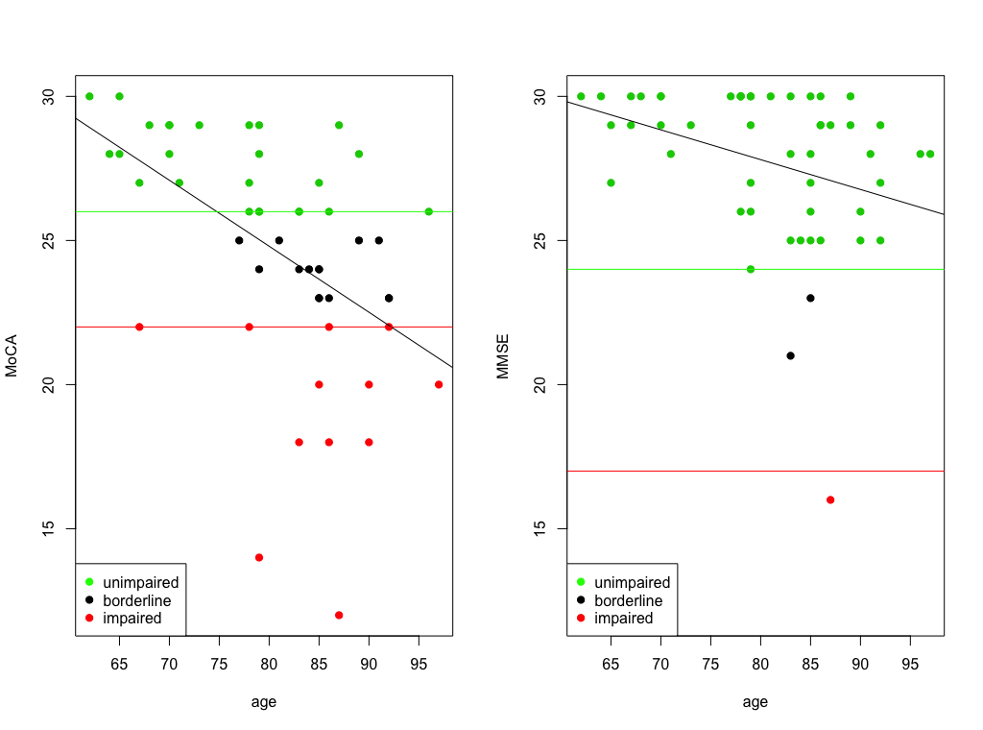

Slide 4
Unclear what to do with patients who end up in the borderline category
Can we use the scores on the CBS tasks to further categorize our borderline participants?

Slide 5
Within each task separately
 | DS | OOO | GR | R | FM | ML | P | SS | TS | DT | PA | SP
% left in Borderline | 71 | 64 | 57 | 50 | 50 | 50 | 43 | 36 | 36 | 36 | 29 | 21
% moved to Unimpaired | 7 | 14 | 7 | 14 | 14 | 21 | 7 | 29 | 7 | 14 | 0 | 14
% moved to Impaired | 21 | 21 | 36 | 36 | 36 | 29 | 50 | 36 | 57 | 50 | 71 | 64
If borderline score ≥ unimpaired score
(if they did as well or better)
If borderline score ≤ impaired score
(if they did as well or worse)

Slide 6
MoCA – on its own categorizes 73% of all participants
Include Spatial Planning – 94% of participants are categorized
Include Paired Associates – 92% of participants are categorized
Which combination of tests best categorizes borderline participants
(using more than one test, categorizing in the same direction)
SP & PA – 88% of all participants
SP & TS – 88% of all participants
(these tests do better on their own)
Which combination of tests best categorizes all participants
(set cut offs based on categories, then recategorize ALL)
DT & SP
SP & TS
TS & PA
Equally successful – at 37% of participants (worse than MoCA on its own)

Slide 7
regression
MoCA
MoCA scores are best predicted by: Feature Match and Odd One Out
Adjusted R² = 0.6483 = 0.65
Age was included as a factor and predicts 22% of the variance in MoCA scores (adjusted R² = 0.2216) on its own
 | DS | OOO | GR | R | FM | ML | P | SS | TS | DT | PA | SP
% left in Borderline | 71 | 64 | 57 | 50 | 50 | 50 | 43 | 36 | 36 | 36 | 29 | 21
% moved to Unimpaired | 7 | 14 | 7 | 14 | 14 | 21 | 7 | 29 | 7 | 14 | 0 | 14
% moved to Impaired | 21 | 21 | 36 | 36 | 36 | 29 | 50 | 36 | 57 | 50 | 71 | 64

Slide 8
regression
MMSE
MMSE scores are best predicted by: Odd One Out and Grammatical Reasoning
Adjusted R² = 0.4148 = 0.41
Age was included as a factor and predicts 6% of the variance in MMSE scores (adjusted R² = 0.0634) on its own
 | OOO | FM | DS | TS | GR | ML | SS | R | SP | PA | DT | P
% left in Borderline | 78 | 78 | 72 | 67 | 61 | 61 | 44 | 39 | 39 | 33 | 28 | 22
% moved to Unimpaired | 17 | 0 | 11 | 11 | 11 | 17 | 28 | 17 | 17 | 0 | 22 | 33
% moved to Impaired | 6 | 22 | 17 | 22 | 28 | 22 | 28 | 44 | 44 | 67 | 50 | 44

Slide 9
Conclusions
On its own the MoCA classified 73% of participants into impaired or unimpaired
MoCA + Spatial Planning – 94% of participants are categorized
Feature Match and Odd One Out best predict MoCA scores
A MoCA ‘replacement’ test could be a 3 test battery
FM, OOO, & SP

Slide 10
r = 0.74
r = 0.55

Slide 11
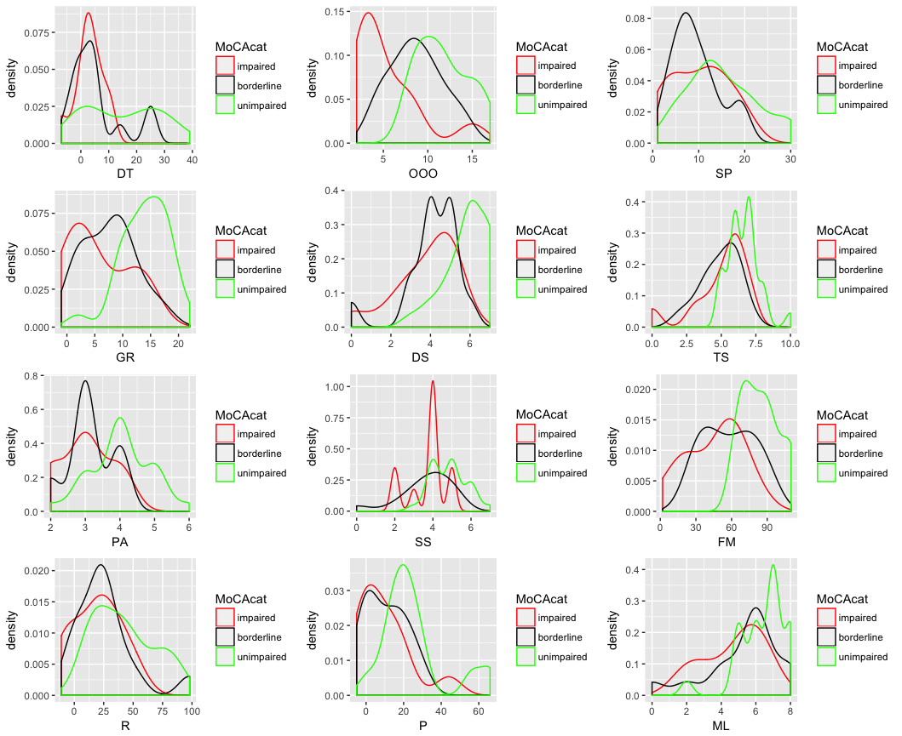

Slide 12
takeaways
Further insight into working memory and reasoning abilities provides better classification into impaired or unimpaired groups
Important for diagnostic and treatment purposes
Computerized testing can be used with older adults
Only 1 person did not complete all 12 tasks
Test administration is consistent between sessions – important for tracking abilities over time

