Slide 1
Lab Retreat
Avital Sternin
September 6, 2017

Slide 2
Things I can talk about
fMRI data + follow-up studies
Speech data + rCA

Slide 3
Why is memory for music so special?
Can you remember all of the lyrics to your favourite song from high school?
Why do patient’s with Alzheimer’s disease remember lyrics to songs from their youth but may not remember the names of common objects?

Slide 4
Evidence for specific memory for music: Case studies
Patient CN: bilateral temporal lobe damage led to severe, music specific agnosia (Peretz, 1996)
Recognized lyrics, but did not recognize previously familiar music
Normal performance on musical perceptual tests
Patient PM: encephalitis led to severe ante- and retrograde amnesia (Finke et al, 2012)
Professional cellist
Severe memory impairments, but performed like healthy musicians on music recognition tests
Notes:
CN -
PM – severe semantic and episodic memory deficits – poor performance on Wechsler memory scale

Slide 5
From case studies…
Proposed musical lexicon that “contains all the representations of the specific musical phrases to which one has been exposed during one’s lifetime” (Peretz & Coltheart, 2003)
The musical lexicon is separate from the verbal lexicon
Notes:
Posterior inferior temporal cortex (PITC) may be an interface between lyrics and melody to facilitate the recognition of familiar songs (Saito et al, 2012)

Slide 6
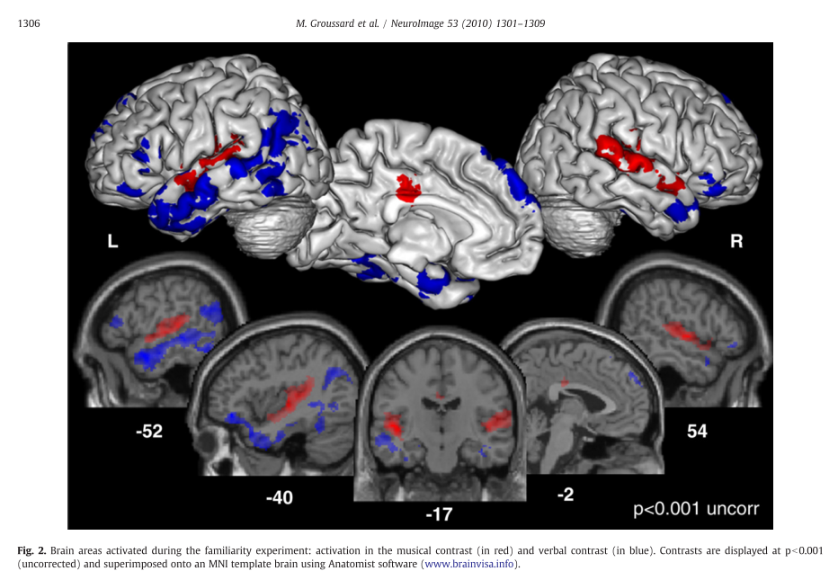
Evidence for separate networks
[Music-Verbal] [Verbal-Music]
Notes:
Music contrast – RED - Bilateral activation in superior temporal gyri, left middle cingulate, and right insula
Verbal contrast – BLUE – left-sided activation in the inferior and middle temporal gyri, medial superior and inferior pars triangularis frontal gyri, posterior MTG, on the right – inferior orbitofrontal cortex, middle temporal pole and the anterior part of the hippocampus and cerebellum

Slide 7
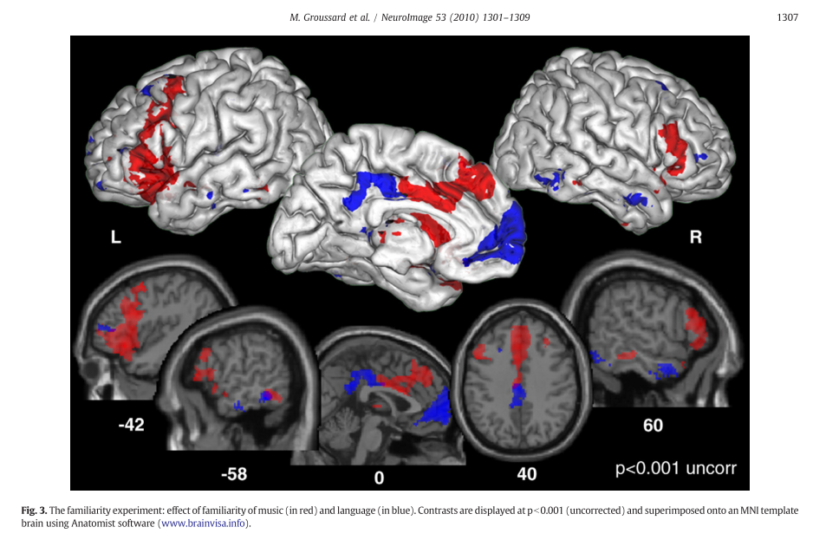
Areas where activity increased with familiarity Music Verbal
Notes:
“parametric regressor modeling familiarity was constructed,”
Greater activity for music in an extended network that included the bilateral inferior frontal gyrus (BA45) (extending to the middle frontal gyrus), the posterior part of the inferior and middle temporal gyri (BA20/37), the medial superior frontal gyrus (BA10) and the right superior temporal pole (BA38).
The verbal familiarity analysis revealed greater activity in the left medial superior frontal gyrus (BA10), the middle cingulate cortex bilaterally, the left putamen and thalamus, and the inferior and middle parts of the frontal (BA47/46) and temporal gyri (BA20/21) bilaterally. We also found activation of the posterior part of the right hippocampus and the left parahippocampal cortex.

Slide 8
Study 1
Identify neural correlates underlying familiar and lyric-based music in healthy adults
Novel feature: We will train participants on unknown music
Notes:
ISS: Abrams 2013
We found that music synchronizes brain responses across listeners in bilateral auditory midbrain and thalamus, primary auditory and auditory association cortex, right-lateralized structures in frontal and parietal cortex, and motor planning regions of the brain.

Slide 9
Current Questions
Is there a neural pattern that differentiates familiar from unfamiliar music?
Is it consistent across participants?
How does the presence of lyrics interact with music familiarity?
Is memory better with lyrics?

Slide 10
Project Outline
Scanning session 1
Training – 2-3 weeks
Scanning session 2

Slide 11
Stimuli
16 unfamiliar songs
4 spoken words
4 sung lyrics (acapella, no music)
4 instrumental music only
4 ‘whole’ songs (music + lyrics)

Slide 12
Project Outline
Scanning session 1 – all 16 stim
Baseline familiarity test
ISS and BOLD scans
Training – 2-3 weeks
Scanning session 2

Slide 13
Project Outline
Scanning session 1 – all 16 stim
Baseline familiarity test
ISS and BOLD scans
Training – 2-3 weeks – only 8 stim
Music player with questions
Lab sessions 2x per week
Scanning session 2

Slide 14
Project Outline
Scanning session 1 – all 16 stim
Baseline familiarity test
Scan 1
Training – 2-3 weeks – only 8 stim
Music player with questions
Lab sessions 2x per week
Scanning session 2 – all 16 stim
Final familiarity test
Scan 2

Slide 15
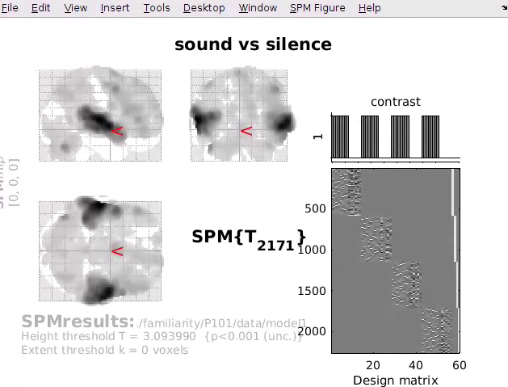
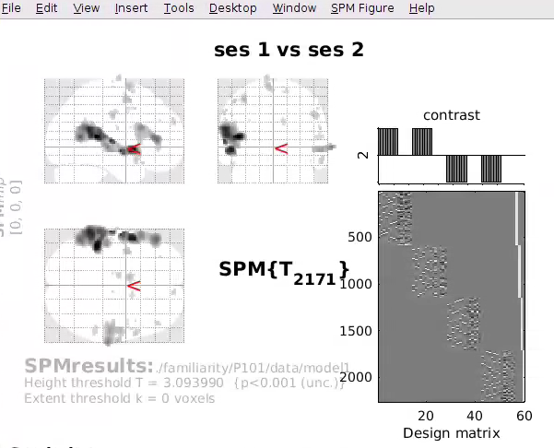

Slide 16
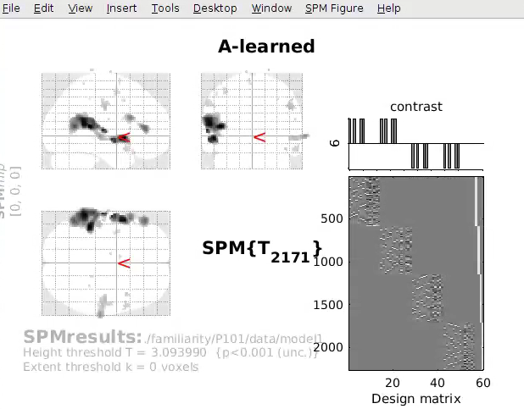
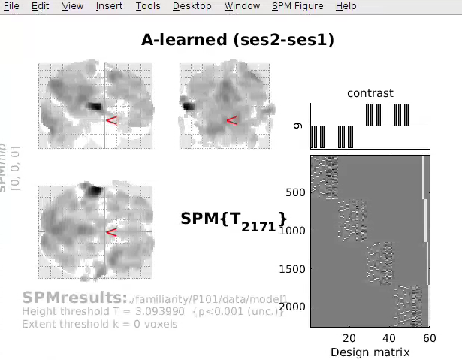

Slide 17
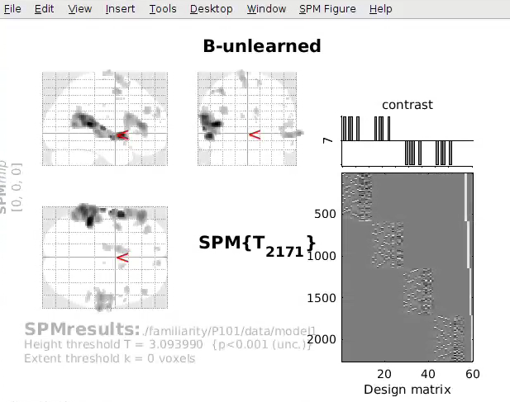
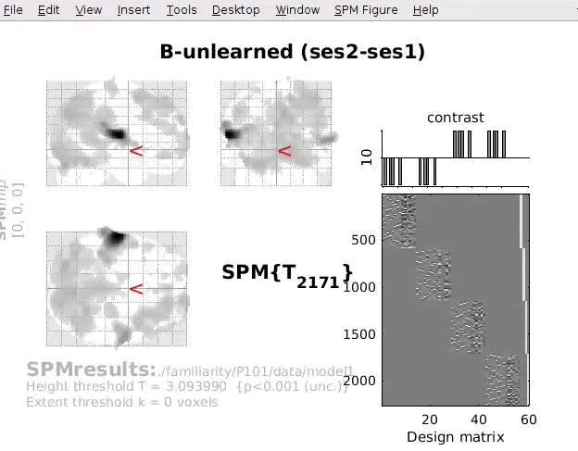

Slide 18
Familiarity tests
Lyric modification
Forced choice between original and modified lyric
Full set in session 1 and session 2 (~25)
Subset during lab training session (10, monitor progress)
Melody familiarity
Short clips (2 sec) – Old vs New task
learned vs. unlearned songs
During session 2 (~25 clip pairs)
Notes:
----- Meeting Notes (17-05-11 10:57) -----
music + lyrics association

Slide 19
Other Study: Music Synchronization in Alzheimer’s
Hitchcock movie, familiar, unfamiliar music
inter-subject synchrony
Young controls from current study
Alzheimer’s patients & age-matched controls in new study
(with MacDonald lab)

Slide 20
Other Study: Music Synchronization in Alzheimer’s
How does inter-subject synchrony change in Alzheimer’s?
How is consciousness disrupted in Alzheimer’s?
Where does Alzheimer’s disease fall on the consciousness ‘continuum’?

Slide 21
Speech and rCA

Slide 22
rCA Correlational component analysis
Produces linear components that are maximally correlated in time
Dmochowski, J., Sajda, P., Dias, J., Parra, L. 2012. Correlated Components of Ongoing EEG Point to Emotionally Laden Attention – A Possible Marker of Engagement? Frontiers in Human Neuroscience

Slide 23
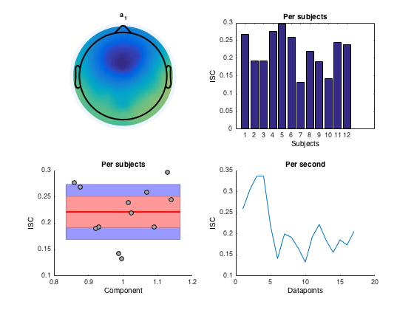

Slide 24

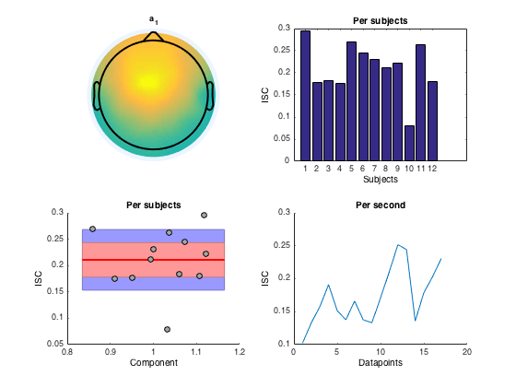
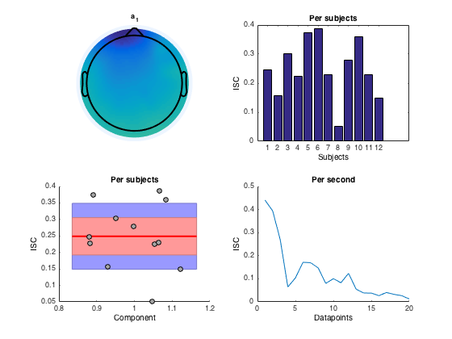
Hungry
imagination
perception
rhythm
speech

Slide 25
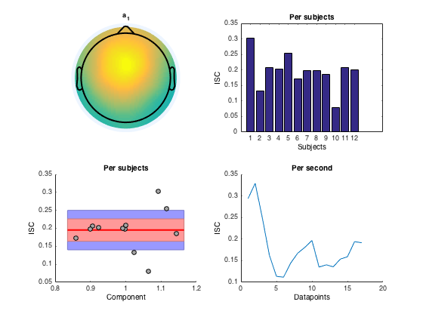
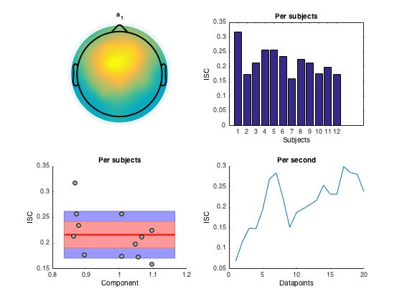
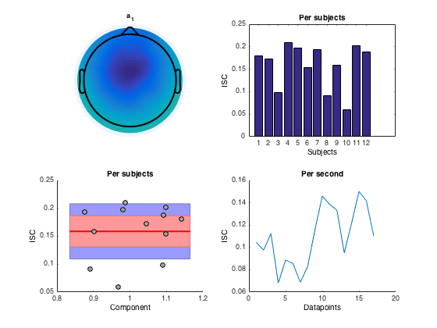
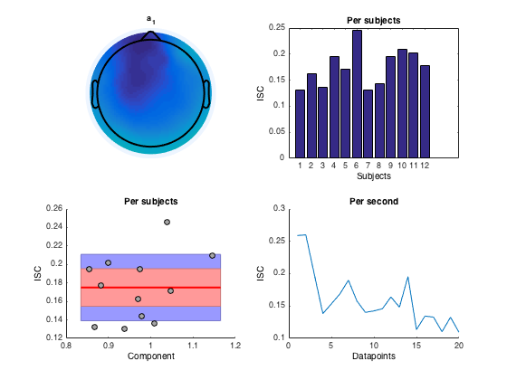
Hurts
imagination
perception
rhythm
speech

Slide 26
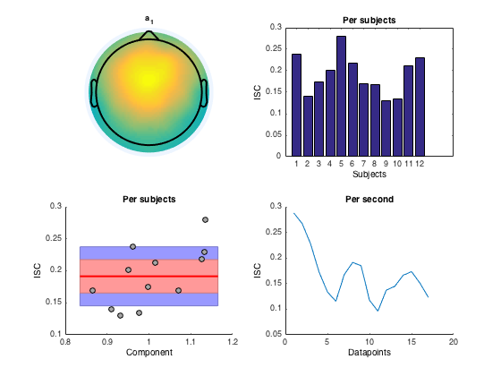
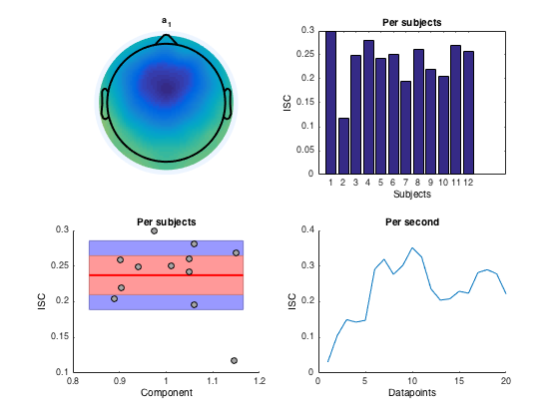
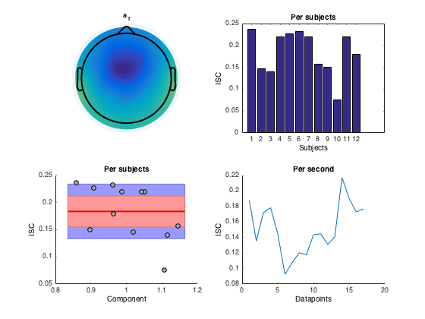
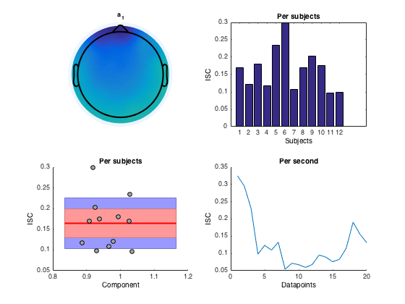
No
imagination
perception
rhythm
speech

Slide 27
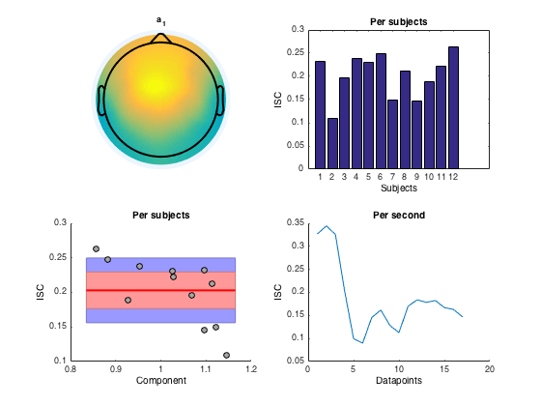
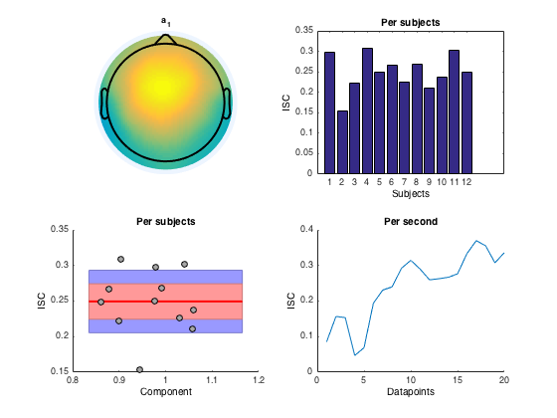
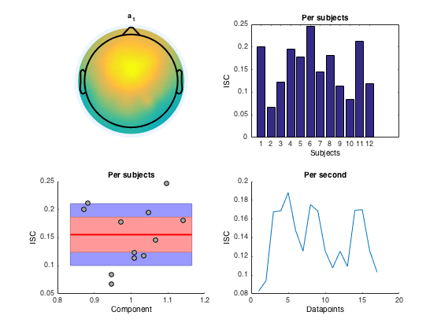
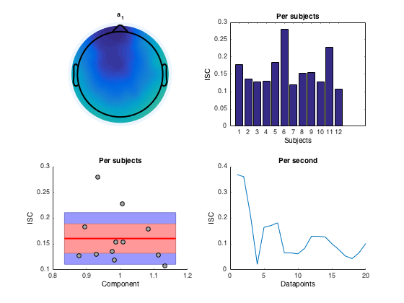
Yes
imagination
perception
rhythm
speech

Slide 28
Thank you

Slide 29
AD + memories
Music can be used as a memory aid in AD
Learning new song lyrics (Moussard et al, 2012 & 2014; Simmons-Stern et al, 2010 & 2012)
Autobiographical memories can be evoked by music
Memories are more vivid (Belfi et al, 2015)
Memories are more specific (El Haj et al, 2012)
Dorsal MPFC is involved in triggering these memories (Janata, 2009)

