Slide 1
Committee Meeting
May 3, 2018

Slide 2
General question
Evidence that memory for music is preserved in late stages of Alzheimer’s disease
Why is memory for music ‘special’?
How does the way the brain processes or remembers music change as we age?
Using:
BOLD fMRI data
Inter-subject synchrony
Memory
Music
Aging
Notes:
Starting with Young adults & music
Speech and movie has been done
Moving to healthy older adults
Same music paradigm as younger adults
Introduce well known music
Maybe Hitchcock movie?
Finally to dementia/AD
Use well known music only
Use well characterized stim – Hitchcock movie, Taken, etc

Slide 3
What is new?
Characterizing music familiarity without using long-known music
Training paradigm controls for musical characteristics between known and unknown music
Inter-subject synchrony
The way synchrony to music changes as we age has not yet been characterized.
Exploring how other factors relate to synchrony (e.g. familiarity, cognition)

Slide 4

= data collection & analysis ongoing
Young Adults
Marker of music familiarity
BOLD fMRI data
Tightly controlled familiarity
How lyrics/language interact with familiarity
Young Adults
Music synchrony
What does it look like when young adults synchronize to familiar/unfamiliar music?
Movies/speech has been done – music is a novel stimulus
Older Adults (healthy)
How does the marker of music familiarity change with age?
Run music training paradigm & use long known music
BOLD fMRI data
Older Adults (healthy)
How does music synchrony change with age?
What does it look like when older adults synchronize to familiar/unfamiliar music?
Synchrony to long known music as comparison
Older Adults
How does cognition change as we age?
CBS as an addition to better differentiate MoCA scores
CBS scores
CBS scores
CBS scores
Early AD or dementia
How does the marker of music familiarity change with aging disorders?
BOLD fMRI data
Long known stim only
Early AD or dementia
How does music synchrony change with aging disorders?
Synchrony to long known stim only
CBS scores
CBS scores
Notes:
----- Meeting Notes (18-05-03 13:27) -----
Add CBS to young adults - email out to young adults
hampshire - cbs & synchrony

Slide 5
Training Paradigm
Scan 1
Training
Scan 2
Scan 1 – all 16 stimuli
Baseline familiarity test
fMRI scan
Training – 2-3 weeks – only 8 stimuli
Music player with questions
Lab sessions 2x per week
Scan 2 – all 16 stimuli
Final familiarity test
fMRI scan
Notes:
Over 2-3 weeks, participants listen to 8 stimuli using an online music player that records each time they listen to the songs.
They also come in to the lab twice a week to listen to the songs in lab (to make sure that they are at least listening to them that much) and to fill out a number of questionnaires.

Slide 6
Familiarity test 1
Lyric modification
Forced choice between original and modified lyric
1. But don’t rush me now, I can hear you coming
2. But don’t rush me now, I can hear you calling
Notes:
Describe what the two familiarity tests are

Slide 7
Familiarity test 2
Melody Familiarity
Forced choice between 2 sec clips
Familiar vs Unfamiliar
Scan 1
Training
Scan 2
Full set
(25 pairs)
Notes:
Describe what the two familiarity tests are

Slide 8
Data so far
14 participants
Average age: 24
6 males
# of listens: 7-23
# of days between scans: 14-29

Slide 9
Lyric Modification Task
In lab sessions
14 participants
Notes:
Lab session 1= baseline
Lab session 6 = after scan 2
Each line is one participant – they all get better! They are learning the songs
Average before scan 1 = 36.5%
Average after scan 2 = 82%

Slide 10
Final Behavioural Memory Tests
scores after scan 2
Notes:
How do the familiarity test scores after scan 2 relate to the number of times a participant heard the song
Doesn’t look related to lyric modification score
Looks related to melody memory score
----- Meeting Notes (18-05-03 13:27) -----
melodic memory related to lyric mod?
behavioural results related to fmri results

Slide 11
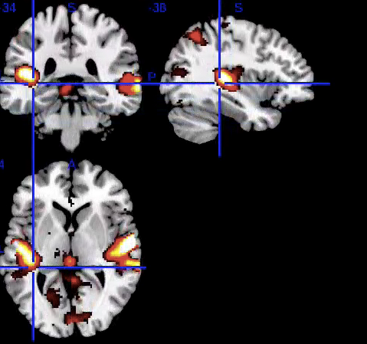
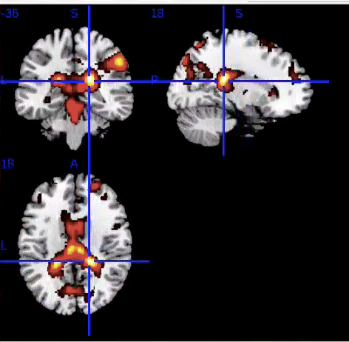
Preliminary fMRI results
Familiarity covaries with auditory activity in the superior temporal gyrus
More activity the less familiar the songs are
Familiarity X presence of lyrics
More activation to familiar music with lyrics than familiar music without lyrics or unfamiliar music
Both significant at the cluster level
Notes:
----- Meeting Notes (18-05-03 13:27) -----
effects of interest - F interest

