Slide 1
Design set up
Scan 1
Training
Scan 2
To be learned
Unlearned
Learned
Unlearned
A capella
Instrumental
Spoken
whole
A capella
Instrumental
Spoken
whole
A capella
Instrumental
Spoken
whole
A capella
Instrumental
Spoken
whole
8 different songs
(4 types)
Same as in scan 1
8 different songs
(4 types)
19 participants

Slide 2
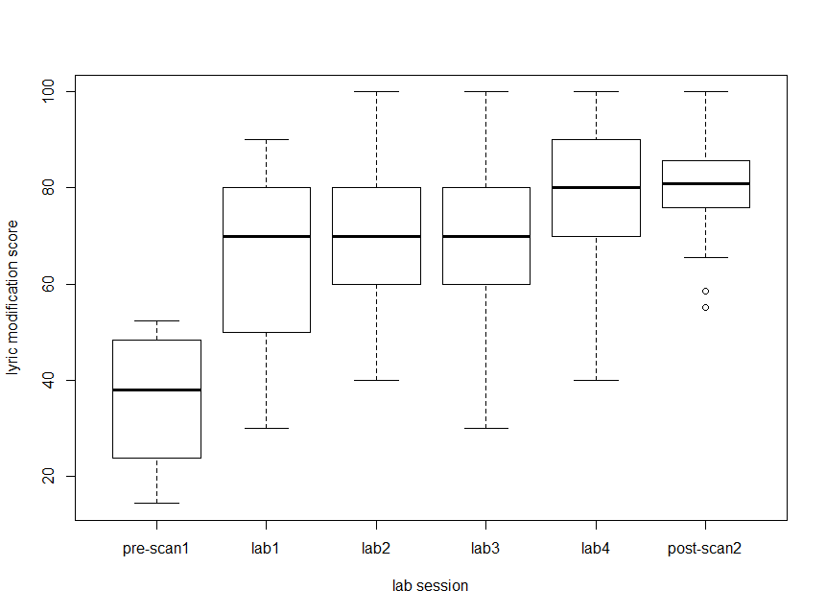
Lyric modification score – participants are learning the lyrics to songs

Slide 3
GLM vs ISC results
No systematic differences based on familiarity
In GLM or ISC
Stim type differences
GLM and ISC show S >A>W>I (across whole brain)
Pattern analysis to differentiate stim
Does MVPA show different areas beyond GLM/ISC?
still working on this

Slide 4
Intersubject synchrony in ROIs
Frontal, Auditory, Cingulate, Basal Ganglia, Cerebellum
Method:
Extract mean synchrony value from each ROI, for each participant
‘how synchronized was the activity in this participant’s ROI to everyone else’s activity’
Ran stats on the mean values

Slide 5
ISC stats
Ignoring Session:
ROIs that differentiate 4 stimuli

Slide 6
Session 1
ROIs that differentiate 4 stimuli

Slide 7
Session 2
ROIS that differentiate 4 stimuli

Slide 8
ISC stats
2x4 ANOVA (ses x stim type)
No interactions between type and session
Within Session 2:
Familiar stimuli differentiated by Cerebellum 7b_R only
Unfamiliar stim differentiate by Frontal Operculum only
T-tests show no difference between synchrony in familiar and unfamiliar stim in Session 2
T-tests show differences in some ROIs between synchrony in familiar stim between ses 1 and ses 2 with ses 1 > ses 2

Slide 9
Summary

Slide 10
Cognition?

Slide 11
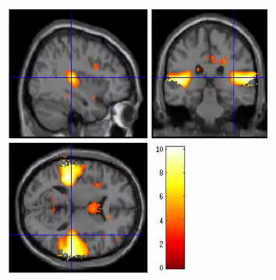
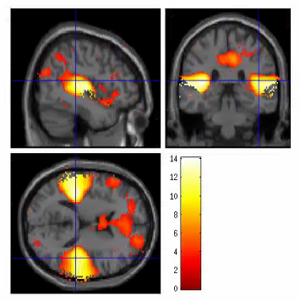
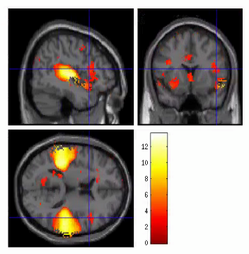
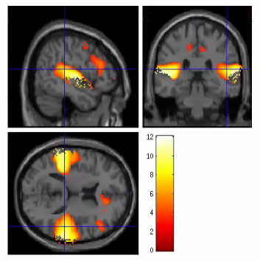
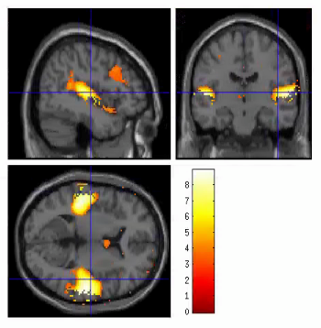
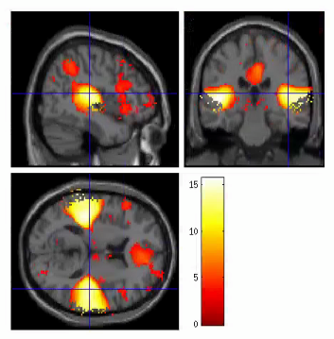
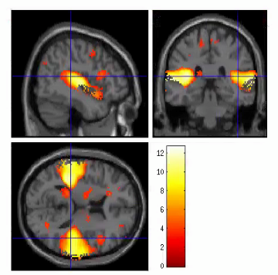
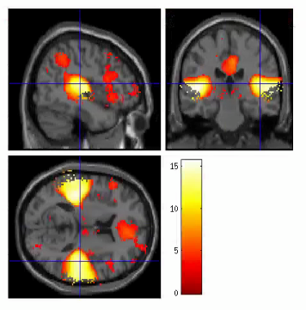
Instrumental
spoken
A capella
whole
Uncor. 0.001

