Slide 1
Baseline
(Pre-anaesthesia state)
Titration
Stage 1
(Sedated state)
Titration
Stage 2
(Anaesthesia state)
Recovery
Resting state scan
(10 min)
Resting state scan
(10 min)
Resting state scan
(10 min)
T1 scan
(10 min)
DTI
(10 min)
T2,
FLAIR?
Story 1 (7 min task + 3 min instructions etc.)
Story 3 (7 min task + 3 min instructions etc.)
Story 5 (7 min task + 3 min instructions etc.)
Story 2 (7 min task + 3 min instructions etc.)
Story 4 (7 min task + 3 min instructions etc.)
Story 6 (7 min task + 3 min instructions etc.)
30 min
15 min
30 min
15 min
30 min
30 min
Cp0 Cp 1.0 LOC
0 min 30 60 90 120

Slide 2
Analysis
Directly compare the amount of synchrony across maps:
Mor created synchrony maps for the 5 stories we have so far:
I compared the maximal correlation value in the PCC in each of the 5 datasets I have, keeping the number of subjects and samples constant (i.e. 18 subjects; 300 TRs). The values are:
Green Eyes – r = 0.4
Slumlord – r = 0.35
Pieman – r = 0.35
Vodka – r = 0.33
Tunnel – r = 0.29
How best to compare these 4 maps to the synchrony data we have on the Taken clip?

Slide 3
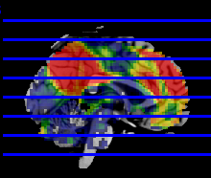
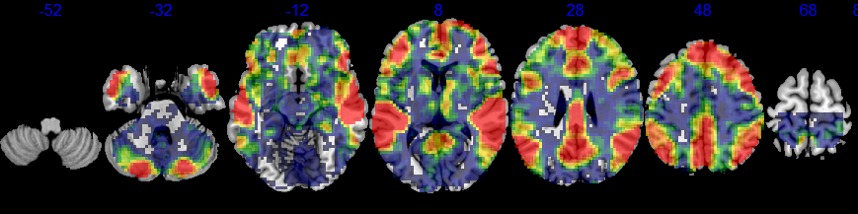
ISC maps from Tunnel Under the World (7 mins)

Slide 4
To be decided
Plan for 6 stories, 2 at each level
currently have four stories, Taken clip maybe a 5th and Mor is looking into getting access to a sixth story.
Behavioral study in awake volunteers
6 stories too much to remember?
Pretest stories for memory component?
Gather information on how suspenseful/interesting the stories are at regular intervals?
Interested in frontoparietal/DMN network interplay so salience/novelty/suspenseful/interesting rating will be useful
Mimicking the timeline of the fMRI study, to better understand the memory results (time/anaesthesia impact)

Slide 5
Budget
£20,000 allocated for scanning in year 1
£354 charity scan rate
56.5 hours of scanning
22.5 participants; We should aim for 25
25 * £75 = £1875 Volunteer time

Slide 6
Scanning start
All students finishing now, vivas eminent
New students starting in October

