Slide 1
Music & Memory
fMRI data overview

Slide 2
General question
Evidence that memory for music is preserved in late stages of Alzheimer’s disease
Why is memory for music ‘special’?
How does the way the brain processes or remembers music change in the presence of lyrics?
Using:
BOLD fMRI data
Inter-subject synchrony
Memory
Music
Lyrics
Notes:
Starting with Young adults & music
Speech and movie has been done
Moving to healthy older adults
Same music paradigm as younger adults
Introduce well known music
Maybe Hitchcock movie?
Finally to dementia/AD
Use well known music only
Use well characterized stim – Hitchcock movie, Taken, etc

Slide 3
What is new?
Characterizing music familiarity without using long-known music
Training paradigm controls for musical characteristics between known and unknown music

Slide 4
Training Paradigm
Scan 1
Training
Scan 2
Scan 1 – 8 stimuli (songs)
Baseline familiarity test
fMRI scan
Training – 2-3 weeks – only 4 stimuli
Music player with questions
Lab sessions 2x per week
Scan 2 – 8 stimuli
Final familiarity test
fMRI scan

Slide 5
Design set up
Scan 1
Training
Scan 2
To be learned
Unlearned
Learned
Unlearned
A capella
Instrumental
Spoken
whole
A capella
Instrumental
Spoken
whole
A capella
Instrumental
Spoken
whole
A capella
Instrumental
Spoken
whole
8 different songs
(4 types)
Same as in scan 1
8 different songs
(4 types)

Slide 6
Data
22 participants (12F/10M)
Average age 24
Average # of listens: 13 (4-20)
Average # of days between scans: 20 (14-29)

Slide 7
6 behavioural measures
Familiarity – objective # of listens from music player
Lyric modification test (created in lab)
Old vs New melody memory (created in lab)
Lyric Orientation Score (borrowed from different lab)
BAT – melody memory
BAT – beat perception

Slide 8
Familiarity test 1
Lyric modification
Forced choice between original and modified lyric
1. But don’t rush me now, I can hear you coming
2. But don’t rush me now, I can hear you calling
Notes:
Describe what the two familiarity tests are

Slide 9
Familiarity test 2
Old vs New
Forced choice between 2 sec clips
Familiar vs Unfamiliar
Scan 1
Training
Scan 2
Full set
(25 pairs)
Notes:
Describe what the two familiarity tests are

Slide 10
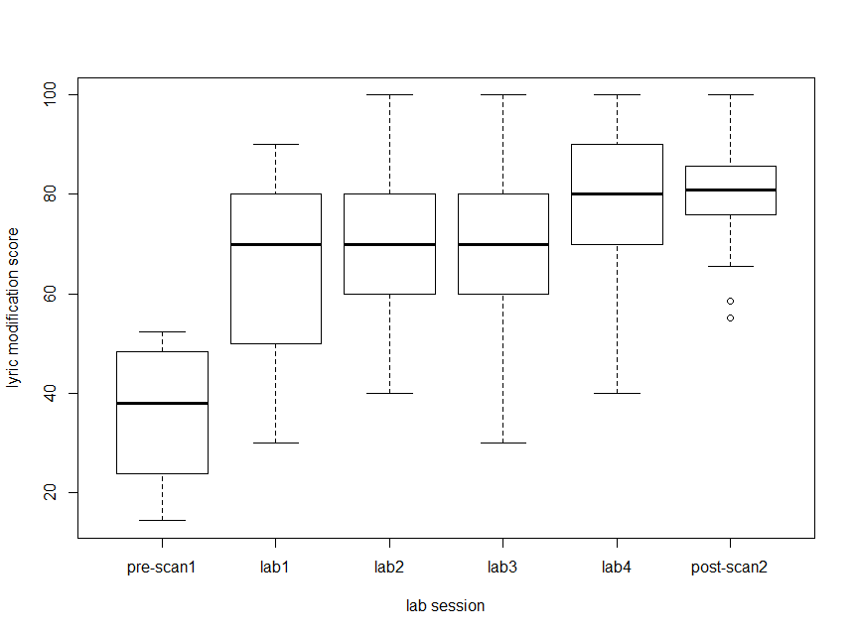
Lyric modification score – participants are learning the lyrics to songs

Slide 11
Design set up
Scan 1
Training
Scan 2
To be learned
Unlearned
Learned
Unlearned
A capella
Instrumental
Spoken
whole
A capella
Instrumental
Spoken
whole
A capella
Instrumental
Spoken
whole
A capella
Instrumental
Spoken
whole
8 different songs
(4 types)
Same as in scan 1
8 different songs
(4 types)

Slide 12
Intersubject Synchrony

Slide 13
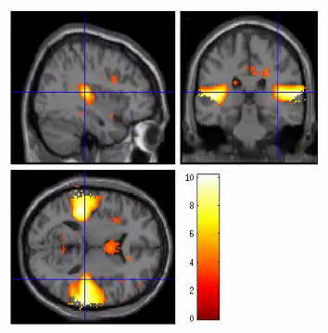
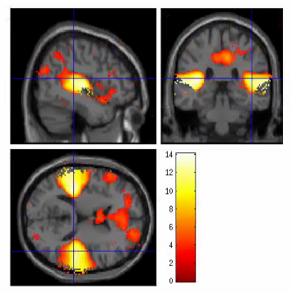
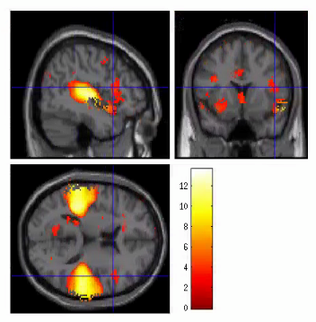
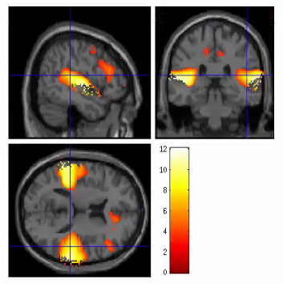
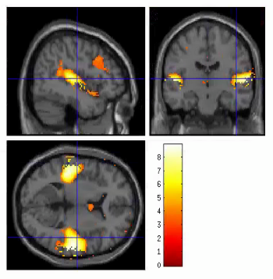
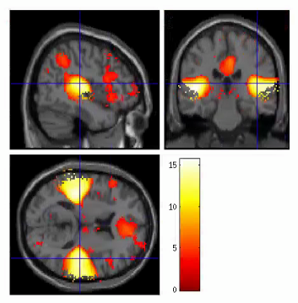
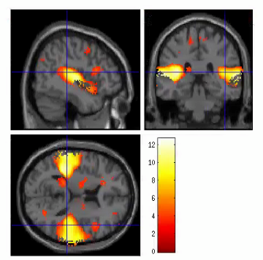
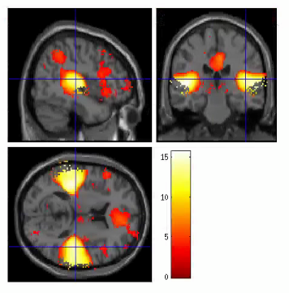
Instrumental
spoken
A capella
whole
Uncor. 0.001

Slide 14
Intersubject Synchrony
Are there differences across:
Session 1 v Session 2 (learning manipulation)
Song type (lyric manipulation)

Slide 15
Intersubject Synchrony
Sanity Check: Are there differences between the two counterbalancing groups?
Comparing all 8 songs from Session 1
No difference between groups
Group A – Group B contrast shows no sig voxels
Group B – Group A contrast shows no sig voxels

Slide 16
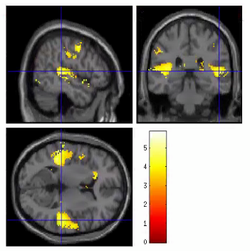
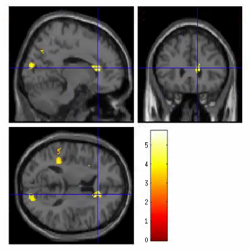
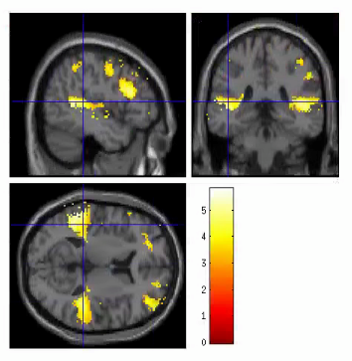
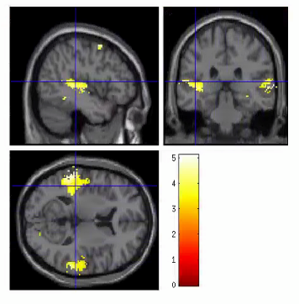
Session 1 – Session 2
Instrumental
A capella
spoken
whole

Slide 17
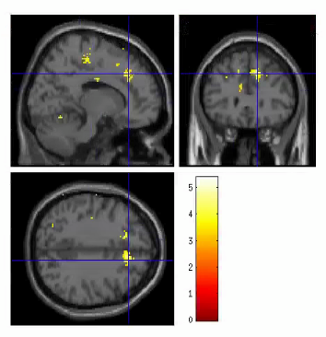
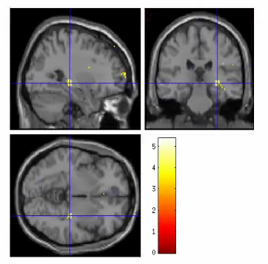
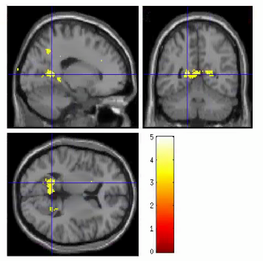
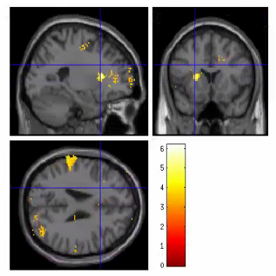
Session 2 – Session 1
Instrumental
A capella
spoken
whole

Slide 18
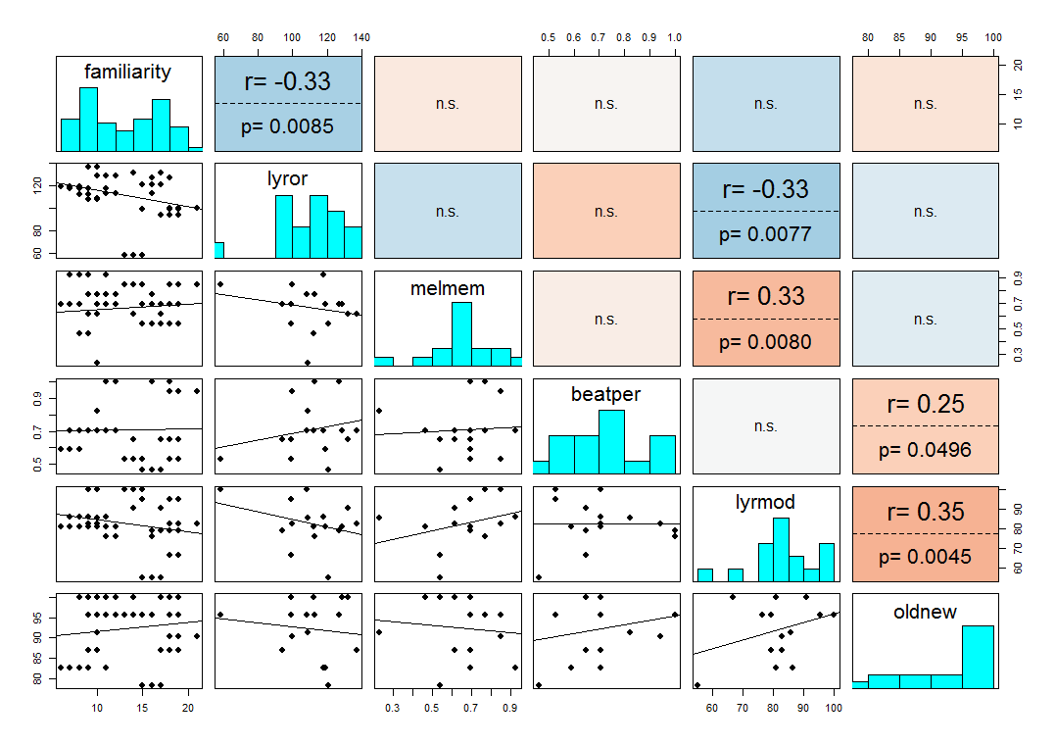
Correlations between 6 behavioural covariates
# of listens
BAT
BAT

Slide 19
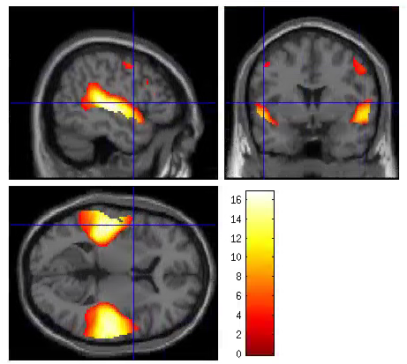
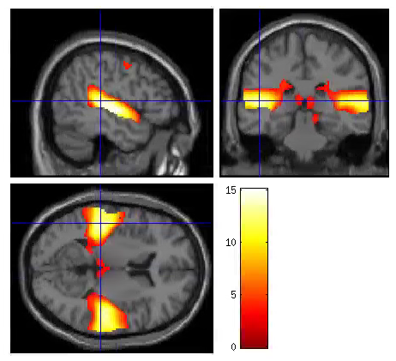
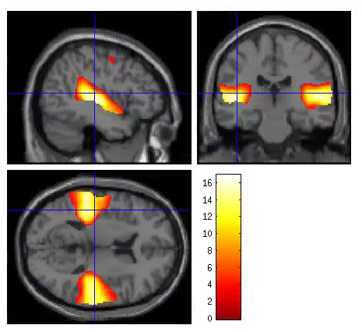
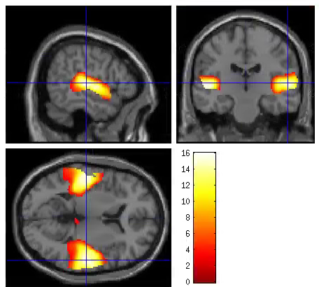
Activation during Learned and unlearned songs
S1TBL
S2TBL
S1UL
S2UL

Slide 20
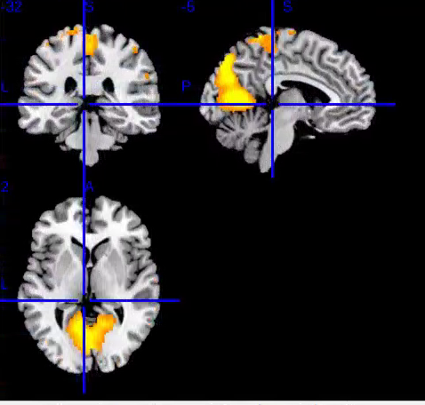
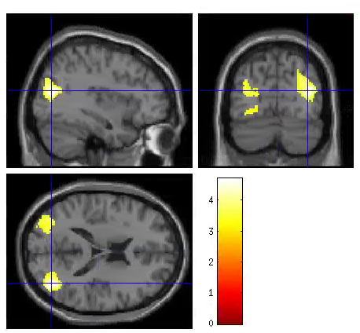
Are there differences between learned and unlearned songs?
(S2TBL-S2UL)-(S1TBL-S1UL) – no significant peaks or clusters
Across sessions
S1TBL-S2TBL or S2TBL-S1TBL – n.s.
S2UL-S1UL – n.s.
S1UL-S2UL – sig. clusters in paracentrul Lobule (L/R) and Lingual (L/R)
Within sessions
S2TBL-S2UL or S2UL-S2TBL – n.s.
S1TBL-S1UL – n.s.
S1UL-S1TBL – sig. clusters in L/R mid Occipital
Notes:
S1UL-S1TBL
31, -74, 18
-38, -78, 28
S1UL-S2UL

