Slide 1
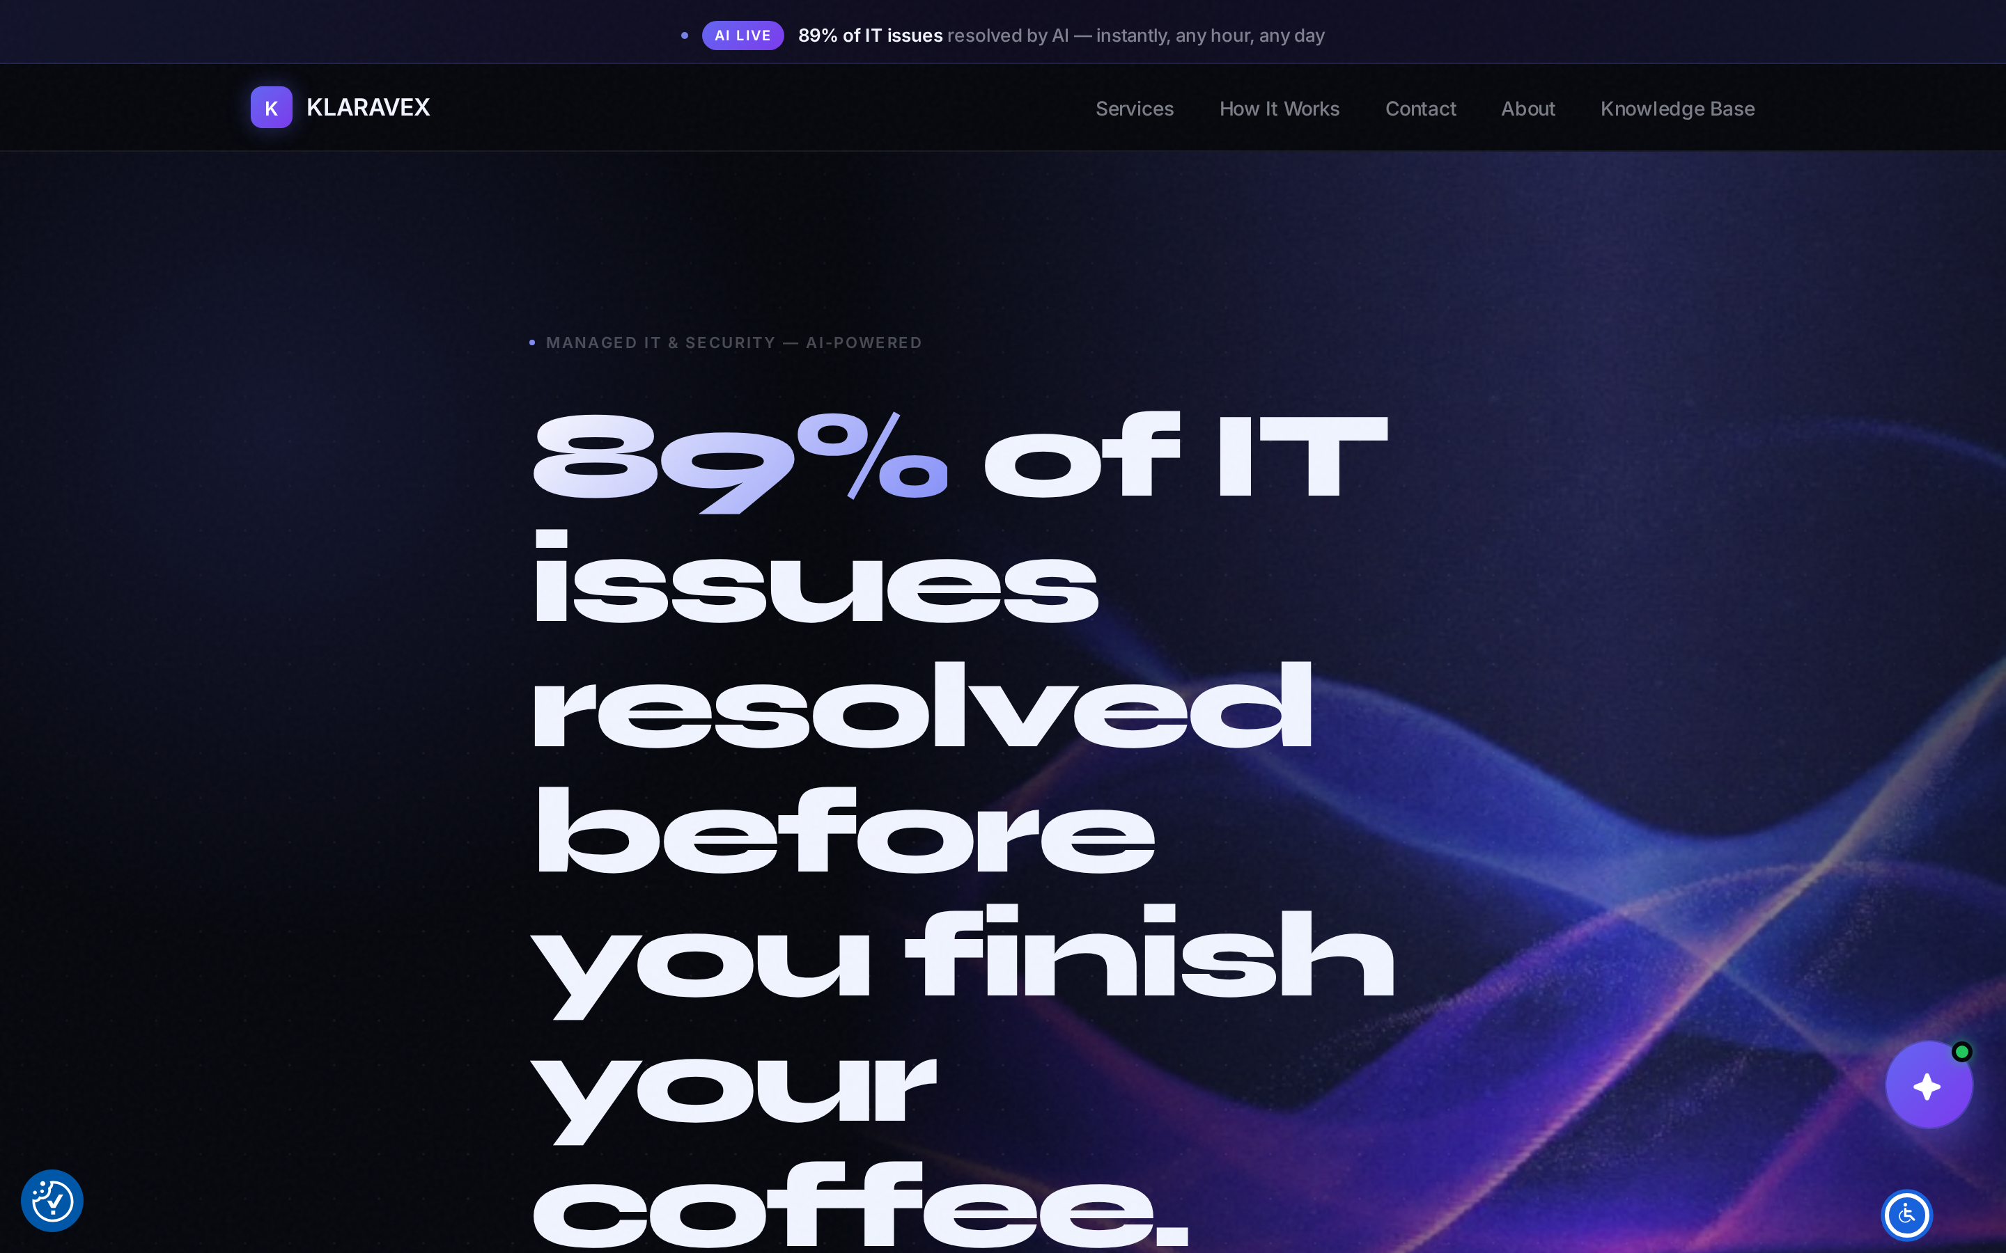
Klaravex
AI-native managed IT and security for American small business.
Investor briefing · August 2026
klaravex.com

Slide 2
THE PROBLEM
02
Small firms face enterprise-grade threats with no IT department.
No help at 2 a.m.
Priced for enterprises
Conflicted advice
Traditional MSPs run human ticket queues. SMBs wait hours for a password reset and days for real answers.
Full-service IT and security is built and priced for 500-seat companies — a 12-person law firm can't buy it.
Most providers earn vendor commissions, so the 'recommendation' is whatever pays the reseller best.
Insurers, clients, and regulators now demand security readiness from firms this size — the pressure is structural, not optional.

Slide 3
THE SOLUTION
03
Klara AI answers instantly. A senior engineer owns the hard 11%.
89%
24/7
2hr
$0
of IT issues resolved by AI — instantly, any hour, any day
AI coverage across every US time zone — no queue, no hold music
senior engineer SLA for the cases that need human judgment
vendor commissions — advice with no reseller conflict
The AI is always labeled — clients know when they're talking to Klara AI and when a certified engineer has taken over. That transparency is the trust wedge against both chatbot-washing and legacy MSPs.

Slide 4
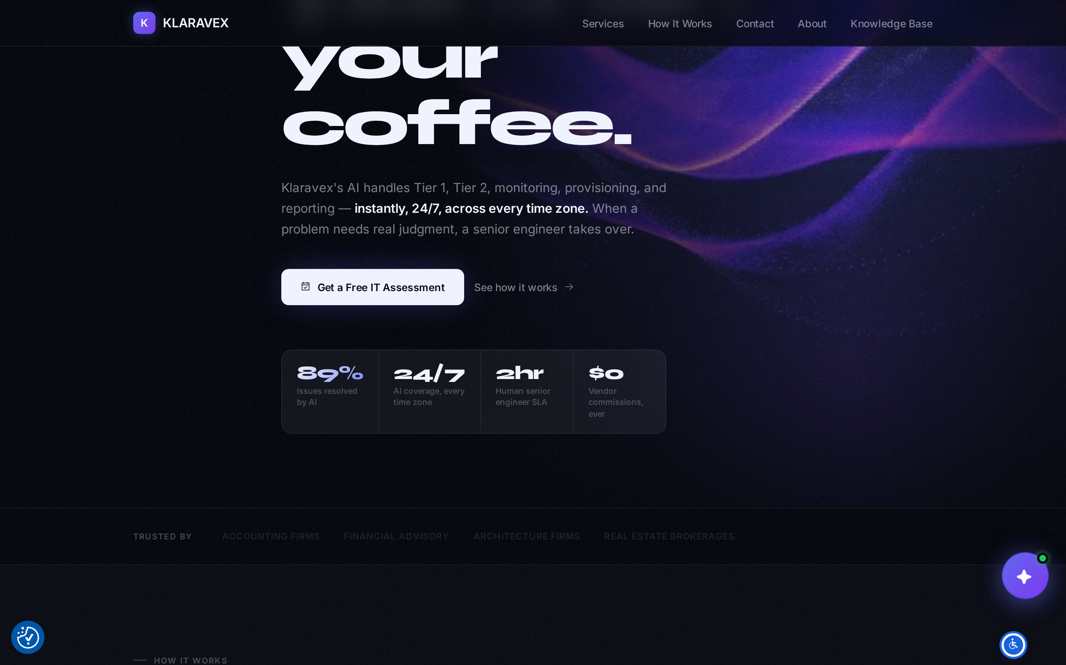
PRODUCT · BUSINESS
04
Full-stack IT department, per-seat price
klaravex.com
Four pillars, fourteen services — network & security, strategy & vCIO, cloud & productivity, infrastructure & support
Readiness for HIPAA, SOC 2, and cyber-insurance — what insurers now require of small firms
Client portal: live system status, AI chat, named engineer, auto-documentation

Slide 5
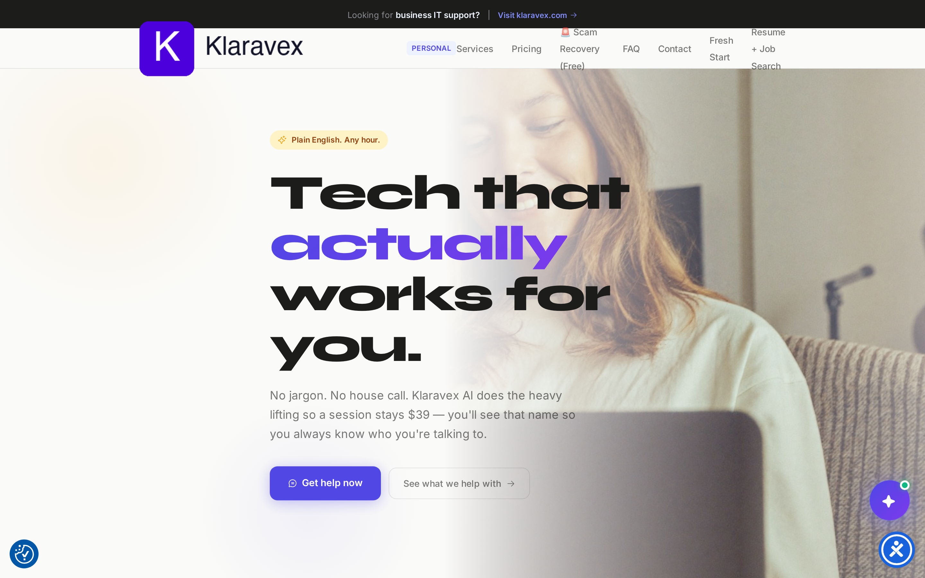
PRODUCT · CONSUMER
05
The same AI, sold to households
personal.klaravex.com
Plain-English tech help from $29 a session — no truck roll, so AI keeps the price a fraction of a house call
Family and senior plans, scam recovery offered free — a trust engine that seeds the brand
Consumer track doubles as top-of-funnel: the household buyer is often the small-business owner

Slide 6
BUSINESS MODEL
06
Recurring, per-seat, AI-margin economics
Foundation
Assurance
Directive
Consumer
$49
$79
$129
Sessions from $29 Plans $29–$39 / month Cash-pay, zero CAC when it converts from free scam-recovery help.
per user / month
per user / month
per user / month
Lean teams that need IT to just work
Firms with data, payments, or insurance exposure
Regulated firms that need audit-ready security
Every tier is delivered AI-first. The marginal cost of the 89% is compute — human cost concentrates only on the 11% and on sales. That's the structural margin advantage over labor-priced MSPs.

Slide 7
MARKET
07
A $71B US market, majority SMB, growing 11% a year
$71B
~58%
11%
US managed services market, 2026 — projected $120B by 2031
of that market is small and medium enterprises — the fastest-growing segment
CAGR 2026–2031, driven by cyber-insurance mandates and the security skills gap
The demand driver is structural: insurers require 24/7 monitoring for renewal, and SMBs cannot hire the $165K/yr security engineers this work demands. They must buy it as a service — and AI-native delivery is the only way to serve a 10-seat firm profitably.
Source: Mordor Intelligence, United States Managed Services Market (2026).

Slide 8
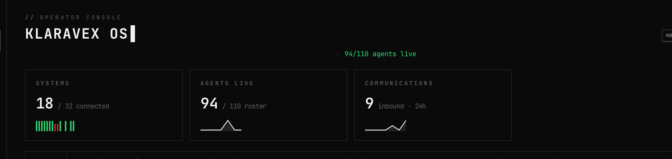
WHY WE WIN
08
The company itself runs on the product.
Klaravex OS — our own operating console — runs delivery, growth, and operations with a fleet of AI agents. The cost structure competitors would need years to copy is our default.
Same playbook the clients buy: AI does the volume, humans do the judgment. It compounds — every client interaction trains better runbooks, every runbook lowers the marginal cost of the next client.

Slide 9
GO-TO-MARKET
09
Vertical wedge, automated demand
Regulated verticals first
Always-on demand engine
Two-track funnel
Law, accounting, and medical practices — where readiness pressure is highest and a named senior engineer closes the deal.
AI-researched outbound, daily content, and search — the same automation that runs delivery runs acquisition, at software cost.
Consumer help builds trust at $29; the same buyer signs their 12-person firm at $79–$129 a seat.
Free offers do the selling: a 45-minute IT assessment for businesses, free scam-recovery help for consumers. Both produce a documented, named-engineer first impression.

Slide 10
WHERE WE ARE
10
Built, live, and selling
Product live
Klara AI resolution, senior-engineer escalation, and the client portal are in production — not a prototype.
Both surfaces shipping
klaravex.com (business) and personal.klaravex.com (consumer) are live with published pricing.
Acquisition running daily
The automated outbound, content, and ads engine is on and producing pipeline every business day.
Entity & IP
Klaravex LLC (Wyoming), nationwide US remote delivery, trademark filed (USPTO serial 99856526).
Current traction metrics (clients, MRR, pipeline) shared in the data room / live conversation.

Slide 11
The MSP industry is a labor business. We rebuilt it as a software business.
Raising to scale sales and onboarding across the three launch verticals. [amount + terms — see one-pager]
Anthony Stewart · Founder
hello@klaravex.com · klaravex.com

